Slide 1
Introduction to Programming with Python

Slide 2
Pre-Requisites
Required Personal Interest.

Slide 3
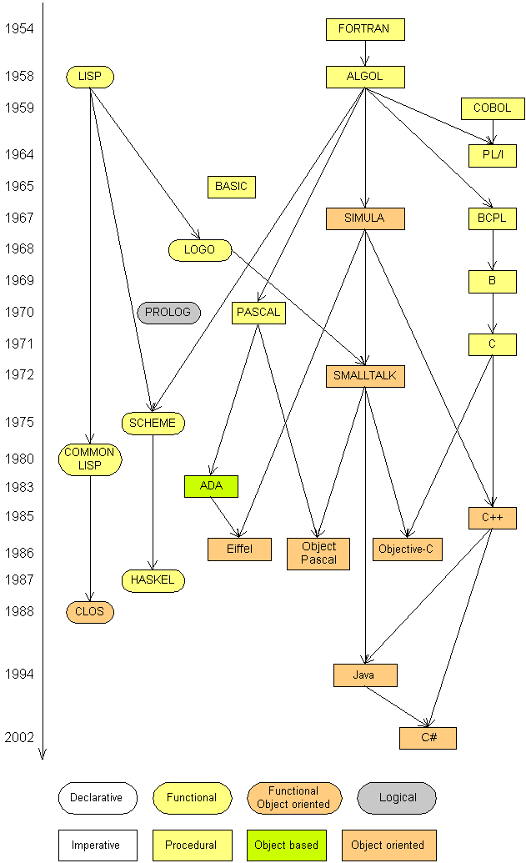
Introduction
Some influential ones:
  FORTRAN
    science / engineering
  COBOL
    business data
  LISP
    logic and AI
  BASIC
    a simple language

Slide 4
Introduction
Computer Programming languages are basically classified into two types - High Level Programming Language and Low Level Programming Languages.
Low level Programming languages: Assembly Language and Machine Language.
High level Programming Languages:- Python, Java, C, C++, Ruby, Perl, Python, Basic, JavaScript and many more.
high level languages will be converted into a machine readable form by a compiler or interpreter. DIFFERENCE BETWEEN THE HIGH AND THE LOW LEVEL LANGUAGE: Low level language is machine readable form of program. Whereas the high level language will be in human readable form

Slide 5




Compiling and interpreting
Many languages require you to compile (translate) your program into a form that the machine understands.
Python is instead directly interpreted into machine instructions.
compile
execute
source code
Hello.java
byte code
Hello.class
output
interpret
source code
Hello.py
output

Slide 6
Why Python
Easy to learn
Free Source
Interactive
Interpreted
Modular
Dynamic
Object-oriented-programming (OOPs)
Portable (UNIX-based systems, Mac OS, MS-DOS, OS/2, and various versions of Microsoft Windows)
High level & English Like
Extensible in C++ & C
Powerful in Analytics and Web programming (Scripting)

Slide 7
Python uses in
Google
YouTube
Facebook
NASA
NSA
Drop Box
Mozilla
Instagram
Spotify
Quora
Netflix
Reddit
Etc..

Slide 8
Course Objective
To understand why Python is a useful language for developers.
To learn how to design and program Python applications.
To learn how to use lists, tuples, and dictionaries in Python programs.
To learn how to identify Python object types.
To learn how to use indexing and slicing to access data in Python programs.
To define the structure and components of a Python program.
To learn how to write loops and decision statements in Python.
To learn how to write functions and pass arguments in Python.
To learn how to build and package Python modules for reusability.
To learn how to read and write files in Python.

Slide 9
Course Objective
To learn how to design object‐oriented programs with Python classes.
To learn how to use class inheritance in Python for reusability.
To learn how to use exception handling in Python applications for error handling.
To learn to how python useful for web scripting
To learn how Python is useful Machine Learning & data science.

Slide 10
Course Duration
Total – 30 days.
Approach hours – 45 hours.
Daily 1 hour and Weekends long sessions.

Slide 11
Python History
Python was conceived in the late 1980s, and its implementation began in December 1989 by Guido van Rossum at Centrum Wiskunde & Informatica (CWI) in the Netherlands

Slide 12
Python Environments & Download
From Python.org
Version 2.7
Version 3.6.X

Slide 13
IDE setup- Anaconda Distribution
  Anaconda Distribution set up.
Notes:
Dividing by 0 crashes the program.

Slide 14
Identifiers & Continuation & Assignment
Variables –
Functions –
Modules –
Classes –
All names starts with A to Z or a to z or _(underscore) & 0 to 9
Line Continuation -- \ (For [],(),{} continuation not required)
Comments for single line- #
Comments for multiple lines - “”” “””
Assignment: A=10, a=b=10, a,b,c = 1,’xyz’,10
Key words:- and, as, assert, break, class, continue, def, del, elif, else, except, exec, finally, for, from, global, if, import, in, is, lambda, not, or, pass, print, raise, return, try, while, with, yield

Slide 15
Python variables
Numbers
String
List
Tuple
Dictionary
Sets

Slide 16
Numbers
Integers
Floating
Long
Complex
-------------------------------------------------------
del x ,[y]
Number conversions

Slide 17
Functions on Numbers
Mathamatical abs(x) ceil(x) exp(x) Floor(x) Log(x) Max(x1,x2,..xn) Min(x1,x2,..) Pow(x,y) Sqrt(x) Round(x[,n]) | Random functions Choice(seq) randrange([start],stop,[,step]) Random() Seed([x]) Shuffle(list) Uniform(x,y) Trigonometric & otherfunctions Pi E All Trigonometric functions

Slide 18
raw_input
raw_input : Reads a string of text from user input.
Example:
  name = input("Howdy, pardner. What's yer name? ")
  print name, "... what a silly name!"
  Output:
  Howdy, pardner. What's yer name? Paris Hilton
  Paris Hilton ... what a silly name!

Slide 19
Strings
Index
Substrings : [],[:], [-1]
Concatenation: +
Repetition: *
\t,\b,\n,\s,\a etc..
in and not in
% - print (‘Student name: %name and total marks %s’ %(‘Rakesh’,367)

Slide 20
String Functions
len(string)
count(str, beg= 0,end=len(string))
find(str, beg=0 end=len(string))
isalpha()
isalnum()
isdigit()
islower()
Isupper()
isnumeric()
upper()
zfill (width)
capitalize()
center(width, fillchar)

Slide 21
String properties
len(string) - number of characters in a string
(including spaces)
str.lower(string) - lowercase version of a string
str.upper(string) - uppercase version of a string
Example:
name = "Martin Douglas Stepp"
length = len(name)
big_name = str.upper(name)
print big_name, "has", length, "characters"
Output:
MARTIN DOUGLAS STEPP has 20 characters

Slide 22
List
Define with : []
Index: [],[:],[-1]
Del list1[2]
List1 + list2 - Concatenation
Len(lis1)
Max(list1)
Min(list1)
List(seq) – convers tuple into list

Slide 23
List Functions
List.append(obj)
List.insert(index,obj)
List.remove(obj)
List.reverse()
List.sort()
List.count(obj)
List.extend(seq)
List.index(obj)
Try exercises on two dimensional lists (arrays)

Slide 24
Tuple
Define with : ()
Tuple id Immutable object – cannot edit or change the values of tuple elements.
Del tup1 - Removing individual tuple elements is not possible
Tup1+tup2 – Concatenation
Index: [],[:],[-1]
Cmp(tup1, tup2)
Len(tup1)
Max(tup1)
Min(tup1)
tuple(seq) – convers list into tuple

Slide 25
Dictionary
Define with – {key:value,…}
Dict[key]
For update – dict[key]=new value
Del dict[key] – remove entry with key
dict.clear() – remove all entries in dict
Del dict – delete entire dict
Len(dict)
Str(dict) – printable string representation of a dict
Type(variable) – return variable type

Slide 26
Dictionary functions
Dict.items() – return a list of dict’s (key,value) as tuple
Dict.keys() – return list of dict keys
Dict.get(key, default=None) – for Key key, returs value or default if key not in dict
Dict.fromkeys(seq[,values]) – create a new dict with keys from seq and values set to values.
Dict.copy() – returns shallow copy of dict.
Try Shallow copy and Deep Copy on Lists.
Dict.update(dict2) – adds dictinary dict2’s key-values pair to dict.
Dict.values() – retunrs only dict values.

Slide 27
Set
Set defines with: {x,y,..}
Type(set1)

Slide 28
input
input : Reads a number from user input.
  You can assign (store) the result of input into a variable.
  Example:
  age = input("How old are you? ")
  print "Your age is", age
  print "You have", 65 - age, "years until retirement"
  Output:
  How old are you? 53
  Your age is 53
  You have 12 years until retirement
Exercise: Write a Python program that prompts the user for his/her amount of money, then reports how many Nintendo Wiis the person can afford, and how much more money he/she will need to afford an additional Wii.

Slide 29
Arithmetic Operators-1
Operator Description Example
A=10, b=20.
+ Addition Adds values on either side of the operator. a + b = 30
- Subtraction Subtracts right hand operand from left hand operand. a – b = -10
* Multiplication Multiplies values on either side of the operator a * b = 200

Slide 30
Arithmetic Operators-2
/ Division Divides left hand operand by right hand operand b / a = 2
% Modulus Divides left hand operand by right hand operand and returns remainder b % a = 0
** Exponent Performs exponential (power) calculation on operators a**b =10 to the power 20
// Floor Division - The division of operands where the result is the quotient in which the digits after the decimal point are removed. 9//2 = 4 and 9.0//2.0 = 4.0

Slide 31
Comparison Operators-1
a=10, b=20
== If the values of two operands are equal, then the condition becomes true. (a == b) is not true.
!= If values of two operands are not equal, then condition becomes true. (a != b) is true.
<> If values of two operands are not equal, then condition becomes true. (a <> b) is true. This is similar to != operator.
> If the value of left operand is greater than the value of right operand, then condition becomes true. (a > b) is not true.
< If the value of left operand is less than the value of right operand, then condition becomes true. (a < b) is true.

Slide 32
Comparison Operators-2
>= If the value of left operand is greater than or equal to the value of right operand, then condition becomes true. (a >= b) is not true.
<= If the value of left operand is less than or equal to the value of right operand, then condition becomes true. (a <= b) is true.

Slide 33
Assignment Operators-1
= Assigns values from right side operands to left side operand c = a + b assigns value of a + b into c
+= Add AND It adds right operand to the left operand and assign the result to left operand c += a is equivalent to c = c + a
-= Subtract AND It subtracts right operand from the left operand and assign the result to left operand c -= a is equivalent to c = c - a
*= Multiply AND It multiplies right operand with the left operand and assign the result to left operand c *= a is equivalent to c = c * a
/= Divide AND It divides left operand with the right operand and assign the result to left operand c /= a is equivalent to c = c / a

Slide 34
Assignment Operators-2
%= Modulus AND It takes modulus using two operands and assign the result to left operand c %= a is equivalent to c = c % a
**= Exponent AND Performs exponential (power) calculation on operators and assign value to the left operand c **= a is equivalent to c = c ** a
//= Floor Division It performs floor division on operators and assign value to the left operand c //= a is equivalent to c = c // a

Slide 35
Bitwise Operators-1
a = 0011 1100 = 60
b = 0000 1101 = 13
----------------- -------
a&b = 0000 1100
a|b = 0011 1101
a^b = 0011 0001
~a = 1100 0011
*****************************************************************
& Binary AND Operator copies a bit to the result if it exists in both operands. (a & b) = 12 - (means 0000 1100)
| Binary OR It copies a bit if it exists in either operand. (a | b) = 61 - (means 0011 1101)
^ Binary XOR It copies the bit if it is set in one operand but not both. (a ^ b) = 49 (means 0011 0001)

Slide 36
Bitwise Operators-2
~ Binary - Ones Complement It is unary and has the effect of 'flipping' bits. (~a ) = -61 (means 1100 0011 in 2's complement form due to a signed binary number.
<< Binary Left Shift The left operands value is moved left by the number of bits specified by the right operand. a << 2 = 240 - (means 1111 0000)
>> Binary Right Shift The left operands value is moved right by the number of bits specified by the right operand. a >> 2 = 15 -(means 0000 1111)

Slide 37
Logical Operators
and
Logical AND If both the operands are true then condition becomes true. (a and b) is true.
or
Logical OR If any of the two operands are non-zero then condition becomes true. (a or b) is true.
not
Logical NOT Used to reverse the logical state of its operand. Not (a and b) is false.

Slide 38
Identity Operators
is Evaluates to true if the variables on either side of the operator point to the same object and false otherwise. x is y, here is results in 1 if id(x) equals id(y).
is not Evaluates to false if the variables on either side of the operator point to the same object and true otherwise. x is not y, here is not results in 1 if id(x) is not equal to id(y).

Slide 39
Membership Operators
in Evaluates to true if it finds a variable in the specified sequence and false otherwise. x in y, here in results in a 1 if x is a member of sequence y.
not in Evaluates to true if it does not finds a variable in the specified sequence and false otherwise. x not in y, here not in results in a 1 if x is not a member of sequence y.

Slide 40
Operators precedence
** Exponentiation (raise to the power)
~ + - complement, unary plus and minus (method names for the last two are +@ and -@)
* / % // Multiply, divide, modulo and floor division
+ - Addition and subtraction
>> << Right and left bitwise shift
& Bitwise 'AND'
^ | Bitwise exclusive `OR' and regular `OR'
<= < > >= Comparison operators
<> == != Equality operators
= %= /= //= -= += *= **= Assignment operators
is is not Identity operators
in not in Membership operators
not or and Logical operators

Slide 41
Condition / Decision Making/ Selection (if/elif/else)

Slide 42

if statement: Executes a group of statements only if a certain condition is true. Otherwise, the statements are skipped.
If syntax:
  if condition:
  statement(s).

Slide 43
If…else
if condition:
statement(s)
else:
statement(s)
Elif
  If condition:
  statement(s)
  Elif condition:
  statement(s)
  Elif condition2:
  statement(s)
  ………………..
  Else:
  statement(s)

Slide 44
Repetitions/loops (for, while)

Slide 45
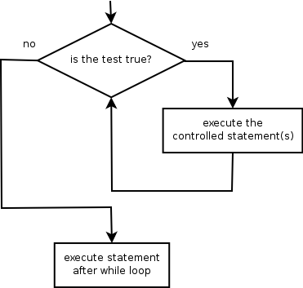
Looping

Slide 46
Python Loops
While Expression:
  Statement(s)

Slide 47
Cumulative loops
Some loops incrementally compute a value that is initialized outside the loop. This is sometimes called a cumulative sum.
  sum = 0
  for i in range(1, 11):
  sum = sum + (i * i)
  print "sum of first 10 squares is", sum
  Output:
  sum of first 10 squares is 385
Exercise: Write a Python program that computes the factorial of an integer.

Slide 48
while
while loop: Executes a group of statements as long as a condition is True.
  good for indefinite loops (repeat an unknown number of times)
Syntax:
  while condition:
  statements
Example:
  number = 1
  while number < 200:
  print number,
  number = number * 2
  Output:
  1 2 4 8 16 32 64 128

Slide 49
Loop Exercises
How to order a list in reverse
How to print a pyramid
Write even numbers up to 100
Terminate loop until you type no for student details.

Slide 50
Functions-1
function is a block of organized, reusable code that is used to perform a single, related action. Functionsprovide better modularity for your application and a high degree of code reusing. As you already know,Python gives you many built-in functions like print(), etc. but you can also create your own functions.
Function blocks begin with the keyword def followed by the function name and parentheses ( ( ) ).
Any input parameters or arguments should be placed within these parentheses. You can also define parameters inside these parentheses.
The first statement of a function can be an optional statement - the documentation string of the function or docstring.

Slide 51
Functions -2
The code block within every function starts with a colon (:) and is indented.
The statement return [expression] exits a function, optionally passing back an expression to the caller. A return statement with no arguments is the same as return None.
def functionname( parameters ):
"function_docstring"
function_suite
return [expression]
Example:
def printme( str ):
"This prints a passed string into this function"
print str
return

Slide 52
Functions-3
You can call a function by using the following types of formal arguments:
Required arguments - arguments passed to a function in correct positional order. the number of arguments in the function call should match exactly with the function definition.
Keyword arguments - Keyword arguments are related to the function calls. When you use keyword arguments in a function call, the caller identifies the arguments by the parameter name.
Default arguments - A default argument is an argument that assumes a default value if a value is not provided in the function call for that argument. The following example gives an idea on default arguments

Slide 53
Functions-4
Variable-length arguments - You may need to process a function for more arguments than you specified while defining the function. These arguments are called variable-length arguments and are not named in the function definition, unlike required and default arguments.
def functionname([formal_args,] *var_args_tuple ):
Key word arguments – Variable length and Key word parameters.
def functionname([formal_args,] **var_args_tuple ):

Slide 54
Python Anonymous Functions
Lambda function:-
lambda arg1, arg2, ...argN : expression using arguments
sum = lambda x, y: x + y # def sum(x,y): return x + y
Return

Slide 55
Function variables
Global vs Local variables
Variables that are defined inside a function body have a local scope, and those defined outside have a global scope. This means that local variables can be accessed only inside the function in which they are declared, whereas global variables can be accessed throughout the program body by all functions. When you call a function, the variables declared inside it are brought into scope.

Slide 56
Module
a module is a file consisting of Python code. A module can define functions, classes and variables. A module can also include runnable code.
import module1[, module2[,... moduleN]
Import module as md
from modname import name1[, name2[, ... nameN]]
From modname import module1 as md
Example – os, math,dir([module name]),globals(),locals(),sys etc..

Slide 57
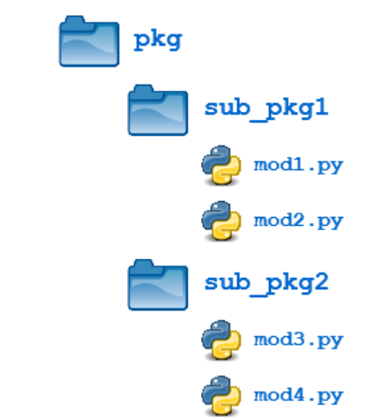
Packages
Packages in Python
A package is a hierarchical file directory structure that defines a single Python application environment that consists of modules and subpackages and sub-subpackages, and so on.

Slide 58
File Handling -1
Open File:
file_object=open(f_name[,access_mode][,buffering])
Mode | Description
r | Opens a file for reading only. The file pointer is placed at the beginning of the file. This is the default mode.
rb | Opens a file for reading only in binary format. The file pointer is placed at the beginning of the file. This is the default mode.
r+ | Opens a file for both reading and writing. The file pointer is placed at the beginning of the file.
rb+ | Opens a file for both reading and writing in binary format. The file pointer is placed at the beginning of the file.
w | Opens a file for writing only. Overwrites the file if the file exists. If the file does not exist, creates a new file for writing.
wb | Opens a file for writing only in binary format. Overwrites the file if the file exists. If the file does not exist, creates a new file for writing.
w+ | Opens a file for both writing and reading. Overwrites the existing file if the file exists. If the file does not exist, creates a new file for reading and writing.
wb+ | Opens a file for both writing and reading in binary format. Overwrites the existing file if the file exists. If the file does not exist, creates a new file for reading and writing.
a | Opens a file for appending. The file pointer is at the end of the file if the file exists. That is, the file is in the append mode. If the file does not exist, it creates a new file for writing.
ab | Opens a file for appending in binary format. The file pointer is at the end of the file if the file exists. That is, the file is in the append mode. If the file does not exist, it creates a new file for writing.
a+ | Opens a file for both appending and reading. The file pointer is at the end of the file if the file exists. The file opens in the append mode. If the file does not exist, it creates a new file for reading and writing.
ab+ | Opens a file for both appending and reading in binary format. The file pointer is at the end of the file if the file exists. The file opens in the append mode. If the file does not exist, it creates a new file for reading and writing.

Slide 59
File Handling-2
S.No | Atrribute | Description
1 | file.closed | Returns true if file is closed, false otherwise.
2 | file.mode | Returns access mode with which file was opened.
3 | file.name | Returns name of the file.

Slide 60
File handling-3
File_object.close()
File_object.read()
File_object.write(string)
File_object.tell()
File_object.seek(offset[,from]) → from 0 is start from file start ,1- current position, 2- end of the file.
File_object.rename(current_filename,new_filename)
Os.remove(path\file_name)
Os.mkdir(‘path\newdir’)
Os.chdir(‘path\newdir’)
Os.rmdir(‘path\dirname’)
Os.getcwd()

Slide 61
File Handling-4
file.close() Close the file. A closed file cannot be read or written any more.
file.flush() Flush the internal buffer, like stdio's fflush. This may be a no-op on some file-like objects.
file.fileno() Returns the integer file descriptor that is used by the underlying implementation to request I/O operations from the operating system.
file.isatty() Returns True if the file is connected to a tty(-like) device, else False.
next(file) Returnss the next line from the file each time it is being called.
file.read([size]) Reads at most size bytes from the file (less if the read hits EOF before obtaining size bytes).
file.readline([size]) Reads one entire line from the file. A trailing newline character is kept in the string.

Slide 62
File Handling-5
file.readlines([sizehint]) Reads until EOF using readline() and return a list containing the lines. If the optional sizehint argument is present, instead of reading up to EOF, whole lines totalling approximately sizehint bytes (possibly after rounding up to an internal buffer size) are read.
file.seek(offset[,whence]) Sets the file's current position.
file.tell() Returns the file's current position
file.truncate([size]) Truncates the file's size. If the optional size argument is present, the file is truncated to (at most) that size.
file.write(str) Writes a string to the file. There is no return value.
file.writelines(sequence) Writes a sequence of strings to the file. The sequence can be any iterable object producing strings, typically a list of strings.

Slide 63
Date & Time -1
time.time() → returns the current system time in ticks since 12:00am, January 1, 1970
Index Field Values
0 4-digit year 2008
1 Month 1 to 12
2 Day 1 to 31
3 Hour 0 to 23
4 Minute 0 to 59
5 Second 0 to 61 (60 or 61 are leap- seconds)
6 Day of Week 0 to 6 (0 is Monday)
7 Day of year 1 to 366 (Julian day)
8 Daylight savings -1, 0, 1, -1 means library determines DST

Slide 64
Date & Time -2
Index Attributes Values
0 tm_year 2008
1 tm_mon 1 to 12
2 tm_mday 1 to 31
3 tm_hour 0 to 23
4 tm_min 0 to 59
5 tm_sec 0 to 61 (60 or 61 are leap- seconds)
6 tm_wday 0 to 6 (0 is Monday)
7 tm_yday 1 to 366 (Julian day)
8 tm_isdst -1, 0, 1, -1 means library determines DST

Slide 65
Date & Time -3
time.time()
time.localtime()
time.asctime()
time.timezone – offset in seconds (>0 in the Americas; <=0 in most of Europe, Asia, Africa).
time.tzname

Slide 66
Date & Time -4
S.No | Function | Description
1 | time.altzone | The offset of the local DST timezone, in seconds west of UTC, if one is defined. This is negative if the local DST timezone is east of UTC (as in Western Europe, including the UK). Only use this if daylight is nonzero.
2 | time.asctime([tupletime]) | Accepts a time-tuple and returns a readable 24-character string such as 'Tue Dec 11 18:07:14 2008'.
3 | time.clock( ) | Returns the current CPU time as a floating-point number of seconds. To measure computational costs of different approaches, the value of time.clock is more useful than that of time.time().
4 | time.ctime([secs]) | Like asctime(localtime(secs)) and without arguments is like asctime( )
5 | time.gmtime([secs]) | Accepts an instant expressed in seconds since the epoch and returns a time-tuple t with the UTC time. Note : t.tm_isdst is always 0
6 | time.localtime([secs]) | Accepts an instant expressed in seconds since the epoch and returns a time-tuple t with the local time (t.tm_isdst is 0 or 1, depending on whether DST applies to instant secs by local rules).
7 | time.mktime(tupletime) | Accepts an instant expressed as a time-tuple in local time and returns a floating-point value with the instant expressed in seconds since the epoch.
8 | time.sleep(secs) | Suspends the calling thread for secs seconds.
9 | time.strftime(fmt[,tupletime]) | Accepts an instant expressed as a time-tuple in local time and returns a string representing the instant as specified by string fmt.
10 | time.strptime(str,fmt='%a %b %d %H:%M:%S %Y') | Parses str according to format string fmt and returns the instant in time-tuple format.
11 | time.time( ) | Returns the current time instant, a floating-point number of seconds since the epoch.
12 | time.tzset() | Resets the time conversion rules used by the library routines. The environment variable TZ specifies how this is done.

Slide 67
Date & Time -5
Sr. No. | Function | Description
1 | calendar.calendar(year,w=2,l=1,c=6) | Returns a multiline string with a calendar for year formatted into three columns separated by c spaces. w is the width in characters of each date; each line has length 21*w+18+2*c. l is the number of lines for each week.
2 | calendar.firstweekday( ) | Returns the current setting for the weekday that starts each week. By default, when calendar is first imported, this is 0, meaning Monday.
3 | calendar.isleap(year) | Returns True if year is a leap year; otherwise, False.
4 | calendar.leapdays(y1,y2) | Returns the total number of leap days in the years within range(y1,y2).
5 | calendar.month(year,month,w=2,l=1) | Returns a multiline string with a calendar for month of year, one line per week plus two header lines. w is the width in characters of each date; each line has length 7*w+6. l is the number of lines for each week.
6 | calendar.monthcalendar(year,month) | Returns a list of lists of ints. Each sublist denotes a week. Days outside month of year are set to 0; days within the month are set to their day-ofmonth, 1 and up.
7 | calendar.monthrange(year,month) | Returns two integers. The first one is the code of the weekday for the first day of the month month in year; the second one is the number of days in the month. Weekday codes are 0 (Monday) to 6 (Sunday); month numbers are 1 to 12.
8 | calendar.prcal(year, w=2, l=1, c=6) | Like print calendar.calendar(year, w, l, c).
9 | calendar.prmonth(year, month, w=2, l=1) | Like print calendar.month(year, month, w, l).
10 | calendar.setfirstweekday(weekday) | Sets the first day of each week to weekday code weekday. Weekday codes are 0 (Monday) to 6 (Sunday).
11 | calendar.timegm(tupletime) | The inverse of time.gmtime: accepts a time instant in time-tuple form and returns the same instant as a floating-point number of seconds since the epoch.
12 | calendar.weekday(year,month,day) | Returns the weekday code for the given date. Weekday codes are 0 (Monday) to 6 (Sunday); month numbers are 1 (January) to 12 (December)

Slide 68
OOPs concepts
Inheritance | A process of using details from a new class without modifying existing class.
Encapsulation | Hiding the private details of a class from other objects.
Polymorphism | A concept of using common operation in different ways for different data input. Operator Overloading Function Overloading

Slide 69
Classes -1
class ClassName:
'Optional class documentation string’
class_suite
class Student:
‘student class for all students'
Stdcount = 0
def __init__(self, name, marks):
self.name = name
self.marks = marks
Student.stdcount += 1

Slide 70
Classes -2
def displaycount(self):
  print "Total Students %d" % Student.stdCount
def displaystudent(self):
print "Name : ", self.name, ", Salary: ", self.marks
emp1 = Student(“Abhi", 262)
emp2 = Student(“Rithwik", 320)
emp1.displaystudent()
emp1.age = 7 # Add an 'age' attribute.
emp1.age = 8 # Modify 'age' attribute.
del emp1.age # Delete 'age' attribute.
The first method __init__() is a special method, which is called class constructor or initialization method that Python calls when you create a new instance of this class.

Slide 71
Classes-3
__dict__: Dictionary containing the class's namespace.
__doc__: Class documentation string or none, if undefined.
__name__: Class name.
__module__: Module name in which the class is defined. This attribute is "__main__" in interactive mode.
__bases__: A possibly empty tuple containing the base classes, in the order of their occurrence in the base class list.
print “Student.__doc__:", Student.__doc__
print “student.__name__:", Student.__name__
print “Student.__module__:", Student__module__
print “Student.__bases__:", Student.__bases__
print “Student.__dict__:", Student.__dict__

Slide 72
Classes-4
method __del__(), called a destructor, that is invoked when the instance is about to be destroyed. This method might be used to clean up any non-memory resources used by an instance.
class Point:
def __init( self, x=0, y=0):
self.x = x
self.y = y
def __del__(self):
class_name = self.__class__.__name__
print class_name, "destroyed"

Slide 73
Claases-5
pt1 = Point()
pt2 = pt1
pt3 = pt1
print id(pt1), id(pt2), id(pt3) # prints the ids of the obejcts
del pt1
del pt2
del pt3

Slide 74
Oops
Inheritance: The transfer of the characteristics of a class to other classes that are derived from it.
Encapsulation/Data Abstraction/Data hiding: An object's attributes may or may not be visible outside the class definition. You need to name attributes with a double underscore prefix, and those attributes then are not be directly visible to outsiders.
Polymorphism:
Function overloading: The assignment of more than one behavior to a particular function. The operation performed varies by the types of objects or arguments involved.
Operator overloading: The assignment of more than one function to a particular operator.
  Special methods or magic methods or ‘dunders’

Slide 75
Inheritance
class SubClassName (ParentClass1[, ParentClass2, ...]):
'Optional class documentation string’
class_suite
Multiple Inheritance
Multilevel Inheritance
Method overwriting: Sub class method/function can overwrite its parent class method by use this feature we can write different functionality in Subclass method.

Slide 76
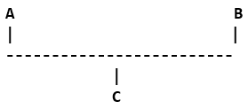
Types of Inheritance

Slide 77
Exceptions-1
EXCEPTION NAME DESCRIPTION
Exception Base class for all exceptions
StopIteration
Raised when the next() method of an iterator does not point to any object.
SystemExit Raised by the sys.exit() function.
StandardError: Base class for all built-in exceptions except StopIteration and SystemExit.
ArithmeticError: Base class for all errors that occur for numeric calculation.
OverflowError: Raised when a calculation exceeds maximum limit for a numeric type.

Slide 78
Exceptions-2
FloatingPointError Raised when a floating point calculation fails.
ZeroDivisonError
Raised when division or modulo by zero takes place for all numeric types.
AssertionError Raised in case of failure of the Assert statement.
AttributeError Raised in case of failure of attribute reference or assignment.
EOFError
Raised when there is no input from either the raw_input() or input() function and the end of file is reached.
ImportError Raised when an import statement fails.

Slide 79
Exceptions-3
KeyboardInterrupt
Raised when the user interrupts program execution, usually by pressing Ctrl+c.
LookupError Base class for all lookup errors.
IndexError Raised when an index is not found in a sequence.
KeyError Raised when the specified key is not found in the dictionary.
NameError
Raised when an identifier is not found in the local or global namespace.
UnboundLocalError
Raised when trying to access a local variable in a function or method but no value has been assigned to it.

Slide 80
Exceptions-4
EnvironmentError: Base class for all exceptions that occur outside the Python environment.
IOError: Raised when an input/ output operation fails, such as the print statement or the open() function when trying to open a file that does not exist.
OSError: Raised for operating system-related errors.
SyntaxError: Raised when there is an error in Python syntax.
IndentationError: Raised when indentation is not specified properly.
SystemError: Raised when the interpreter finds an internal problem, but when this error is encountered the Python interpreter does not exit.

Slide 81
Exceptions -5
SystemExit: Raised when Python interpreter is quit by using the sys.exit() function. If not handled in the code, causes the interpreter to exit.
TypeError: Raised when an operation or function is attempted that is invalid for the specified data type.
ValueError: Raised when the built-in function for a data type has the valid type of arguments, but the arguments have invalid values specified.
RuntimeError: Raised when a generated error does not fall into any category.
NotImplementedError: Raised when an abstract method that needs to be implemented in an inherited class is not actually implemented.

Slide 82
Exception-6
try:
You do your operations here;
......................
except ExceptionI:
If there is ExceptionI, then execute this block.
except ExceptionII:
If there is ExceptionII, then execute this block.
......................
else:
If there is no exception then execute this block.

Slide 83
Exceptions-7
try:
You do your operations here;
......................
except:
If there is any exception, then execute this block.
......................
else:
If there is no exception then execute this block.

Slide 84
Exceptions-8
try:
You do your operations here;
......................
Due to any exception, this may be skipped.
finally:
This would always be executed.

Slide 85
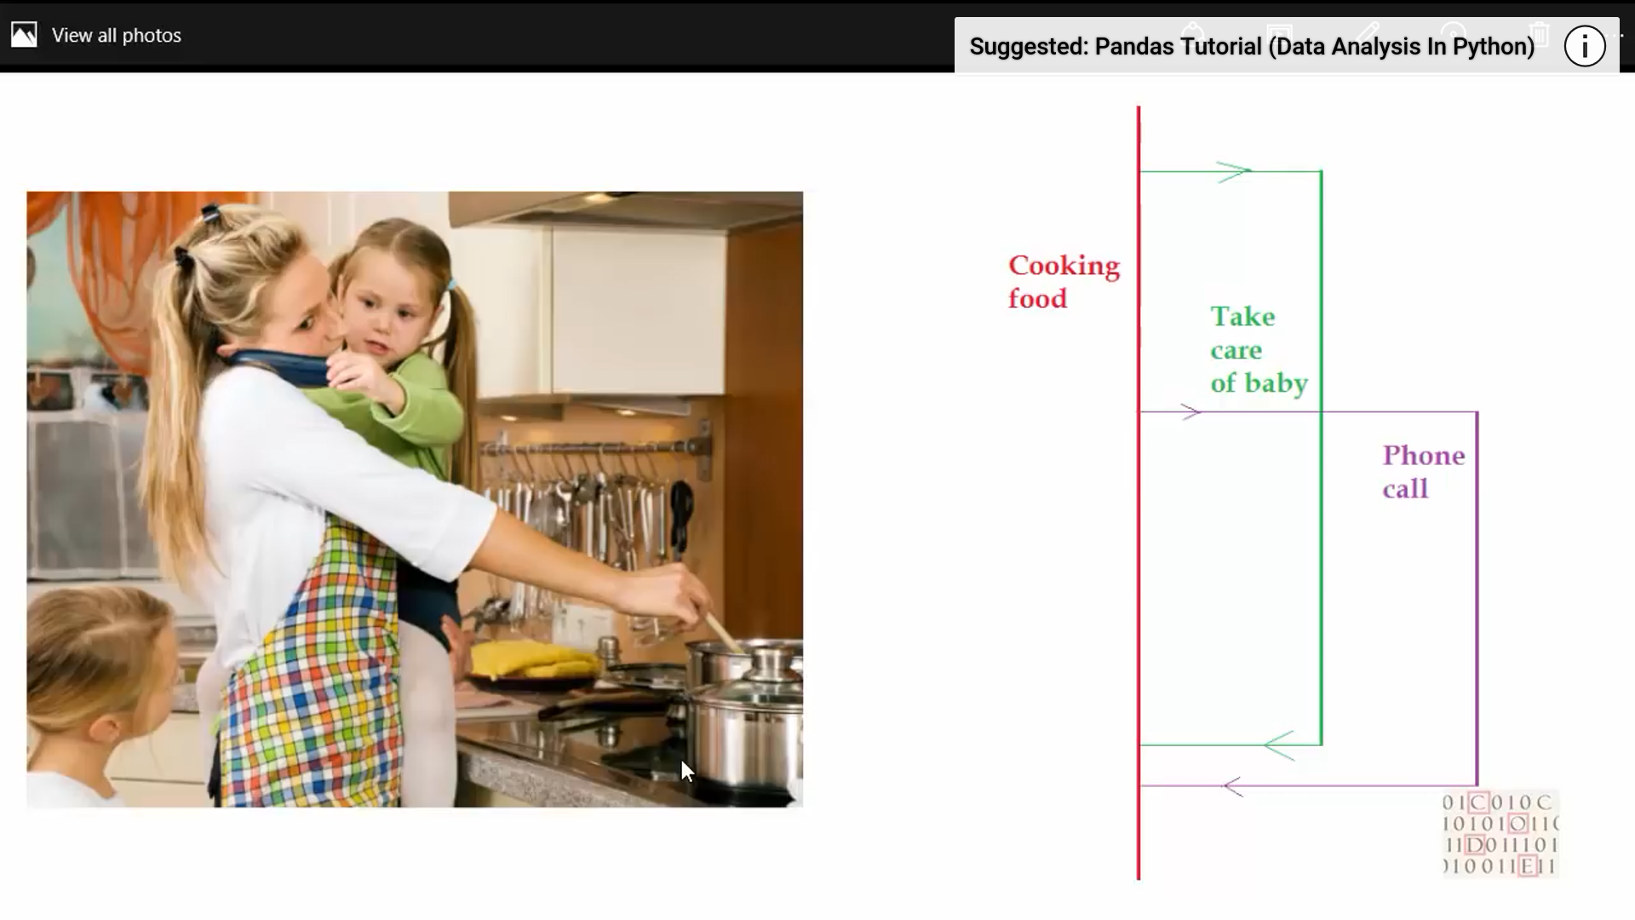
Multi Threading

Slide 86
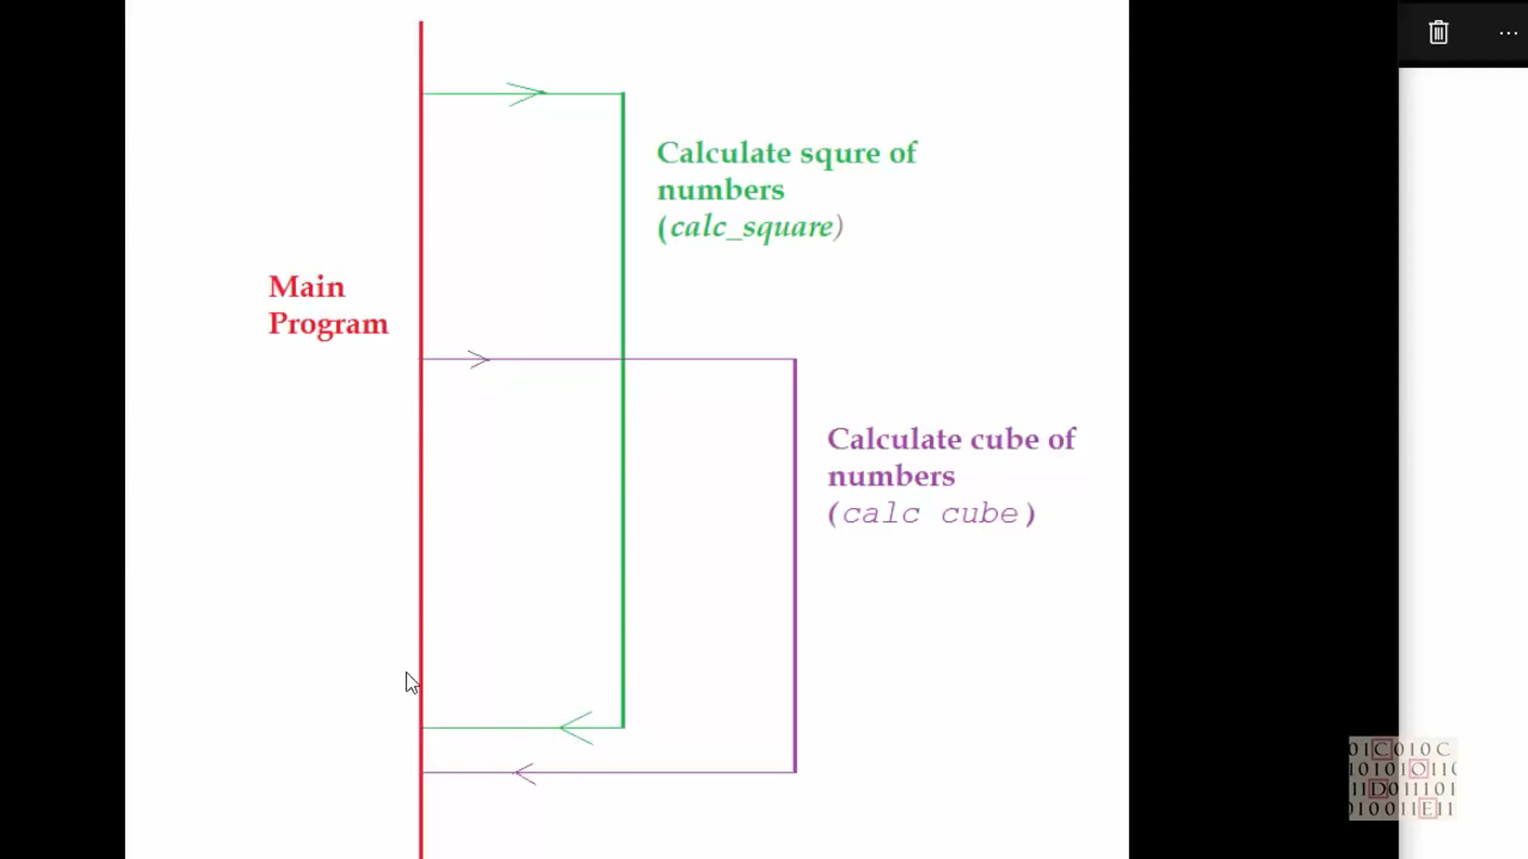

Slide 87
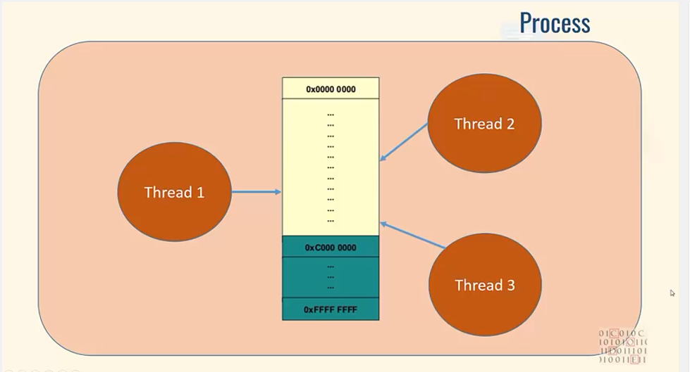
Multi Threading

Slide 88
Multithreading
Pros:
* Lightweight - low memory footprint
* Shared memory - makes access to state from another context easier
* Allows you to easily make responsive UIs
* Great option for I/O-bound applications
Cons:
* Code is usually harder to understand and to get right - the potential for race conditions increases dramatically
* Not interruptible/killable

Slide 89
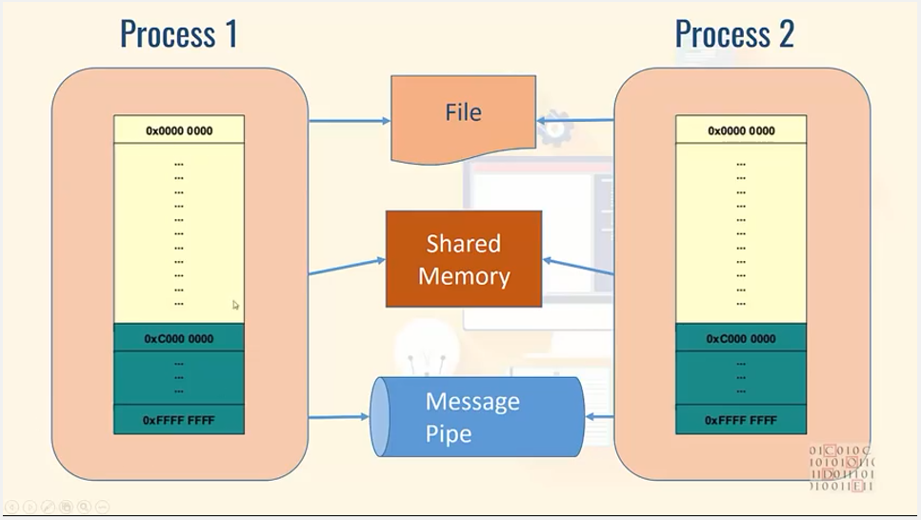
Multi processing

Slide 90
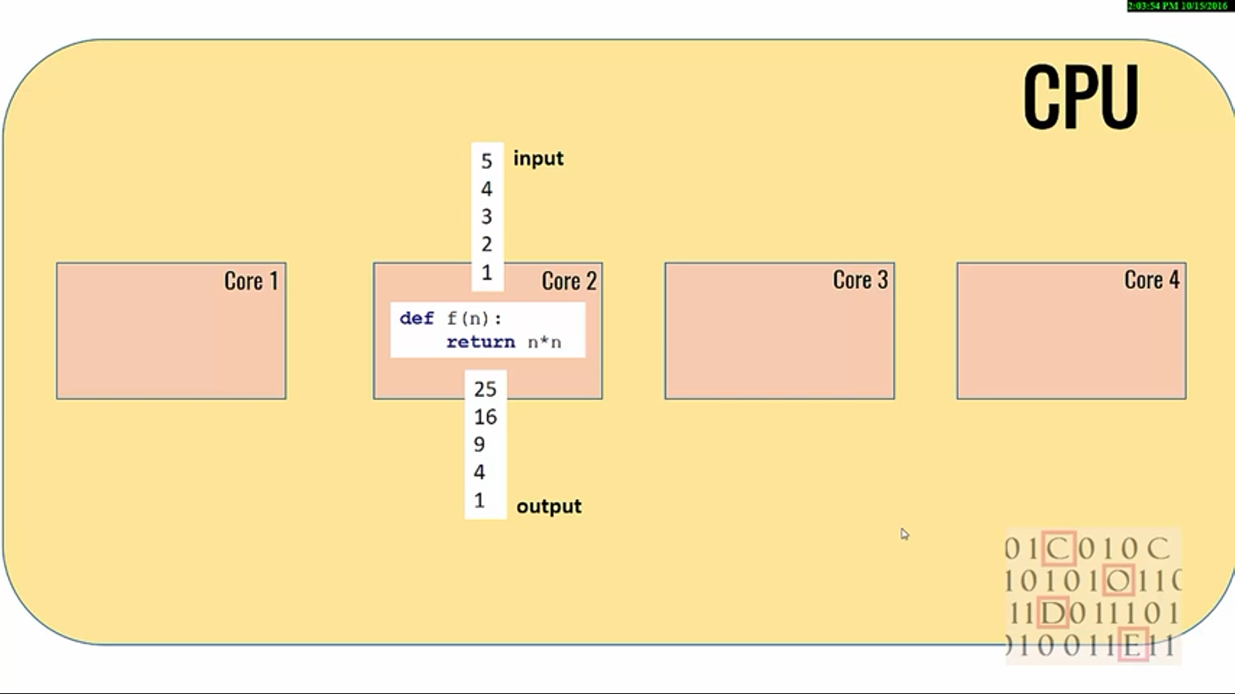
Multi Porcessing

Slide 91
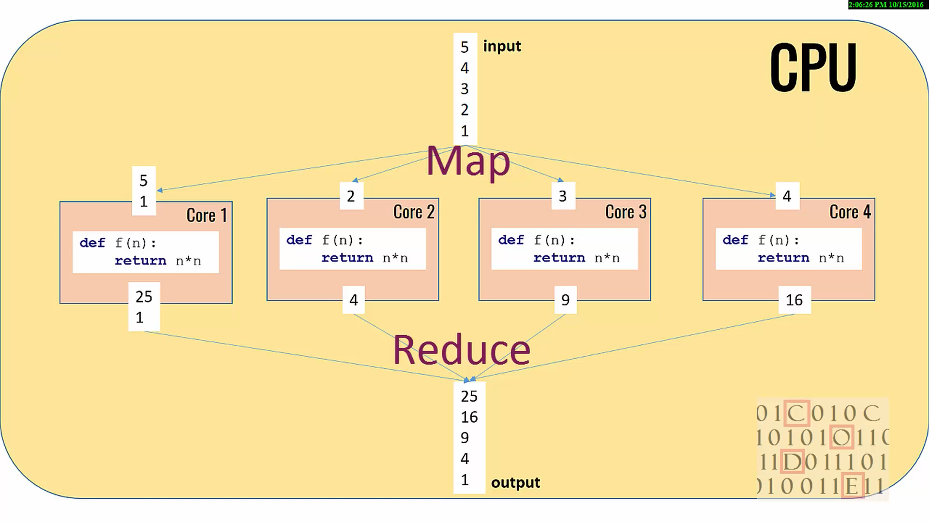
Multi Processing

Slide 92
Multi Processing
Pros:
* Separate memory space
* Code is usually straightforward
* Code is usually straightforward
* Child processes are interruptible/killable
Cons:
* Larger memory footprint

Slide 93
Pandas -1- for Data anlysis
Fast and efficient DataFrame object with default and customized indexing.
Tools for loading data into in-memory data objects from different file formats.
Data alignment and integrated handling of missing data.
Reshaping and pivoting of date sets.
Label-based slicing, indexing and subsetting of large data sets.
Columns from a data structure can be deleted or inserted.
Group by data for aggregation and transformations.
High performance merging and joining of data.
Time Series functionality.

Slide 94
Pandas -2
A Data frame is a two-dimensional data structure, i.e., data is aligned in a tabular fashion in rows and columns.
Features of DataFrame
Potentially columns are of different types
Size – Mutable
Labeled axes (rows and columns)
Can Perform Arithmetic operations on rows and columns
pandas.DataFrame( data, index, columns, dtype, copy)

Slide 95
Pandas – 3
S.No | Parameter & Description
1 | data data takes various forms like ndarray, series, map, lists, dict, constants and also another DataFrame.
2 | index For the row labels, the Index to be used for the resulting frame is Optional Default np.arrange(n) if no index is passed.
3 | columns For column labels, the optional default syntax is - np.arrange(n). This is only true if no index is passed.
4 | dtype Data type of each column.
5 | copy This command (or whatever it is) is used for copying of data, if the default is False.

