Slide 1

Route Optimizers
Presenter: Saumya Raj (Team Leader)
Durgesh Giri
Abhishek Meena
Sahil Ahmad

Slide 2
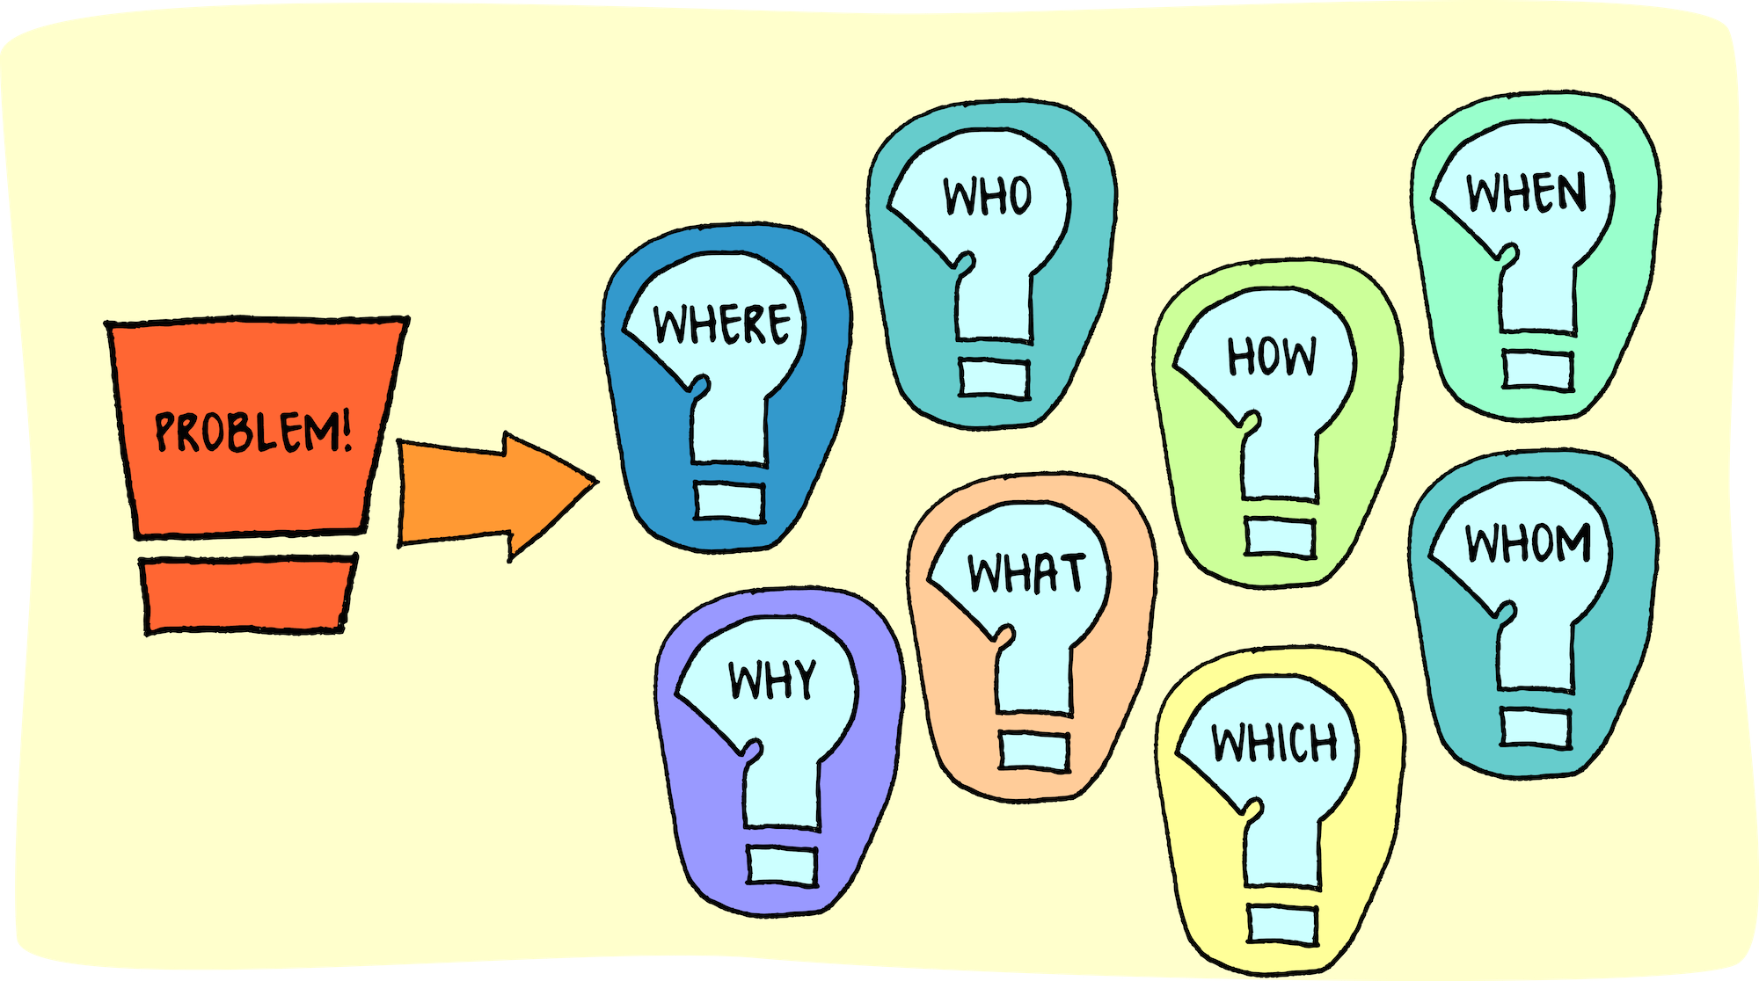
Problem Statement
Challenges of Urban Traffic Congestion

Slide 3

Proposed Solution
Accurate Traffic Demand Forecasting
Data Collection
Model Training
We will gather and process comprehensive traffic- related data, ensuring effective analysis and insights into congestion patterns, thereby enabling informed decision-making for traffic management solutions.
By utilizing advanced ensemble learning models, we will train our system on the processed data, ensuring high accuracy in traffic demand
predictions that can significantly reduce congestion.

Slide 4

Dataset Overview
Essential features for traffic prediction
Data Sources
Key Features
Temporal Dynamics
We gathered extensive data from various sources, including traffic sensors, weather stations, and urban infrastructure, to ensure a comprehensive understanding of traffic patterns and behaviors.
The dataset includes critical features such as road types, lane numbers, and environmental conditions, which collectively enhance the accuracy of our traffic demand predictions through detailed analysis.
Time-based features like peak hours and seasonal trends were included, allowing our model to capture fluctuations in traffic demand, essential for effective urban traffic management strategies.

Slide 5

Feature Engineering
Cyclic
Incorporating time cyclic features enhances traffic pattern recognition for improved forecasting and analysis of traffic demand trends.
Interaction
Detection
Exploring interaction features improves model precision.
Peak hour detection flags
optimize prediction accuracy.

Slide 6

Geohash Encoding
Encoding
Geohash categories are transformed with mean demand values, optimizing data representation and enhancing predictive accuracy in traffic forecasting models.
Leakage
Behavior
Safeguard against data leakage.
Captures nuanced location- based traffic behavior.

Slide 7

Ensemble Architecture
Utilizing Advanced Machine Learning Techniques
Model Diversity
Core Models
Weighted Predictions
Integrating multiple models enhances prediction accuracy, leveraging the strengths of different algorithms to capture complex traffic patterns and improve overall forecasting performance across varying conditions.
The ensemble consists of cutting- edge models such as LightGBM, XGBoost, and CatBoost, each contributing unique advantages that bolster robustness and reliability in traffic demand forecasting.
By employing a weighted ensemble approach, we optimize the final predictions based on model performance, ensuring that the most reliable models influence the outcomes to a greater degree.

Slide 8

Validation Strategy
Ensuring Robust Model Performance
Cross Validation
Leakage Prevention
Generalization
Implementing 5-Fold Cross Validation allows for reliable model evaluation by partitioning the dataset into training and validation sets, ensuring comprehensive performance insights and reduced overfitting risks.
Utilizing leakage-safe target encoding techniques preserves the integrity of the validation process, ensuring accurate evaluations without introducing biases from the training data into the validation set.
This validation strategy enhances generalization performance, ensuring that the model maintains high accuracy across diverse traffic scenarios, ultimately leading to more dependable traffic demand predictions.

Slide 9

95.37%
R² Score Achievement
Our ensemble learning models achieved an impressive R² score of 95.37%, demonstrating high prediction accuracy and robust capabilities in accurately forecasting traffic demand.

Slide 10

Innovations
Encoding
Fold-safe target encoding ensures reliable demand predictions by preventing data leakage, which enhances the integrity of the model and maintains the accuracy of results across different folds.
Engineering
Detection
Advanced time features enhance predictions.
Traffic peak detection
identifies critical patterns.

Slide 11



Future Impact of Optimization
Enhancing Urban Mobility
By implementing our solution, cities can experience smarter traffic management, reducing congestion and promoting sustainable urban development while embracing IoT technologies for enhanced connectivity.

Slide 12

Thank You
We appreciate your time and engagement with our presentation on traffic demand prediction.

