Slide 1
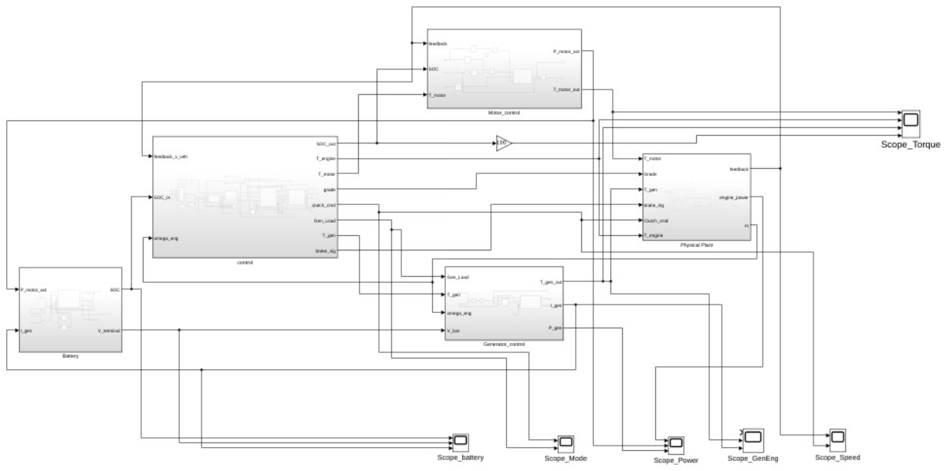
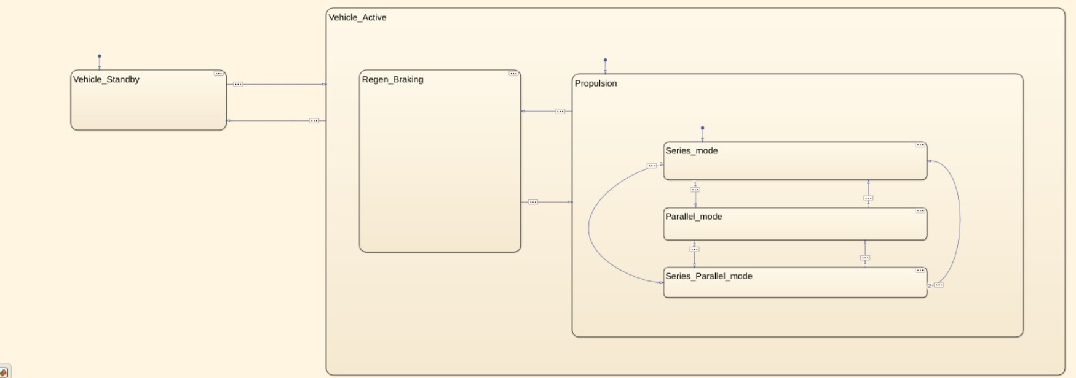
Design and Simulation of a Series-Parallel Hybrid Electric Vehicle (HEV) Using MATLAB Simulink and Stateflow
KPIT Apex Lab
Raj Sawala | Amaan Mulla | Karan Patil Mentor: Padma Dwivedi
Presentation deck
Notes:
Introduce the project as a complete Simulink + Stateflow HEV model, not just a control block. Emphasize that this presentation follows the latest corrected model and the final documentation.

Slide 2
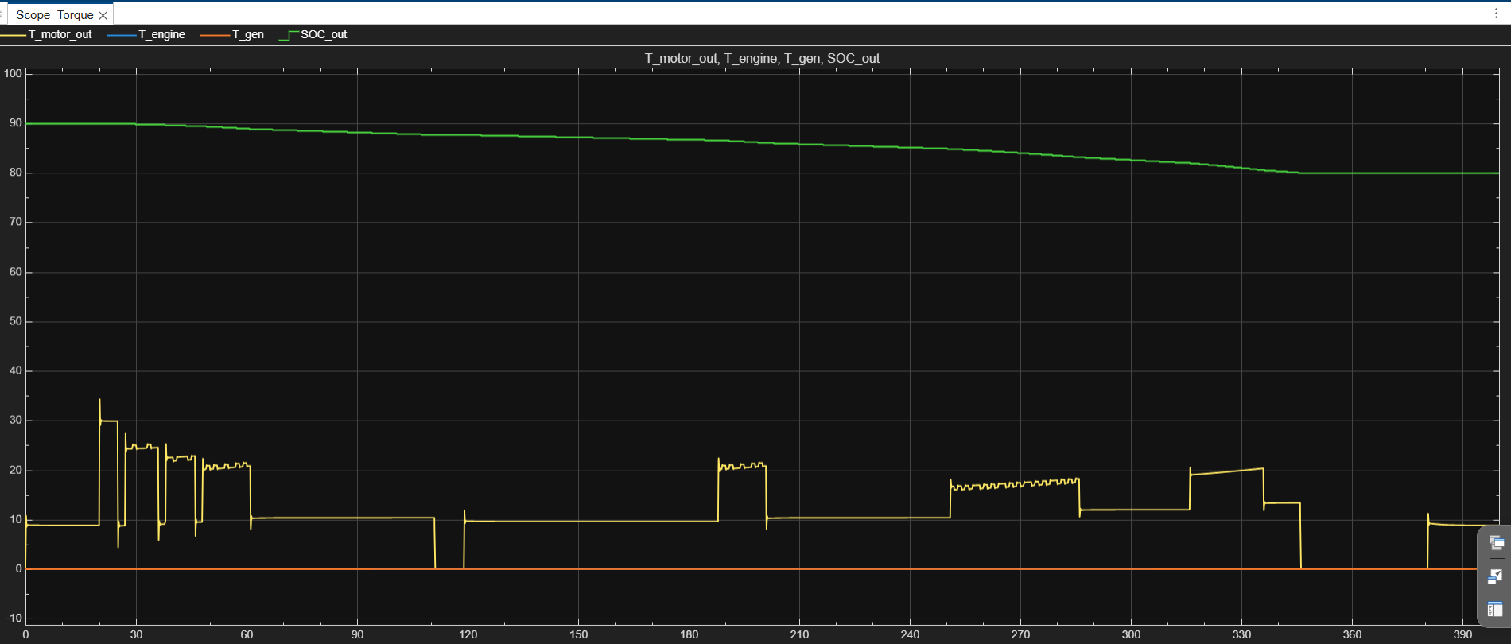
WHAT I WILL COVER
Presentation roadmap
Problem
& objective
HEV system
architecture
Subsystem
design
Control +
Stateflow EMS
Simulation
results
Limitations +
upgrades
Top-level Simulink model
Drive Cycle 2 result window
Focus of presentation: explain how driver demand, battery SOC, engine/generator operation, motor torque limiting and the Simscape physical plant interact in closed loop.
Series-Parallel HEV Model | KPIT Apex Lab
01
Notes:
Give a short map of the talk. Mention that the deck is built for viva-style explanation: objective, model architecture, subsystem design, results, limitations.

Slide 3
WHY THIS MODEL WAS BUILT
Project objective
Main objective
Build a series-parallel HEV simulation that combines control logic, electrical energy flow and physical vehicle dynamics.
Modeling aim
Show how engine, motor, generator, battery and clutch decisions change with speed demand, SOC and road grade.
Presentation aim
Demonstrate subsystem-wise implementation, EMS mode selection and simulation behavior for Drive Cycle 2.
This is a control-oriented student HEV model: the powertrain is simplified enough to understand, but complete enough to test energy-management decisions.
Series-Parallel HEV Model | KPIT Apex Lab
02
Notes:
State the project objective clearly. This is not a detailed production-calibrated vehicle, but it has all major HEV signal paths and control decisions.

Slide 4
FIVE MAIN SUBSYSTEMS
Top-level system architecture
control
EMS brain: selects drive cycle, computes T_req, Stateflow mode and torque split.
Physical Plant
Simscape vehicle/driveline: converts torque and brake commands into speed feedback.
Battery + actuators
Battery estimates SOC/voltage. Motor_control and Generator_control condition torque/power signals.
Closed-loop idea: v_ref / drive cycle → DriverPI → T_req → EMS mode → torque split → plant → speed feedback. The plant output closes the loop, so torque demand changes with vehicle response instead of staying independent.
Top-level model: Battery, Motor_control, Generator_control, Physical Plant and control
Series-Parallel HEV Model | KPIT Apex Lab
03
Notes:
Use this slide to explain the full signal flow. Point out that feedback_v_veh closes the loop back to control.

Slide 5
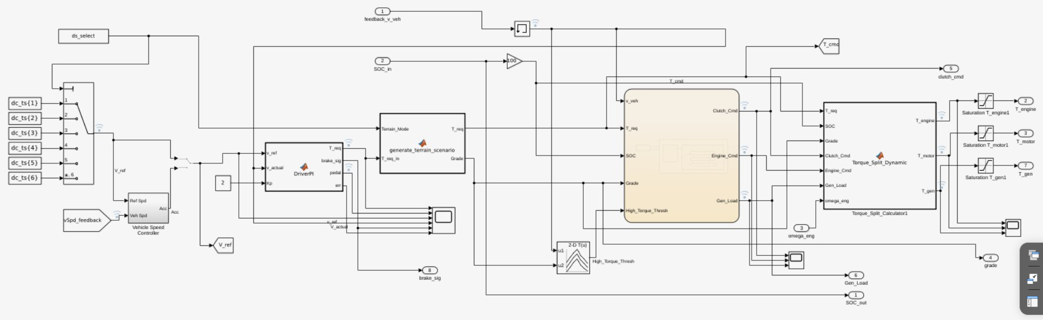
DRIVE CYCLE, PI DRIVER, STATEFLOW EMS AND TORQUE SPLIT
Control subsystem
Updated control subsystem screenshot
dc_ts{1..6}
selection
DriverPI
T_req + brake
Terrain
Grade
Stateflow
mode
Torque Split
T_engine/T_motor/T_gen
Explanation path: selected drive cycle gives v_ref; DriverPI compares v_ref with actual feedback and creates T_req/brake_sig; terrain block adds grade; Stateflow selects mode; Torque_Split converts mode into T_engine, T_motor and T_gen.
Series-Parallel HEV Model | KPIT Apex Lab
04
Notes:
Explain the control subsystem left to right. Mention ds_select chooses one of six drive cycles. DriverPI generates T_req and brake_sig. Stateflow decides the operating mode. Torque_Split_Dynamic computes the commands.

Slide 6
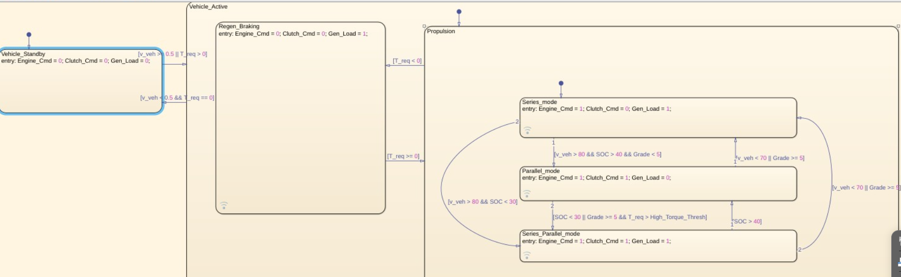
MODE LOGIC FOR SERIES-PARALLEL OPERATION
Energy Management System: Stateflow modes
Vehicle_Standby
No propulsion command; engine, clutch and generator load are off.
Regen_Braking
Triggered when T_req < 0; motor path supports negative torque if SOC permits.
Series_mode
Engine drives generator; motor provides road torque. Useful for lower speed or charging-support conditions.
EMS Stateflow chart with entry actions and transition conditions
Parallel / Series-Parallel
Clutch engages engine to driveline; motor assists or generator absorbs surplus depending on demand and SOC.
How to present it
This is a rule-based EMS. Speed, SOC, grade and T_req decide whether the vehicle behaves like series, parallel or series-parallel HEV.
Alternate compact Stateflow overview
Series-Parallel HEV Model | KPIT Apex Lab
05
Notes:
This is the most important control slide. Explain standby, regen, series, parallel and series-parallel modes. Emphasize that entry actions produce Engine_Cmd, Clutch_Cmd and Gen_Load.

Slide 7
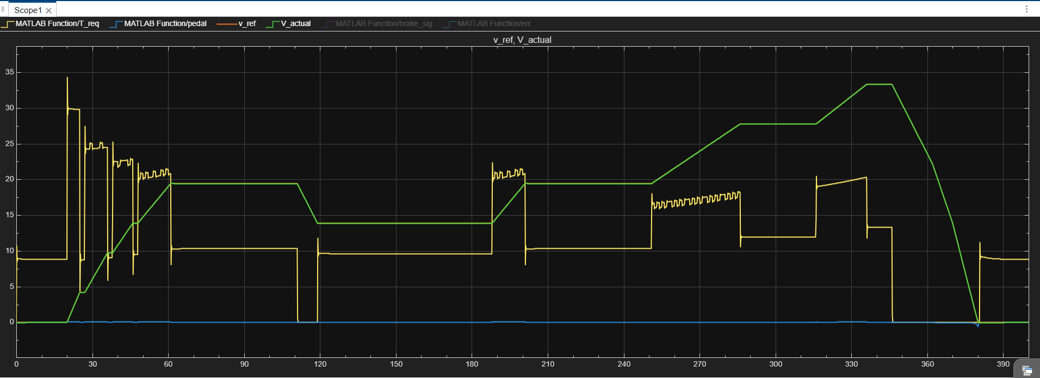
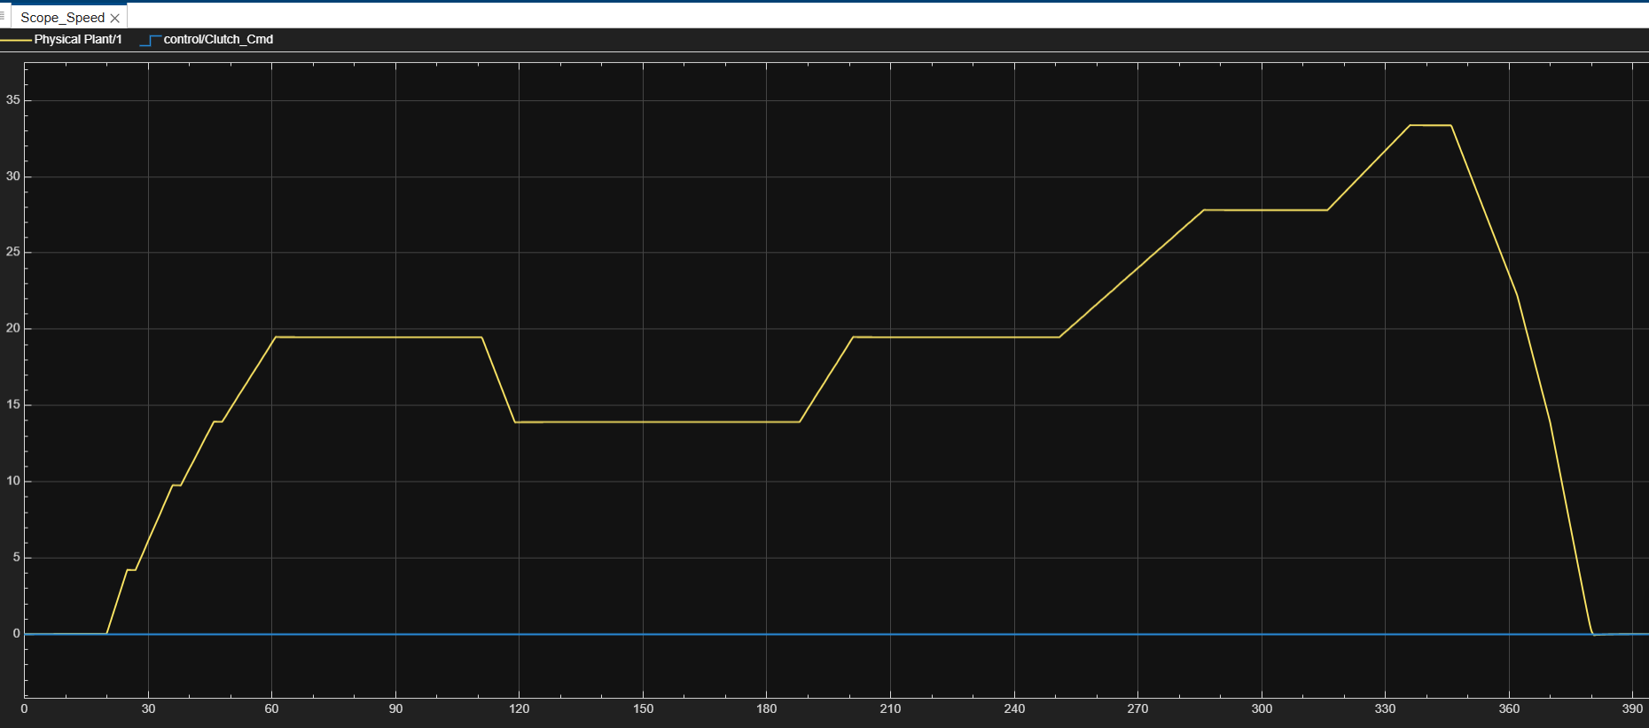
DRIVE CYCLE 2 RESPONSE
DriverPI and speed tracking
DriverPI internal scope: T_req, pedal, v_ref and v_actual
Scope_Speed: actual speed and clutch command
DriverPI logic: • Error = reference speed − actual speed • PI controller converts error to pedal command • Positive pedal → filtered T_req • Negative pedal → brake_sig
Observation for Drive Cycle 2: Actual speed follows the reference profile with delay due to vehicle inertia, torque limits and drivetrain dynamics. This proves the controller is connected in closed loop.
Series-Parallel HEV Model | KPIT Apex Lab
06
Notes:
Use this slide for closed-loop explanation. The speed plot is for Drive Cycle 2. The PI driver generates torque when actual speed is below the reference.

Slide 8
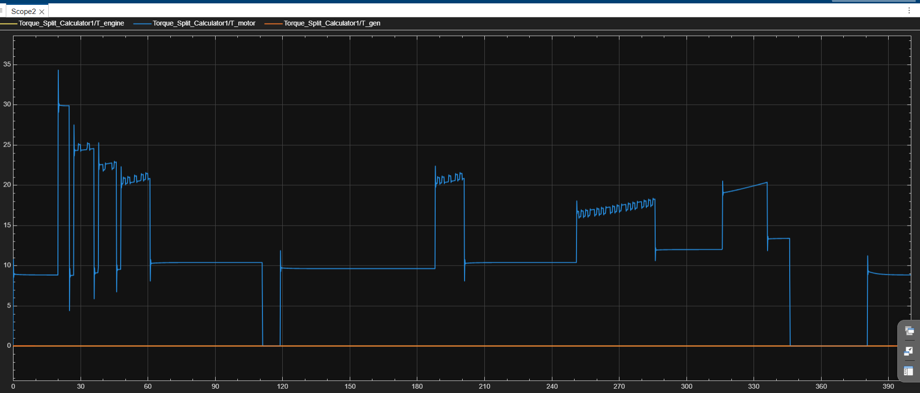
HOW EMS COMMANDS BECOME TORQUE COMMANDS
Torque split logic
Torque_Split_Calculator outputs
Scope_Torque: motor, engine, generator and SOC
Drive Cycle 2 interpretation: motor torque is the active propulsion contributor in this run, while engine/generator values remain near zero. The SOC trace slowly decreases, showing battery energy is being used for traction. In viva, use this slide to connect EMS command outputs with actual torque behavior.
Engine_Cmd
Clutch_Cmd
Gen_Load
T_req + SOC + Grade
T_engine / T_motor / T_gen
Series-Parallel HEV Model | KPIT Apex Lab
07
Notes:
Do not claim generator charging is active if the graph shows zero. Say the Drive Cycle 2 result mostly uses motor torque and shows a decreasing SOC trend.

Slide 9
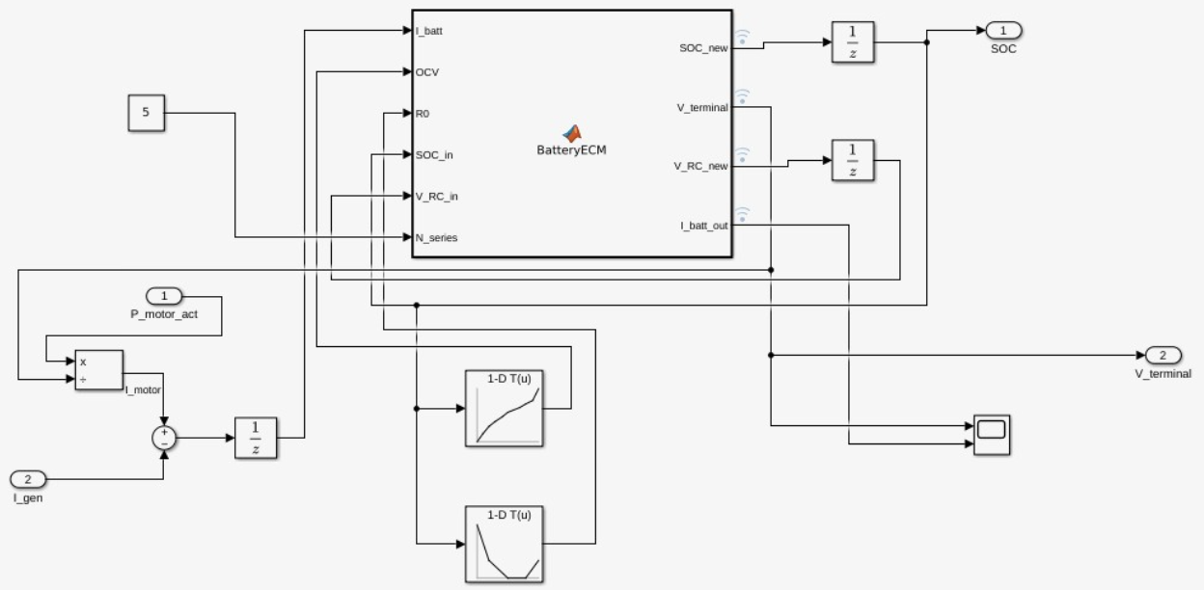
PACK-LEVEL ECM WITH DISCRETE UPDATE
Battery subsystem
Discrete ECM update: I_batt = I_motor − I_gen SOC_new = SOC_in − I_batt·dt/(C_nom·3600) V_RC_new = V_RC_in + dt·(−V_RC/(R1·C1)+I_batt/C1) V_terminal = OCV_pack − I_battR0_pack − V_RC_pack
What it estimates
SOC and terminal voltage based on motor power demand and generator charging current.
Why delays are used
Battery subsystem: net current, OCV/R0 lookup, BatteryECM and delays
1/z blocks hold SOC and V_RC states, making the ECM a discrete-time update rather than a pure algebraic loop.
Presenter note: Battery is modeled at pack level using N_series scaling. The model is suitable for energy-flow and SOC behavior demonstration; final validation requires real battery parameters.
Series-Parallel HEV Model | KPIT Apex Lab
08
Notes:
Explain that BatteryECM is a 1RC equivalent circuit model. It is discrete in the latest model: SOC_new and V_RC_new are fed back through delay blocks.

Slide 10
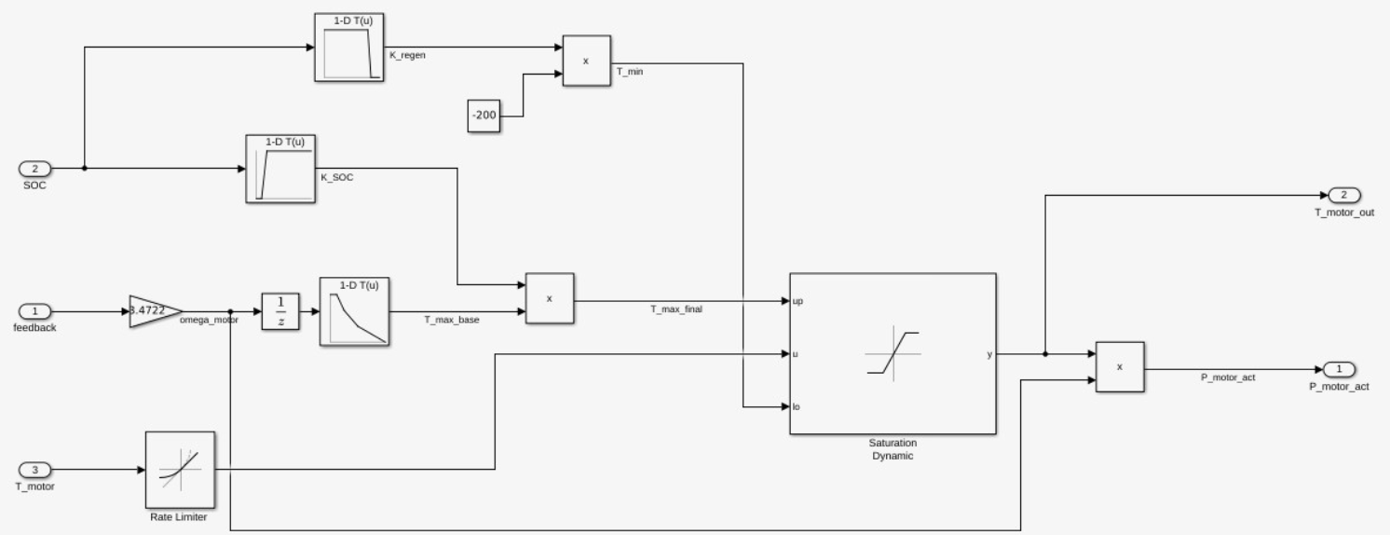
TORQUE LIMITING AND PROTECTION LAYER
Motor control subsystem
Speed-based torque limit
T_max_base reduces available torque as motor speed increases.
SOC derating
K_SOC blocks motor assistance at very low SOC and permits full torque above the threshold band.
Regen protection
K_regen blocks regenerative braking at high SOC to avoid overcharging.
Dynamic saturation
Final torque is bounded between computed upper/lower limits, then converted into motor power.
Motor_control subsystem
Series-Parallel HEV Model | KPIT Apex Lab
09
Notes:
Explain each lookup table and the role of dynamic saturation. Motor_control is a protection layer, not the EMS brain.

Slide 11
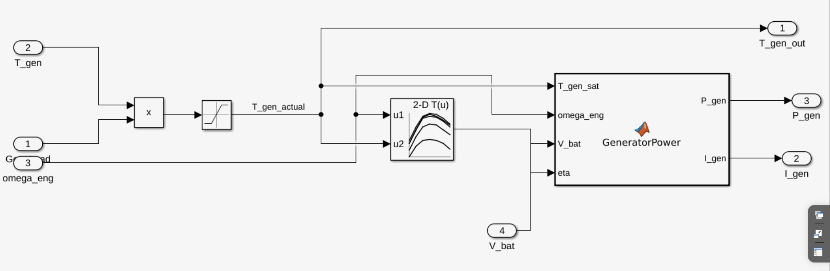
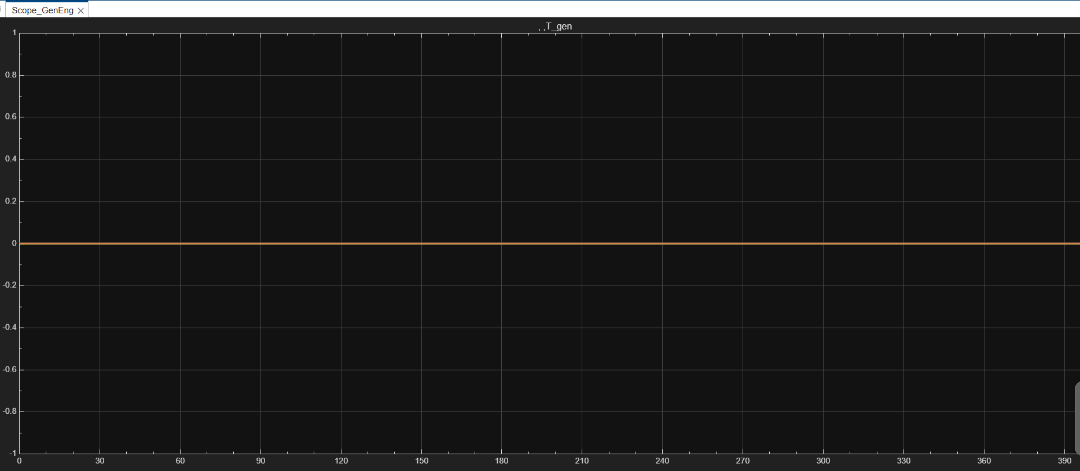
TORQUE COMMAND TO CHARGING CURRENT
Generator control subsystem
T_gen_actual = saturate(Gen_Load · T_gen)
η = LUT(omega_eng, T_gen_actual)
P_gen = T_gen_sat · omega_eng · η
I_gen = clamp(P_gen / V_bat, 0, I_max_charge)
Latest model correction: η from the 2-D efficiency LUT is connected to GeneratorPower. For the shown Drive Cycle 2 run, generator current is almost zero because the EMS does not strongly request charging in this case.
Generator_control subsystem with efficiency map and GeneratorPower block
Drive Cycle 2 generator/engine scope
Series-Parallel HEV Model | KPIT Apex Lab
10
Notes:
Explain Gen_Load gating and generator torque saturation. Mention eta is now connected in the latest model.

Slide 12
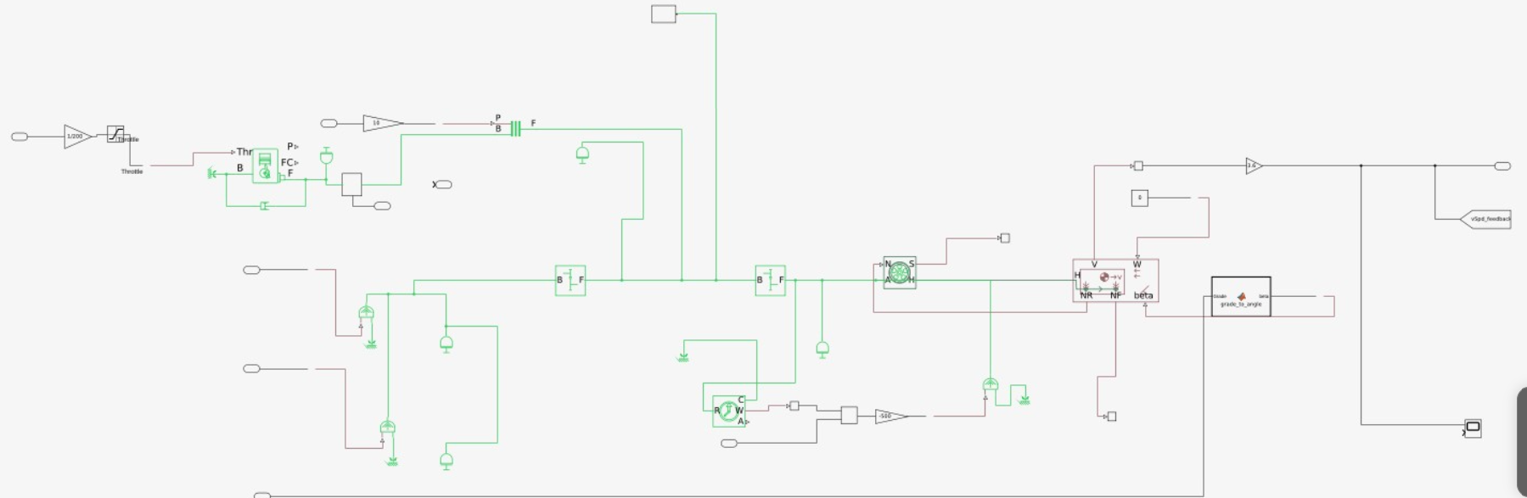
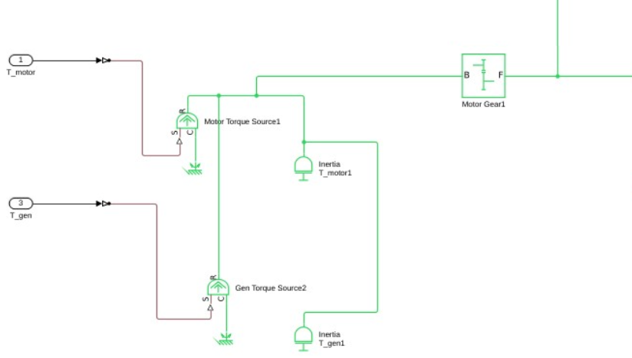
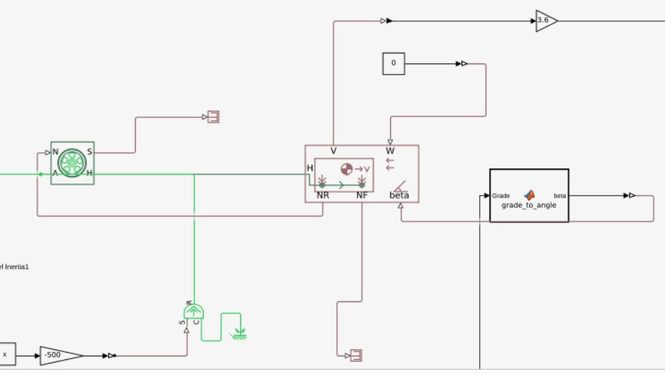
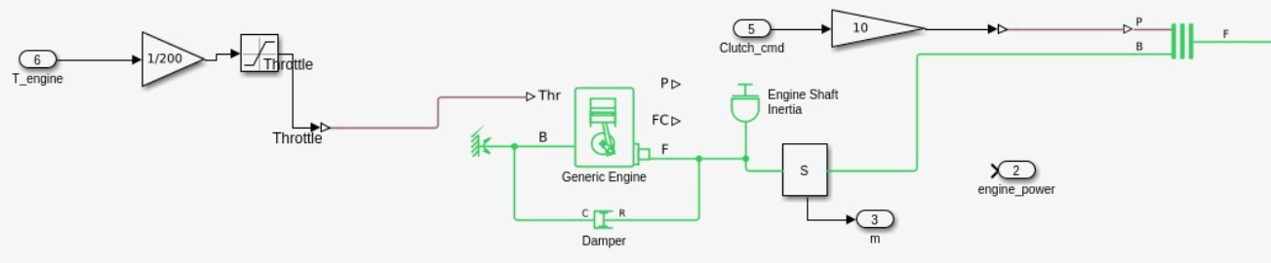
MECHANICAL TOPOLOGY AND VEHICLE DYNAMICS
Physical Plant: Simscape driveline
Engine + clutch path
Motor/generator torque source path
Tire, vehicle body and grade conversion
The plant converts control outputs into physical response: ideal torque sources create shaft torque, gears transmit it to wheels, tire/vehicle body generate longitudinal motion, and sensors return speed and engine feedback.
Series-Parallel HEV Model | KPIT Apex Lab
11
Notes:
Point out physical components: generic engine, clutch, motor/generator torque sources, gears, tire and vehicle body.

Slide 13
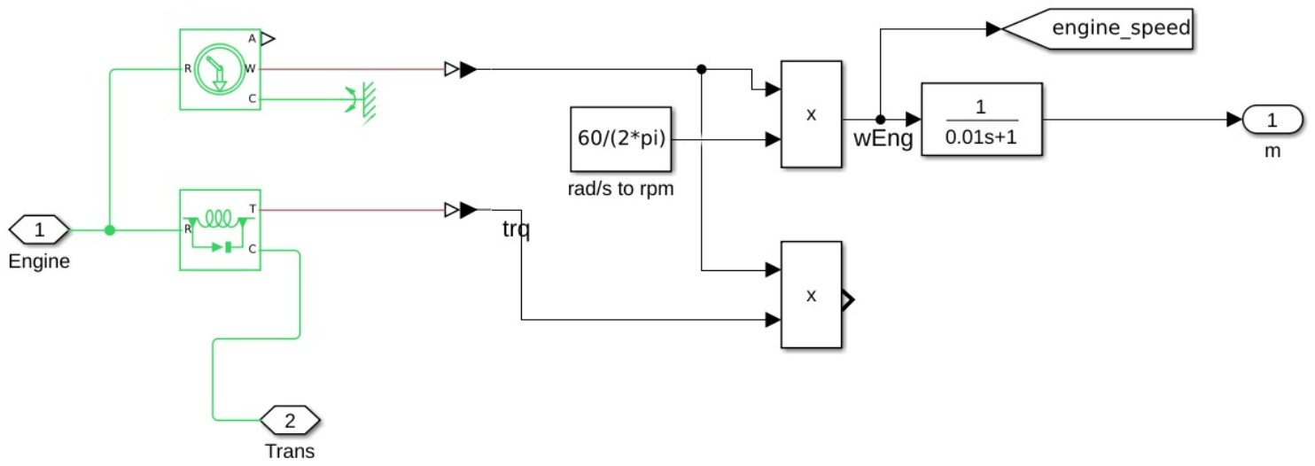
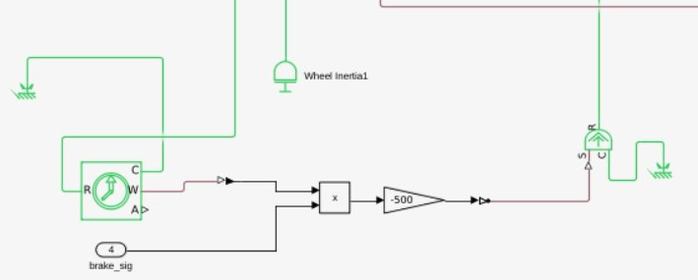
FEEDBACK SIGNALS USED BY EMS AND SCOPES
Engine and sensing path
Engine torque command, throttle and clutch path
Engine torque/speed/power sensing subsystem
Engine speed is converted from rad/s to rpm, filtered and returned to control. Torque and angular speed are multiplied to estimate engine power.
Brake actuator close-up
Vehicle body speed feedback
Series-Parallel HEV Model | KPIT Apex Lab
12
Notes:
Use this slide to explain feedback. The engine sensor produces speed and power information, which is important for generator and control blocks.

Slide 14
SPEED RESPONSE AND TORQUE BEHAVIOR
Simulation results: Drive Cycle 2
Speed feedback and clutch command
Torque split and SOC trend
Speed result: the actual vehicle speed follows the Drive Cycle 2 pattern with acceleration, cruise and deceleration segments. This validates the closed-loop connection from control → plant → feedback.
Torque result: motor torque responds to acceleration demand. Engine/generator stay near zero in this specific case, so this run mainly demonstrates electric traction and SOC consumption.
Series-Parallel HEV Model | KPIT Apex Lab
13
Notes:
Talk through the plots. Emphasize that these are Drive Cycle 2 results. Be honest that engine/generator are almost inactive in these results.

Slide 15
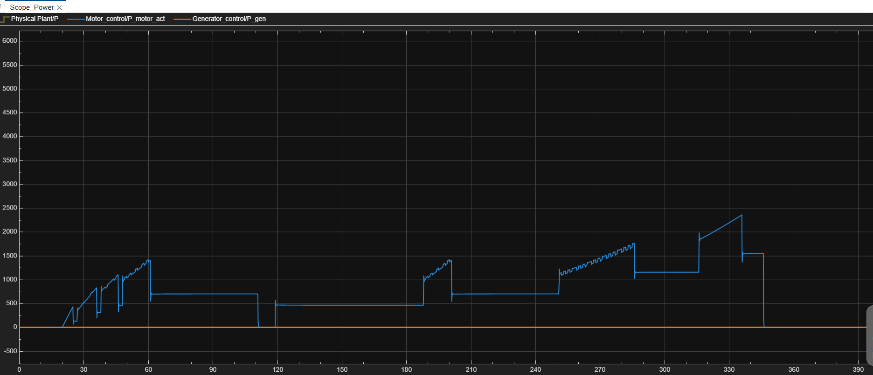
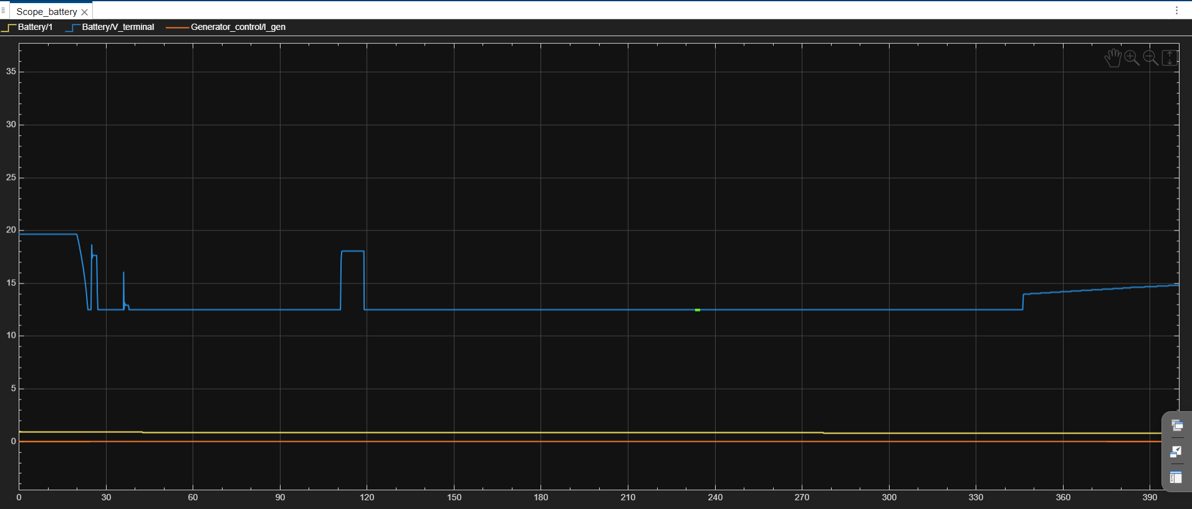
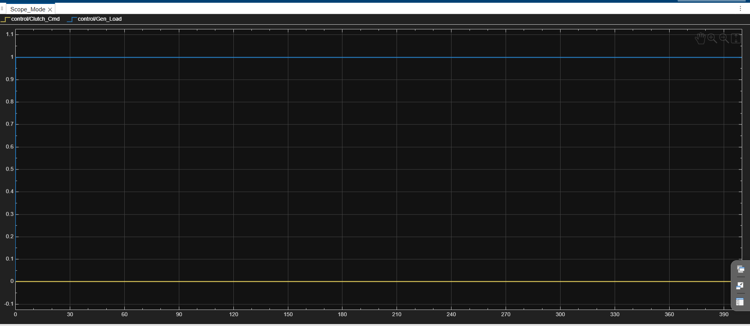
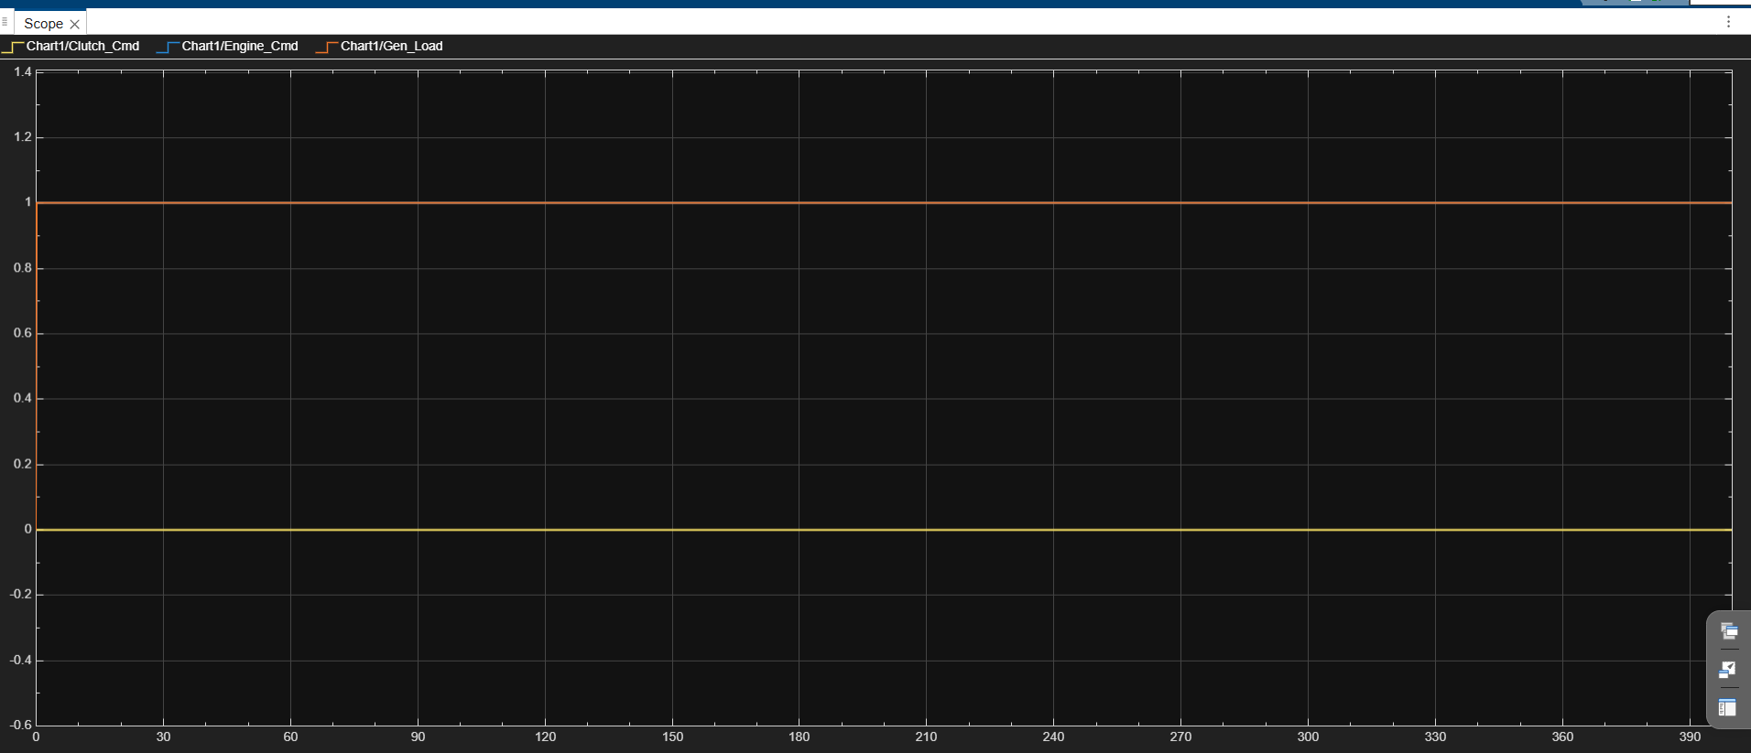
POWER, BATTERY AND COMMAND BEHAVIOR
Simulation results: energy and mode signals
Power exchange: engine, motor, generator
Battery SOC, terminal voltage and I_gen
Mode command scope: Clutch_Cmd and Gen_Load
Stateflow command scope: clutch, engine and generator load
Drive Cycle 2 result summary: motor power dominates propulsion, battery voltage remains bounded, SOC decreases gradually, and mode-command scopes show why generator charging is inactive for this run.
Series-Parallel HEV Model | KPIT Apex Lab
14
Notes:
Explain the energy behavior. Motor power tracks acceleration demand. Battery voltage stays within limits. Mode/command scopes are useful for debugging Stateflow decisions.

Slide 16
WHAT IS WORKING AND WHAT STILL NEEDS CHECKING
Model status and validation checks
Verified from latest model
BatteryECM is discrete-time. GeneratorPower includes efficiency η. DriverPI uses PI logic. Physical Plant returns speed, power and engine-speed feedback.
Simulation behavior
Speed response, torque demand and motor power show a coherent Drive Cycle 2 run. SOC remains bounded and voltage stays clamped.
Integrated closed-loop model
Important viva note
If asked why generator values are near zero, explain that current thresholds and selected Drive Cycle 2 keep the run mostly motor-dominant.
Open technical check
Confirm whether omega_eng used in power equations is rpm or rad/s. If it is rpm, power scaling should be corrected before final quantitative validation.
Closed-loop DriverPI response
Series-Parallel HEV Model | KPIT Apex Lab
15
Notes:
This slide gives the current status. Mention corrections made from latest model and the remaining unit-consistency check.

Slide 17
HONEST ENGINEERING SCOPE
Limitations and future upgrades
Simplified powertrain
Ideal torque sources and estimated parameters make the model control-oriented, not production-calibrated.
Drive-cycle and grade assumptions
Drive Cycle 2 result is shown; more scenarios should be simulated across all dc_ts{1..6} and grades.
Battery parameter validation
EMS can be improved with hysteresis and validated thresholds
C_nom, R1, C1, OCV and R0 maps should be aligned with a real battery pack or cited source.
Recommended upgrades
Recommended upgrades: add fuel-consumption/BSFC map, motor efficiency map, SOC recovery test, mode-change hysteresis, and compare all six drive cycles instead of only Drive Cycle 2.
More result cases can validate engine/generator activity
Series-Parallel HEV Model | KPIT Apex Lab
16
Notes:
Be honest about limitations. This is appreciated in viva because it shows engineering judgment. Future upgrades should include unit checks, efficiency maps and multiple drive cycles.

Slide 18
WHAT THE HEV MODEL DEMONSTRATES
Conclusion
The project successfully integrates a series-parallel HEV architecture in MATLAB Simulink and Stateflow. It includes a battery ECM, generator control, motor torque protection, Simscape physical plant, Stateflow EMS and dynamic torque-split logic.
For presentation, the strongest story is: drive-cycle demand creates torque request, Stateflow selects operating mode, torque split commands the plant, and scopes verify the response.
Complete integrated model
Thank you
Questions?
Drive Cycle 2 torque/SOC result
Series-Parallel HEV Model | KPIT Apex Lab
17
Notes:
Conclude with the closed-loop story. Invite questions. If asked about the most important block, say the control subsystem and Stateflow EMS.

