Slide 1

SENTINEL
Unified Viewing & Metadata Analytics
Gujarat Police Innovation Challenge 2026 · Model 2
Built by RuVision Thinking Labs

Slide 2
BACKGROUND
The Problem
▸ 26 Government Departments operate independent CCTV systems — different vendors, VMS platforms, storage architectures, and retention periods (7 to 15+ days).
▸ Central command centres must access these feeds through multiple separate viewer systems — no single pane of glass.
▸ High-value law-enforcement databases already exist and are digitized — VAHAN (vehicle registration), eGujCop / CCTNS (stolen vehicles, wanted persons), AFIS / NAFIS — but they are siloed from live video.
▸ Result: no automated, real-time correlation between what a camera sees and what these databases already know.
SENTINEL — Gujarat Police Innovation Challenge 2026 · Model 2
2

Slide 3
SOLUTION MODEL
Model 2 — Unified Viewing & Metadata Analytics
▸ Direct RTSP / ONVIF / vendor-API connection to each camera or VMS.
▸ No middleware or federation layer introduced.
▸ Departmental VMS and storage systems remain completely untouched and continue operating independently.
WHY MODEL 2, NOT 3/4
▸ 26 departments' VMS/storage diversity makes a federation layer a multi-department program — not a hackathon-timeline build.
▸ Delivers exactly the two capabilities the evaluation tests: live unified view + AI vehicle tracing.
▸ Lowest integration risk: zero dependency on any department changing its systems.
SENTINEL — Gujarat Police Innovation Challenge 2026 · Model 2
3

Slide 4
ARCHITECTURE
End-to-End Data Flow
Departmental CCTV / VMS
Capture Layer
ANPR Analytics
Watchlist & Alerting
Route Reconstruction
Unified Dashboard
→
→
→
→
→
No video is ever centrally stored — only structured detection metadata (plate text, camera, timestamp, confidence).
▸ Capture: TCP-forced RTSP, PTS-derived timing, exponential-backoff reconnect.
▸ Analytics: YOLO plate detector + PaddleOCR, CPU-only, configurable sample rate.
▸ Storage: SQLite metadata log (schema-compatible upgrade path to PostgreSQL).
SENTINEL — Gujarat Police Innovation Challenge 2026 · Model 2
4

Slide 5
ENGINEERING — PROVEN, NOT JUST DESIGNED
Live Stream Ingestion
▸ TCP-forced RTSP, PTS-derived timing (never wall-clock or declared FPS), exponential backoff reconnect.
▸ Tolerant of decoder warm-up noise and mixed H.264 / H.265 codecs — confirmed live on the sandbox grid.
▸ Camera inventory always pulled live from the gateway catalogue — zero hardcoded camera IDs.
VALIDATED AGAINST THE LIVE 30-CAMERA SANDBOX
▸ Found and fixed a real cross-thread cv2.VideoCapture segfault during load testing — a genuine stability bug, not a hypothetical one.
▸ Confirmed automatic reconnect/recovery after a forced restart.
▸ Ran a clean, multi-camera, multi-hour unattended session: zero crashes, zero unwanted reconnects, 480+ real detections logged.
SENTINEL — Gujarat Police Innovation Challenge 2026 · Model 2
5

Slide 6
AI-POWERED VIDEO ANALYTICS
Finding — and Fixing — the Plate-Legibility Bottleneck
1
Most sandbox cameras are wide-angle overhead junction cams — genuinely not plate-resolvable at distance. An honest finding, not a failure.
2
Went back to the camera catalogue's own display names and found a toll-plaza camera ("Tollnaka") — camera metadata, not just camera count, was the actionable signal.
3
On that camera's legible plate crop, our first OCR engine (EasyOCR) capped at ~0.3 confidence after heavy tuning. Swapping to PaddleOCR on the identical crop, no other change: 0.87 confidence.
4
Even then the real pipeline still failed — root cause was our own bounding-box crop clipping characters. Fixed by padding the detector's box 75% of its own size, verified against real detector output.
5
Result over a multi-hour unattended run: 480+ detections above threshold across three independently-confirmed cameras — full plausible Indian plates, not fragments (e.g. GJ05AU9828 at 0.96 confidence).
SENTINEL — Gujarat Police Innovation Challenge 2026 · Model 2
6

Slide 7
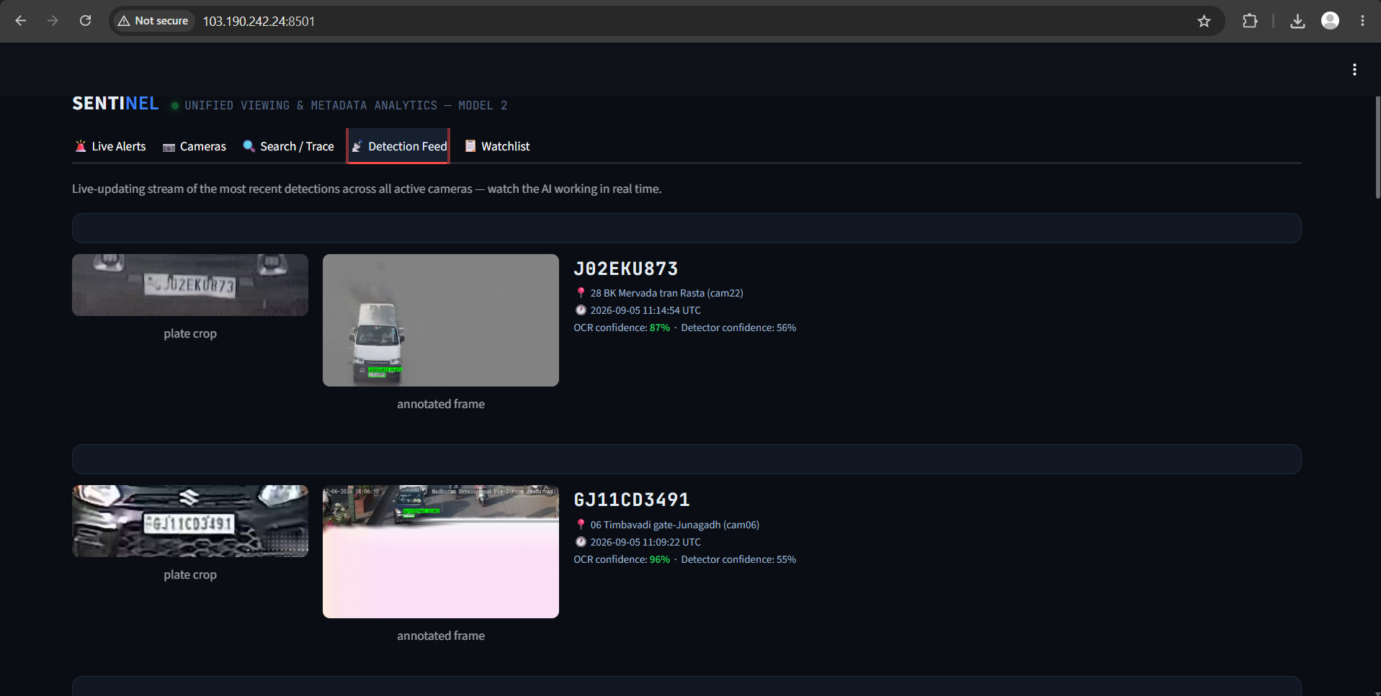
AI ANALYTICS — LIVE EVIDENCE
Detection Feed: Watch the AI Working in Real Time
SENTINEL — Gujarat Police Innovation Challenge 2026 · Model 2
7
Real crop + real annotated frame (bounding box drawn by the detector) for two different live-detected vehicles — not staged.

Slide 8
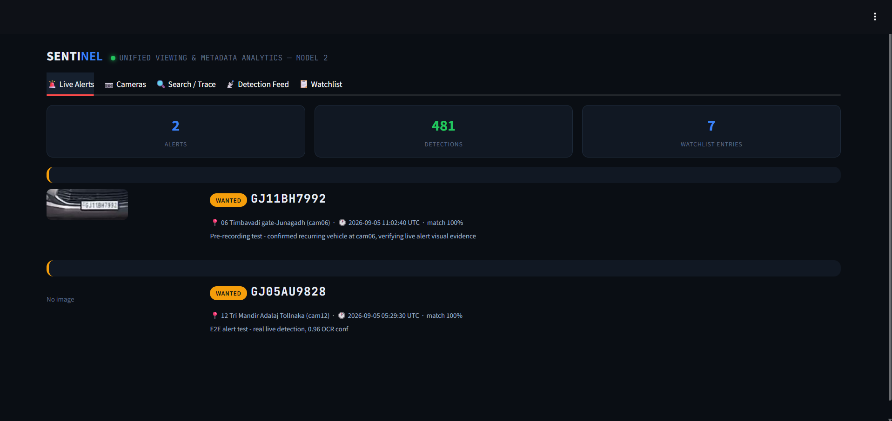
WATCHLIST CORRELATION
Real-Time Alerting
▸ Every OCR read — not sampled after the fact — is normalized and matched immediately.
▸ Two-pass matching: exact + OCR-confusion-aware pass (0/O, 1/I, 5/S, 8/B, 2/Z), then fuzzy-similarity fallback.
▸ A match writes an alert with camera, plate, PTS timestamp, confidence, and matched entry — visible on the dashboard within seconds, no manual refresh.
▸ Designed to plug into VAHAN / eGujCop-CCTNS as the real watchlist source in production; a representative watchlist is used for this demo, as explicitly permitted.
Real watchlist match — 100% confidence, real plate crop, real timestamp.
SENTINEL — Gujarat Police Innovation Challenge 2026 · Model 2
8

Slide 9
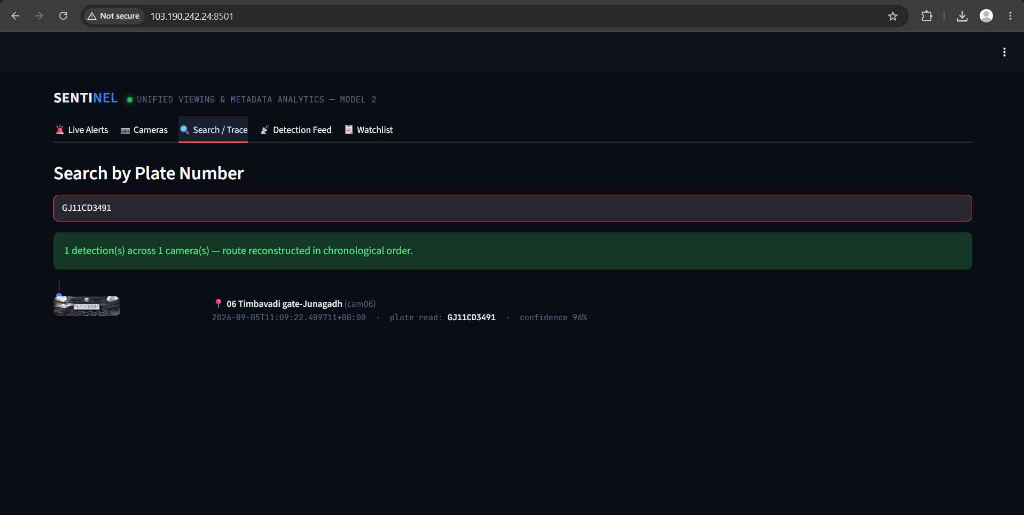
THE EVALUATION'S CORE TEST
Vehicle Route Reconstruction
▸ Given a plate, returns every (camera, location, timestamp) detection in chronological order.
▸ Verified: one real vehicle detected 4 times within 16 seconds, correctly linked across OCR readings of BV2807 and 8V2807 — the confusion-variant matching fix, found via this exact data.
HONEST STATUS
▸ Three cameras independently confirmed ANPR-viable, ran simultaneously for hours, 480+ real detections.
▸ Comprehensive exact + confusion-variant check: no same-plate sighting across two different cameras yet — real traffic timing and this sandbox's camera mix, not a code limitation.
Real search result — visual timeline with plate crop.
SENTINEL — Gujarat Police Innovation Challenge 2026 · Model 2
9

Slide 10
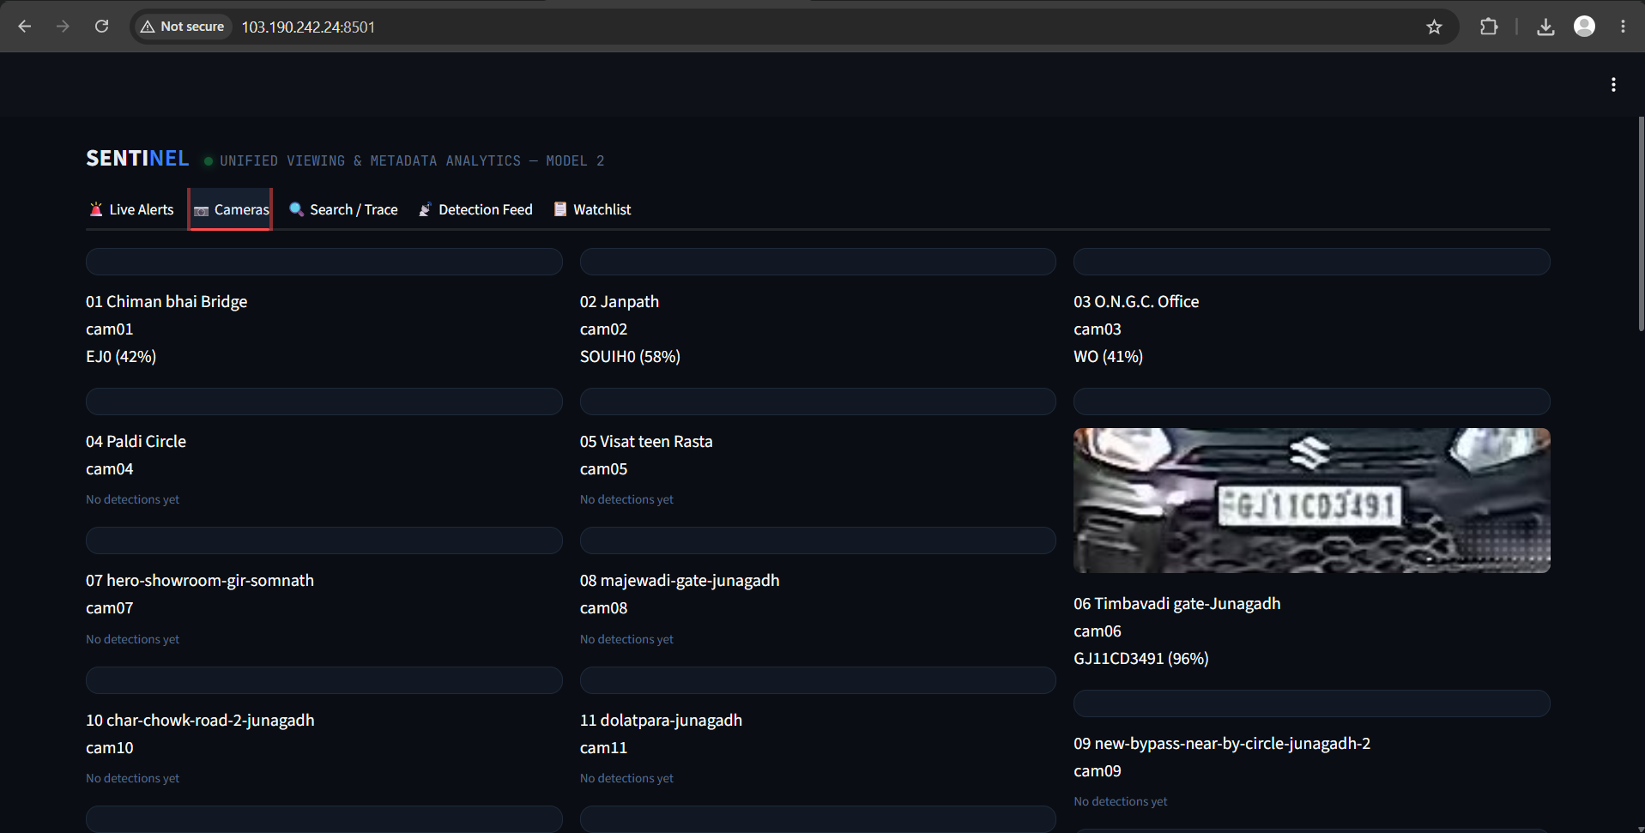
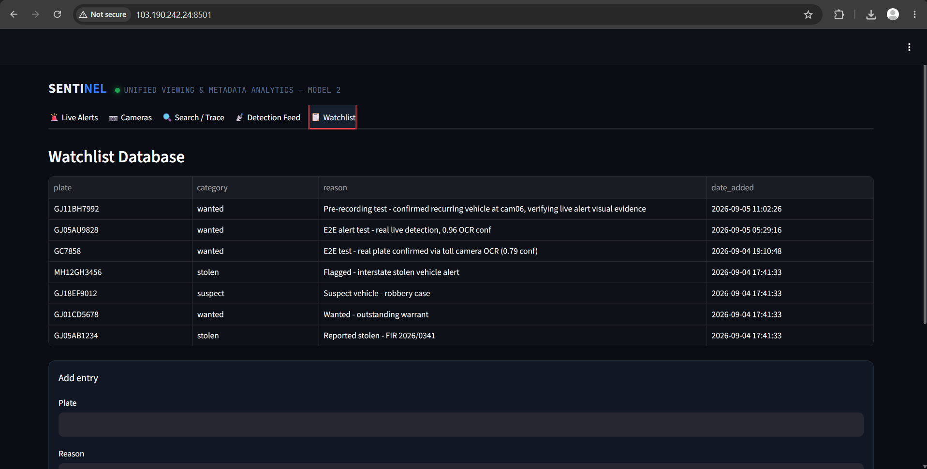
UNIFIED CONTROL-ROOM VIEW
The Dashboard
Camera grid — live thumbnails, last-seen plate per camera.
Watchlist administration.
SENTINEL — Gujarat Police Innovation Challenge 2026 · Model 2
10

Slide 11
IMPLEMENTATION
Technology Stack
Capture
OpenCV + FFmpeg backend (Python)
Detection
Ultralytics YOLO — pretrained, CPU-only
OCR
PaddleOCR (PP-OCRv6)
Storage
SQLite (pilot); schema-compatible path to PostgreSQL
Dashboard
Streamlit, custom dark theme
No GPU, no external message bus required at this scale — deliberately minimal-dependency for fast, reliable deployment.
SENTINEL — Gujarat Police Innovation Challenge 2026 · Model 2
11

Slide 12
PATH TO STATEWIDE SCALE
Scalability, Security & Deployment
▸ Horizontal scale-out: independent capture/ANPR workers, sharded by camera set — no component assumes a single-machine camera count.
▸ Edge pre-filtering + GPU/accelerator path is the realistic route to ~80,000-camera scale; this prototype's frame-sampling and confidence knobs are exactly what moves to edge-side config.
▸ Credentials never logged (verified in code); consume-only design — never pushes to or controls any gateway.
▸ No department's existing VMS, storage, or retention policy is touched.
▸ RBAC, audit logging, and TLS-everywhere are the production hardening path beyond this prototype.
SENTINEL — Gujarat Police Innovation Challenge 2026 · Model 2
12

Slide 13
EXPECTED OUTCOMES
Operational Benefits
▸ Single pane of glass across departments — without a multi-year federation program.
▸ Automated, continuous watchlist correlation — proactive alerting instead of manual after-the-fact video review.
▸ Fast, low-risk path to statewide expansion: same architecture, more camera shards, no redesign required.
SENTINEL — Gujarat Police Innovation Challenge 2026 · Model 2
13

Slide 14
HONEST ABOUT CURRENT SCOPE
What's Next
▸ Face Recognition (FRS) and other analytics — explicitly out of scope for this build, bonus territory.
▸ Live VAHAN / eGujCop integration — currently a representative demo watchlist, as explicitly permitted by the challenge rules.
▸ Edge deployment pilot for bandwidth-constrained districts.
SENTINEL — Gujarat Police Innovation Challenge 2026 · Model 2
14

Slide 15
Thank you
SENTINEL — Unified Viewing & Metadata Analytics

