Slide 1
Data Analysis Platform
Developed at
Dharmsinh Desai University
Developed by
Patel Jaydeep(IT-082)
Shah Dishant(IT-105)
Shah Fenil(IT-106)
Shah Raj(IT-110)
Internal Guide : Prof.(Dr.) Mukesh Goswami

Slide 2
Introduction
Project Definition:
With this product we facilitate them and their data analyzers to better understand their data and with attractive charts they can get insight of their data along with the data modelling which will help them to predict the useful information.
Purpose:
The purpose of this system is to save time and money of the Data Scientists/Clients for visualizing their Data and to get better insight of the data

Slide 3
Introduction
Scope:
This project is to visualize data in form of charts and can find the pattern of their sales and relation between the different categorically related data
Objective:
To save the time and effort of data scientist.

Slide 4
No.
Summary of Work Done
System Design Model | Iterative Waterfall Model
No of Use Cases prepared | 1
No of Sequence Diagrams prepared | 4
No. of classes prepared and implemented | 24
Line of Code in project | 5100-6700
Line of Code (excluding auto generated code) | 4000-5000
No of Test cases figures | 12

Slide 5


Hardware Requirement
Software Requirement
Desktop/Laptop having: -
At least 2 GB RAM and 2 GB External Storage
Good Internet Connectiontivity
Any browser supporting Javascript

Slide 6




Technology
Parts of Software | Used Technology
Front End Language | HTML, CSS, Javascript
Tools for Development | Notepad++
Data Access Layer | Firebase Authentication
Tools for Development | Sublime
Back End Language | Python, Flask
Tools for Development | PyCharm

Slide 7
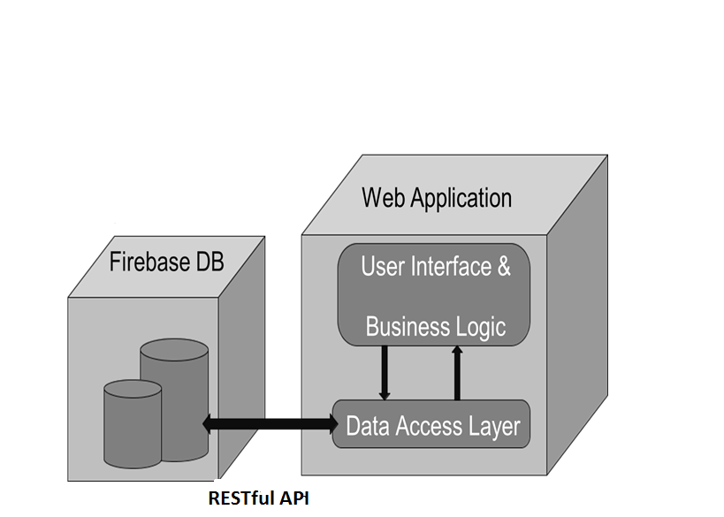
Application Architecture

Slide 8
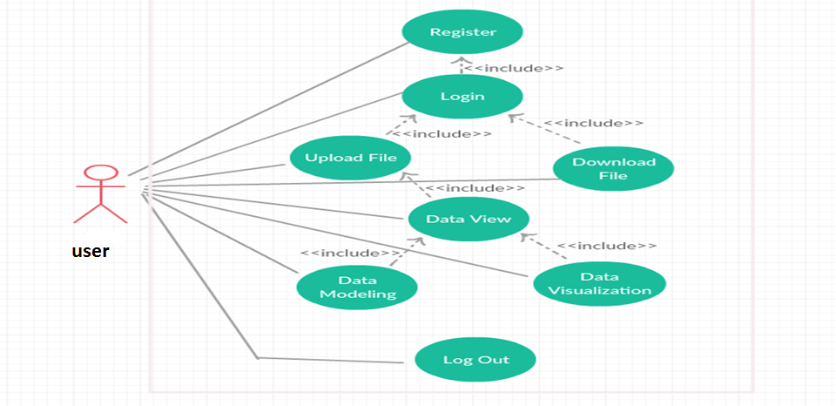
Use Case Diagram

Slide 9
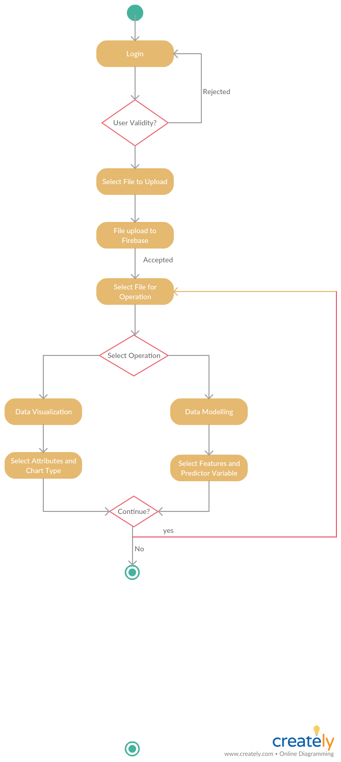
System Activity Diagram

Slide 10
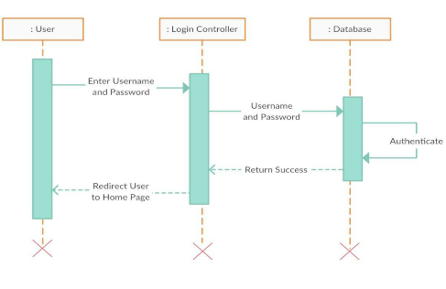
Sequence Diagram
(Login-Sequence Diagram)

Slide 11
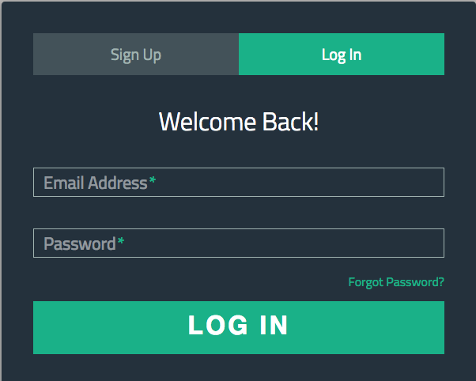
Login Screen

Slide 12

Challenges
While developing Login Functionality, As this functionality is provided by the FIREBASE ,we didn’t face as such any problem in the logic building but only while integrating it with the Flask framework it was a little difficult to call the REST API of Firebase login module ,so at that point we tried to understand the flow of the whole flask framework and learned about how a REST API works .

Slide 13
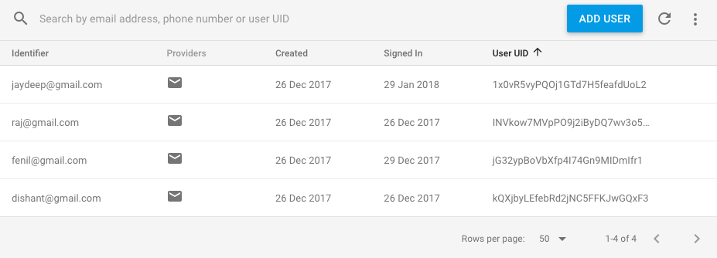
Authentication page

Slide 14
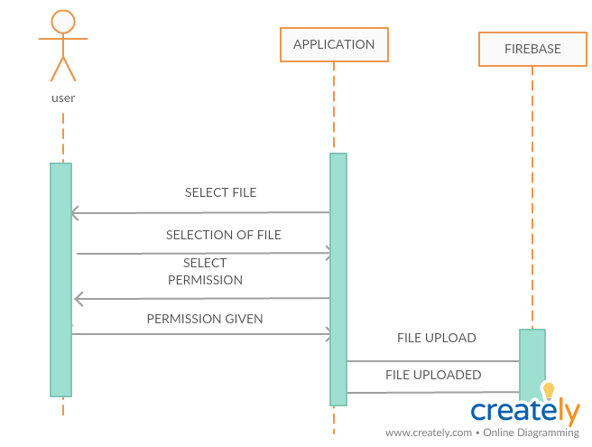
Sequence Diagram (File Upload-Sequence Diagram)

Slide 15
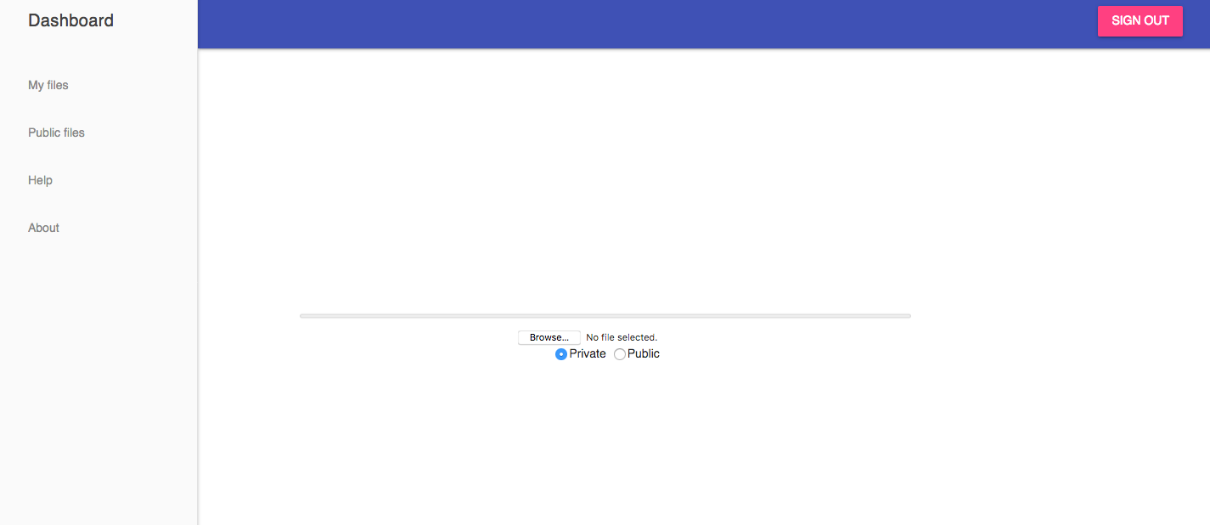
Dashboard Page

Slide 16
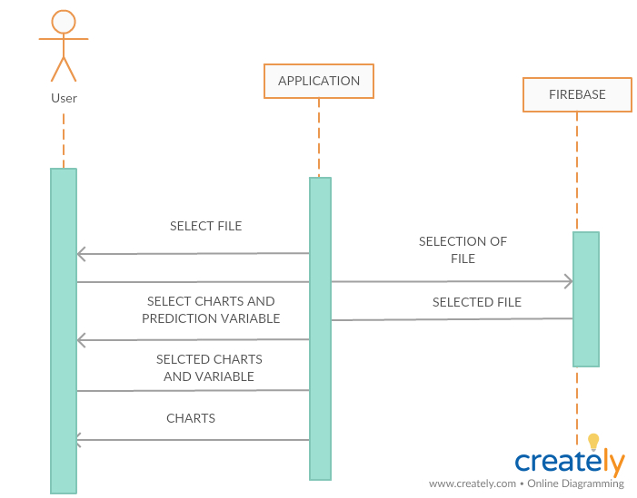
Sequence Diagram(Data Visualization-Sequence Diagram)

Slide 17
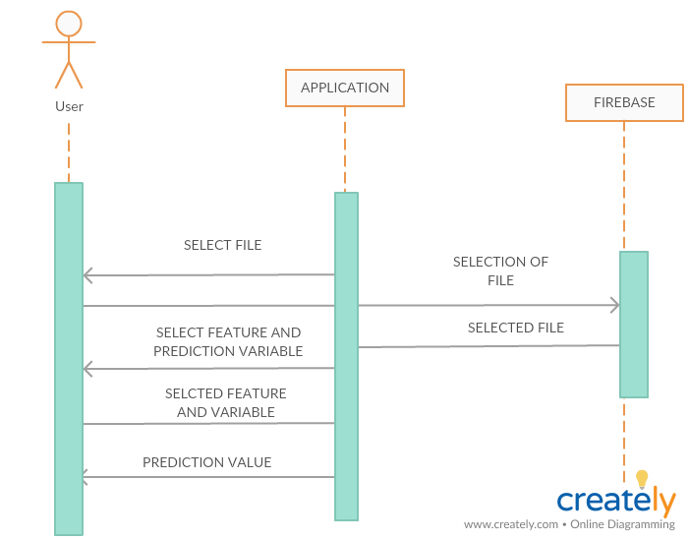
Sequence Diagram(Data Predictor-Sequence Diagram )

Slide 18
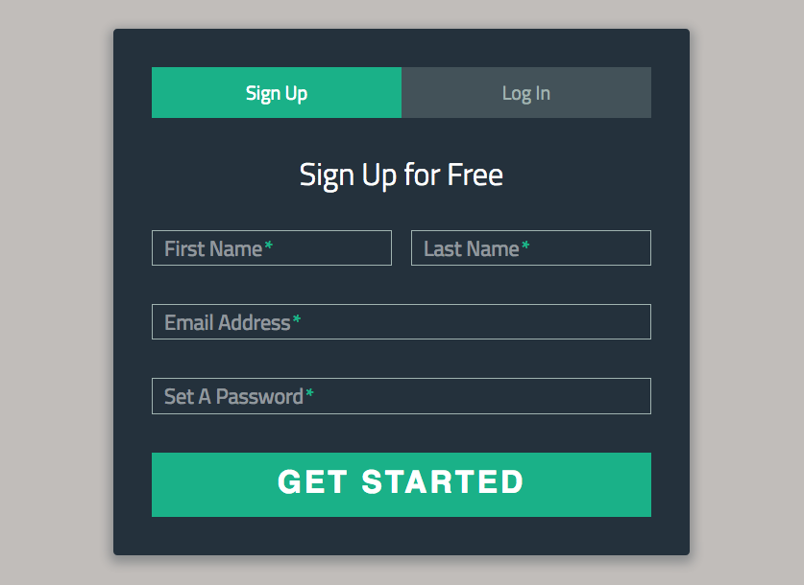
Sign-Up Screen

Slide 19
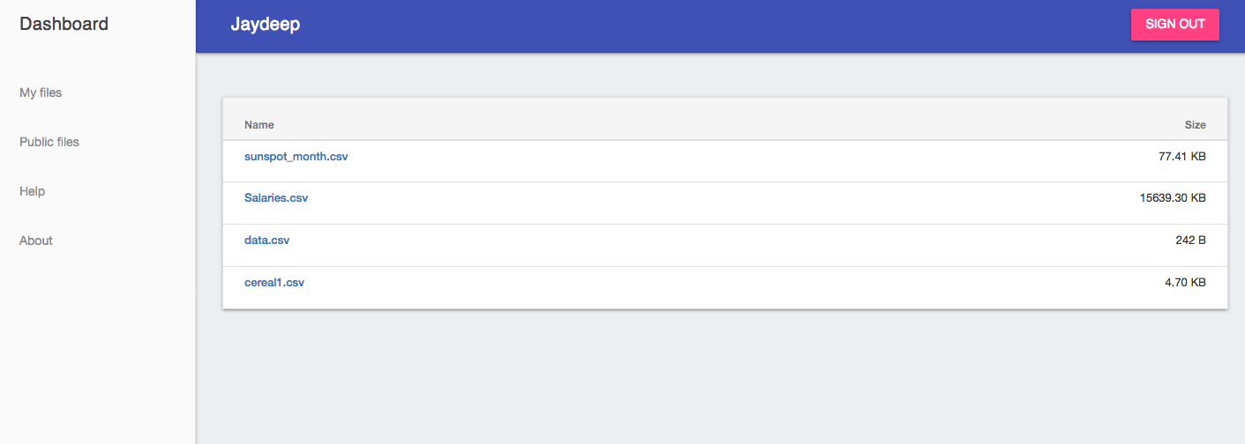
Data View Page

Slide 20
Challenges
Implementing this functionality to the show the user ,his already uploaded files , was somewhat a difficult task as the files uploaded by the user are needed to be stored on the Firebase storage and to be retrieved whenever required by the user.
From the above problem, we learnt how to retrieve the data stored from a cloud storage and to make it shown to the user.
Also it was a difficult a part to implement the constraint of allowing only the authorized person to access his files which are Private and Public files should be accessed by all the users.

Slide 21
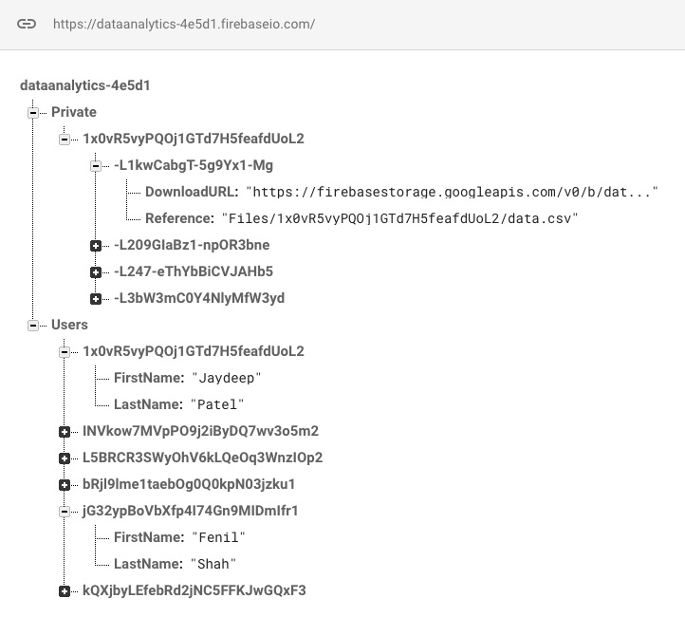
User Details and File Location

Slide 22
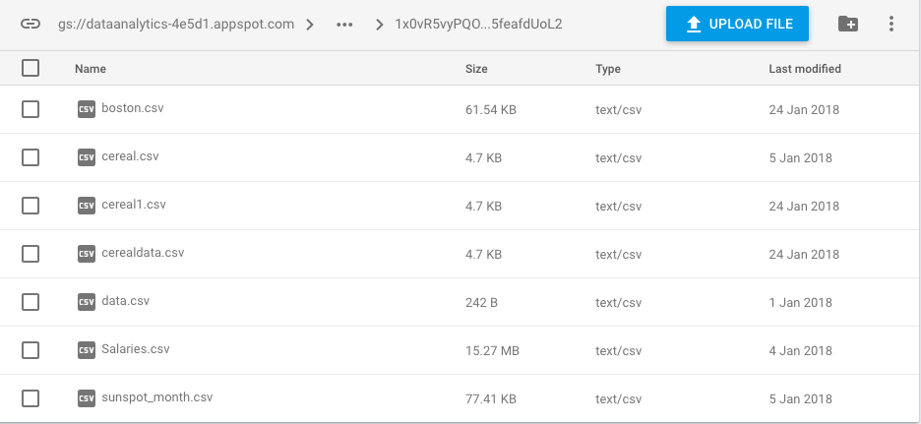
File Storage

Slide 23
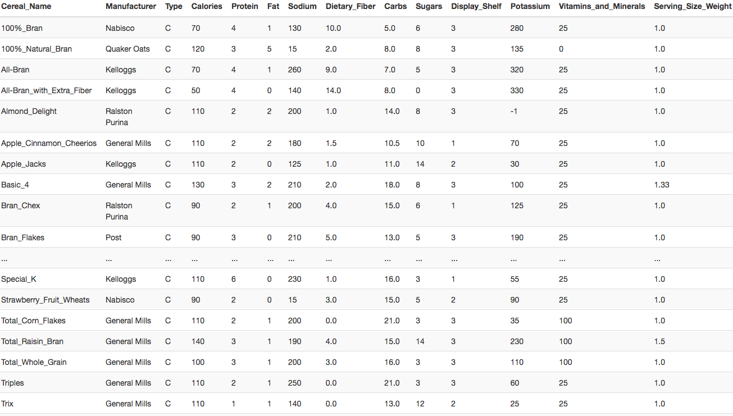
Show Sample Data Page

Slide 24
Challenges
While Implementing the functionality of showing the user the file data we faced a problem of showing the whole data of the file.
So here we used the Pandas library , a python library , which helped us to create a Data Frame with selected records from the data file which helped us to implement this functionality.

Slide 25
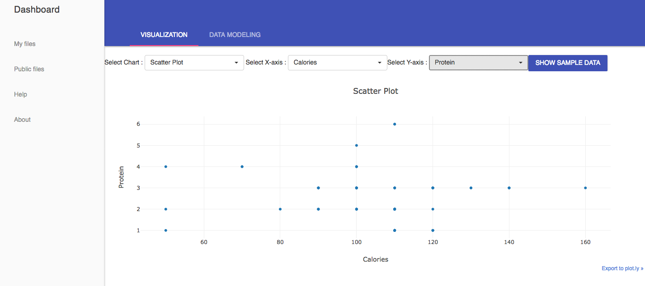
Data Visualization-Scatter Plot using Plotly

Slide 26
Data Visualization
Implementing the functionality to form charts from the data file was one of the main task of our project & also the hardest part.
The main part was to fetch the data from the cloud storage and then populating it to the chart parameters like axes, etc.
We have tried two charting libraries :
a)D3.js :- A javascript based charting.
b)Plotly :- A Python based Charting library.

Slide 27
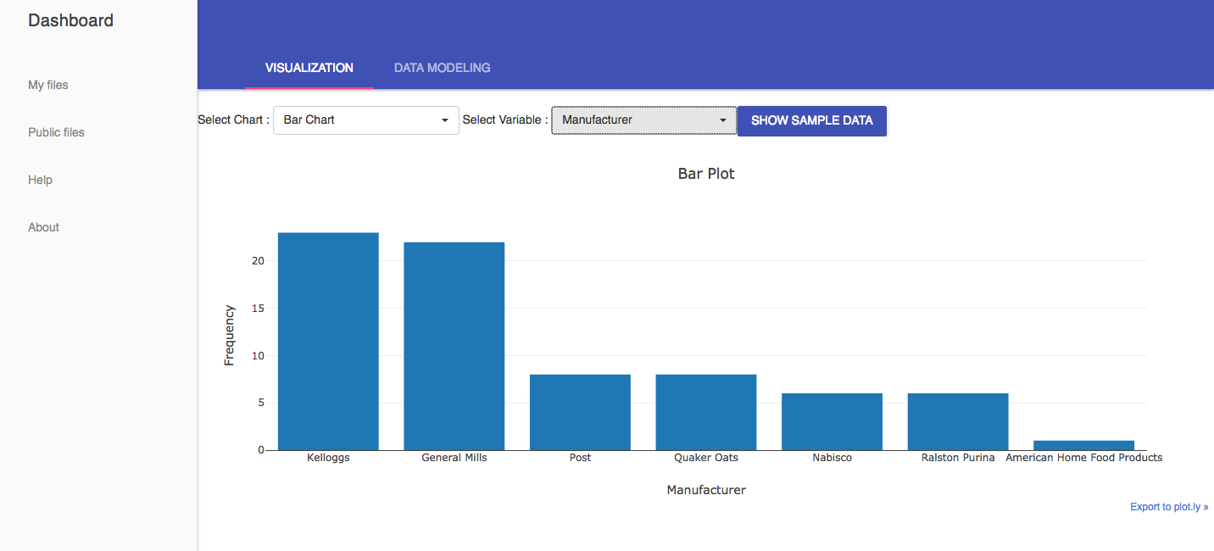
Data Visualization-Bar Chart using Plotly

Slide 28
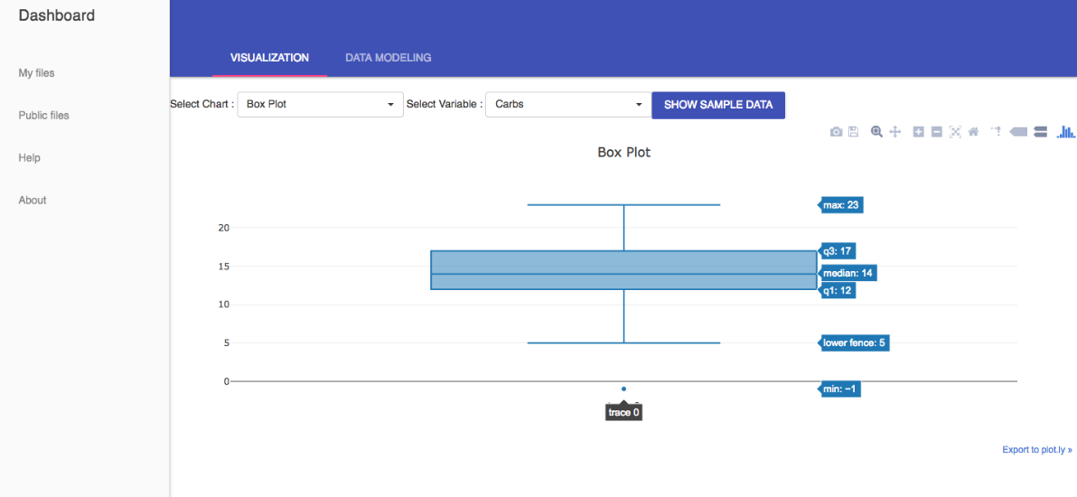
Data Visualization-Box Plot using Plotly

Slide 29
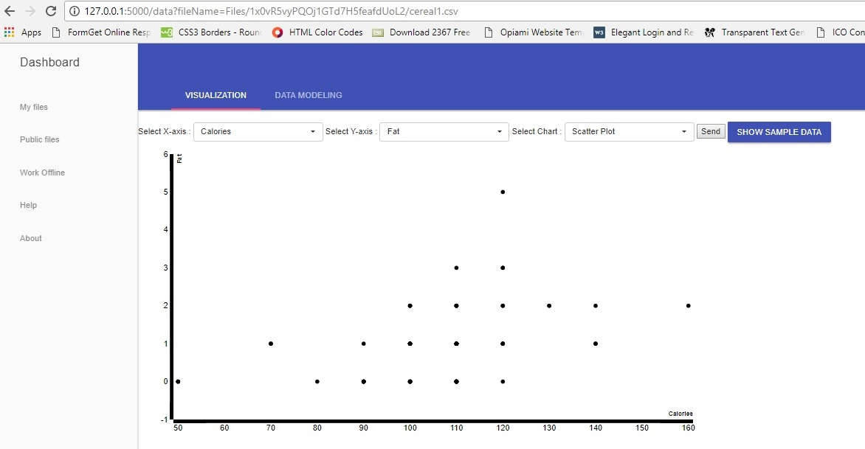
Data Visualization-Scatter Plot using d3.js

Slide 30
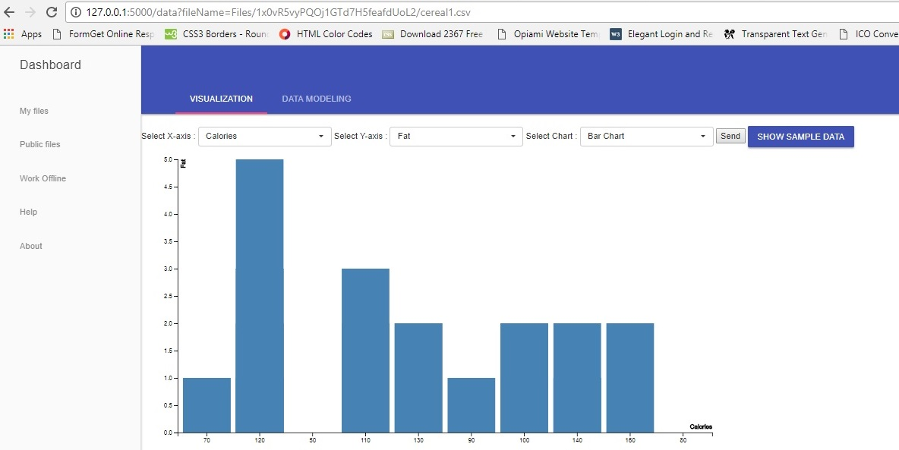
Data Visualization-Bar Chart using d3.js

Slide 31
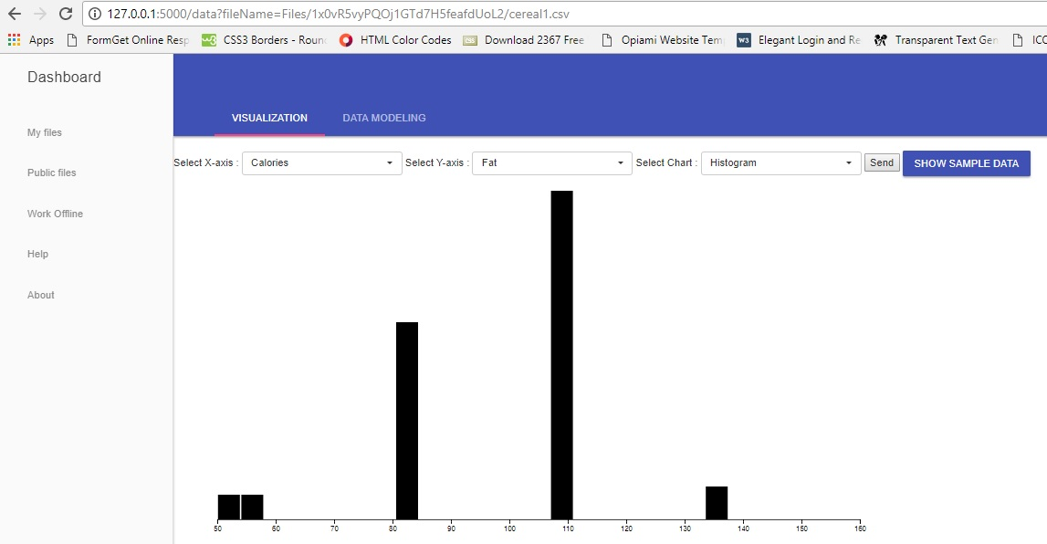
Data Visualization-Histogram using d3.js

Slide 32
Challenges
From the charts formed using D3.js and Plotly, we can conclude the using plotly for creating charts is more feasible then using D3..js.
As D3 is a javascript based library might not work every time (e.g. in case the client browser is javascript disabled.) and also in case where the structure of a chart varies , D3.js gives improper results, while Plotly works much comfortably in such scenarios.
So, when we want to implement the charting functionality where the structure of chart do not vary(e.g. at the admin side ,to view usage of application, crash reports, etc.) D3.js works fine.
But, When we want to use charting on client side where the structure of charts depend on the user input- Plotly is more feasible.

Slide 33
No.
Plotly Vs D3
Plotly is a python based charting library | D3.js is a Javascript based library
Plotly provides some extra options on the sides of the chart like zoom-in, zoom-out, show closest data on hover, etc. | In D3.js the developer needs to provide these options by himself
In this graph cannot be formed on the developer’s choice. | In D3.js Developer can customize the graph by adding the svg elements and events
Plotly is easy to use | D3.js is not as it needs extensive coding

Slide 34
DATA PREDICTION
Here, we’ve used the Linear Regression Data Modelling Technique to predict the value of a predictor variable selected by user based on the user selected features from the selected file.
For this functionality ,we used the Scikit-learn Machine learning libraries which provides a python based machine learning libraries to implement the Data modelling techniques.

Slide 35
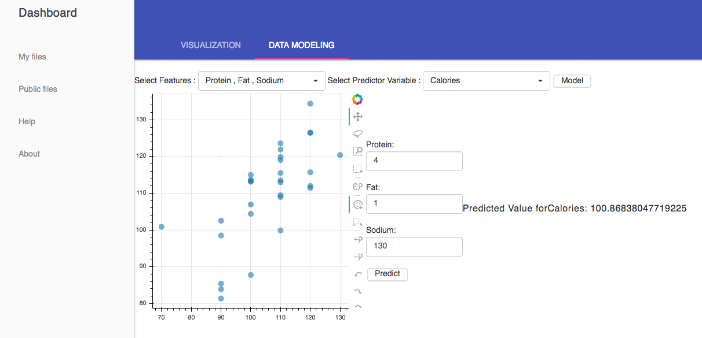
Data Modeling-Linear Regression

Slide 36

Conclusion
It was a great experience in working with new Google’s Firebase Cloud Hosted Database Technology and handling whole development of the project.
Used various Charting-Libraries .
Learnt various rich GUI components.

Slide 37

Future Enhancement
Better User Interaction.
Various Types of Charts Can be added.
User Customization in charts can be added.

Slide 38
Thanks!

