Slide 1
GUJARAT POLICE INNOVATION HACKATHON 2026
SENTINEL
VMS Federation & Middleware — Reference Model 3
Statewide CCTV integration across 26 departments and heterogeneous VMS platforms — without replacing existing systems or centralizing raw video.
Problem Statement: Statewide CCTV Integration

Slide 2
PROPOSED SOLUTION MODEL
Model 3: VMS Federation & Middleware
Adapters normalize each department's existing feed; only metadata & events cross a shared bus; raw video stays where it already lives.
Model 1
Not viable: 26 departments, sunk procurement, no guaranteed common migration schedule.
Full VMS Replacement
Model 2
~96 Gbps statewide bandwidth (see slide 9), single point of failure, single huge attack surface.
Centralized Video Storage
Model 3
Departments keep existing VMS; onboarding is additive (one new adapter); fastest realistic path to a correlated statewide view.
Federation & Middleware — THIS SUBMISSION
Model 4
Cannot do cross-camera / cross-department vehicle tracing — the hackathon's stated technical evaluation focus.
Edge-AI Only, No Correlation
Model 5
Reasonable long-term target — but a procurement/vendor decision, not a hackathon prototype's to presuppose. Model 3's bus/adapter pattern is a clean on-ramp to it later.
Hybrid Cloud-Native SaaS
SENTINEL — Reference Model 3: VMS Federation & Middleware
2

Slide 3
SOLUTION OVERVIEW
Objectives & Key Innovations
Objectives
Key Innovations
▪ Prove the federation pattern end-to-end on real video, real ANPR, and a real watchlist match with a live alert — not mocked
▪ Make cross-camera vehicle tracing — the hackathon's stated evaluation focus — a first-class, fast API
▪ Keep the architecture honestly incremental: every “at scale, X becomes Y” claim maps to a component actually built tonight
▪ Vendor-agnostic by construction: onboarding a new department = one new adapter class, zero core-logic changes
▪ Metadata-only federation: raw video never leaves its source; only detection events, timestamps, and evidence crops cross the bus
▪ One correlation engine, many feeds: cross-camera trace works identically whether sightings came from a live RTSP grid or a snapshot-poll DVR
What was actually built and verified tonight
▪ 4 vendor adapters (3 simulated with genuinely distinct ingestion mechanics + 1 real, authenticated live government RTSP grid)
▪ Real YOLOv8n + EasyOCR ANPR, real event bus, real correlation engine, real Postgres-backed watchlist matching and alerting
▪ Real JWT/RBAC dashboard with GIS map, vehicle-trace timeline, and live WebSocket alerts
SENTINEL — Reference Model 3: VMS Federation & Middleware
3

Slide 4
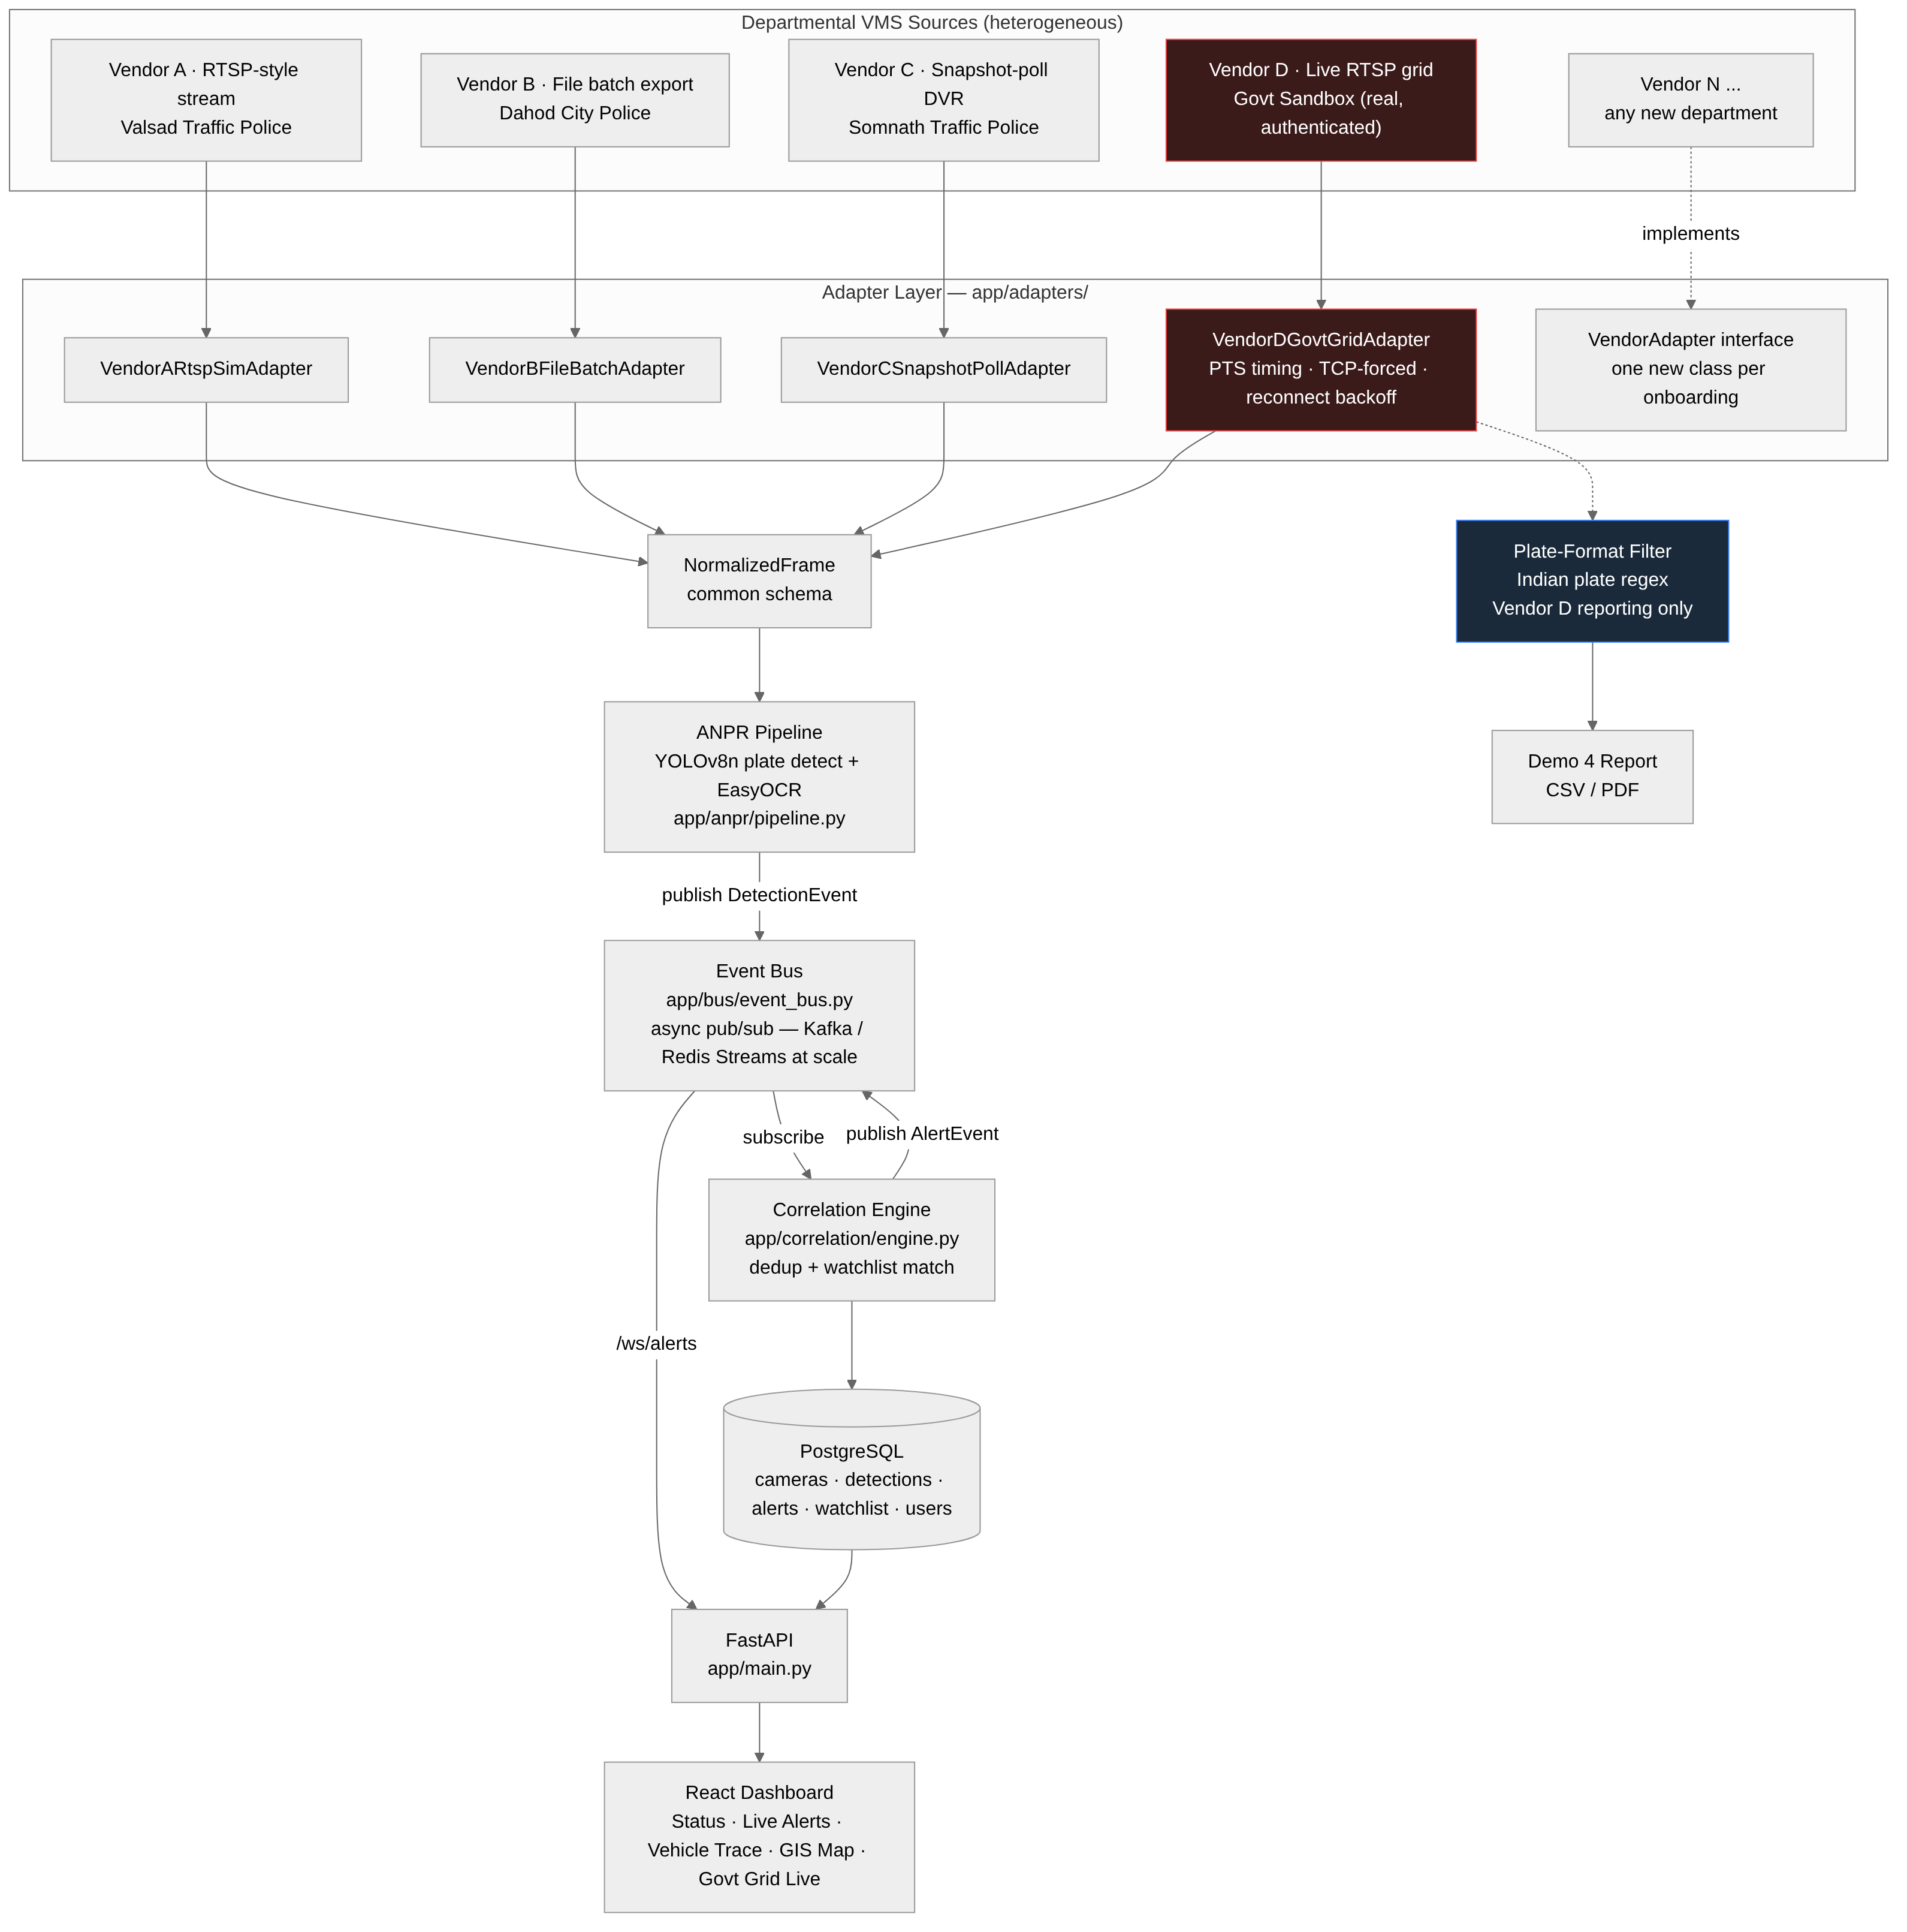
SYSTEM ARCHITECTURE
Federation Architecture — End to End
SENTINEL — Reference Model 3: VMS Federation & Middleware
4

Slide 5
SYSTEM ARCHITECTURE
End-to-End Data Flow (as implemented)
1
Adapter
One of 4 vendor adapters (3 simulated + 1 live govt RTSP grid) samples frames and normalizes them into a common NormalizedFrame schema.
2
ANPR Pipeline
YOLOv8n locates plate regions on a 640px-downscaled frame; EasyOCR reads text from each crop at full resolution.
3
Event Bus
Each plate read becomes a DetectionEvent, published to the bus — not a direct function call. In-process async pub/sub tonight; Kafka/Redis Streams contract-compatible at scale.
4
Correlation Engine
The single place a “match” decision is made: dedupes detections (10s window), checks the watchlist table, decides sighting vs. alert.
5
Alert + Persistence
On a match, an AlertRecord is written and an AlertEvent published; all detections/alerts land in PostgreSQL.
6
Dashboard
FastAPI serves REST + a /ws/alerts WebSocket; the React dashboard shows live alerts, GIS map, and vehicle-trace timelines within seconds.
SENTINEL — Reference Model 3: VMS Federation & Middleware
5

Slide 6
AI-POWERED VIDEO ANALYTICS
ANPR Pipeline — Real Detection, Real OCR
Pipeline
Verified accuracy (real footage)
▪ Detection: YOLOv8n (plate-detector weights), 640px-downscaled input, CPU-only inference
▪ Recognition: EasyOCR on each full-resolution plate crop; multi-fragment text concatenation
▪ Sampled-frame processing (1 frame / 1–2s), not full-rate — the single biggest lever for CPU-only, and the basis for statewide GPU sizing (slide 9)
▪ Measured: ~0.1–0.2s/frame on CPU across all sources
▪ Vendor B clip: plate read correctly as BGY888 in 13/19 sampled frames, confidence 0.83–0.99 — the reproducible watchlist-match demo
▪ Vendor C clip: 100% detection rate; OCR close-but-imperfect on a stylized mixed-script novelty plate — a font edge case, not a pipeline defect
▪ Vendor A clip: 0 reads — plates genuinely not legible at filmed distance, kept deliberately to show a realistic heterogeneous fleet
Honest finding — real government feed (Demo 4)
▪ 68 real detections from 7 reachable live government cameras — 0 passed independent Indian-plate-format validation
▪ Root cause (confirmed by direct frame inspection): every reachable camera captured real night footage; the detector keyed on the camera's own burned-in overlay text (location/timestamp banner), not a vehicle
▪ This confirms the full live pipeline — real authenticated RTSP, real PTS timing, real inference — works end-to-end; the result reflects camera content at capture time, not a pipeline failure
SENTINEL — Reference Model 3: VMS Federation & Middleware
6

Slide 7
CORRELATION & ALERTING
Watchlist Matching → Real-Time Alerts
▪ A PostgreSQL watchlist table holds stolen/wanted-vehicle records (plate, reason, priority, flagging department)
▪ The correlation engine is the single subscriber to the detection-event stream — every plate read from every vendor/camera is checked against the same watchlist, regardless of source
▪ Deduplication: repeated detections of the same plate on the same camera within a 10-second window collapse into one sighting, not a spam of alerts
▪ On a match: an AlertRecord is persisted and an AlertEvent is published — the dashboard's WebSocket relays it live, confirmed to reach the UI within seconds of the match
BGY888
0.969
10s
<5s
reproducible watchlist match → real alert
OCR confidence on the matched plate read
dedup window — 13 raw reads → 1 alert
detection → dashboard, over live WebSocket
SENTINEL — Reference Model 3: VMS Federation & Middleware
7

Slide 8
KEY TECHNOLOGIES
Stack & Frameworks
Backend & AI
Data & Messaging
Frontend & Auth
Deployment
▪ Python / FastAPI
▪ YOLOv8n (Ultralytics) — plate detection
▪ EasyOCR — text recognition
▪ OpenCV + FFmpeg — RTSP/video I/O
▪ PostgreSQL (timestamptz-correct schema)
▪ In-process async pub/sub bus tonight
▪ Kafka / Redis Streams — contract-compatible swap at scale
▪ React + Leaflet (GIS map)
▪ JWT auth, 2-role RBAC (admin / department-user)
▪ WebSocket live alert feed
▪ Docker Compose (all 3 services)
▪ Kubernetes — designed statewide topology
▪ Verified locally via micromamba (no-root path)
SENTINEL — Reference Model 3: VMS Federation & Middleware
8

Slide 9
SCALABILITY, INTEROPERABILITY, SECURITY
From 5 Cameras to 80,000
Sizing method (worked, assumption-stated — not fabricated precision)
~3,400
~35–40
1.6 Gbps
~145 TB/yr
GPUs statewide (T4/A10-class, +20% headroom)
correlation-engine replicas, partitioned by region
sustained bandwidth — ~60x less than full video centralization
cold-tier archival storage
Interoperability
Security & Deployment
▪ Onboarding a new department = one new adapter class; zero changes to bus, correlation engine, or API
▪ Designed protocol support: ONVIF Profile S/G, vendor REST/SDK adapters, MQTT/webhook push
▪ 26-department onboarding requirements documented per department (camera inventory, VMS/protocol, network link, consumed data)
▪ Implemented: bcrypt + JWT auth, 2-role RBAC enforced at API + UI, credential redaction on the live-feed adapter
▪ Designed for production: TLS everywhere, encryption at rest, audit logging, API gateway hardening, secrets manager
▪ Kubernetes multi-zone topology; Docker Compose used for tonight's single-host demo
SENTINEL — Reference Model 3: VMS Federation & Middleware
9

Slide 10
EXPECTED IMPACT
Operational Benefits for Policing & Public Safety
▪ Faster stolen/wanted-vehicle recovery: automated watchlist matching replaces manual bulletin checks, alert reaches an operator within seconds of a sighting
▪ Cross-department correlation in seconds, not days: a vehicle trace query today can take 1–3 days of manual cross-department coordination — federated correlation makes it instant
▪ No re-platforming cost or disruption: departments keep existing VMS investments; CAPEX avoided vs. full replacement (Model 1) estimated at ~$36M in hardware/licensing alone
▪ Statewide oversight without statewide video centralization: Home Department gets a correlated, real-time view without the bandwidth, storage, and single-point-of-failure cost of centralizing raw video
Cost framing (hackathon-stage estimate, not procurement-grade)
▪ Statewide CAPEX ≈ $18–23M (GPU compute is 65–80% of this); OPEX ≈ $4.2–8M/yr (owned) or $11–20M/yr (cloud-rented)
▪ Vs. Model 1 full VMS replacement hardware/licensing alone ≈ $36M — before ongoing re-platforming disruption cost
SENTINEL — Reference Model 3: VMS Federation & Middleware
10

Slide 11
ROADMAP
Path to Statewide, and Future Integrations
Tonight
Pilot Dept.
District
Statewide
5 cams, 3 adapters, Compose
~500–1,000 cams, 1 dept, first GPU node
~10,000 cams, multi-dept, DB sharding
80,000 cams, 26 depts, multi-zone K8s, DR active
Future integrations — documented, explicitly not built (no mock responses)
▪ VAHAN — vehicle registration lookup enriching a plate match with registered-owner details
▪ SARTHI — driving license database cross-reference
▪ eGujCop — bidirectional case management / FIR linkage (watchlist entries already reference FIR numbers in this demo)
▪ AFIS / NAFIS — face recognition, as a second analytics module running parallel to ANPR on the same normalized frame stream
SENTINEL — Reference Model 3: VMS Federation & Middleware
11

Slide 12
A working federation, not a diagram
4 real adapters · real ANPR · real correlation · real alerts · real cross-camera trace · a real, authenticated connection to government infrastructure.
Every claim in this deck traces to code, a test, or a log in the submitted repository.
SENTINEL — Reference Model 3: VMS Federation & Middleware
12

