Slide 1


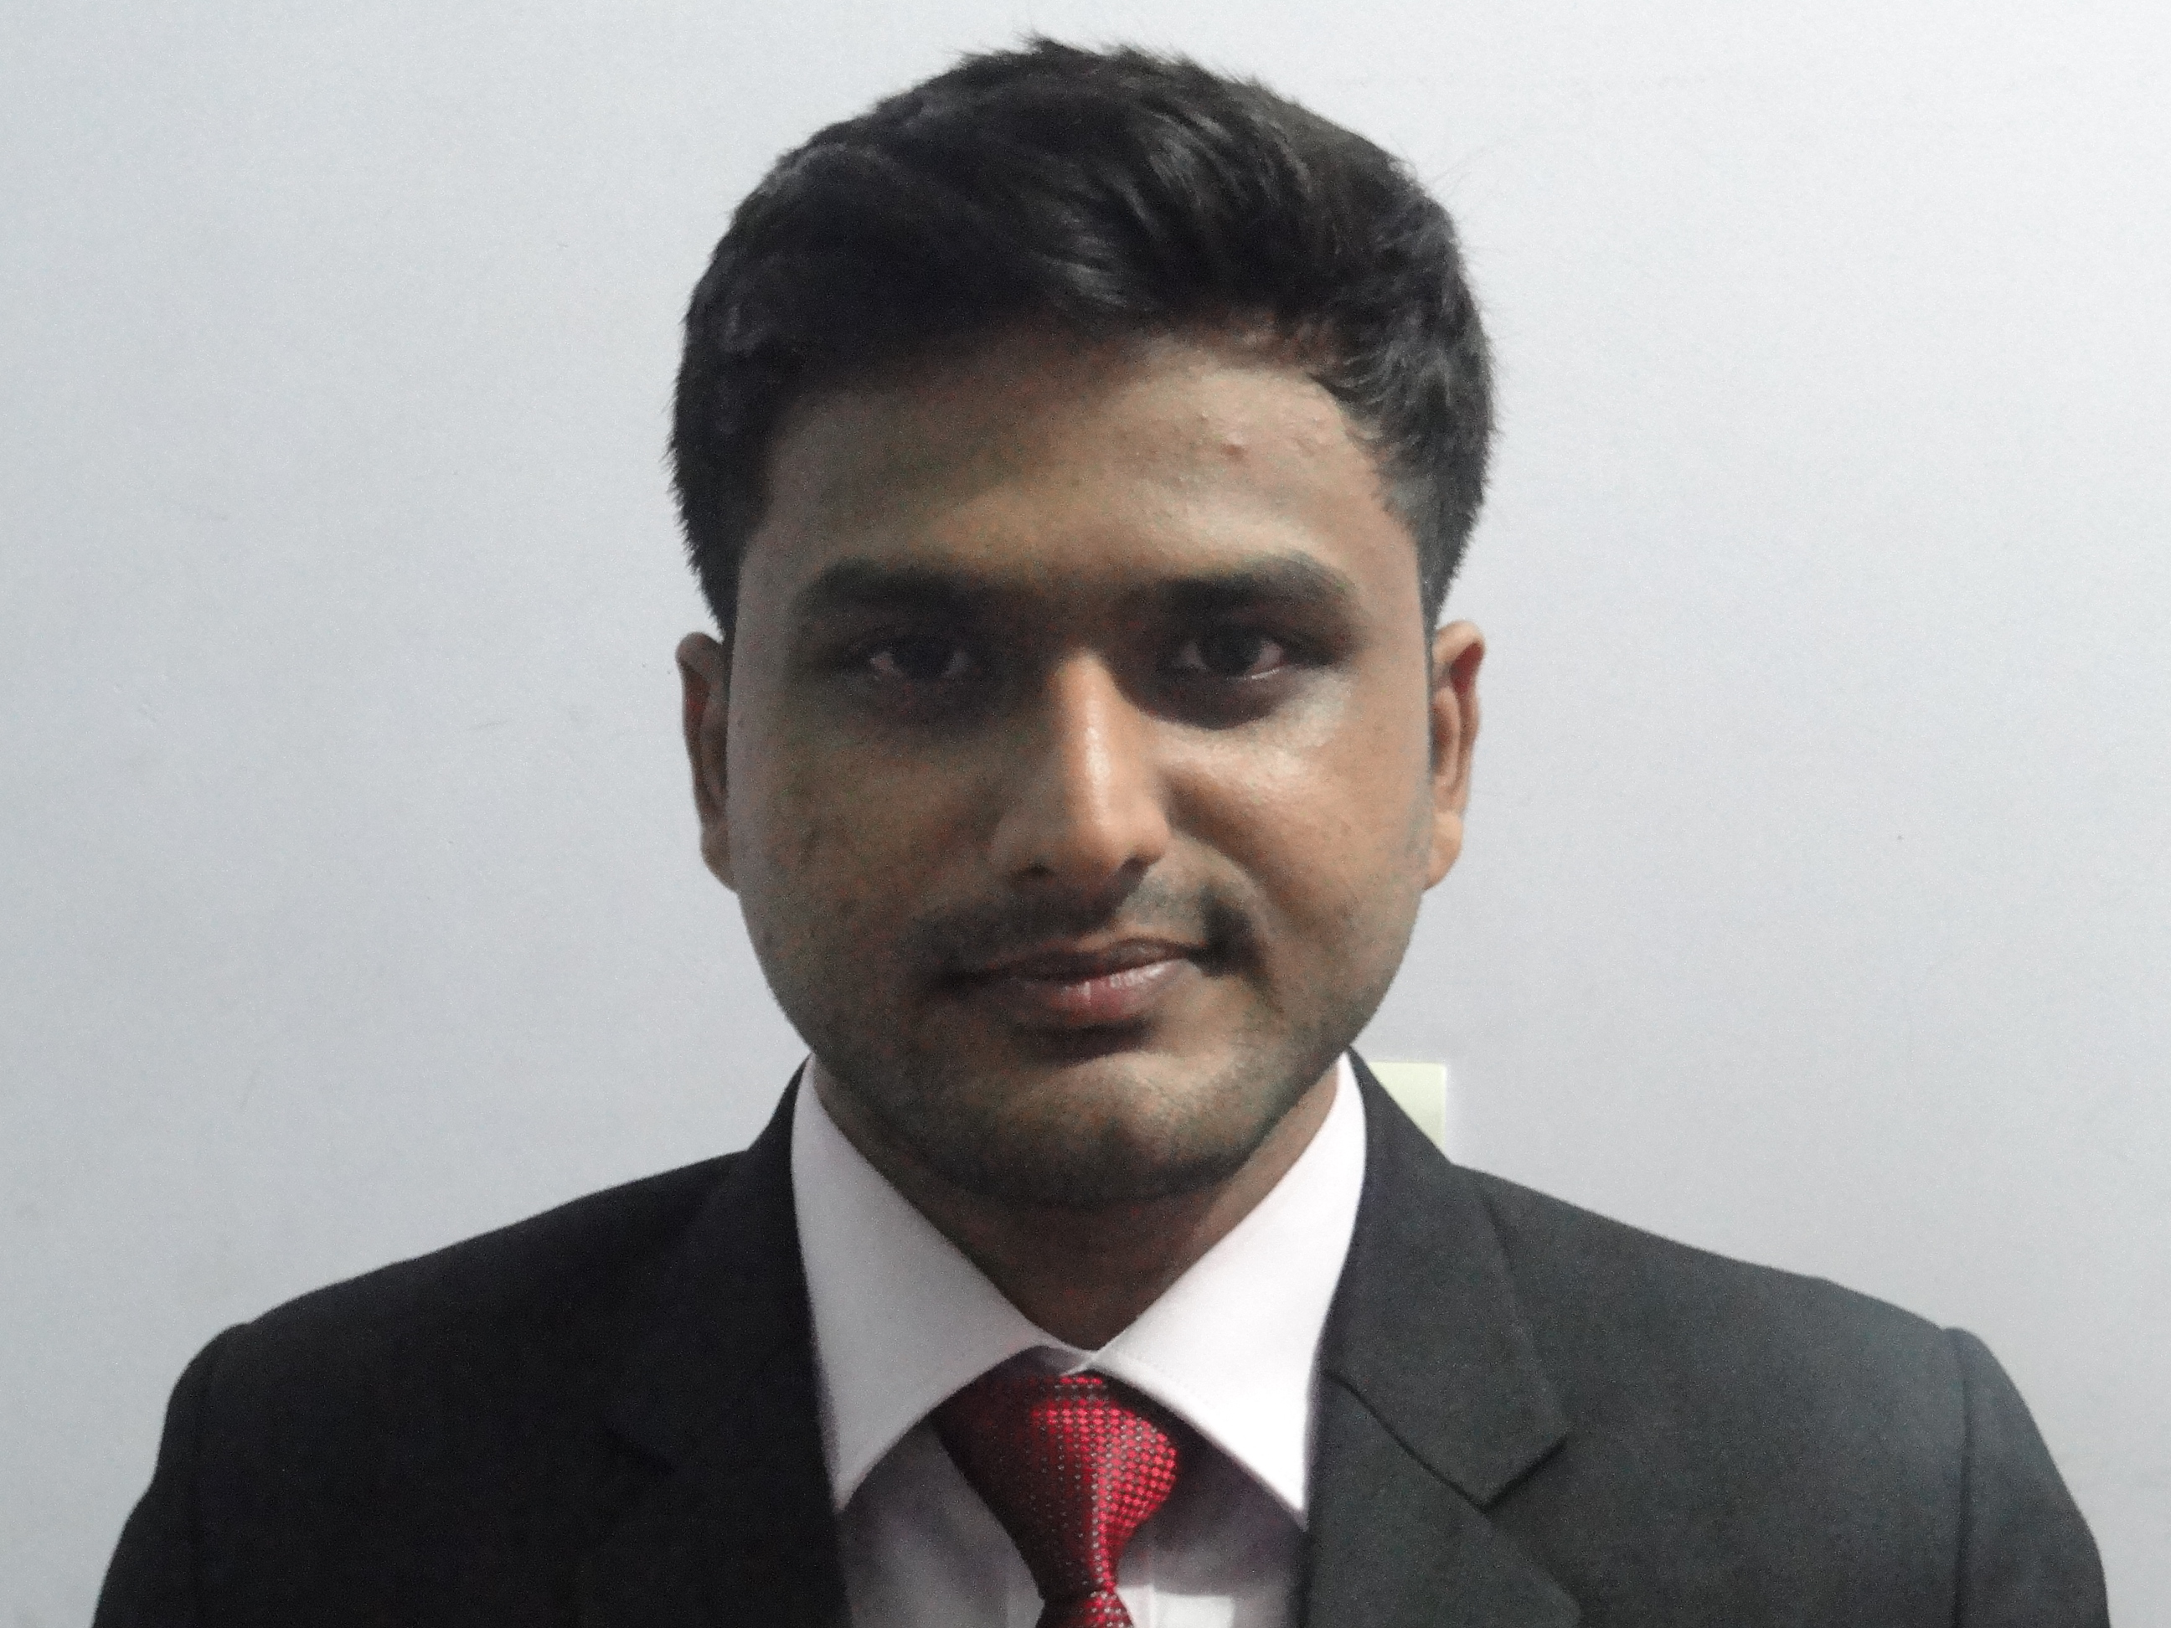
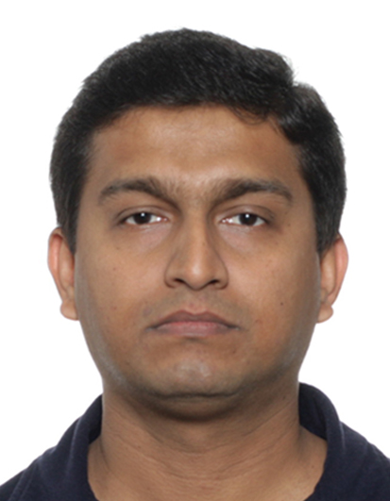

Immersive and intuitive driving environment using haptic and visual technologies
Rajshekhar Mukherjee
300030835
Kuntal Ghosh
100958992
Matthieu Scherrer
100958992
ELG 5121 Multimedia Communications, Fall 2017

Slide 2
What we proposed
Making driving assistance systems safer as well as more immersive by
encoded haptic system to interact with the driver
provide additional audio, visual feedback to the driver.

Slide 3
What we’ve achieved
Tactile Haptic (vibration sensor), Audio (buzzer), Visual (LED), Video feedback (embedded annotation on video) in real time with a Lane departure warning detection system
Implemented a very necessary and prevalent safety feature included in all modern cars within Advanced Driver Assist System

Slide 4
Future work
Include various types of ADAS safety systems along with Lane departure system
Example : Lane Assist System, Pedestrian tracking and vehicle collision warning system
Moving from PC based system to a commercial embedded system module (GPU or dedicated signal processing on-board chip)
Faster interface between serial protocol and MATLAB interface

