Slide 1
SMARTGRID-X
Seven buildings on a real campus draw 62–85% of their average power when they are at their emptiest.
Occupancy-aware energy-waste and anomaly analysis of the I-BLEND campus dataset
Rajwardhan Shinde · MD3135 Data Science · T.Y. B.Tech, VIT Pune
Notes:
Give the finding before the method. Everything after this slide is evidence for it. Do not open with the dataset.

Slide 2
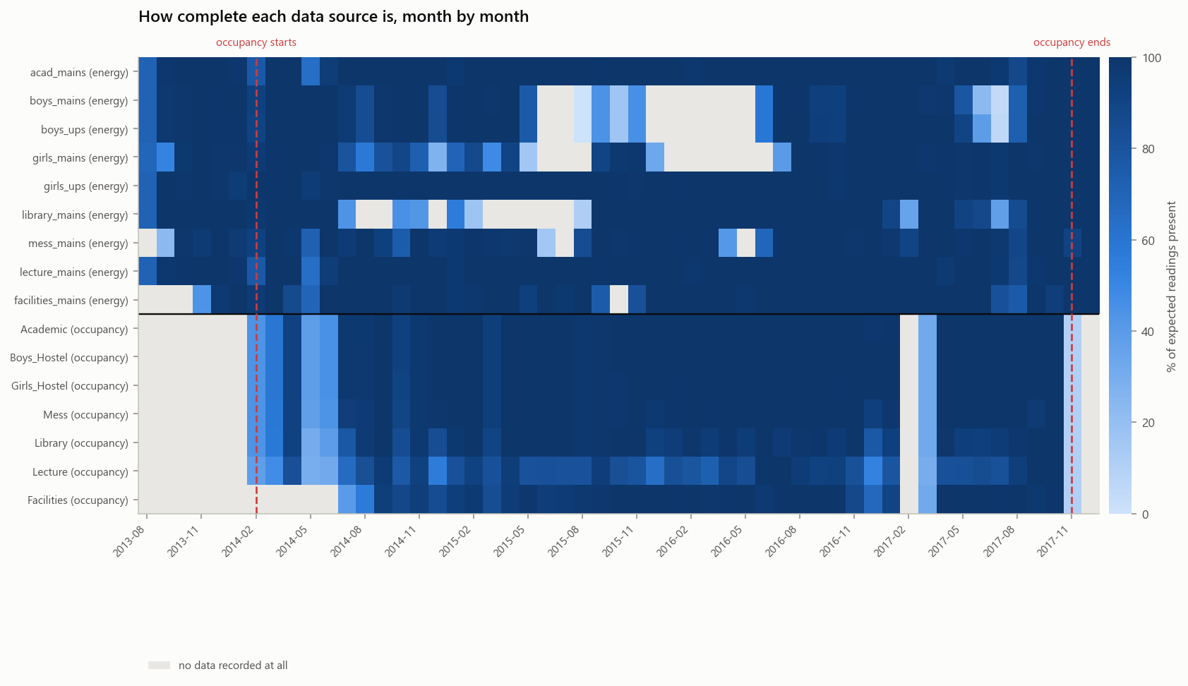
Buildings use power when nobody is there
Measuring it needs energy data and occupancy data together. I-BLEND has both: 1-minute meters on seven IIIT-Delhi buildings plus WiFi device counts, Feb 2014 – Nov 2017.
Notes:
I-BLEND has been published and re-used, but as an energy dataset. Its occupancy half has not been used to ask what the energy was for. That is the whole contribution: the methods are standard.

Slide 3
Occupancy never reads zero
1
5%
0–20%
the minimum occupancy count in every one of the seven buildings
of each building's own 95th percentile — the relative threshold we use instead
the range that threshold is swept across, so the finding does not rest on one cutoff
Idle phones stay connected, so "empty" is not a state this dataset can report.
The question had to be re-specified around a threshold relative to each building's own scale — an absolute cutoff would mean "deserted" in the 400-device Academic building and "busy" in Facilities.
Notes:
This is the slide where the examiner learns we read our own data -- so say it before anyone asks. We did not get the data we wanted; we got data that could not answer the question as originally worded, and re-specified the question rather than pretending otherwise.

Slide 4
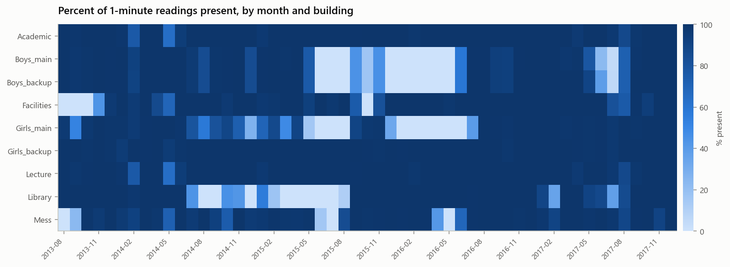
What the cleaning found
81.7% of Lecture readings are exactly 0 W — a dead meter, not an idle building. Negative power factor on up to 66% of rows is a sign convention, not corruption: dropping it would have destroyed 58% of the Library record.
Notes:
The guiding rule is flag, never delete. An outlier in an energy meter might be an error, or it might be exactly the abnormal event Phase 6 exists to detect. Deleting it would delete the thing being studied.

Slide 5
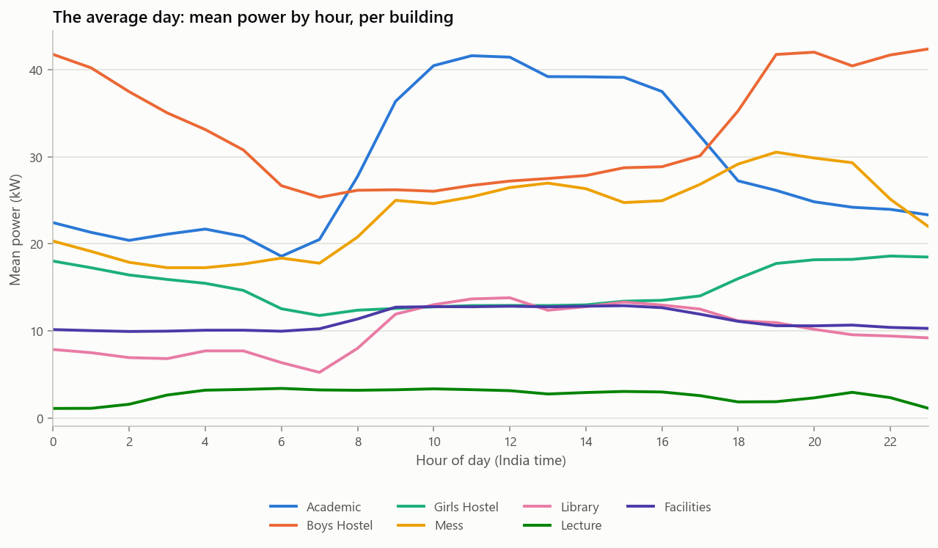
What a normal day looks like
Academic peaks at 41 kW and still draws about 20 kW at 3 a.m. The hostels do the opposite. Facilities is nearly flat — its consumption barely knows what time it is.
Notes:
The overnight floor is the subject of this whole project. It never reaches zero in any building.

Slide 6
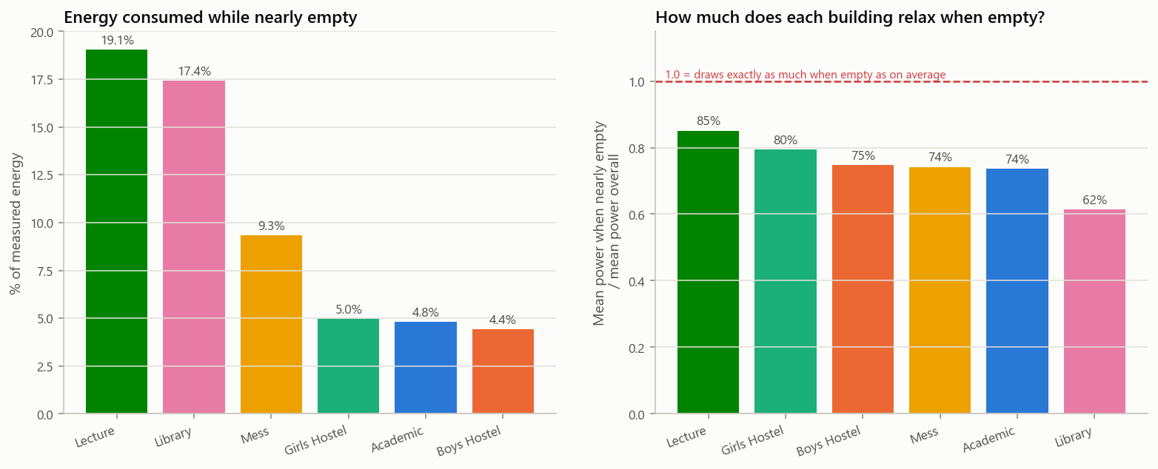
The headline
Lecture draws 85% of its average power when nearly empty. Library, the best on campus, still draws 62%. In every building the base load is the larger share of consumption.
Notes:
Give the intensity ratio, not just the energy share. The share depends partly on how often a building is empty, which is a fact about the timetable; the ratio isolates the building's own behaviour.

Slide 7
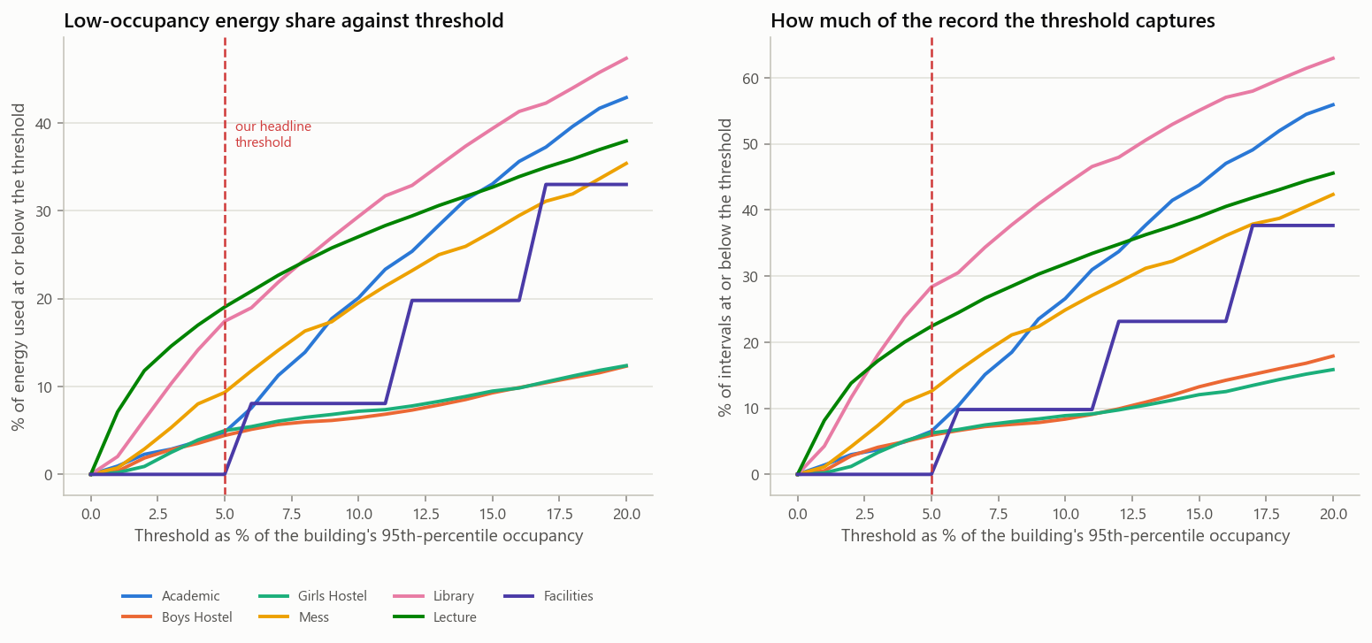
Is the headline robust?
The threshold is a judgement, so here is every other threshold. The rankings do not move. The base load computed by a completely independent route agrees.
Notes:
Pre-empt the obvious attack. The definition of low occupancy is the most consequential choice in the project, so it is swept rather than asserted.

Slide 8
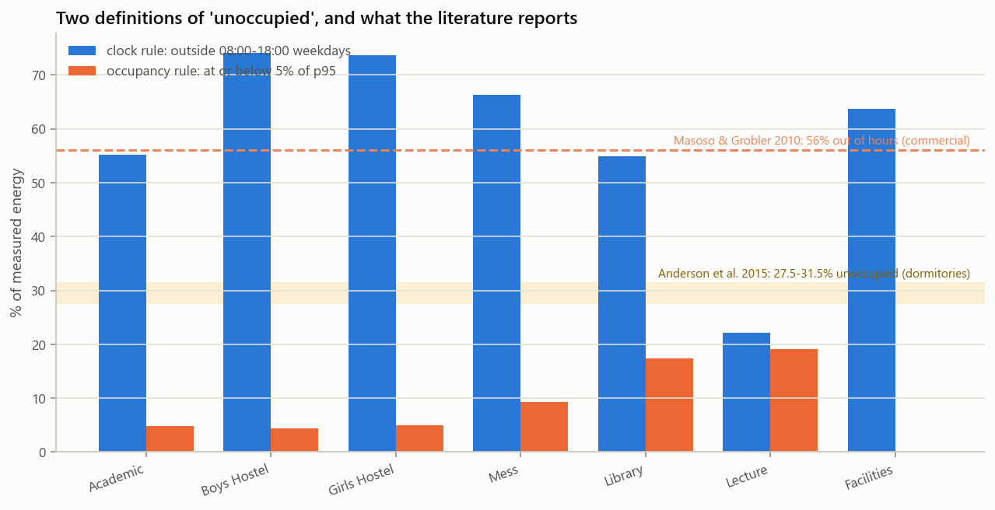
Does it match anyone else?
Applying Masoso & Grobler's own clock-based definition to our data gives 55.2% and 55.0%, against their published 56%. Different continent, fifteen years apart.
Notes:
This is the credibility slide. It is an independent check that the pipeline measures what it claims to, not a restatement of our own number.

Slide 9
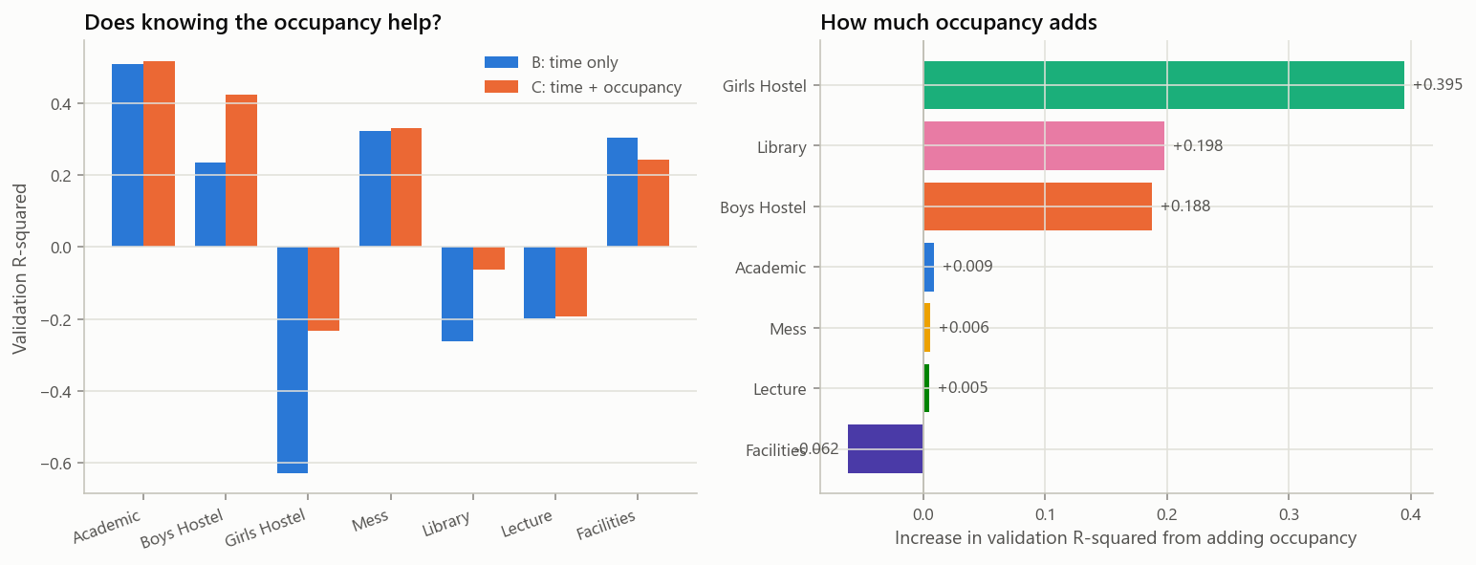
Can we predict it?
Occupancy adds only +0.107 to validation R² — and just +0.078 once outdoor temperature is known, because occupancy and heat are both seasonal and this campus empties in the hottest months.
Notes:
Say the negative result plainly. It matches published work, and three different analyses in this project reached it independently. Also: there are no lag features, deliberately — a model that knows recent power tracks waste instead of flagging it.

Slide 10
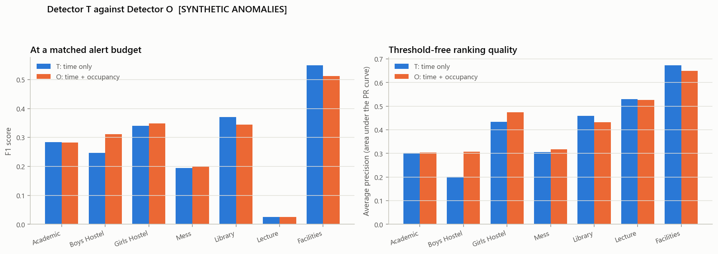
Can we detect it automatically?
Two detectors, the same data, one difference: whether the model knows how many people are there. Occupancy helps consistently, but by only one to three points — and most on sustained waste rather than spikes.
Notes:
Say SYNTHETIC out loud: the anomalies are injected, because real faults on this campus were never labelled. And mention the trap we caught — the fixed threshold we originally specified was not a fair comparison, because it let the two detectors fire at different rates. On that test our own detector loses, and we report it first.

Slide 11
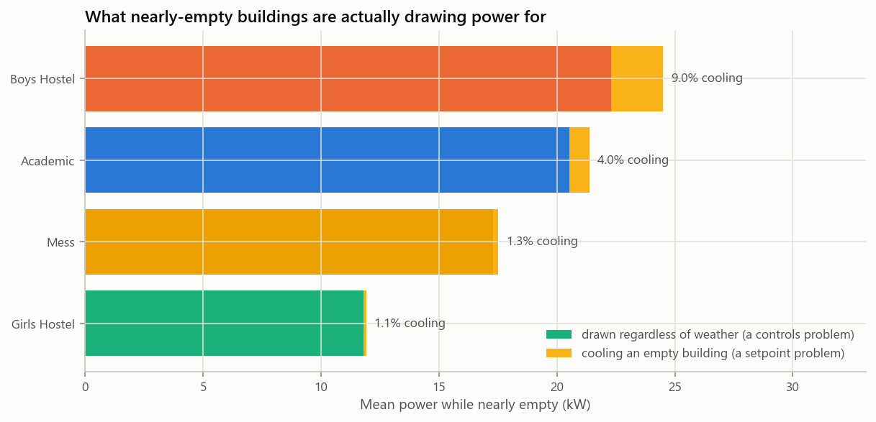
How much of it is just air conditioning?
The obvious objection, answered with data: cooling is only 1–9% of the power drawn while a building is nearly empty. The rest runs on a timetable nobody revisits.
Notes:
Lead with the negative control: Facilities climbs +62% from mild to hot weather while Lecture falls 12% — that is how we know the method detects cooling when cooling is there. Say that Library and Lecture cannot be decomposed at all: both are shut in the hot months, so season and usage are confounded, and we report 'not identifiable' rather than a number.

Slide 12
Limitations, said before anyone asks
WiFi counts devices, not people. One person with a phone and a laptop is two — which makes our numbers a lower bound, not an inflated one.
Airport weather is 25 km from campus. A measured proxy, not campus weather. Better than the unmeasured confound it replaced; not the same thing.
The anomalies are synthetic. Real faults were never labelled, so the detector comparison is fair but the absolute scores are not a field result.
Lecture has only 18.9% usable data. Kept in every table with that number visible, because dropping the building that embarrasses the method is how an analysis becomes dishonest.
One campus, one climate, four years. Nothing here establishes what any other building does.
Notes:
Saying these first is the point. Every one of them is already in the report's limitations section; none is being conceded under pressure.

Slide 13
The opportunity is the fixed part of the load
This is a controls and commissioning problem, not a sensing problem.
Only 1–9% of it is cooling — the rest is equipment running on a timetable nobody revisits, which is the cheap kind of waste to fix. The Library, at 62%, proves the number can be moved.
62–85%
1–9%
50
of average power, drawn while nearly empty
of that is cooling — the rest is schedule
judgement calls logged, including the ones that shrank the finding
Notes:
Close by demonstrating the dashboard: streamlit run dashboard/app.py — pick a building, pick a week, show the flagged periods and the temperature panel underneath them.
If asked what is new: the methods are standard. What we could not find published is anyone using I-BLEND's own occupancy stream to quantify, per building, how much of a campus's electricity is used while it is nearly empty — with a threshold-sensitivity curve and a controlled test of whether occupancy helps a detector.

