Slide 1
Docker...
...and DevOps - 20190718

Slide 2
Introductions and About me
Rajshri Mohan
Proud batch of 2010-2014 BE CSE
I work at IQZ Systems
I build stuff
I fix things
I lead a team
What this talk is going to be about
DevOps
Docker
Industry and Docker
A demo

Slide 3
Before we do this...
You can call me “Rajshri”. Or “dude”. Or “bro”.
Or anything, but “sir”.
Feel free to stop me anytime if you do not understand something I mention.
Be vocal. I like engaging in conversations.
And I hate sermons.

Slide 4
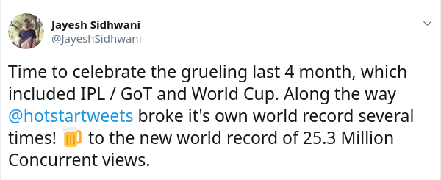
What made this possible?

Slide 5
DevOps?
“DevOps is a set of practices that automates the processes between software development and IT teams, in order that they can build, test, and release software faster and more reliably.” - Atlassian
“DevOps is a set of software development practices that combine software development (Dev) and information technology operations (Ops) to shorten the systems development life cycle while delivering features, fixes, and updates frequently in close alignment with business objectives.” - Wikipedia

Slide 6
DevOps?
Traditional method of software deployment has shortcomings
Continuous Integration & Continuous Deployment
Infrastructure as Code

Slide 7
Containerization
Transportation of goods
Old school methods
Shipping containers
Container Engine
Is Docker the only container engine?
Docker and rkt
Why isolate?

Slide 8
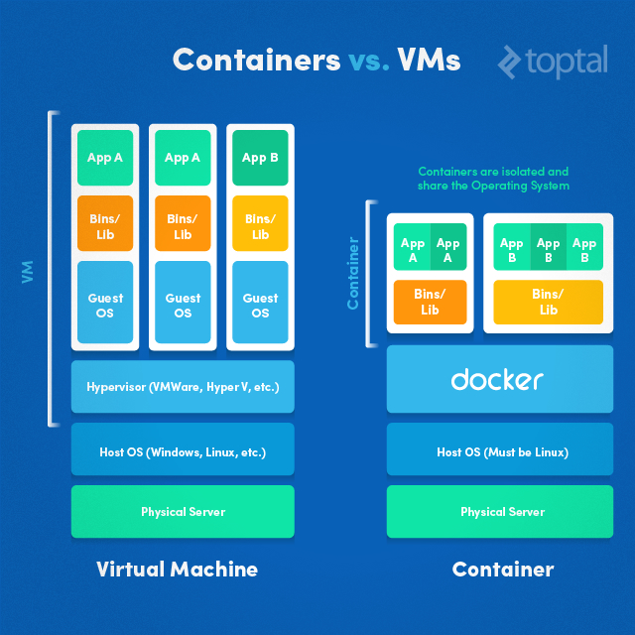
Containerization
VM
Bulky and bloated
High resource utilization
Architectural differences
Hypervisor
Containers
Lightweight
Resource sharing due to minimal footprint
Architecture agnostic
Runtime/Engine
Image shamelessly stolen from TopTal :P

Slide 9
Docker and DevOps
“Build once; Deploy anywhere.”
Brings infrastructure management to the developer.
Reduces unnecessary man power. Or in another perspective, makes man power highly efficient.

Slide 10
Containerization in Docker
The Dockerfile
Filesystem isolation
Volumes
Network isolation
Caching and Layers

Slide 11
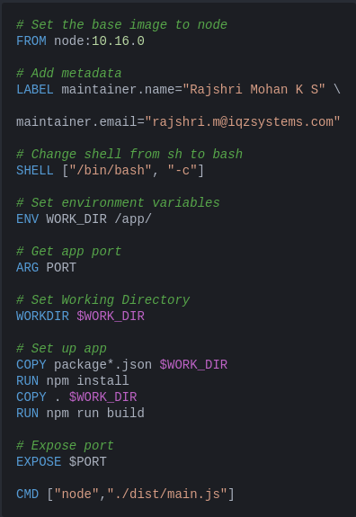
The Dockerfile
Defines how a container should be built.
Caching and Layers
A more complex example (external)

Slide 12
“But it works in my computer”
The problem
How Docker solves this
Platform agnostic deployments
Windows
Linux
Mac, etc.
Advantages for developers, testers, and business.

Slide 13
Demo

Slide 14
Adoption
Cloud providers
AWS
Azure
GCP
Deployment Tools
Jenkins
GitLab
And more…
Kubernetes

Slide 15
Advantages
How Docker enables CI/CD

Slide 16
Questions?

Slide 17
Thanks and stuff...
Contact
IQZ is hiring ;)

Slide 18
return 0;

