Slide 1

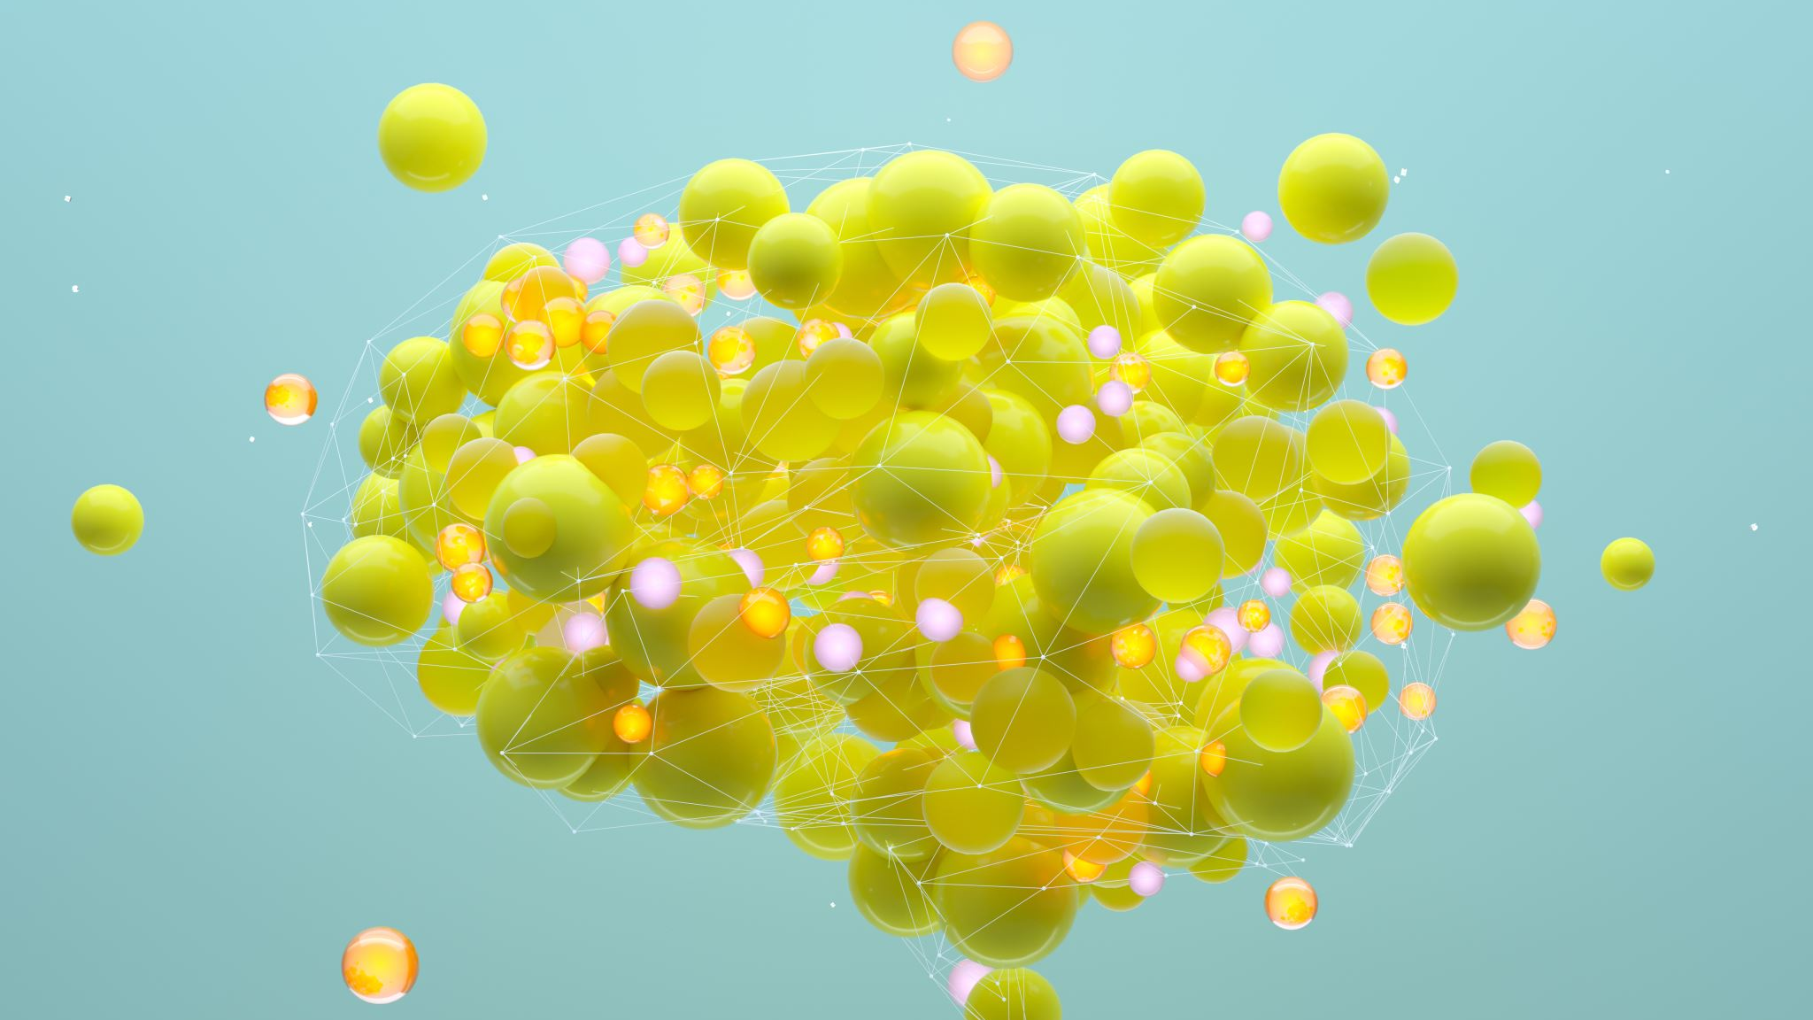
Generative AI Multi-Agent System
-TCS
-By Rajshri Simhadri

Slide 2
Types in GENAI
GUI
GUI
NLP
Rules based GEN
NLP
LLM
Rule based Chatbots: Answers FAQ’s
Creative Open Ended Chatbots

Slide 3
Agentic AI
Multi-Agentic AI
Definition | A single intelligent agent that can perceive, reason, plan, and act autonomously. | Multiple intelligent agents that collaborate, compete, or coordinate to achieve goals
Core Idea | One agent controls the entire task pipeline. | Tasks are distributed among multiple specialized agents.
Architecture | Centralized decision-making. | Coordinated decision-making.

Slide 4
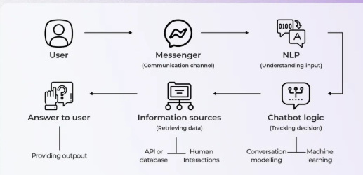
CHATBOT Architecture
Fig. 1.1. Overview of the CHATBOT architecture

Slide 5
Libraries:
langchain
openai
huggingface_hub
python-dotenv
streamlit
TO RUN app.py:

Slide 6
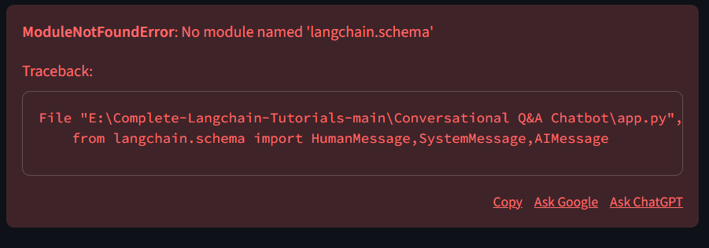
Fig. 1.2. Module Found/Not Found pop up on display

Slide 7
THANK YOU

