Slide 1
Wells Fargo Analytics Challenge
Raja Siddartha Pingilati
rpingila@asu.edu
+1 (480) 886 1673

Slide 2
Business Objective
The derived insights from the given dataset are used to provide Wells Fargo with solutions to
Improve Customer Service
Formulate Marketing Strategies based on customer information
Develop new customized Product Offerings based on customer information
Build efficient Discount Strategies/Offerings based on transactional data to further improve revenue from transactions

Slide 3






Input Data
Web Traffic data
Credit Card Transactions
Month End Balances
Customer Interactions
Customer Service
Marketing Strategies
Product Offerings
Discount Offerings
Data Analysis using R statistical Software

Slide 4
Target Marketing & Product Offerings using Web Traffic Data
Since we have only few records for each Customer, we have decided to target the customer based on the age group he belongs to.
The customers are divided into groups based on the following age ranges
Note:
The factor for grouping can be changed accordingly and similar analysis can be performed.
Domain Knowledge can help identify the factors that can be used to perform further analysis
The final landing pages are assumed to be the information the customer is searching for.
Customer Age Range | Age Group
If Age>50 | Old
If Age between 30 and 40 | Middle Age
If age less than 30 | Young

Slide 5
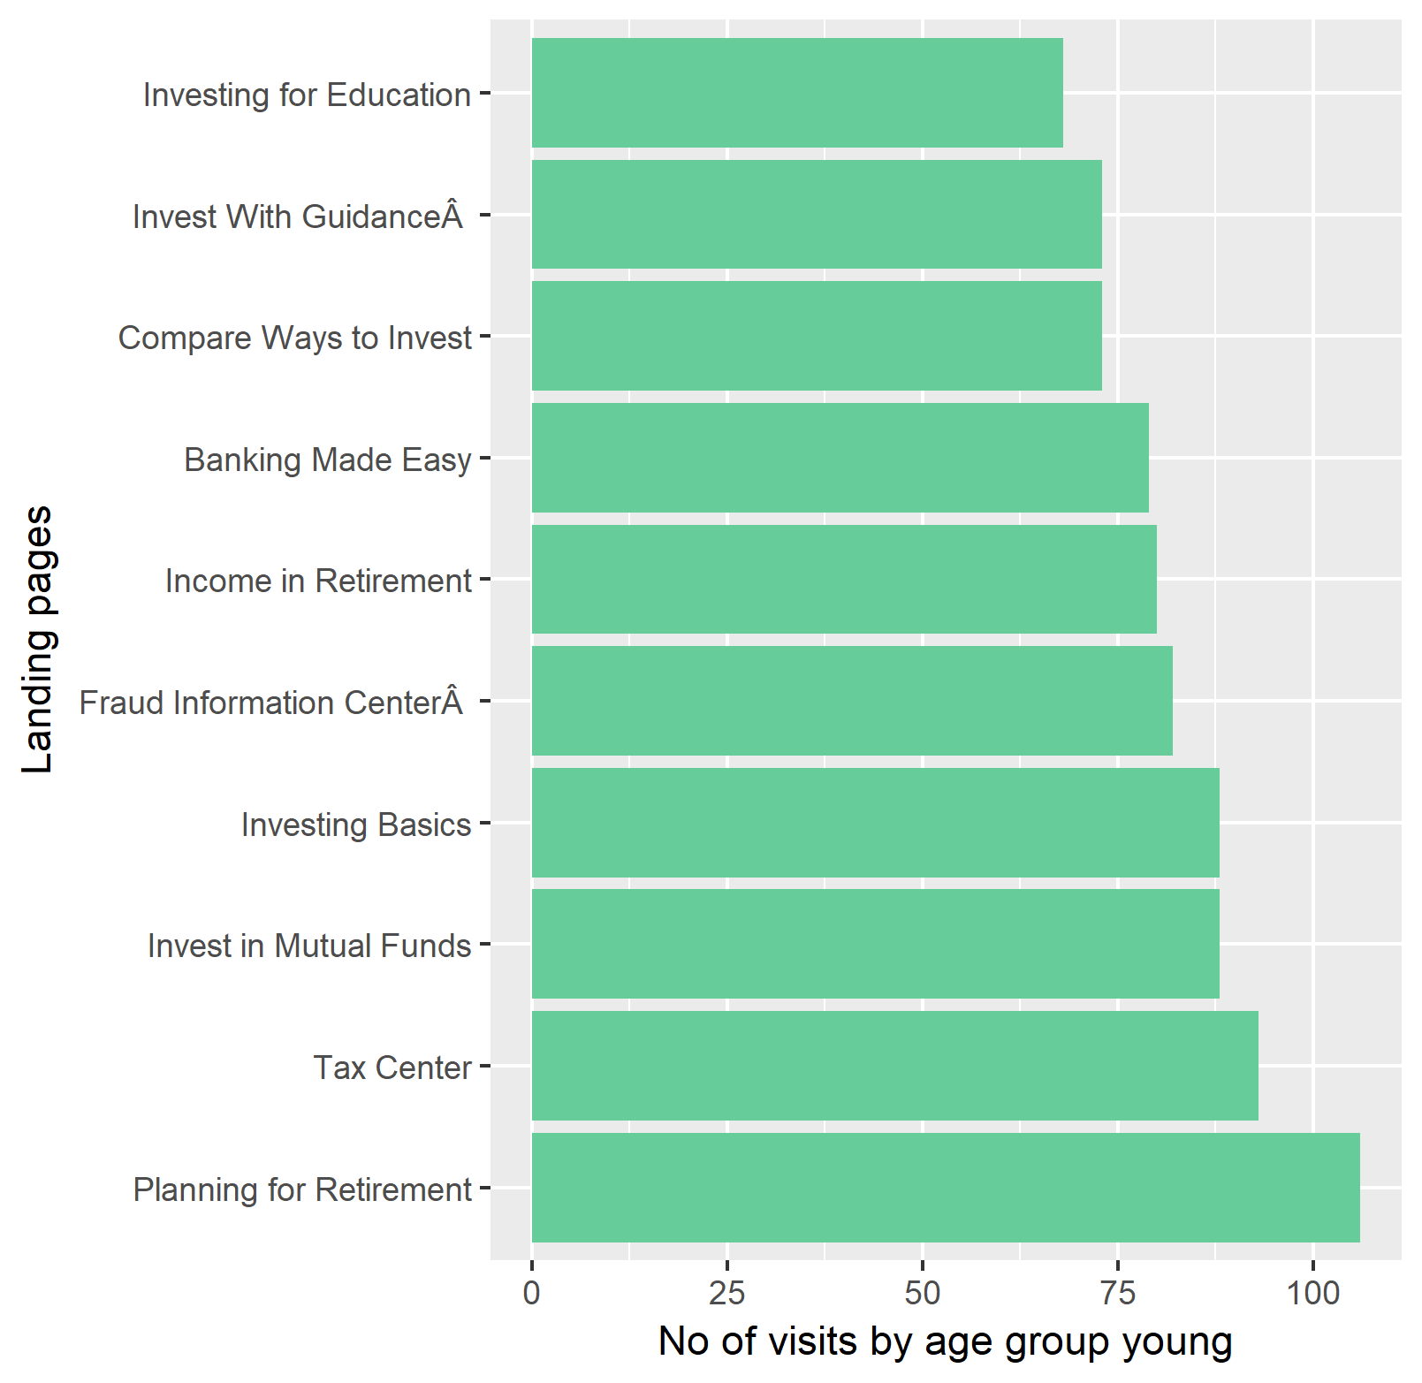
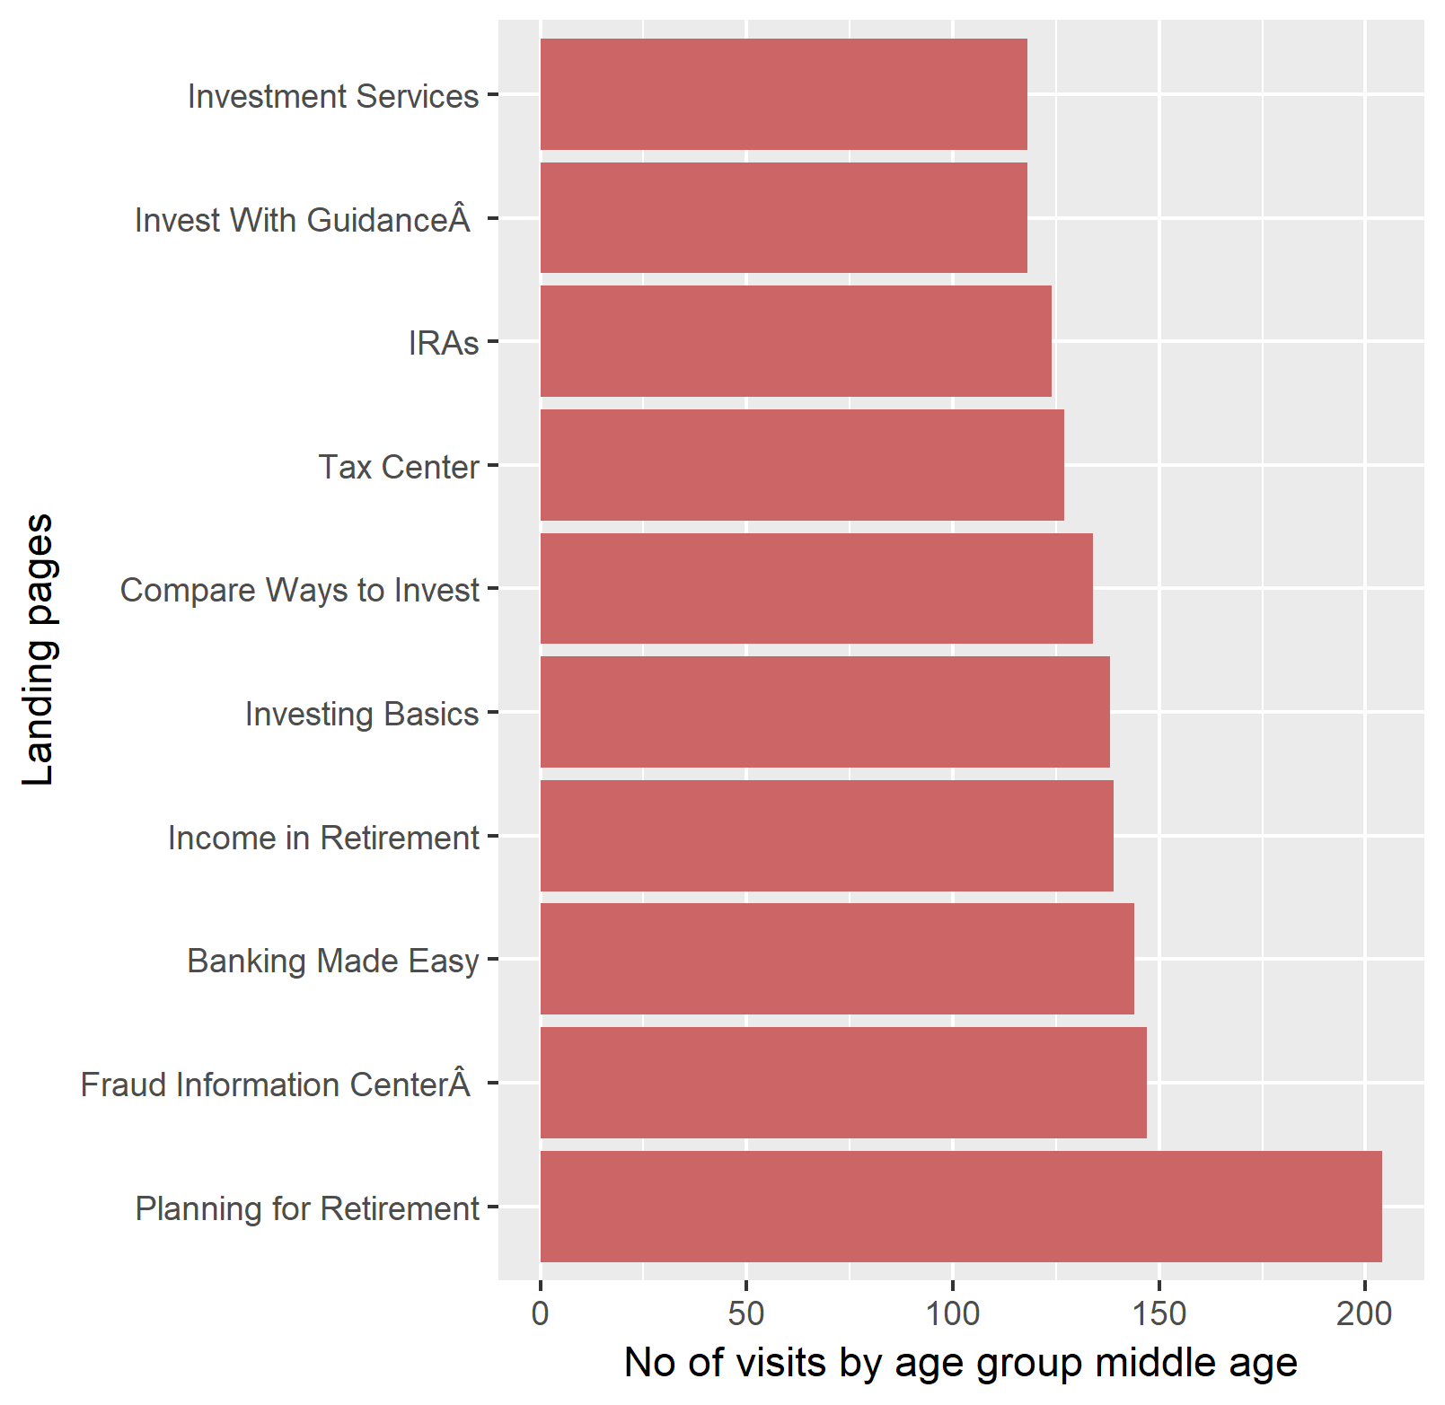
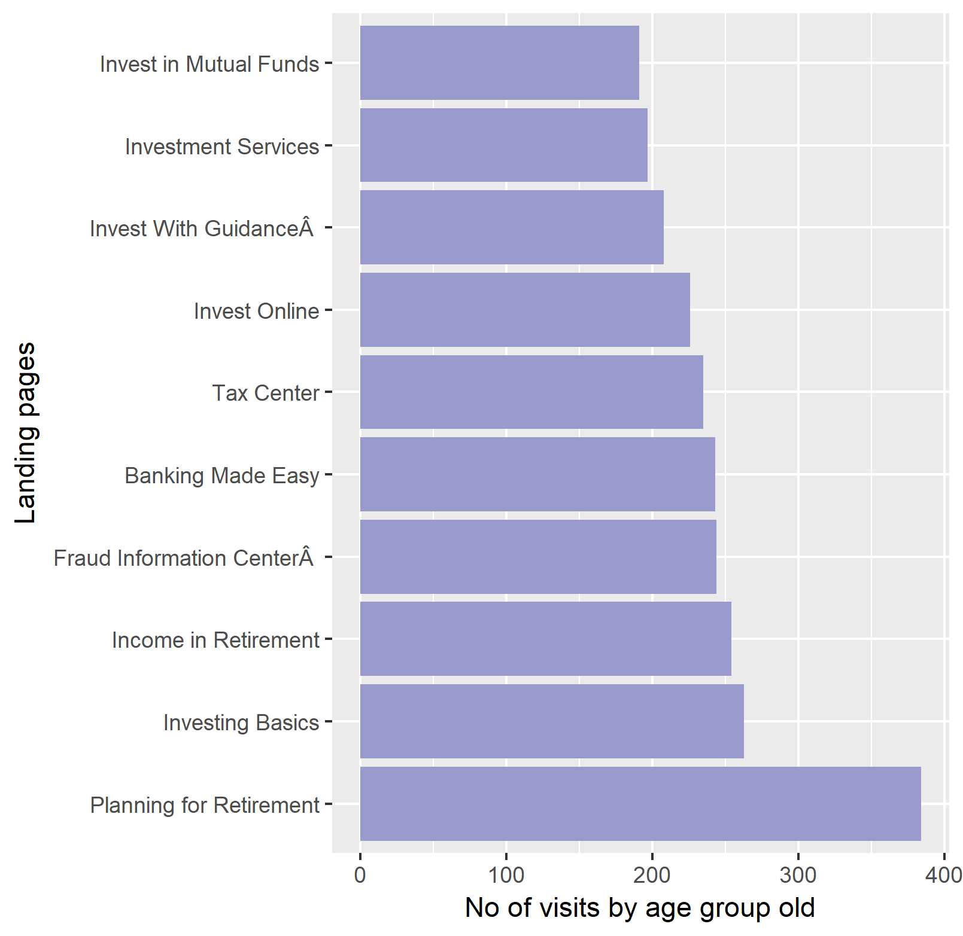
Target Marketing & Product Offerings based on Factor “Age”
Plots showing No of visits of a particular age group to a particular page

Slide 6
Recommendations for Target Marketing and Product Offerings on factor “Age Group”
Planning for Retirement is the most common information customers belonging to all age groups are looking for.
WF can plan more comprehensive product offering in the retirement space to attract more customers.
WF can increase the amount spent to promote Retirement Products
Investment is the other most prominent category among the customers.
The bank should be proactive in offering the customers several investment options.
The bank should try to advertise more on its investment offerings.
Fraud Information Centre is also most frequently searched information for all the age groups.
The bank should analyze why more customers are looking for information on fraud information centre and initiate security measures.

Slide 7
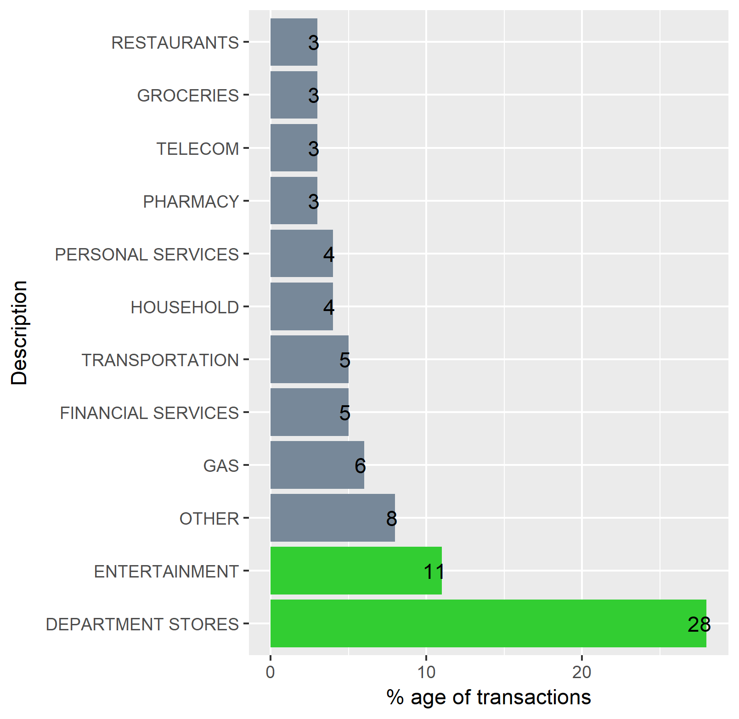
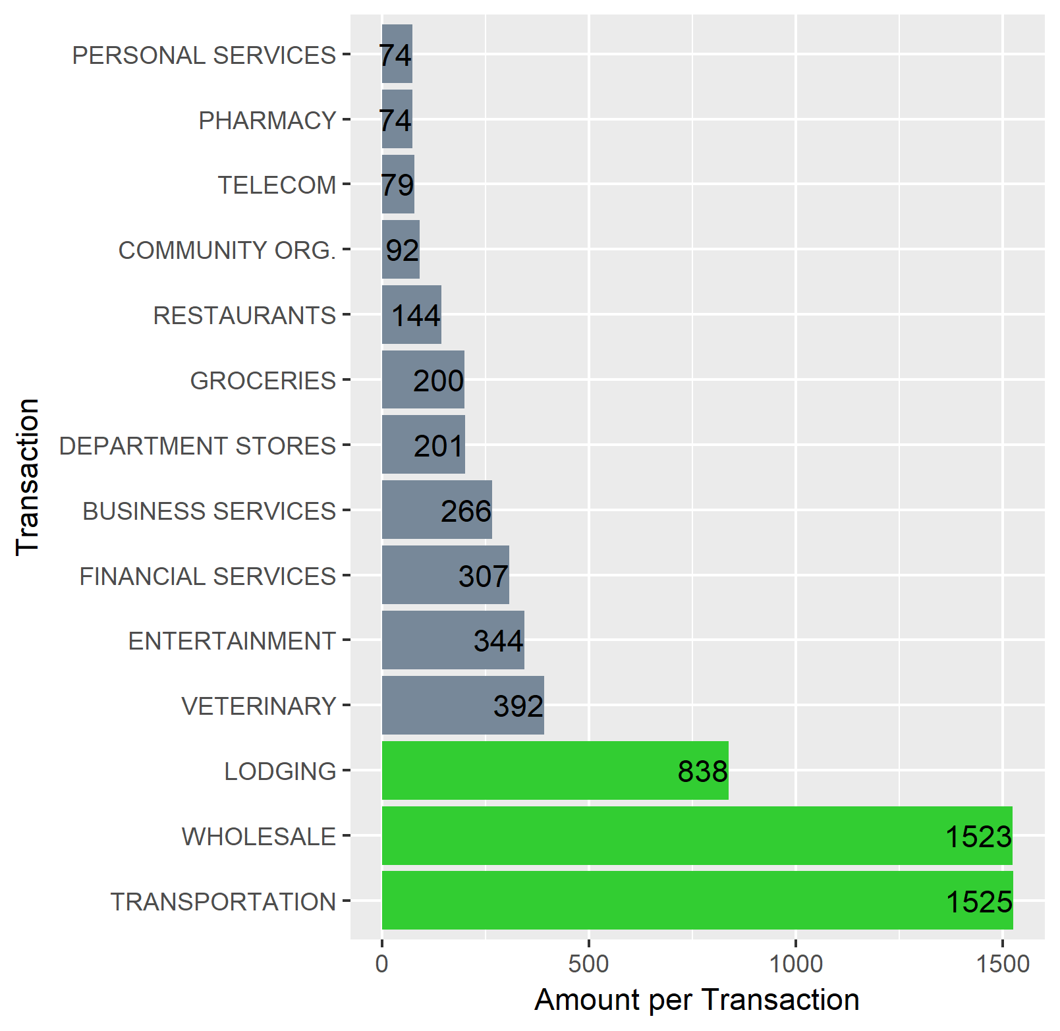
Discount Strategies based on Credit Card Transactions
Plot showing Percentage of Transactions Vs Category where the transactions took place
Plot showing amount per transaction Vs Category where amount is spent
Please note that Education is an Outlier with highest amount per transaction of $4908.
Department stores and Entertainment categories account for at least 40% of the transactions
Transportation and Wholesale have the highest amount spent per transactions
WF can try to increase the number of transactions in the categories where the amount spent per transactions is higher. It can be achieved by increasing reward points or credit card offers in respective categories.
The recommendations are based on the observations that the increase in number of transactions and the amount spent per transaction will lead to more profitability per transaction for WF.

Slide 8
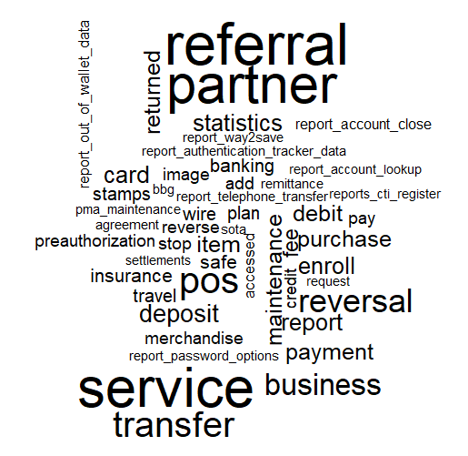
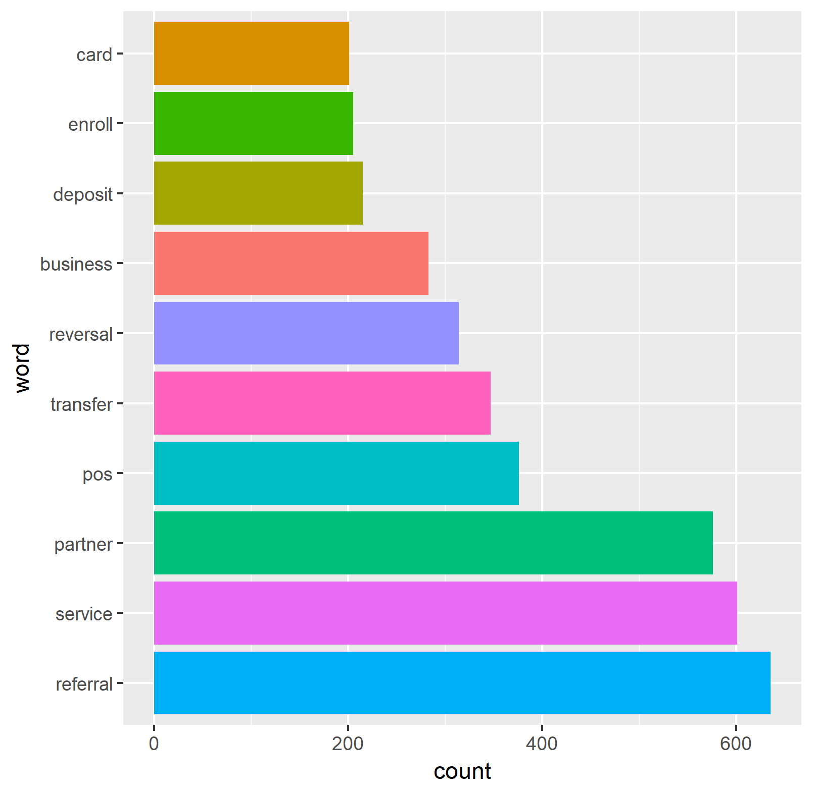
Improve Customer Service by analysing daily interactions
The plots show that the most common interactions are for referral, service and partner categories.
WF can further analyze the categories to provide efficient customer service and to reduce cost by reducing the number of interactions.
With further domain knowledge the model can be considerably improved to observe frequent complaints and provide better service.

Slide 9
THANK YOU

