Slide 1
My first baby steps in speech recognition
Ren (仁) Zhang

Slide 2

TF Speech Recognition
Classify a given ~ 1 second wav file into 12 possible class
Running from Nov 15 2017 to Jan 16 2018
I joined to get free GCP credits, but ended up competing

Slide 3
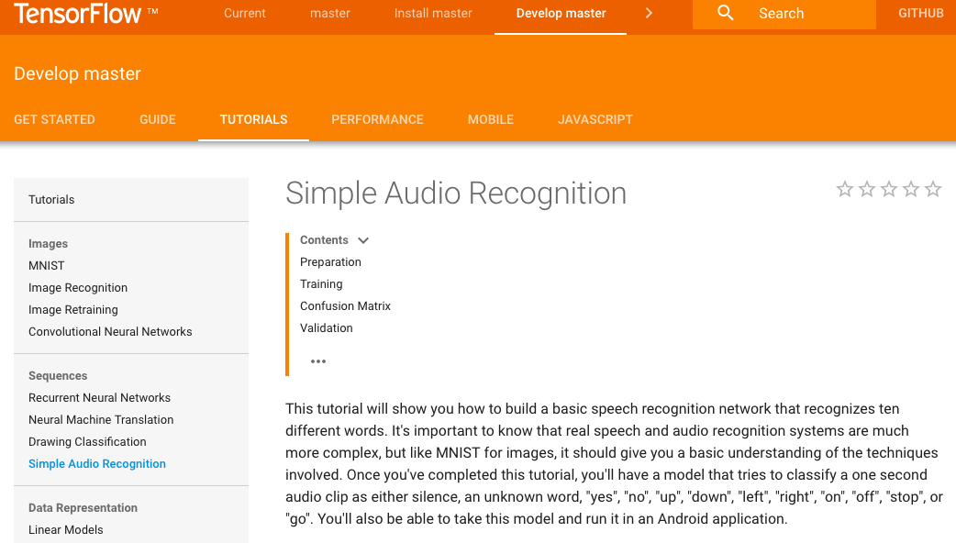
Official Baseline
People tried
Gets ~77% accuracy

Slide 4
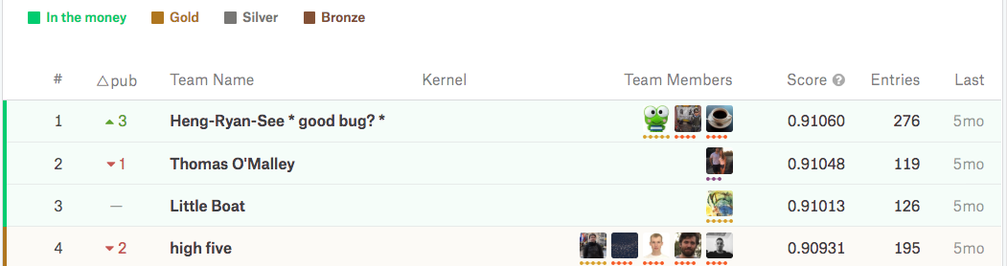
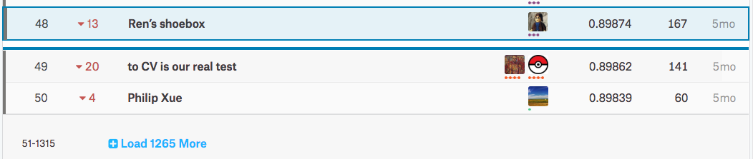
Final ranking
…...

Slide 5
How Kaggle competition works
Kaggle Dataset
Training
Testing
Public board
Private board
Not scored

Slide 6
In the context of this competition
This competition
Training
Testing
158538 wav files
30 %
70 %
?? %
Contains more ‘unknown’ words!
Public board
67121 wav files with 31 labels (~1% label error)
Targets: 10 words + 1 silence + 1 unknown.
Human level accuracy 92 %
(I labeled 5,000 from training data myself to get a feel)
Private board
Not scored

Slide 7
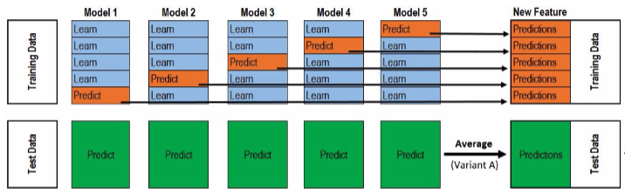
General strategy to Kaggle Competitions
Try come up with a reasonable baseline model first.
Diversification in input features
Create a model zoo
Shared CV splits and do stacking
Image source: https://www.kaggle.com/getting-started/18153#post103381

Slide 8
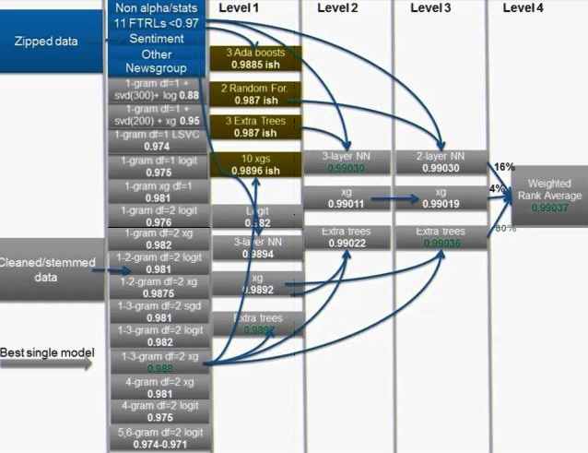
Stacking - 100 times more work for 0.012
Image source: http://blog.kaggle.com/2017/06/15/stacking-made-easy-an-introduction-to-stacknet-by-competitions-grandmaster-marios-michailidis-kazanova/

Slide 9
Baseline 1D CNN
Input (16000,1)
Conv1D (f=4*2^L, k=4,s=1)
Batch Normalization
x2
xL
Starting with L = 4 (82%) and gradually grow to L = 9 (86%)
Trained with Adadelta optimizer with categorical cross entropy loss
Learning rate decay by checking the validation loss / accuracy
As L goes larger, CV results gets better
Front runner on leaderboard during month 1
Activation (Relu)
Max Pooling 1D
...
Activation (Relu)
Global Avg Pooling 1D
Global Max Pooling 1D
Concat
FC
Batch Normalization
x4
Dropout
Softmax

Slide 10
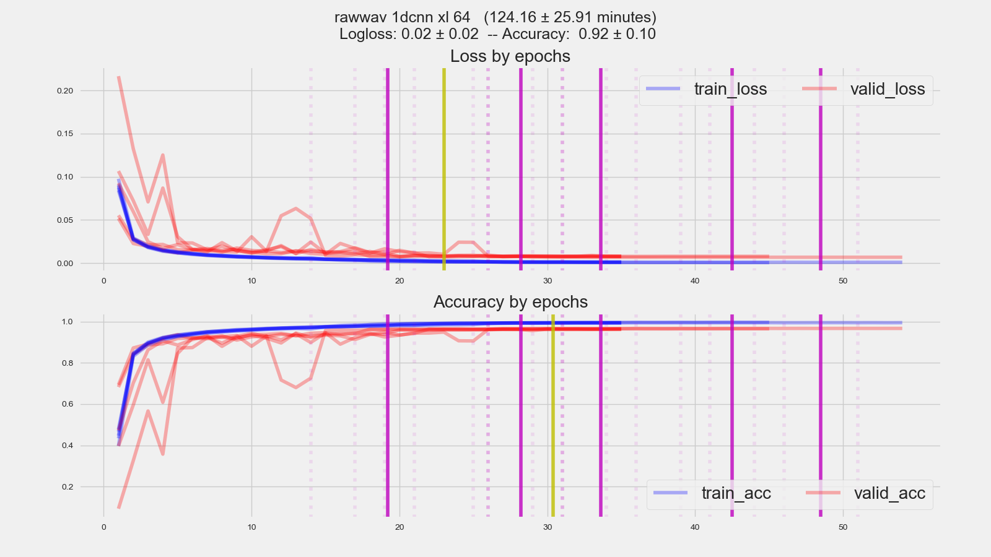
Baseline 1D CNN - Early stopping is tricky

Slide 11
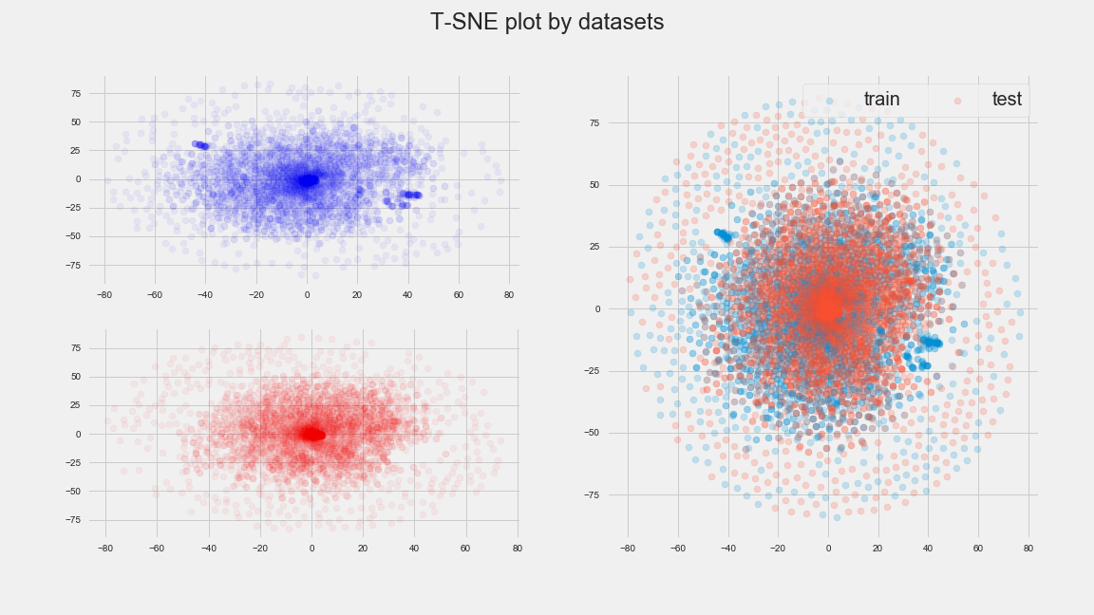
T-SNE Plots - Something is wrong

Slide 12
Augmentation ( Abandoned )
I thought pre-compute transformations is not good idea.
Implemented some transformation in my batch generator.
def batch_generator(X: np.array, y: np.array=None, batch_size: int=128, task: str='train',
noise_level: float=0, shift_level: float=0, stretch_level: float=0):
Severely slow down training and GPU utilization, even with multiprocessing.
Similar situation with 2D image augmentation methods

Slide 13
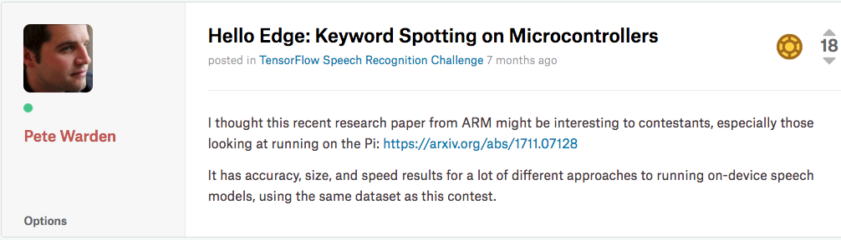
ARM’s paper
They are targeted as small model sizes and quick inference time. (which I am not bound to)
The best model from that paper gets 83% accuracy
Guided me to try 2d features, and their model structures are my starting points.

Slide 14
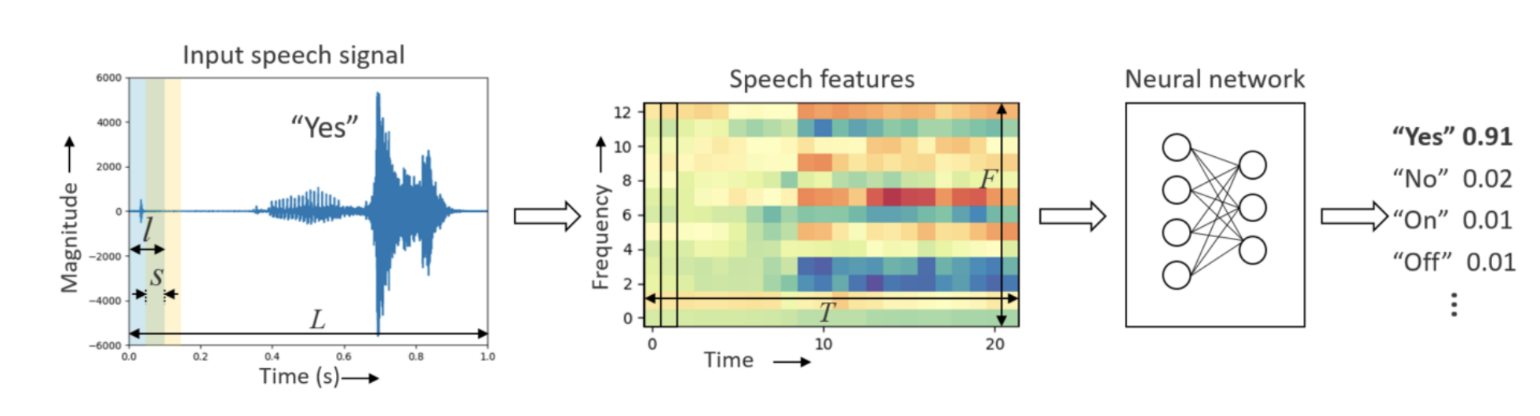
Pipeline
Image source: https://arxiv.org/pdf/1711.07128.pdf

Slide 15
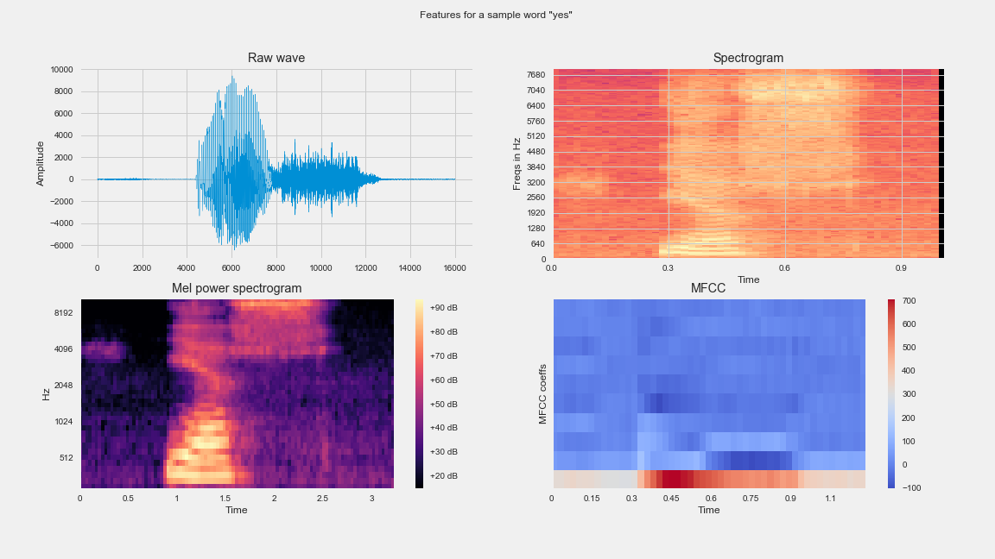
Exploring more features

Slide 16
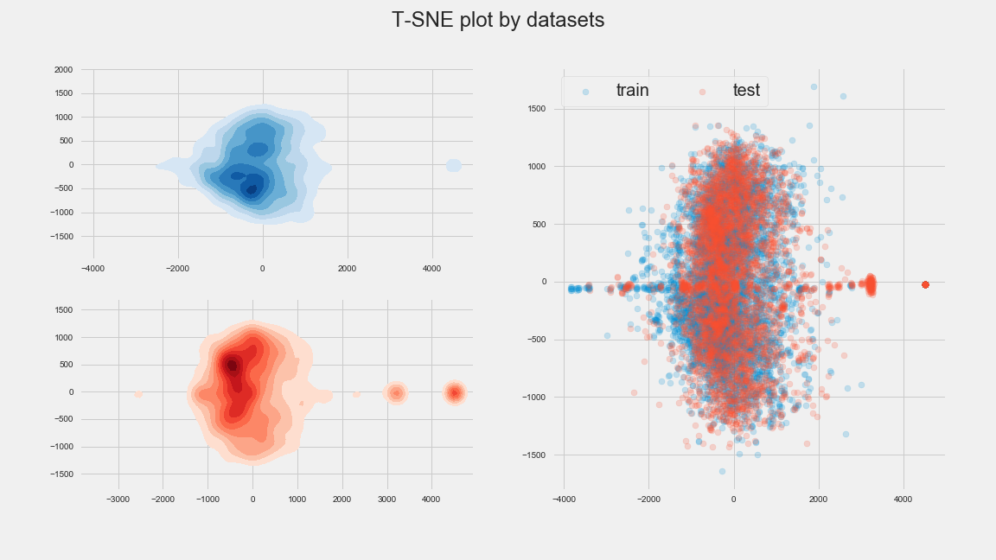
T-SNE Plots - Something is wrong again

Slide 17
Reframe the problem to cope with discrepancy
From multiclass problem with a single label from 12 classes Softmax -> categorical cross entropy Loss
To multilabel problem with 12 labels Sigmoid -> binary cross entropy Loss
To multilabel problem with 31 labels Softmax -> binary cross entropy Loss

Slide 18
Model Zoo
1D VGG style CNN
2D VGG style CNN
LSTM or GRU RNN
Convolutional RNN
Depth-separable CNN
ResNet-18 / 34 .
Fully connected network
A hybrid of CNN and RNN

Slide 19
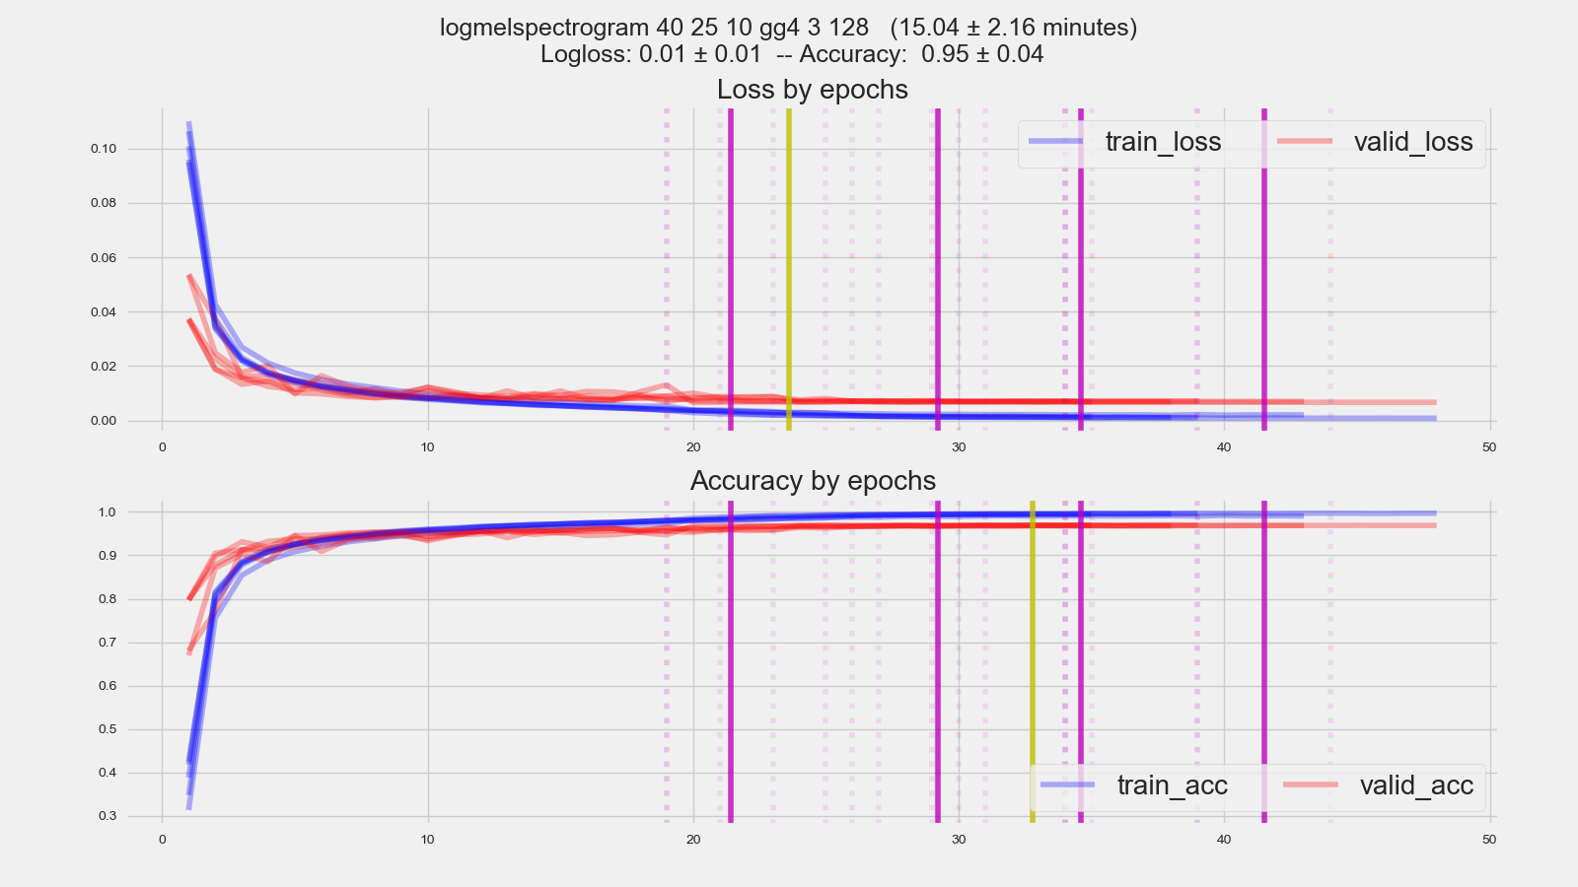
2D VGG style model on mel spectrogram feature

Slide 20
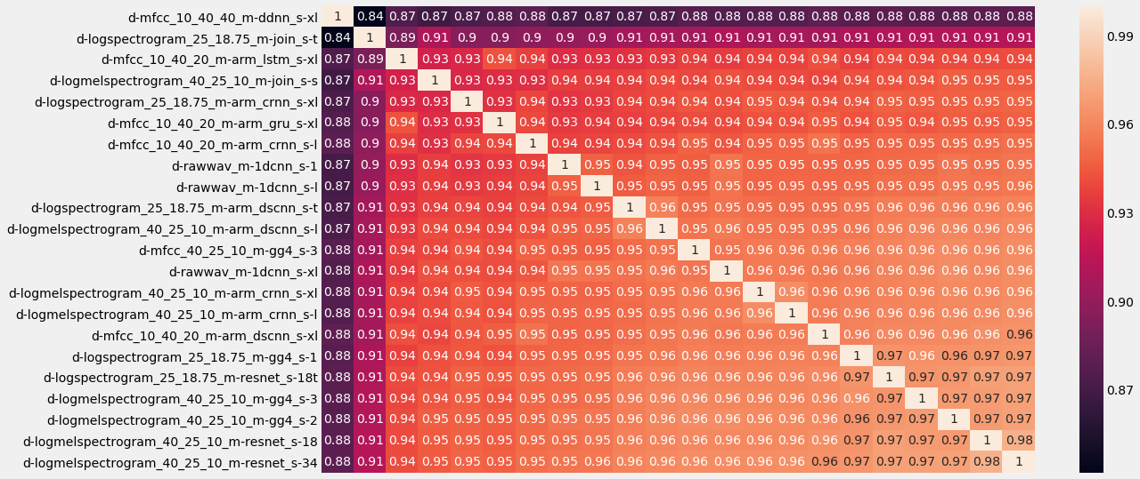
Model Correlations

Slide 21
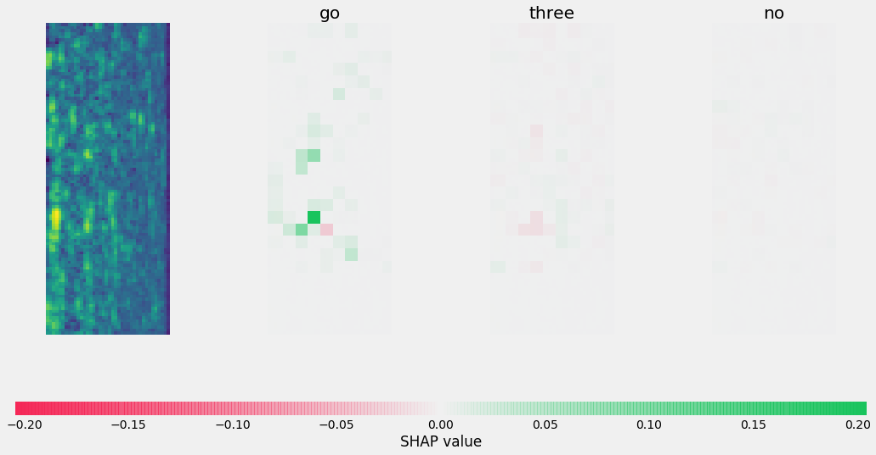
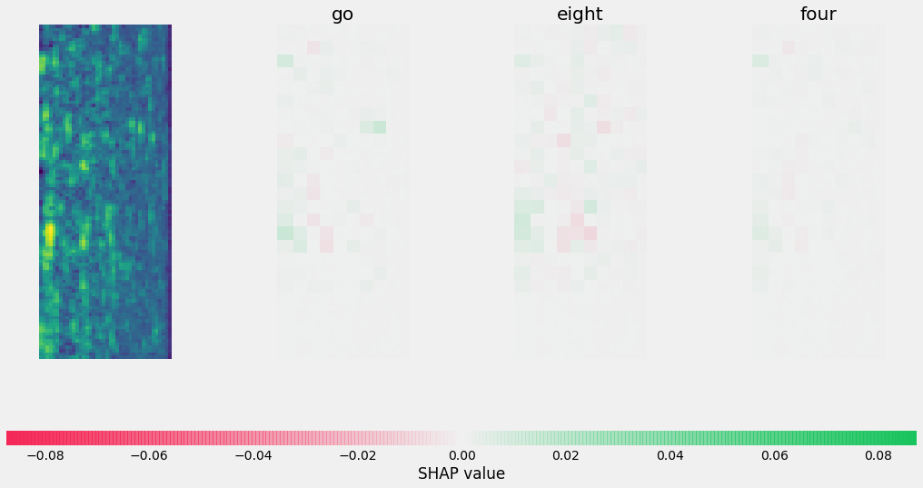
Shap values
VGG
ResNet

Slide 22
Stacking
Ridge regression on 22 meta inputs.
Tuned alpha on the same CV splits as the first layer.
0.5% better than best single model ( ~ 32 positions )
0.2% better than naively averaging all models ( ~ 14 positions )

Slide 23
Thank you~
Link to competition: https://www.kaggle.com/c/tensorflow-speech-recognition-challenge
My code on github: https://github.com/ryancheunggit/tensorflow-speech-recognition-challenge
Took about a week to reproduce everything from scratch on my machine (Intel I7 7700 HK + Titan Xp 12G + 32G RAM)
Q & A

