Slide 1


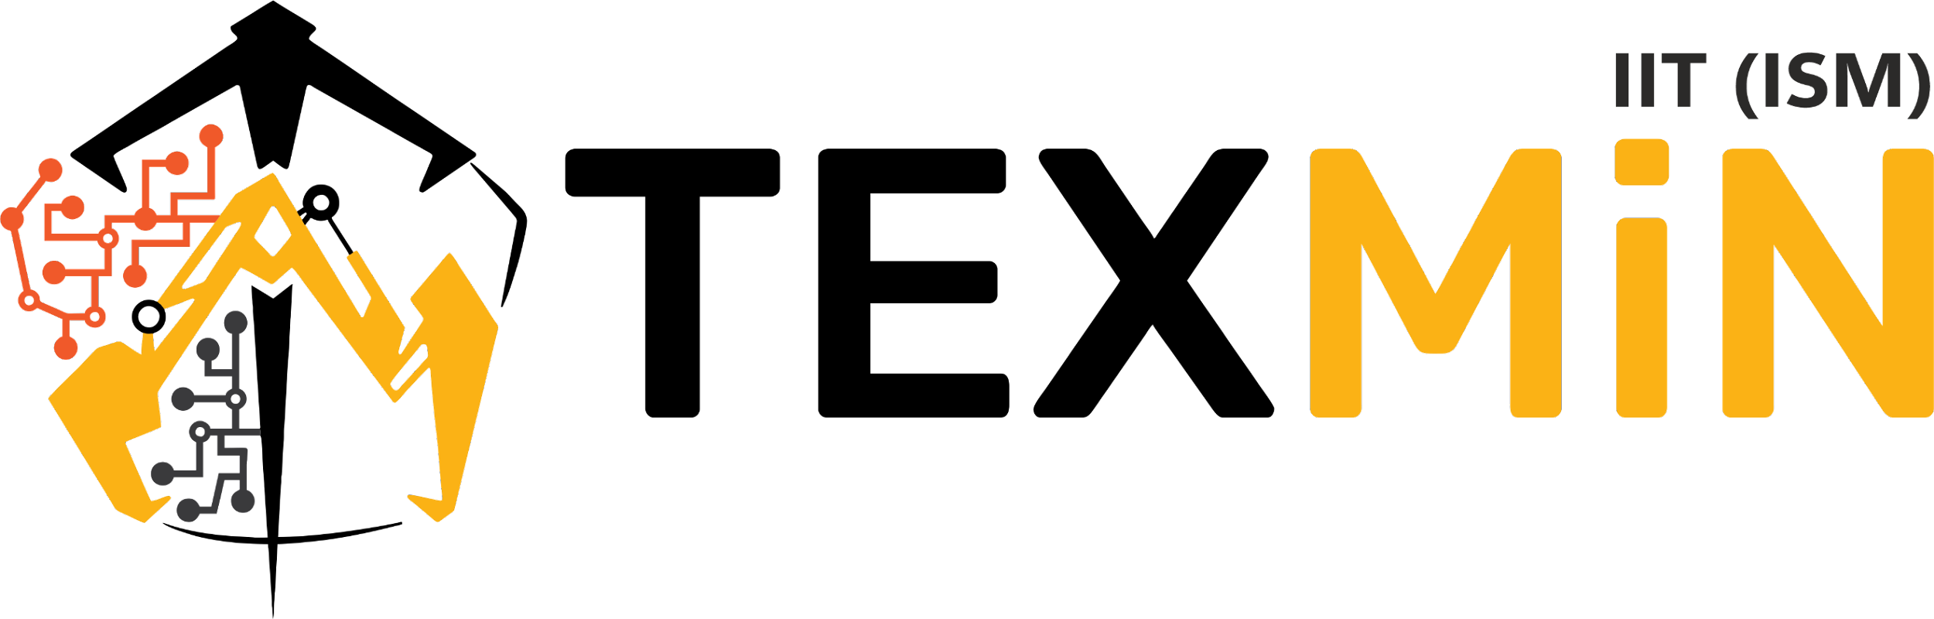

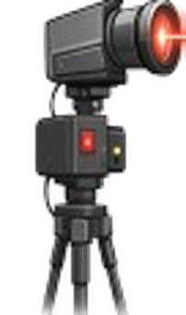
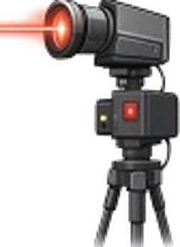
TECHNOLOGY DEVELOPMENT PROPOSAL · FTBI–TEXMiN MINING CPS CoE
Underground nodes · 50–100 m hops
Underground Audio/Video
Communication System
for Miner Safety
and Monitoring
Hybrid free-space optical and LoRa communication for real-time video and emergency alerts in underground mines.
Focus
Funding
Readiness
Institute
4S Mining
Safe, Smart, Sustainable, Social
₹15 lakh
24 months
TRL 2 → TRL 5
Tunnel-level validation
NIT Rourkela
Prof. Sadananda Behera, PI
Prof. Sadananda Behera, Assistant Professor · 98610 77539 · No co-PI · Industry letter: not attached
NIT Rourkela · FTBI–TEXMiN · Title
1 / 16
Notes:
Introduce the project in one line: a hybrid link that carries live video on free-space optics and keeps an alert path on LoRa for underground mines. The ask is ₹15 lakh for 24 months, taking the work from TRL 2 to TRL 5. An industry letter is not attached; the plan for getting one is on slide 12. An auto-tracking FSO prototype already exists in the department and is the starting point.

Slide 2



01
PROJECT TITLE AND OBJECTIVES
Objective
Real-time video from a mine heading to the surface on aligned free-space optical hops. LoRa keeps the alert path alive, and in heavy dust the link switches to Zigbee / Wi-Fi.
Specific objectives
1
2
3
4
5
50–100 m
IMU
LoRa
Multi-hop
Dust switch
Real-time video on FSO links between successive tunnel nodes
Auto-tracking with motorized steering. Department prototype already working
Control, alerts and fallback when an optical hop is interrupted
Transmitter, relays, surface base station. Lab and tunnel-like tests
Zigbee / Wi-Fi takes over when dust is above a threshold. LoRa sends the alert
NIT Rourkela · FTBI–TEXMiN · Objectives
2 / 16
Notes:
Read the objective once, then the four boxes. The existing auto-tracking prototype is the base for the second objective. The last box is the limit of this grant: a lab prototype and a test in a tunnel-like or underground setting. A trial in a working mine comes after that. The fifth box is the dust switch: when the dust level is above a set threshold, the link moves from FSO to Zigbee / Wi-Fi and LoRa reports the change.

Slide 3
02
PROBLEM STATEMENT AND RELEVANCE TO THE MINING SECTOR
Background: communication underground today
Miners at the face depend on a link that rock, water and ground movement regularly remove.
Surface control room
Wi-Fi, LTE: no signal in rock
Cable cut by fall, water, machines
Voice and text do not show the face
Heavy dust weakens optical links
✕
What mines use now
Need: video where there is line of sight, and an alert that survives a cut cable.
Wired phones
Leaky-feeder cable
Low-rate radio
Surface control room
NIT Rourkela · FTBI–TEXMiN · Background and problem
3 / 16
Notes:
Mines today use wired phones, leaky-feeder cable and low-rate radio. These are fine for voice on an intact drift. When a fall or water cuts the cable, the link goes with it, and none of them shows the face. Wi-Fi and LTE do not pass through rock. So the need is a link that carries video where there is line of sight and still sends an alert when the cable or the beam is lost. Dust is a further problem for any optical link, which is why the proposal includes a fallback.

Slide 4
02
PROBLEM STATEMENT AND RELEVANCE TO THE MINING SECTOR
Relevance to underground mining
What an underground heading needs, set against the systems available today.
Works
Partly
Does not
Cable / leaky feeder
Wi-Fi / LTE
LoRa only
FSO only
This proposal
Reach the surface in an emergency
~
✕
✓
~
✓
Until the cable is cut
No signal in rock
Yes, at low data rate
Only with clear sightline
LoRa stays up if beam drops
Live picture of the face
✕
✕
✕
✓
✓
Not what it is for
No usable bandwidth
Too slow for video
Yes, while aligned
Aligned by closed loop
After vibration or a fall
✕
✕
✓
✕
✓
Cable often fails too
Link lost
Alert can still be sent
Beam is lost
Alert stays. Beam reacquired
In heavy dust
✓
~
✓
✕
✓
Not affected
Not affected, rock still blocks
Not affected
Beam scattered, link drops
Switches to Zigbee / Wi-Fi
Fit for an Indian underground mine
~
✕
~
~
✓
Often imported
Not an underground system
Sensors, not video
Mostly shown in lab
Indigenous node
4S Mining. Safe: picture of the face, alert if it drops. Smart: sensing, radios and steering in one node. Sustainable: heavy data on light. Social: fewer people sent in unseen.
NIT Rourkela · FTBI–TEXMiN · Relevance to mining
4 / 16
Notes:
Go down the last column. A cable reaches the surface until it is cut. LoRa can carry an alert but not video. FSO can carry video but loses it when the beam moves. This proposal combines the two and keeps the beam aligned with a feedback loop. It is a system for one heading, not a replacement for voice across the whole mine. The focus area is 4S Mining, shown in the four tiles at the bottom. The dust row: cable and LoRa are not affected by dust, FSO alone loses the beam, and this proposal switches to Zigbee / Wi-Fi.

Slide 5

03
INNOVATION AND UNIQUENESS
What is different in the proposed system
1
2
3
Hybrid link, dust-aware
Multi-hop along the tunnel
IMU auto-tracking
FSO carries video. LoRa carries control and alerts. In heavy dust the link switches to Zigbee / Wi-Fi.
A node every 50–100 m on line of sight. A longer heading needs more relays.
IMU drives a motorized mount and corrects pointing. Prototype exists in the department.
4
5
Why FSO works underground
Video as safety
One cyber-physical node
A live view of the zone a team is about to enter.
Senses (camera, IMU, gas, temperature, humidity), communicates, and steers the beam.
Beam follows the open tunnel
NIT Rourkela · FTBI–TEXMiN · Innovation
5 / 16
Notes:
Spend time on cards 2 and 3. They answer the usual question of how free-space optics can work underground: the beam runs along the open tunnel for 50 to 100 m and the next node picks it up. The IMU mount deals with misalignment, and a first version already runs in the department. Card 1 is the hybrid architecture, which now includes the dust-aware switch to Zigbee / Wi-Fi. Cards 4 and 5 are video as a safety tool and the cyber-physical design.

Slide 6
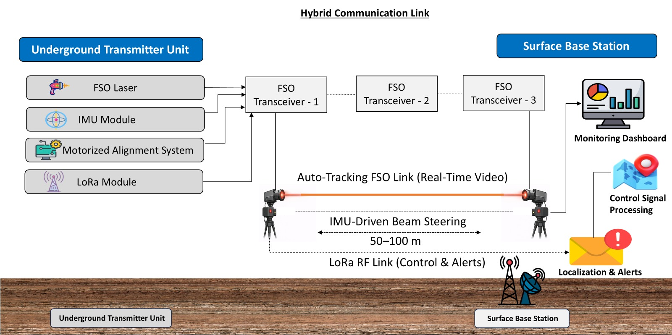
04
TECHNICAL FEASIBILITY AND METHODOLOGY
Proposed scheme
FSO
Video on auto-tracked hops of 50–100 m.
IMU
Holds the beam on the next node.
LoRa
Control and alerts to the surface.
Dust switch
Zigbee / Wi-Fi takes over in heavy dust.
FSO beam: video
Zigbee / Wi-Fi: dust mode
Each node: laser, IMU, motorized mount, LoRa. Surface: dashboard, alerts, localization.
LoRa link: control, alerts
NIT Rourkela · FTBI–TEXMiN · Proposed scheme
6 / 16
Notes:
This is Fig. 1 from the proposal. Walk through it from left to right. Each underground node has a laser, an IMU, a motorized alignment mount and a LoRa module. The orange beam between nodes carries the video, 50 to 100 m per hop. The dotted LoRa link carries control signals and alerts to the surface base station. If a hop is blocked, the video on that hop stops but the alert still arrives. Bit rate and latency targets will be fixed in the first three months, once the camera and laser are chosen. The original figure shows the FSO and LoRa links. The dust fallback to Zigbee / Wi-Fi is explained on the next two slides.

Slide 7

04
TECHNICAL FEASIBILITY AND METHODOLOGY
How one hop works
The picture travels as light. Each node rebuilds it, checks it and sends it on.
AA55
Length
Seq
JPEG
CRC-16
UART 115200 8N1, one direction
Optical frame
Camera node
Relay node
Base station
• Camera + Raspberry Pi
• Packet out of UART
• 650 nm laser, on–off keying
light
• Photodiode, amplifier, comparator
• Second Pi checks CRC, holds JPEG
• Sends the frame again on its own laser
light
• Same receiver chain
• Third Pi checks CRC
• JPEG on the HDMI screen
Three different jobs
Laser
IMU
LoRa
Carries the JPEG only.
Holds the camera head at its angle. It does not find the relay.
Five-byte messages: lock or lost, alert, image OK, dust mode switch.
NIT Rourkela · FTBI–TEXMiN · How one hop works
7 / 16
Notes:
The camera node packs one JPEG into a small frame: start mark, length, sequence number, the JPEG and a CRC. The Pi sends it over UART to a 650 nm laser that is switched on and off with the bits. At the relay, a photodiode, amplifier and comparator turn the light back into bits. A second Pi checks the CRC, keeps the JPEG and sends the same frame out on its own laser. The relay does not amplify the light; it rebuilds the picture. The base does the same and shows the JPEG on a screen. Three separate jobs: the laser carries the JPEG, the IMU holds the camera head at its angle, and LoRa sends five-byte messages such as lock, lost, alert and the dust mode switch.

Slide 8

04
TECHNICAL FEASIBILITY AND METHODOLOGY
Dust-adaptive link switching
Dust scatters the laser beam. When the dust level is too high, the node moves the video to Zigbee / Wi-Fi and LoRa tells the surface.
Clear air: FSO
No
Video on the laser beam, hop by hop.
Dust level
Dust above
threshold?
Checked at each node
Heavy dust: backup
Video on Zigbee / Wi-Fi at a lower data rate.
LoRa
Yes
LoRa alerts the surface
Back to FSO, and the threshold
Sent when the link switches mode, so the control room knows the path has changed.
The link can return to FSO once the dust level falls below the threshold. Threshold and dust measurement are fixed in system design.
NIT Rourkela · FTBI–TEXMiN · Dust switching
8 / 16
Notes:
Mines are dusty, and dust scatters the laser beam, so the optical link can fail even when the tunnel is clear. Each node checks the dust level against a threshold. Below the threshold, video goes on the FSO link. Above it, the node switches the transmission to Zigbee or Wi-Fi at a lower data rate, and LoRa sends an alert so the surface knows the mode has changed. The link can return to FSO when the dust level falls below the threshold. The threshold value and the way dust is measured are fixed during system design.

Slide 9

04
TECHNICAL FEASIBILITY AND METHODOLOGY
Starting point: auto-tracking FSO already working
What this grant adds
Why it can be built here
+
Video on the optical hop
50–100 m
hop within ordinary laser and photodiode modules
+
LoRa for alerts and fallback
In the lab
FSO transceivers, embedded benches, computing
+
Relay nodes along a heading
Designed loss
beam or dust loss: Zigbee / Wi-Fi takes over, LoRa alerts
+
Surface station, underground enclosure
Auto-tracking FSO prototype in the department lab. This unit will be reused.
First milestone: laboratory bench, one relay
Relay laser hand-aimed. IMU loop off for the first JPEG.
Camera node
Relay
Base
existing gimbal, camera, Pi, laser
2–5 m
the one new node
2–5 m
receiver, Pi, HDMI screen
NIT Rourkela · FTBI–TEXMiN · Feasibility
9 / 16
Notes:
This is the working auto-tracking FSO unit in our laboratory. We will reuse it instead of starting alignment from scratch. The grant adds video, LoRa, relay nodes, a surface station and an enclosure for the underground trial. The first milestone is a bench setup: camera node, one new relay and a base, 2 to 5 m apart. The relay laser is aimed by hand and the IMU loop is off for the first JPEG. If the picture appears on the base screen, both hops work. Quote a range or accuracy for the existing unit only if we have the measured number.

Slide 10
04
TECHNICAL FEASIBILITY AND METHODOLOGY
Work plan: 24 months
Year 1
Year 2
1
2
3
4
5
6
7
8
9
10
11
12
13
14
15
16
17
18
19
20
21
22
23
24
1
Procure FSO, IMU, LoRa, cameras, mounts
2
Architecture, communication, dust switch
3
Auto-tracking on the mine node
4
Integrate transmitter, relays, base
5
Laboratory tests
6
Tunnel-like / underground test
7
Documentation, patent, commercial plan
Milestones: M3 hardware · M7 architecture · M11 tracking · M16 integrated · M19 lab · M22 field · M24 report
Risk management
Technical
LoRa alerts, Zigbee / Wi-Fi fallback, modular hardware
Operational
Phased build with test checkpoints
Financial
Conservative budget margins
NIT Rourkela · FTBI–TEXMiN · Work plan
10 / 16
Notes:
Give the gates rather than every row: month 3 hardware, month 7 architecture, month 11 tracking, month 16 integrated prototype, month 19 lab validation, month 22 tunnel-like test, month 24 report and patent filing. Point at row 3 (tracking reuses the existing prototype) and row 6 (the tunnel test depends on the lab results). The three risks at the bottom are from the proposal: LoRa backup with modular hardware, phased testing, and conservative budget margins. The technical risk now also covers the dust fallback.

Slide 11
05
EXPECTED OUTCOMES AND TECHNOLOGY READINESS LEVEL
Outcomes and readiness
Readiness
TRL 1
TRL 2
TRL 3
TRL 4
TRL 5
TRL 6
TRL 7
TRL 8
TRL 9
Today
integrated system
Month 24
tunnel-like test
After this grant
needs a test mine
Deliverables
Hybrid FSO–LoRa prototype: transmitter, relays, surface base station
Real-time video over more than one optical hop
1
2
Auto-tracking recovering from deliberate misalignment
LoRa alert delivered when a hop is interrupted
3
4
Automatic switch to Zigbee / Wi-Fi when dust is above the threshold
Validation report, deployment guidelines, commercialization plan, patent filing
5
6
NIT Rourkela · FTBI–TEXMiN · Outcomes and TRL
11 / 16
Notes:
Keep the TRL numbers exact. The integrated system is at TRL 2 today. The auto-tracking unit is a working subsystem, not the whole link. The target at month 24 is TRL 5, a tunnel-like or underground test. TRL 6 needs a partner or TEXMiN test mine and is outside this grant. What we will measure: hop length against 50 to 100 m, video continuity, time to realign, whether the alert arrives when the beam is blocked, and energy per node.

Slide 12
06
INDUSTRY READINESS AND COLLABORATION
Industry engagement
No industry letter is attached yet. We plan to get one after a supervised trial with an operator or manufacturer.
Months 1–6
Find partners
Find an underground operator and a mine-communications maker. Ask for a letter of interest.
Months 18–22
Trial
Test at a TEXMiN mine or partner drift with their engineer present.
2
4
Months 6–12
Workshop
Their engineer reviews mounting, power, dust and gas zones before the enclosure is frozen.
Months 22–24
Next step
Licence or pilot talk. FTBI incubation if it becomes a venture.
1
3
Users
Asked of TEXMiN, non-financial
Underground coal and metal mines (managers, safety officers, rescue rooms) and mine-communication equipment makers.
Mentorship on mining standards, commercialization guidance, and test-mine access if it can be arranged.
NIT Rourkela · FTBI–TEXMiN · Industry
12 / 16
Notes:
Say this first: an industry letter is not attached. The plan is to find an underground operator and a mine-communication maker in months 1 to 6, hold a workshop with their engineer in months 6 to 12 so that mounting, power, dust and gas-zone limits are known before the enclosure is frozen, and run the trial with them present in months 18 to 22. Avoid naming any company as a partner. From TEXMiN we ask for mentorship on standards, commercialization guidance and test-mine access if possible. Regulatory clearance is taken before any deployment.

Slide 13
07
IMPACT AND COMMERCIALIZATION PLAN
Impact, and how it would be deployed
What the tunnel trial will measure
What it changes for a mine
Video continuity
Alert delivery
Re-entry decisions taken with a current picture of the face
1
on a 50–100 m hop
when a hop is cut or dust forces a switch
The alert does not depend on a single cable
2
Realignment time
Energy per node
An indigenous node, where this class is largely imported
after a deliberate disturbance
and bill of materials
3
Commercial path
This grant
Pilot
Licence or FTBI
Scale
Proves one heading
Supervised, with the partner who signs the letter
Manufacturer licence, or incubated venture
Coverage grows by adding hops
Also fits
Tunnel monitoring
Underground transport
Oil and gas sites
NIT Rourkela · FTBI–TEXMiN · Impact and commercialization
13 / 16
Notes:
The trial gives four measurements: video continuity, alert delivery when the hop is cut, time to realign, and energy per node. We do not yet have figures for lives saved, downtime or rupee savings, so none are quoted. The commercial path is this grant, a supervised pilot, a licence or FTBI incubation, and then growth by adding hops. Video analytics, gas-trend monitoring and drone or robot nodes are future work and are not part of the 24-month deliverables.

Slide 14
08
TEAM DETAILS AND BUDGET SUMMARY
Team
Relevant experience
Principal Investigator
SB
Prof. Sadananda Behera
JLT, JOCN
Indian patent
2 DoT / TCoE projects
Optical links under impairment: soft-failure detection and localization
Published application for a deployable hardware testbed
Co-PI on 6G projects, about ₹80 lakh and ₹82.4 lakh. One is a hybrid transceiver
Assistant Professor
NIT Rourkela
98610 77539
Division of the work
No co-PI. Two project assistants for 24 months. The PI leads every work package.
Mining practice comes from TEXMiN mentors and the industry engineer, before the enclosure is frozen.
Project assistant 1
Project assistant 2
Hardware: FSO, IMU, pan-tilt, LoRa, PCB, enclosure
Software: multi-hop forwarding, video, tracking loop, surface display
₹15,000 / month
₹15,000 / month
NIT Rourkela · FTBI–TEXMiN · Team
14 / 16
Notes:
One line on credibility: the PI works on optical links and hardware testbeds, with two ongoing DoT/TCoE 6G projects and a published Indian patent application. There is no mining co-PI. Mining practice will come from TEXMiN mentors and from the industry engineer in the month-6 workshop. Two project assistants: one for hardware, one for software.

Slide 15
08
TEAM DETAILS AND BUDGET SUMMARY
Budget: ₹15.00 lakh
In ₹ lakh. Institute overhead is zero. Year 1 is ₹7.60 lakh and Year 2 is ₹7.40 lakh.
Head | Year 1 | Year 2 | Total | Share
Project assistants (2) | 3.60 | 3.60 | 7.20 | 48%
Equipment | 2.00 | 1.50 | 3.50 | 23%
Consumables | 0.75 | 0.75 | 1.50 | 10%
Contingency | 0.75 | 0.75 | 1.50 | 10%
Travel | 0.50 | 0.80 | 1.30 | 9%
Overhead | 0 | 0 | 0 | 0%
Total | 7.60 | 7.40 | 15.00 | 100%
₹15.00
lakh · 24 months
Equipment
Year 1: FSO modules, pan-tilt, IMUs, controllers, cameras, LoRa and gateway, batteries, enclosures, edge computer, optics. Year 2: LoRa antennas, PCB fabrication, 3D printer for mounts.
NIT Rourkela · FTBI–TEXMiN · Budget
15 / 16
Notes:
Total ₹15 lakh with no institute overhead. Year 1 is 7.60 and year 2 is 7.40. The two project assistants are the largest head at 7.20 lakh, because this is a build project. Equipment is 3.50 lakh, consumables 1.50, contingency 1.50 and travel 1.30, which is higher in year 2 for the tunnel trials. Gas, temperature and humidity sensors are covered within equipment and consumables.

Slide 16
FTBI–TEXMiN MINING CPS CoE
Thank you.
Request: ₹15 lakh over 24 months, to take the department’s auto-tracking FSO prototype to a hybrid underground link, validated at TRL 5.
Prof. Sadananda Behera
Assistant Professor, National Institute of Technology Rourkela
98610 77539
NIT Rourkela · FTBI–TEXMiN · Close
16 / 16
Notes:
Read the request once and invite questions. Likely questions and short answers. Industry letter: not in the file; the plan is on slide 12. Why FSO underground: the beam runs down the open tunnel for 50 to 100 m and relays follow the heading. Leaky feeder: still useful for voice; this adds a picture and an alert path on one heading. TRL: the integrated system is TRL 2, the target is TRL 5, and TRL 6 needs a partner site. Laser safety: power, enclosure and exposure are part of the month-6 workshop, with clearance before any deployment. Audio: the new capacity is live video; LoRa carries alerts and control. Dust: the node switches to Zigbee or Wi-Fi when the dust level is above a threshold, and LoRa sends the alert.

