Slide 1

PANIMALAR ENGINEERING COLLEGE
(An Autonomous Institution)
Bangalore Trunk Road, Varadharajapuram
Poonamallee,Chennai-600 123
DEPARTMENT OF COMPUTER SCIENCE AND BUSINESS SYSTEMS
TITLE: EcoGuardian - Together for a Greener World
TEAM NO : Batch 03
TEAM MEMBERS:
1. AAMIR FAWAZ R [211422244002]
2. ASMATH AKBAR ALI T [211422244023]
3. DEVOTTHAM D K [211422244035]

Slide 2
OVERVIEW
Objective
Abstract
Literature Survey
Existing System
Limitations of Existing System
Proposed System
Advantages of Proposed System
Architecture Diagram
System Required Specifications
List of Modules
Conclusion
Future Enhancement
References

Slide 3
OBJECTIVE
To develop a digital platform that simplifies and automates the scrap collection process, making it efficient and accessible for both users and scrap shop owners.
To enable users to schedule scrap pickup requests online, providing a user-friendly interface for booking, tracking, and managing scrap collection appointments.
To assist scrap shop owners in managing their inventory and orders, allowing them to receive pickup notifications, update stock details, and streamline business operations.
To provide an admin panel for centralized system management, ensuring secure monitoring of users, scrap shop activities and overall platform functionality.

Slide 4
ABSTRACT
EcoGuardian is a digital scrap management platform that connects users with local scrap shop owners, supporting organized and efficient waste recycling.
The platform provides an easy-to-use interface through which users can request scrap pickups, making the disposal of recyclable materials simple and systematic.
Scrap shop owners access a dedicated dashboard to receive pickup requests, manage inventory, and track stock details for improved operational efficiency.
An integrated admin panel supervises platform activities, ensuring smooth functioning, data security, and proper coordination between users and scrap shop owners.

Slide 5
LITERATURE SURVEY
TITLE OF THE PAPER | AUTHOR | METHODOLOGY USED | DRAWBACK
Scrapify - Digital Solution for Efficient Scrap Collection | Natnael Tamirat et al. | Web-based digital platform connecting users with scrap collectors for scheduling and managing scrap collection | Limited inventory management, no advanced admin monitoring, and lacks extended role-based dashboards
Online Scrap Collection and Management System | Kishore Babu et al. | Web-based system for submitting scrap pickup requests and coordinating collection between users and scrap collectors | Does not include inventory tracking and lacks centralized admin control for monitoring activities
Web-Based Waste Collection Scheduling System | R. Kumar et al. | Online scheduling platform for managing waste and scrap pickup requests using a client–server model | Limited role-based access and no dedicated module for scrap shop inventory management
YEAR OF PUBLICATION
2023
2023
2022

Slide 6
EXISTING SYSTEM
Traditional Scrap Collection System: Relies on phone calls or in-person visits between users and scrap shop owners for scrap collection.
Local Scrap Shop Management System: Scrap shop owners maintain inventory and pickup records using manual or basic record-keeping methods.
Independent Scrap Collection Services: Private scrap collectors provide pickup services through informal and individual arrangements.
Limited Online Scrap Platforms: Some web-based platforms support scrap trading and related services in a limited manner.

Slide 7
LIMITATIONS OF EXISTING SYSTEM
Traditional Scrap Collection System: Lacks digital scheduling and proper coordination, resulting in delays and inconvenience.
Local Scrap Shop Management System: Manual records lead to data inconsistency and inefficient tracking of inventory and pickups.
Independent Scrap Collection Services: Absence of transparency, standardized processes and centralized monitoring reduces reliability.
Limited Online Scrap Platforms: Do not fully support pickup scheduling, inventory management or admin control features.

Slide 8
PROPOSED SYSTEM
EcoGuardian Digital Scrap Management System:
Provides a centralized online platform that connects users with local scrap shop owners for organized scrap collection and recycling.
User Scrap Pickup System:
Users can request scrap pickups through a web-based interface, making the process simple, convenient and structured.
Scrap Shop Owner Management System:
Scrap shop owners receive pickup requests, manage inventory and track scrap collection activities digitally.
Admin Monitoring and Control System:
An admin panel oversees users, scrap shop owners and platform operations to ensure smooth and efficient system functioning.
.

Slide 9
ADVANTAGES OF PROPOSED SYSTEM
Improved Efficiency: Streamlined process for scheduling pickups and managing orders, saving time for both users and scrap shop owners.
Real-Time Tracking: Enables users and scrap shop owners to track orders and transactions seamlessly, ensuring transparency.
Secure Transactions: Integrated payment system ensures safe and reliable transactions between users and scrap shop owners.
Enhanced User Experience: User-friendly interface that simplifies the scrap collection and recycling process for all stakeholders.
Scalability: Easily adaptable to expand services and integrate additional features as the system grows.

Slide 10
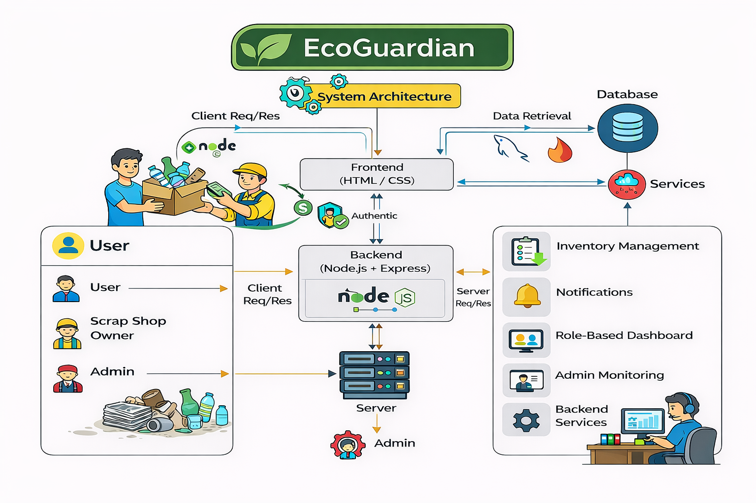
ARCHITECTURE DIAGRAM

Slide 11
SYSTEM REQUIRED SPECIFICATIONS
Software requirements | Hardware requirements
Operating System - Windows 10 or above (Desktop users) | Device: Smartphone / Tablet / Desktop
Operating System - Android 5.0 or iOS 12.0 and above | RAM: Minimum 2 GB
PWA-supported Web Browser (Chrome, Edge, Safari) | Storage: Minimal free space required for PWA
Internet access for accessing server-side services | Camera: Optional (for uploading scrap images)

Slide 12
LIST OF MODULES
User Module
Scrap Shop Module
Admin Module

Slide 13
MODULE 1
USER MODULE:
Registration and Login:
User sign-up and login (email or social media authentication)
Forgot password and reset functionality
Profile Management:
User profile creation and editing (name, address, contact info)
View and update personal details
Scrap Collection Booking:
Request scrap pickup (choose date, time, type of scrap)
View available scrap collection slots and choose a convenient time
Order Tracking and History:
Track the status of ongoing scrap pickups
View past orders and their statuses
Payment Integration:
Secure payment options (PayPal, Razorpay, or Stripe) for scrap collection services
Payment confirmation and receipts
Notifications:
Receive alerts for pickup confirmation, reminders, and status updates
Push notifications and emails for key updates

Slide 14
OUTPUT SNIPS
Main Page
Recycle Products
Manage Order
Sell Side
Account

Slide 15
MODULE 2
SCRAP SHOP MODULE:
Registration and Login:
Register with shop details (name, address, contact number).
Log in using credentials (email, password).
Profile Management:
Update shop information (name, address, contact details).
Manage communication preferences (email and SMS notifications).
Inventory Management:
Add, update, or remove scrap materials from the inventory.
Track stock availability and manage low stock notifications.
Order Management:
View incoming scrap pickup requests and order details.
Accept or reject pickup requests based on availability.
Payment Management:
Track payments received for completed scrap pickups.
Monitor pending payments and view transaction history.
Notifications:
Receive notifications for new orders, status updates, and payments.
Customize notification preferences for different events.

Slide 16
OUTPUT SNIPS
SS Dashboard
Manage Stock
Transactions
Settings
Order Request

Slide 17
MODULE 3
ADMIN MODULE:
Admin Login:
Admin can log in using credentials (username, password).
Admin can reset password if forgotten via email verification.
User and Scrap Shop Management:
View and manage user and scrap shop owner accounts (edit, delete, block).
Approve or reject new scrap shop owner registrations.
System Analytics:
View reports on scrap collection volume, user activity, and recycling trends.
Monitor platform performance and identify areas for improvement.
Transaction Management
Track and resolve payment-related issues (disputes, refunds).
View and monitor all financial transactions on the platform.
Content Management
Manage website content (update terms, policies, FAQs).
Modify or update notification templates and messages.
Notifications
Send announcements or updates to users and shop owners.
Monitor and manage system alerts for the platform.

Slide 18
OUTPUT SNIPS
Dashboard
LeaderBoard
User Management
Shops Management
Analytics & Report

Slide 19
CONCLUSION
EcoGuardian provides a user-friendly platform for scrap collection and recycling.
It connects users with local scrap shops, simplifying the waste management process.
The system streamlines scheduling pickups, tracking orders, and processing secure payments.
It promotes sustainability by encouraging recycling and reducing waste.
The design is easy to navigate, with real-time updates and notifications for users and shop owners.

Slide 20
FUTURE ENHANCEMENT
Mobile App Development
Expand the platform by developing dedicated mobile apps for both Android and iOS to increase user engagement and accessibility.
Include features like push notifications, in-app booking, and real-time updates.
Eco-Reward System
Implement a rewards system where users can earn points for recycling activities, which can be redeemed for discounts or donated to environmental causes.
This will encourage more users to engage in sustainable behavior.
Sustainability Partnerships:
Partner with environmental organizations and local governments to offer incentives or support for users actively participating in recycling efforts, promoting community-wide sustainability.

Slide 21
REFERENCES
A. Kumar, et al., “Web-Based Solid Waste Management System,” International Journal of Computer Applications, vol. 174, no. 5, pp. 1–6, Sep. 2017.
R. Gupta, et al., “Design and Implementation of Online Waste Collection System,” International Journal of Engineering Research & Technology, vol. 8, no. 4, pp. 450–455, Apr. 2019.
S. Patil, et al., “Digital Waste Collection Platform for Urban Areas,” International Journal of Advanced Research in Computer Science, vol. 10, no. 3, pp. 28–33, May 2019.
V. Mehta, et al., “Web Application for Scrap Collection and Recycling,” International Journal of Scientific Research in Computer Science, vol. 7, no. 2, pp. 95–100, Feb. 2020.
K. R. Rao, et al., “Online Waste Pickup Scheduling System Using Web Technologies,” International Journal of Emerging Trends in Engineering Research, vol. 8, no. 6, pp. 2612–2617, Jun. 2020.
P. S. Naik, et al., “Smart Waste Management Using Web and Mobile Applications,” International Journal of Engineering and Advanced Technology, vol. 9, no. 5, pp. 1345–1350, May 2020.
A. Verma, et al., “Recycling Management System Using Client–Server Architecture,” International Journal of Computer Science and Information Technologies, vol. 11, no. 2, pp. 212–217, 2020.
M. Joshi, et al., “Online Platform for Scrap Dealers and Customers,” International Journal of Innovative Research in Technology, vol. 6, no. 10, pp. 345–349, Jan. 2021.
S. Kulkarni, et al., “Digital Waste Management System for Sustainable Cities,” International Journal of Sustainable Development, vol. 14, no. 1, pp. 78–84, Mar. 2021.
R. Nair, et al., “Web-Based Waste Tracking and Monitoring System,” International Journal of Computer Engineering and Technology, vol. 12, no. 3, pp. 56–62, Apr. 2021.

Slide 22
REFERENCES
J. Singh, et al., “Role-Based Waste Collection Management System,” International Journal of Advanced Trends in Computer Science and Engineering, vol. 10, no. 2, pp. 912–918, 2021.
A. Choudhary, et al., “Smart Waste Collection Platform Using Web Services,” International Journal of Research in Engineering and Science, vol. 9, no. 4, pp. 42–47, Apr. 2021.
P. Malhotra, et al., “Waste Recycling Management Through Online Portals,” International Journal of Environmental Science and Technology, vol. 18, no. 7, pp. 1931–1938, Jul. 2021.
S. Desai, et al., “Digital Solution for Scrap Collection and Inventory Management,” International Journal of Innovative Science and Research Technology, vol. 6, no. 8, pp. 456–461, Aug. 2021.
N. Sharma, et al., “Online System for Managing Scrap Pickup and Disposal,” International Journal of Engineering Trends and Technology, vol. 69, no. 9, pp. 123–128, Sep. 2021.
T. R. Anand, et al., “Web-Based Waste Disposal Monitoring System,” International Journal of Computer Applications Technology and Research, vol. 11, no. 1, pp. 19–24, Jan. 2022.
H. Patel, et al., “Integrated Waste Management System Using Web Applications,” International Journal of Modern Engineering Research, vol. 12, no. 2, pp. 66–71, Feb. 2022.
A. Iyer, et al., “Online Scrap Management System for Urban Recycling,” International Journal of Computer Science Engineering and Information Technology Research, vol. 12, no. 3, pp. 101–106, Mar. 2022.
M. Karthik, et al., “Web-Based Platform for Scrap Collection Services,” International Journal of Advanced Research in Engineering and Technology, vol. 13, no. 4, pp. 89–94, Apr. 2022.
R. Banerjee, et al., “Centralized Digital Waste Management System,” International Journal of Information Technology and Management, vol. 14, no. 2, pp. 211–216, Jun. 2022.

Slide 23

Let’s work together to build a cleaner, greener future.

