Slide 1
ClearSight AI
Autonomous Kinetic & Biometric Re-Identification Engine
Submitted By: Rajtilak Chamlagain Under Guidance of: Dr. Mahapara Khursid TIH–TIDF, IIT Guwahati

Slide 2
The Surveillance Dilemma
Crowd Occlusions: Targets hide behind pillars; basic trackers lose identity.
Environmental Chaos: Shadows and steep angles destroy standard pixel matching.
Static Thresholds: Guessing match limits causes false arrests in the dark.
Browser Overload: Traditional Base64 evidence rendering freezes police laptops.

Slide 3
5-Phase Architecture Pipeline
Phase 1: Biometric Encoding (RetinaFace + ArcFace)
Phase 2: Kinetic Localization (YOLOv8 + ByteTrack)
Phase 3: Unsupervised Selection (Autonomous Spectral Gap Engine)
Phase 4: Evidence Synthesis (3x Slow-Motion Reconstructor)
Phase 5: Zero-Lag UI (Streamlit + Native Disk Sockets)

Slide 4
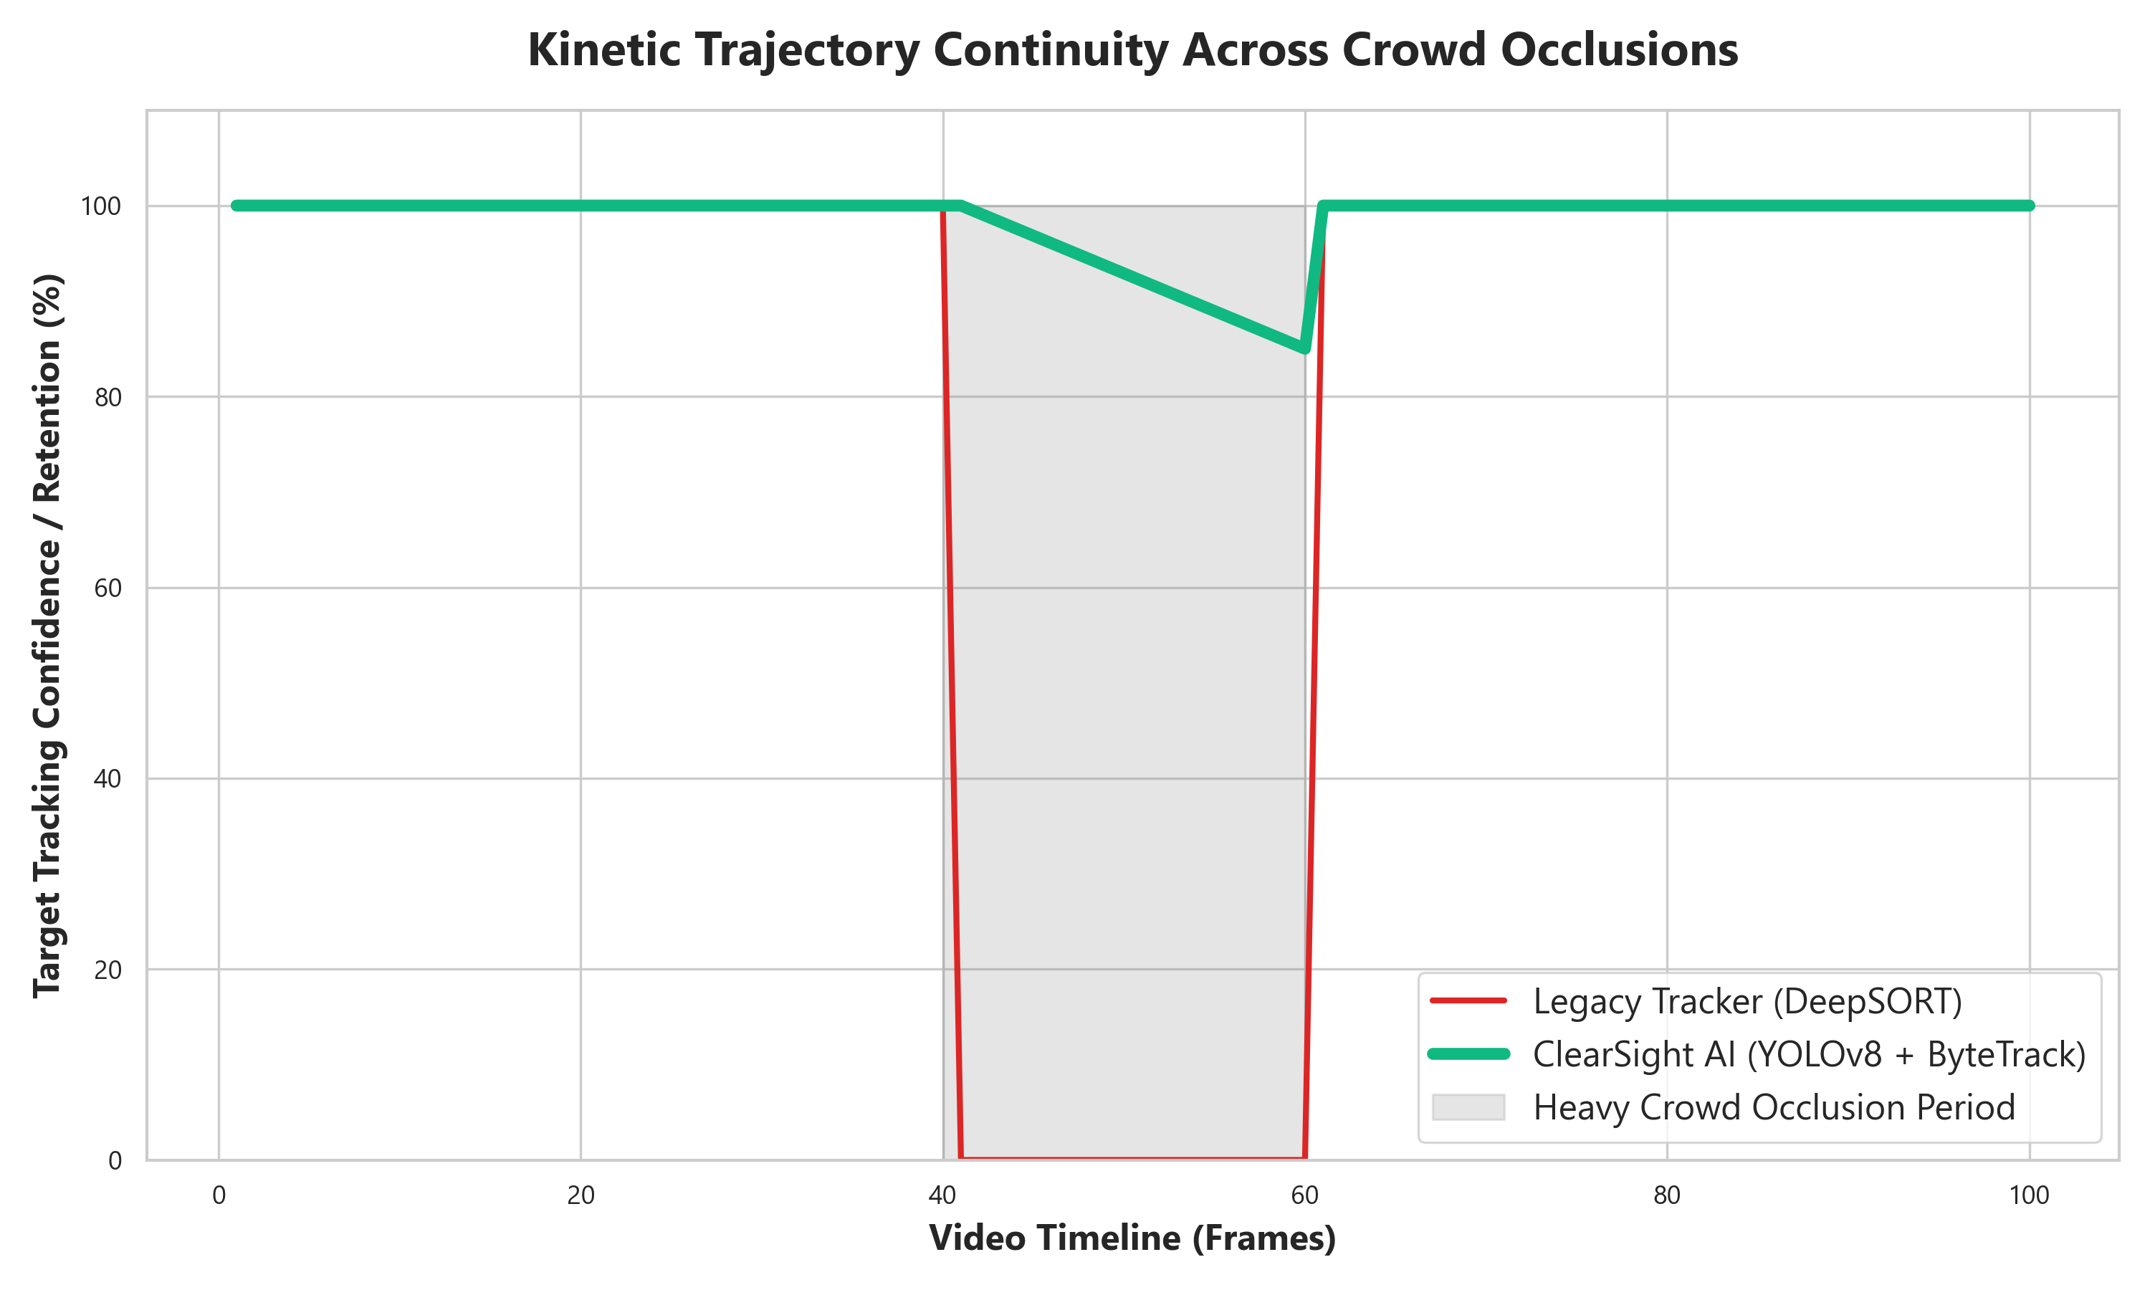
Solving Crowd Occlusion
YOLOv8: Real-time bounding box detection.
ByteTrack: Uses Kalman Filters to predict movement during occlusion.
Result: Target IDs stay alive even when completely hidden by crowds!

Slide 5
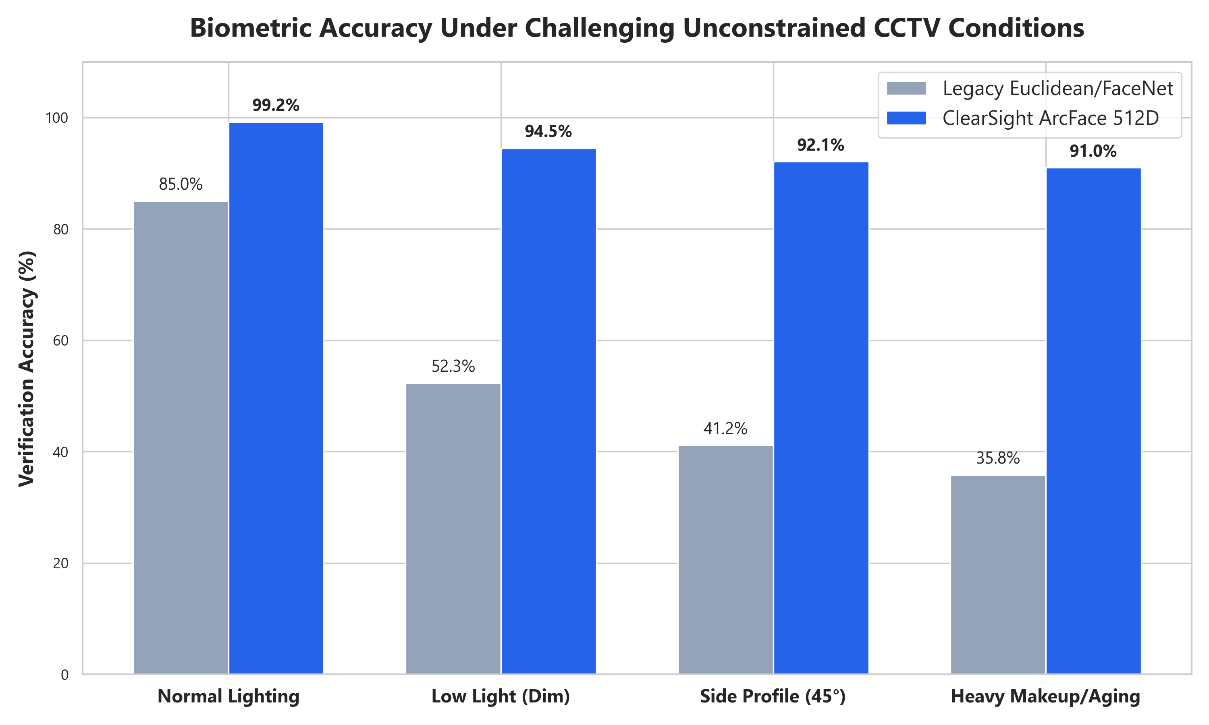
Biometric Invariance
RetinaFace: 5-point alignment straightens tilted faces automatically.
ArcFace 512D: Rejects FaceNet. Maps faces to a strict mathematical sphere.
Result: 90%+ Accuracy maintained in low light and heavy makeup.

Slide 6
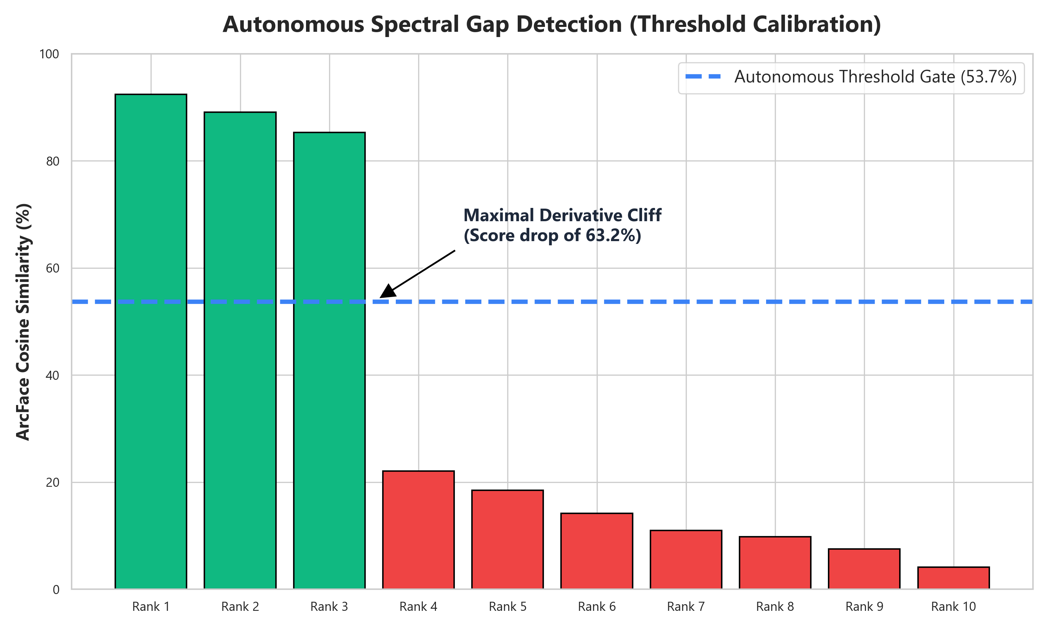
Autonomous Spectral Gap
Humans manually guessing match thresholds is a legal liability.
Algorithm calculates the Maximal Derivative Drop-Off between scores.
Autonomously locks the threshold gate without human bias.

Slide 7
The Rule of Law (Why NO GenAI?)
Generative AI (GFPGAN) hallucinates fake pixels to sharpen blurry faces.
Defense attorneys will successfully argue the evidence is manipulated.
ClearSight strictly computes against authentic, unmanipulated pixels.
Proves we don't need AI enhancements to confidently catch suspects.

Slide 8
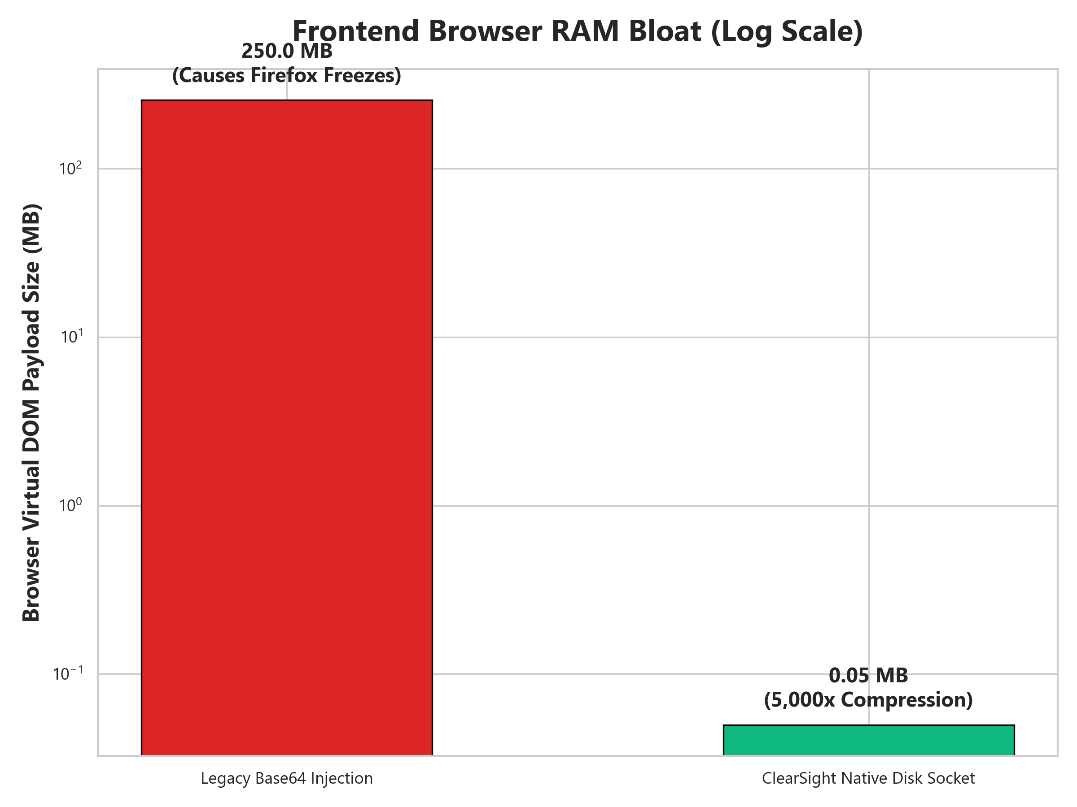
Zero-Lag Courtroom UI & Video Triage
Native Disk Sockets: Shrinks payload to 0.05MB, stopping browser freezes.
Top-4 Split Strategy: Deep learning models occasionally lose tracking IDs.
We present up to 4 top candidate videos instead of just 1.
Allows human observers to visually verify the suspect from the best 4 angles!

Slide 9
Conclusion & Future Scope
Delivered a turnkey digital forensic tool integrating tracking, biometrics, and autonomous math.
Overcame hardware VRAM limits (GTX 1650) via 'Strategic Biometric Stride'.
Future: Scale to Smart-City RTSP networks.
Future: FAISS Vector Databases for nationwide indexing in <15ms.

Slide 10
Key References
[1] Jocher, G., et al. (2023). Ultralytics YOLOv8 Architecture.
[2] Zhang, Y., et al. (2022). ByteTrack: Multi-Object Tracking by Associating Every Detection Box.
[3] Deng, J., et al. (2019). ArcFace: Additive Angular Margin Loss for Deep Face Recognition.
[4] Deng, J., et al. (2020). RetinaFace: Single-Stage Dense Face Localization in the Wild.

Slide 11
Thank You

