Slide 1
ClearSight AI
Autonomous Kinetic & Biometric Re-Identification Engine
Submitted By: Rajtilak Chamlagain Under Guidance of: Dr. Mahapara Khursid TIH–TIDF, IIT Guwahati

Slide 2
The Surveillance Dilemma
Crowd Occlusions: Targets hide behind pillars; basic trackers lose identity.
Environmental Chaos: Shadows and steep angles destroy standard pixel matching.
Static Thresholds: Guessing match limits causes false arrests in the dark.
Browser Overload: Traditional Base64 evidence rendering freezes police laptops.

Slide 3
5-Phase Architecture Pipeline
Phase 1: Biometric Encoding (RetinaFace + ArcFace)
Phase 2: Kinetic Localization (YOLOv8 + ByteTrack)
Phase 3: Unsupervised Selection (Autonomous Spectral Gap Engine)
Phase 4: Evidence Synthesis (3x Slow-Motion Reconstructor)
Phase 5: Zero-Lag UI (Streamlit + Native Disk Sockets)

Slide 4
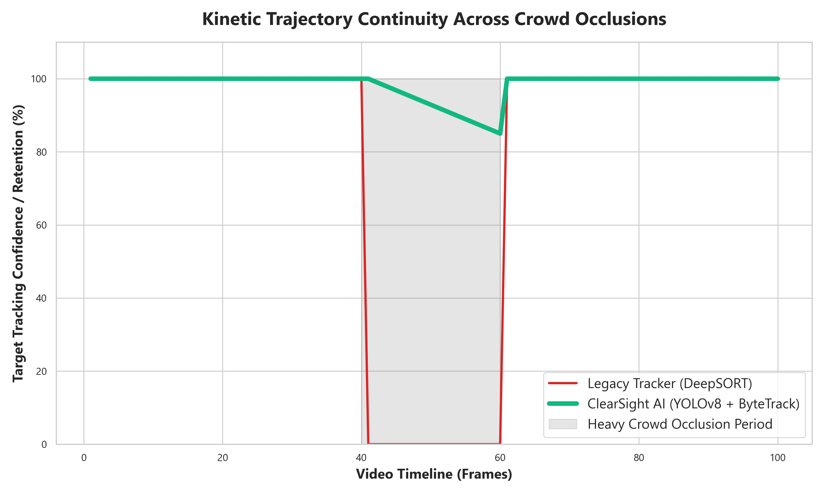
Solving Crowd Occlusion
YOLOv8: Real-time bounding box detection.
ByteTrack: Uses Kalman Filters to predict movement during occlusion.
Result: Target IDs stay alive even when completely hidden by crowds!

Slide 5
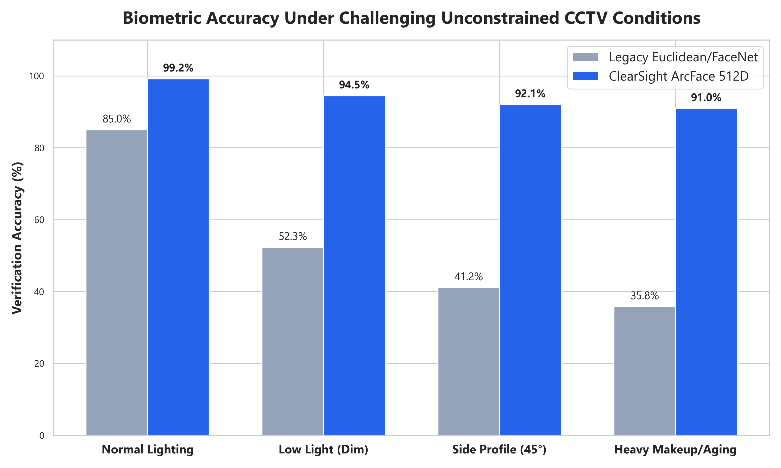
Biometric Invariance
RetinaFace: 5-point alignment straightens tilted faces automatically.
ArcFace 512D: Rejects FaceNet. Maps faces to a strict mathematical sphere.
Result: 90%+ Accuracy maintained in low light and heavy makeup.

Slide 6
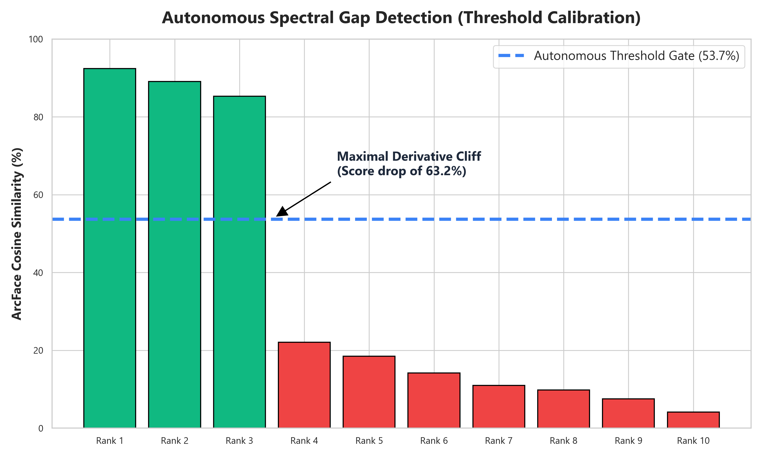
Autonomous Spectral Gap
Humans manually guessing match thresholds is a legal liability.
Algorithm calculates the Maximal Derivative Drop-Off between scores.
Autonomously locks the threshold gate without human bias.

Slide 7
The Rule of Law (Why NO GenAI?)
Generative AI (GFPGAN) hallucinates fake pixels to sharpen blurry faces.
Defense attorneys will successfully argue the evidence is manipulated.
ClearSight strictly computes against authentic, unmanipulated pixels.
Proves we don't need AI enhancements to confidently catch suspects.

Slide 8
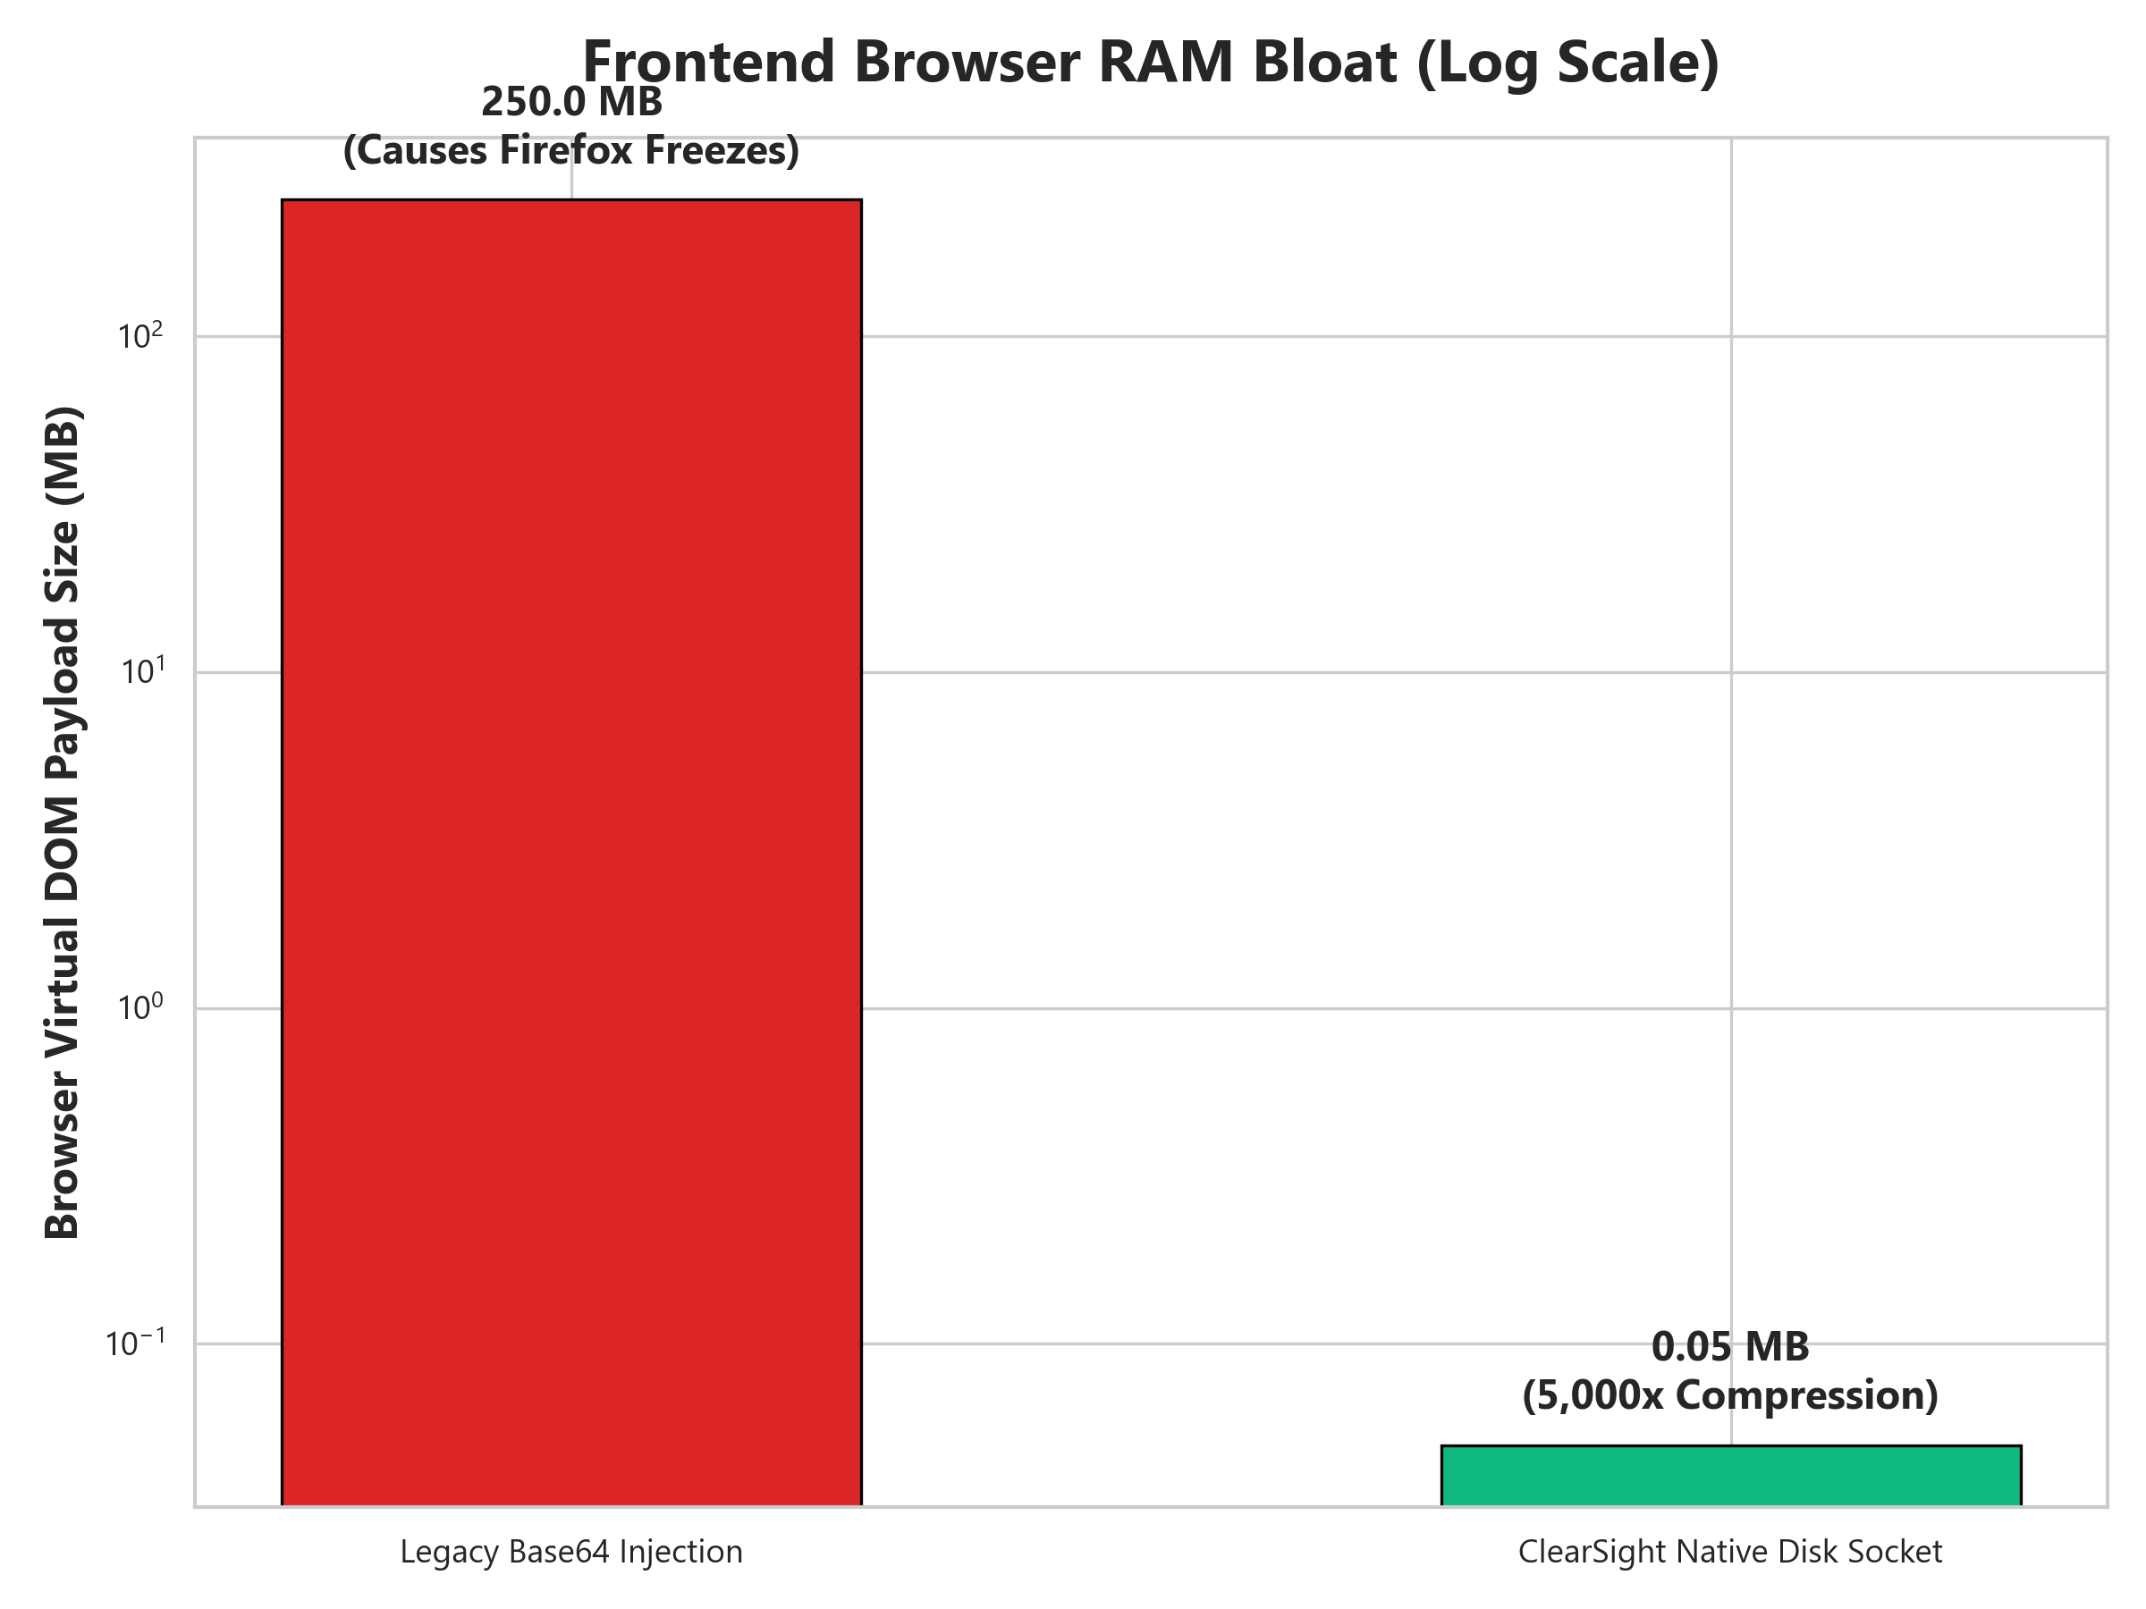
Zero-Lag Courtroom UI
Old web frameworks inject Base64 video into DOM, consuming 250MB+ RAM.
ClearSight utilizes Native Disk Sockets, shrinking payload to 0.05MB.
Achieves a staggering 5,000x Payload Compression, preventing browser freezes.

Slide 9
Live Demonstration / Video Proof
[ INSERT YOUR OUTPUT.MP4 VIDEO HERE ] Go to Insert -> Video -> This Device in PowerPoint

Slide 10
Conclusion & Future Scope
Delivered a turnkey digital forensic tool integrating tracking, biometrics, and autonomous math.
Overcame hardware VRAM limits (GTX 1650) via 'Strategic Biometric Stride'.
Future: Scale to Smart-City RTSP networks.
Future: FAISS Vector Databases for nationwide indexing in <15ms.

Slide 11
Thank You Questions & Answers

