Slide 1

HOLY MARY INSTITUTE OF TECHNOLOGY & SCIENCE (Approved by AICTE, New Delhi, Affiliated to JNTU, Hyderabad)
BOGARAM(V),KEESARA(M),MEDCHAL DISTRICT-501301
2021-2022
DEPARTMENT OF COMPUTER SCIENCE ENGINEERING
AUTOMATION OF RECONNAISSANCE: AN OPEN SOURCE TOOL FOR PENTESTING
By:
N.Aryan Raj (18C91A0561)
P.Sowmya (18C91A069)
P.Rakesh Reddy (18C91A0575)
Under the guidance of
Dr. B. NARSIMHA M.Tech, Ph.D

Slide 2
ABSTRACT
The need for Recon automation is rapidly increasing as ethical hackers are being lazy in performing every little check manually. So as to make the Recon process (Info gathering phase) of penetration testing easy, fast and accurate, a Recon framework with highly sophisticated tools written in languages like bash, go and python needs to be developed and made open source to everyone. Manually doing this task can be very intimidating since a lot of time and efforts are needed in accomplishing this task. So, automation of this task can be very handy to the penetration testers and saves a lot of time as they can focus on other tasks of the further tasks of a penetration test. So, our project is automation to the tedious task of information gathering. This Recon Framework just takes the main top-level domain of the organization as the input, does the recon and stores the result in an organized manner in the corresponding directories. So, all a user needs to do is enter the top-level domain name of the organization on which he/she wants to perform penetration testing.

Slide 3
INTRODUCTION
Reconnaissance, also known as information gathering, is classified as active and passive reconnaissance. Active reconnaissance includes interacting directly with the target. It is important to note that during this process, the target may record IP address and log activity. Passive reconnaissance makes use of the vast amount of information available on the web. When one is conducting passive reconnaissance, one is not interacting directly with the target and as such, the target has no way of knowing, recording, or logging activity. The reconnaissance is aimed at collecting as much information as possible on a target.
The objective of this project to collect as much information as possible. Collecting information and knowing deeply about the target system is known as “Reconnaissance”. This data is the main street for the programmer to hack the target system. It involves Foot printing, Enumeration, and Scanning.

Slide 4
EXISTED SYSTEM :
The existing models available today have very limited features and are not compatible with the modern web development frameworks like MEAN and MERN stacks, Django, Flask or Spring Framework. As these new technologies and tech stacks came into limelight, there are many things which are overlooked and often much vulnerability are missed when tried with the existing recon frameworks. Some of the important things missed by the existing recon frameworks are:
JavaScript file enumeration and analysis.
Automation of Google Dorking.
Automation of some known OWASP vulnerabilities like XSS, SSRF etc.
Absence of project discovery’s nuclei at the time of writing old recon frameworks.
Automation of fuzzing for endpoints on the target.

Slide 5
DISADVANTAGES
Our machine must consist of internet connection otherwise we can not be able to use our machine.
The user must know the basic knowledge of using linux system and as well as basic linux commands.
Cases of Success and Remediation.
Large Number of Unhelpful Alerts.
Attracting Less or Wrong Talent.
Less Focus on OS Vulnerabilities.
Time Limit Issues.
Public Reputation At Stake
Low Possibility of Success and Income.

Slide 6
PROPOSED SYSTEM :
Keeping in view the existing models, this proposed model is an attempt to overcome the limitations of the existing models and having updated tools and techniques which are mostly based on fingerprints of various endpoints of the target web application.
The speed of the recon process is grater as the tools are written in Go and Python.
JavaScript enumeration is made simple than ever before.
The proposed system is here we introduce a new machine(tool) that it will automate the recon(information gathering) process very easily. Here our tool is the combination of port scanning tool, dns scanning tool, subdomain finding tool,screenshotting tool, spidering tool and httpx.

Slide 7
ADVANTAGES
Saves a lot of time.
You know what exactly to look for.
You can easily automate your recon workflow.
Less of a chance to submit Out-of-Scope Issues.
Just like other security methodologies, it enables you to perform better Recon.
Increased Vulnerability Detection.
Reduced Cost.
Realistic Threat Simulation.

Slide 8
SOFTWARE REQUIREMENTS :
Operating System: LINUX, UNIX.
Browser: Google Chrome, Mozilla Firefox.
Frontend: Terminal, Bash Script, GO Language.
Backend: Python(pip).
HARDWARE REQUIREMENTS :
System : Intel i3Core.5th gen
RAM : 4 GB
Storage : 500 GB
CPU : 2 GHz or faster
Architecture : 32-bit or 64-bit

Slide 9
HARDWARE REQUIREMENTS :
RAM up to 4GB.
Hard disk up to 100GB
Pentium IV Processor.
Input device: Keyboard, Mouse.
Output device: Monitor.

Slide 10
IMPLEMENTATION
The implementation of the project is done with the help of GO language. Subfinder is a subdomain discovery tool that discovers valid subdomains for websites by using passive online sources. It has a simple modular architecture and is optimized for speed. subfinder is built for doing one thing only - passive subdomain enumeration, and it does that very well.
Httpx is a fast and multi-purpose HTTP toolkit allow to run multiple probers using library, it is designed to maintain the result reliability with increased threads.
This will run the tool against all the hosts and subdomains in hosts.txt and returns URLs running HTTP webserver.

Slide 11
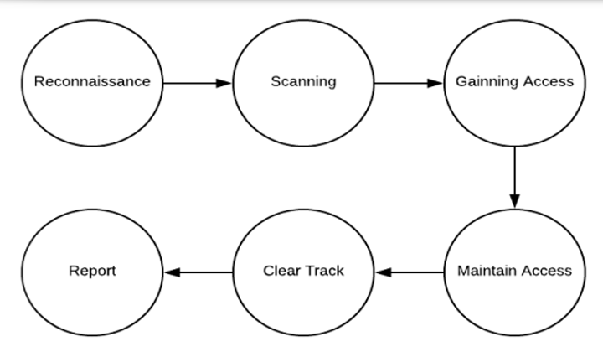
Structure of reconnaissance

Slide 12
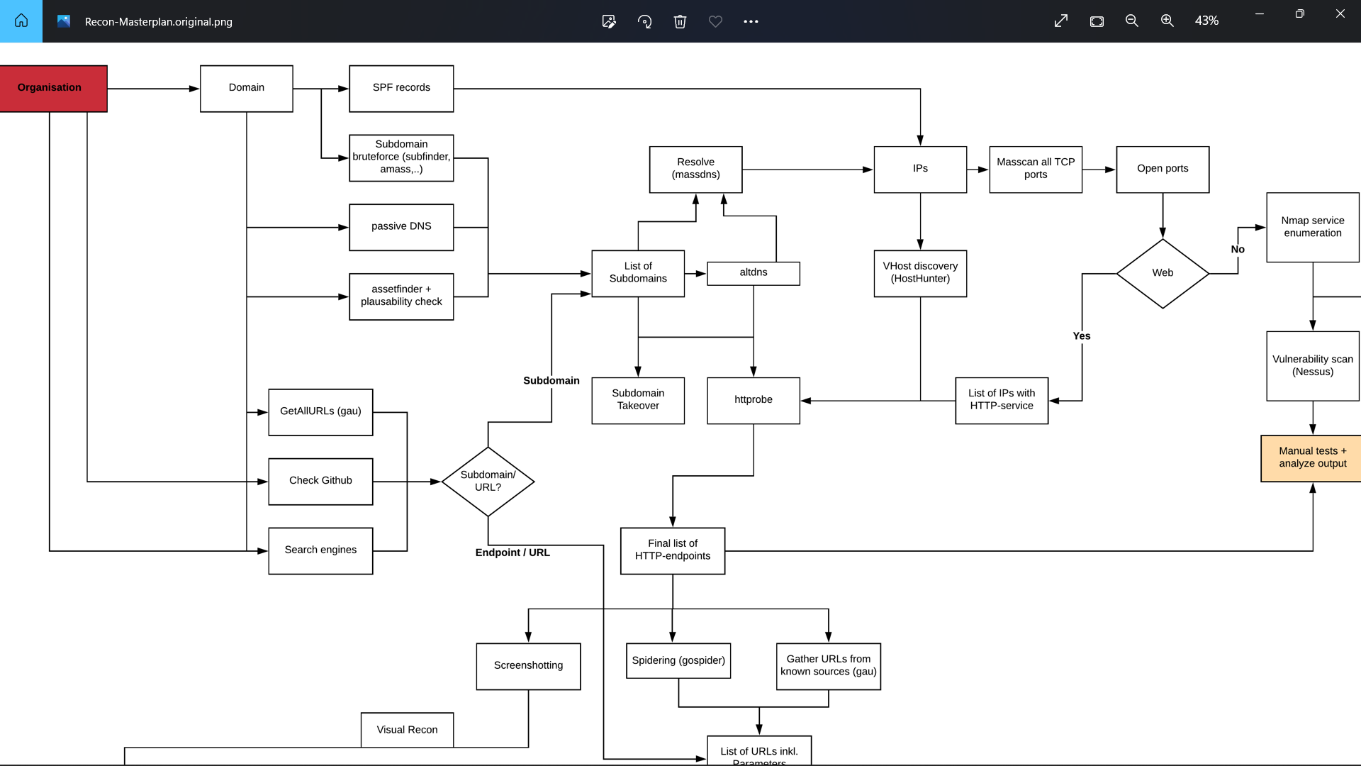
Flow chart for recon method

Slide 13
SYSTEM TESTING
The system provides secured and accurate record of data about gathering the information about an organization.
The main pillar of reliability of the system is the backup of the database, which is continuously maintained and updated to reflect the most recent changes.
The overall stability of the system depends on the stability of the application and the databases.

Slide 14
CONCLUSION
Reconnaissance is significant aspect of any hacking activity. Any data that a programmer can find out about the target can help in recognizable proof of potential assault vectors and focusing on endeavors to possible weaknesses. By utilizing a blend of latent and dynamic observation devices and producers, a programmer can augment the data gathered while limiting the likelihood of discovery. We will be looking to enumerate the infrastructure devices, networks, and systems in place in the environment, assess the ports open and services operating on those ports, fingerprint operating systems.

Slide 15
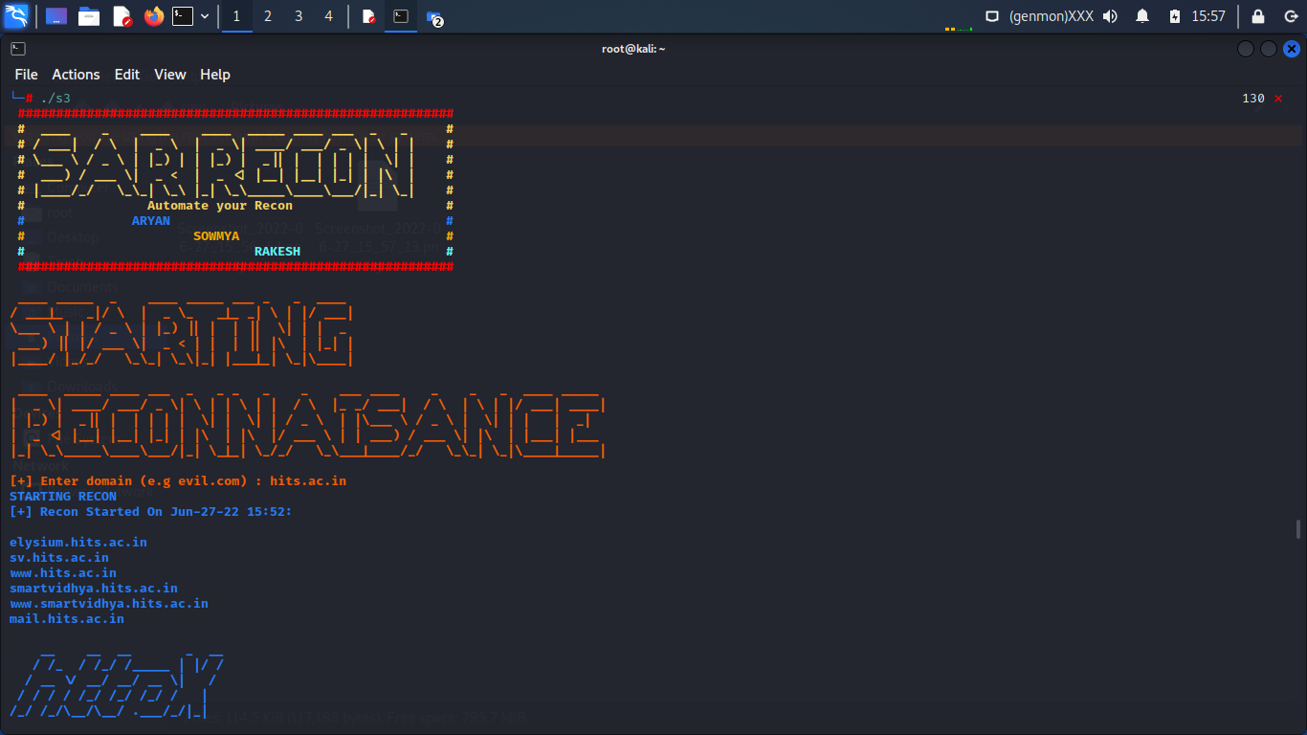
RESULT

Slide 16
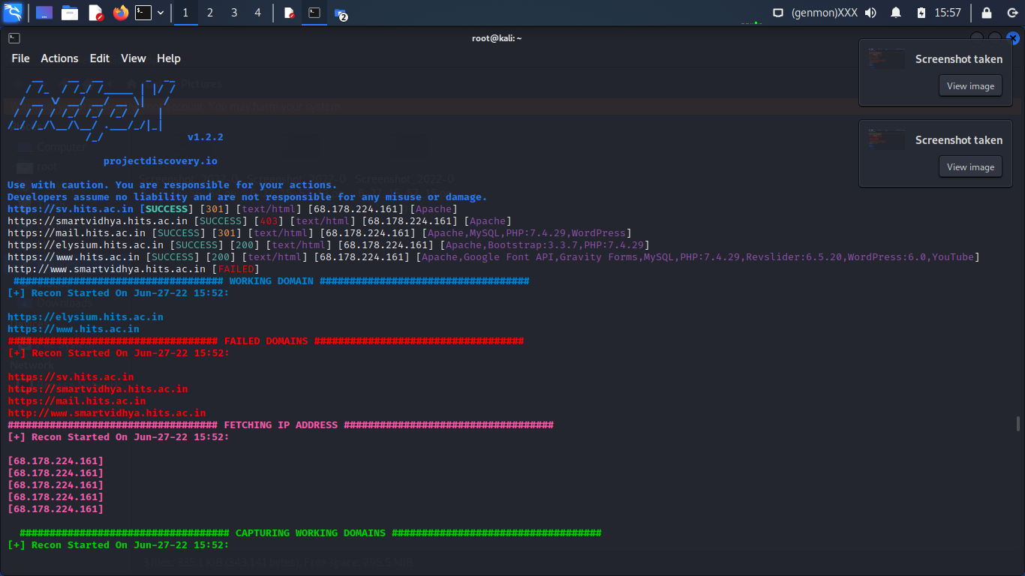

Slide 17
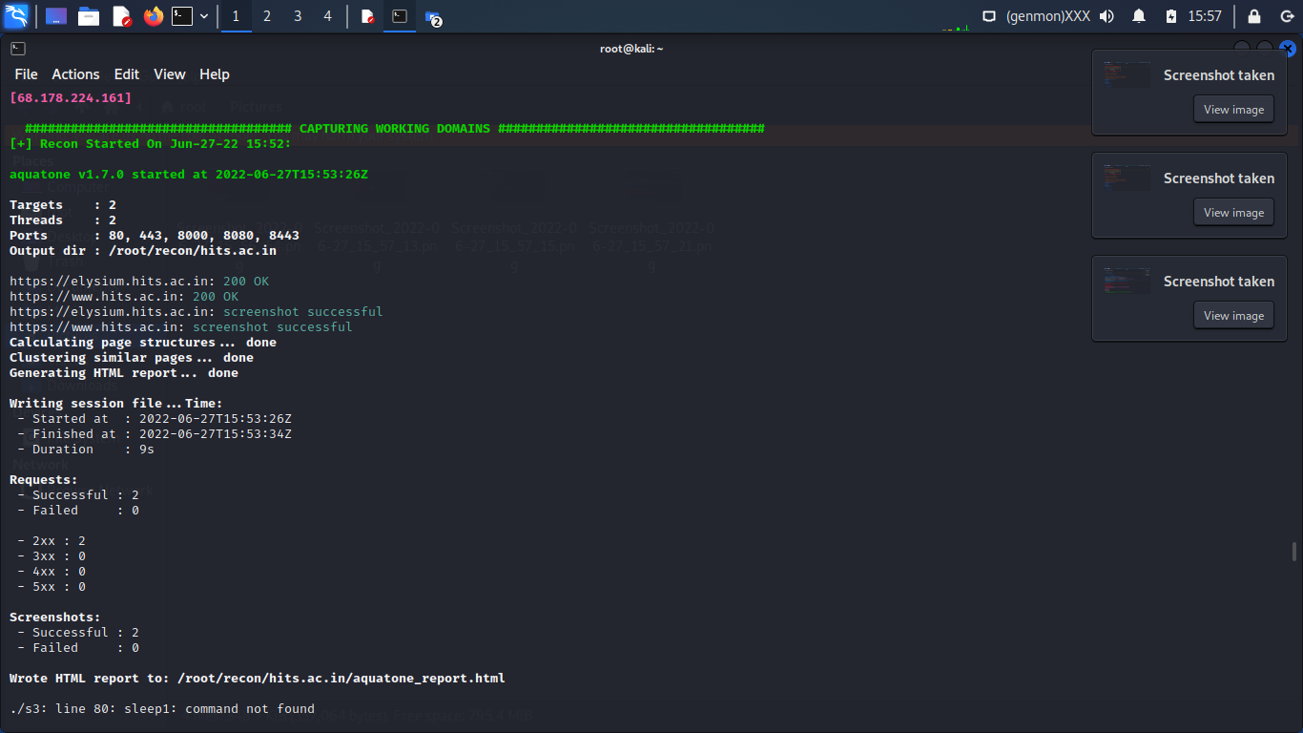

Slide 18
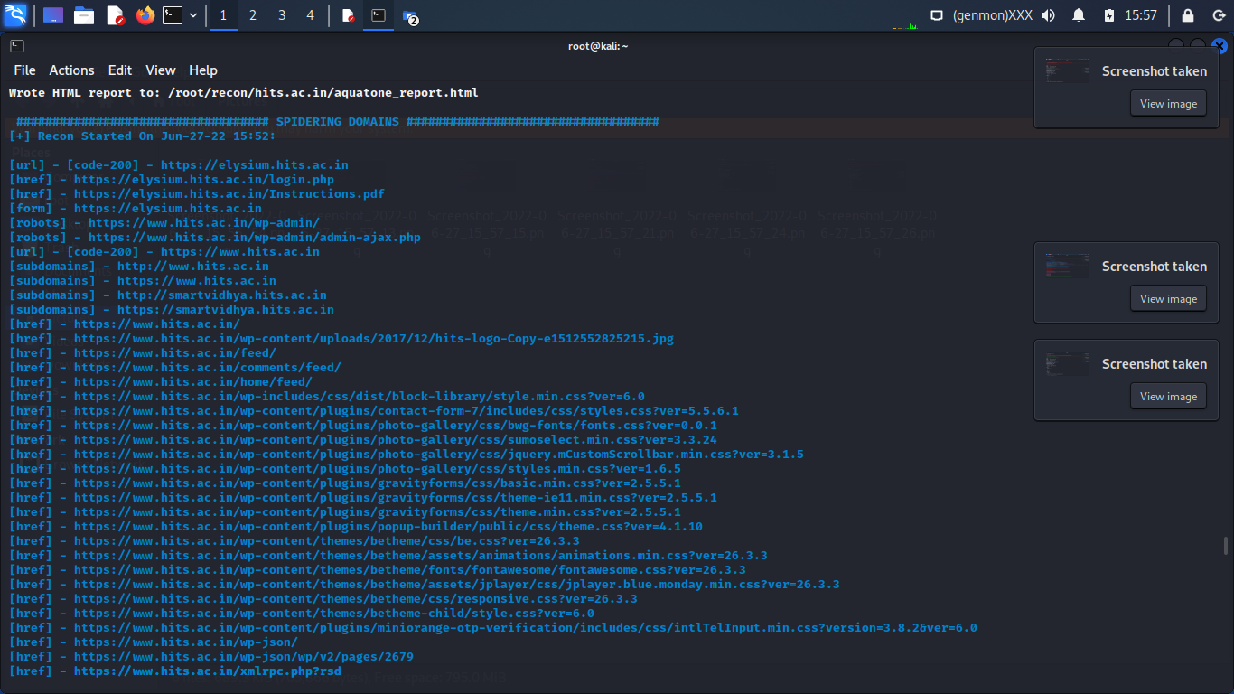

Slide 19
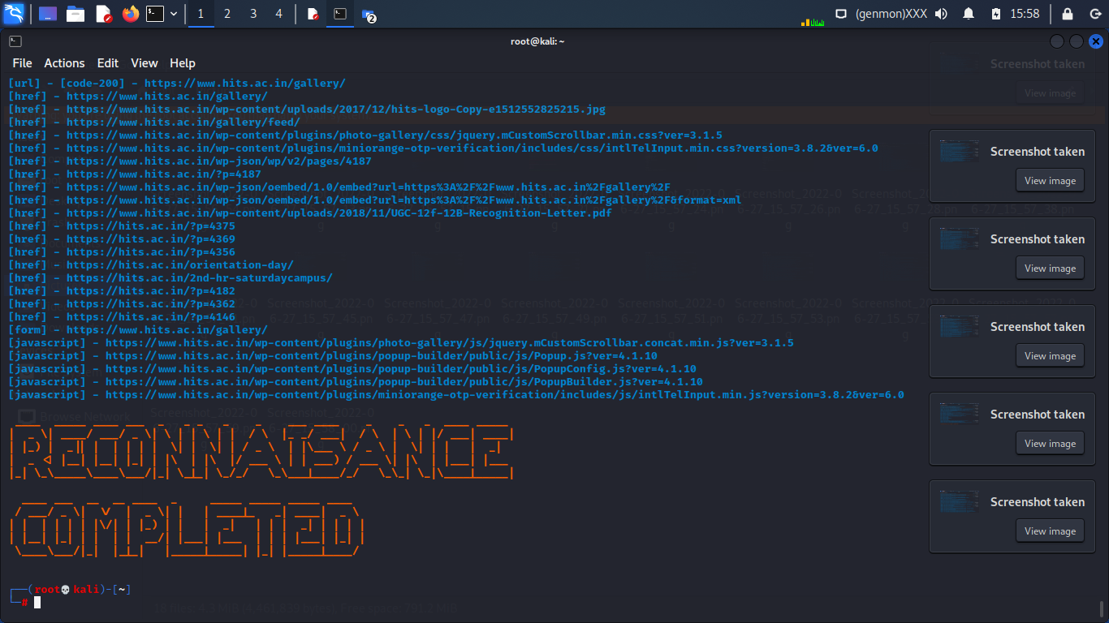

Slide 20


