Slide 1
covid19_dataAnalysis
File created on: 08/19/2021 22:30:59

Slide 2
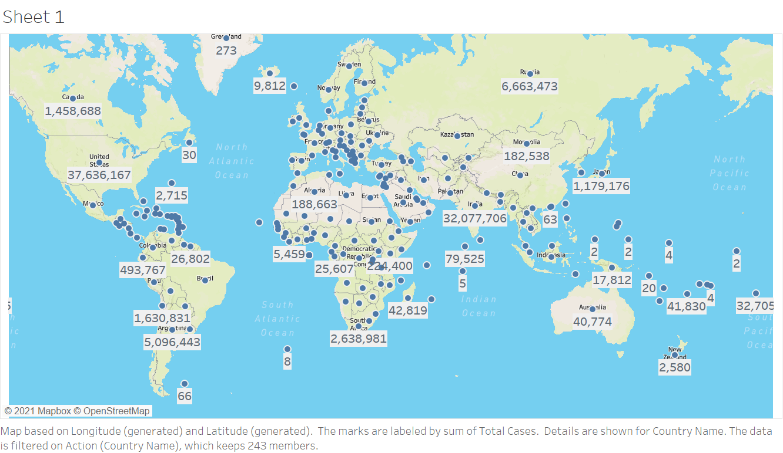

Slide 3
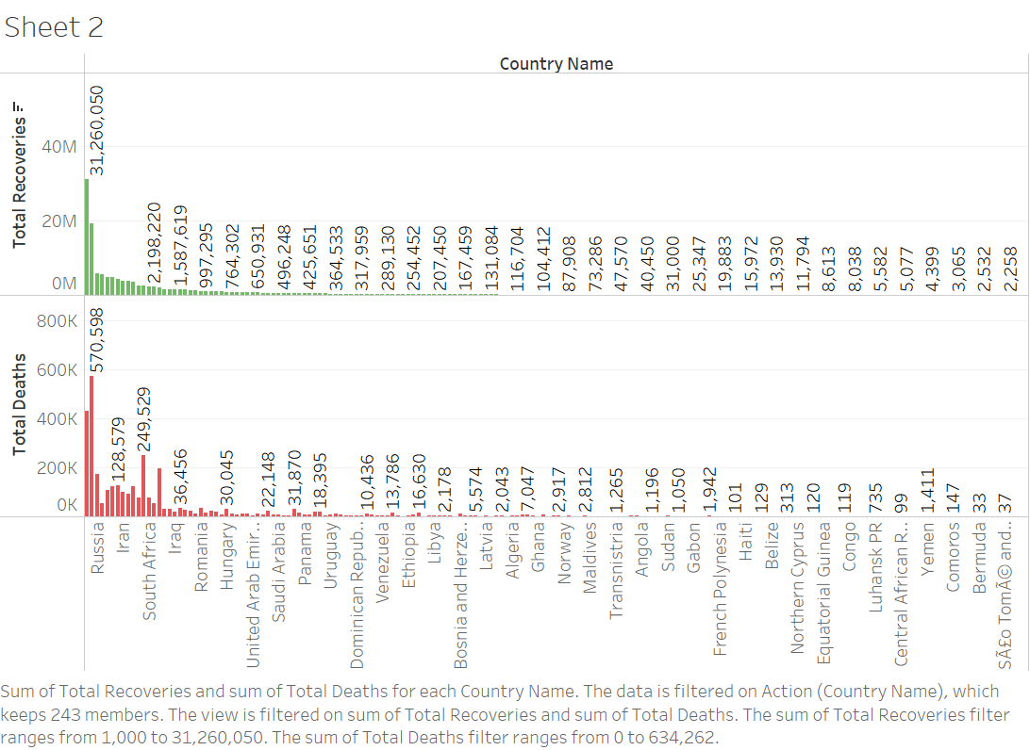

Slide 4
