Slide 1
Analytics and Machine Learning
CII 2-DAY WORKSHOP

Slide 2
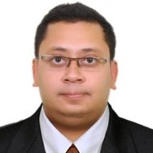
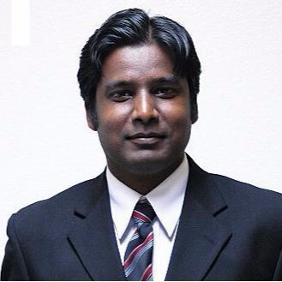
Know Your Speakers
 | Name: Dr. Anish Roychowdhury Designation: Data Scientist Organization: HP Inc. Educational Background: B.Tech (NIT-Durgapur), MS (Louisiana State University, USA), PhD (IISc Bangalore) Work Experience: 8+ years Interests: Data Science/Machine Learning/ Logistics / Sensor Analytics | Invited Lectures (Pro Bono) One Day Workshops Two Day Workshops Corporate Trainings Syllabus Design AI Seminars Conference Planning Data Science Consulting Industry-Academia Collaborations AI community building AI article/blog writing AI Evangelism Feel free to collect our business cards and reach out to us.
 | Name: Dr. Jacob Minz Designation: R&D Manager Organization: Synopsys Inc. Educational Background: B.Tech in CSE (IIT, Kharagpur) , MS & PhD (Georgia Institute of Technology, Atlanta,USA) Work Experience: 11+ Years Interests: Data Science/Big Data/Machine Learning/Deep Learning/AI

Slide 3
Prerequisites
Mathematical Background Resources
Linear Algebra
https://www.khanacademy.org/math/linear-algebra
Linear Regression
https://onlinecourses.science.psu.edu/stat501/node/250
Programming and Data Base Resources
SQL
https://www.youtube.com/watch?v=ZNObiptSMSI&list=PL08903FB7ACA1C2FB
Computational Tool Resources
R Ver 3.4.1 or higher
https://cran.r-project.org/bin/windows/base/
R Studio 1.10.153 or later
https://www.rstudio.com/products/rstudio/download/
Specific Packages to be installed in R
install.packages("dplyr")
install.packages("sqldf")
install.packages("corrplot")
install.packages("ggplot2")
install.packages("class")
install.packages("gmodels")
install.packages("data.table")
install.packages(“caret”)
install.packages(“glmnet”)
install.packages(“ROCR”)
install.packages(“nnet”)
install.packages(“MASS”)

