Slide 1
Introduction to Analytics Day 1 : R and Analytics Workshop CII

Slide 2
Contents
Why Analytics
What Constitutes Analytics
Why we must learn Analytics
How Analytics Helps With Data
Questions Answered
Road Map

Slide 3

When just the math doesn’t cut the ice…

Slide 4
Analytics : Introduction
Definition:
Analytics is the discovery, interpretation, and communication of meaningful patterns in data. Especially valuable in areas rich with recorded information, analytics relies on the simultaneous application of statistics, computer programming and operations research to quantify performance.
Analytics
predictive
Market Segmentation
Retail
Credit Risk
Promotion modelling
Fraud Analytics
Sentiment
Analysis
SKU Association
prescriptive

Slide 5
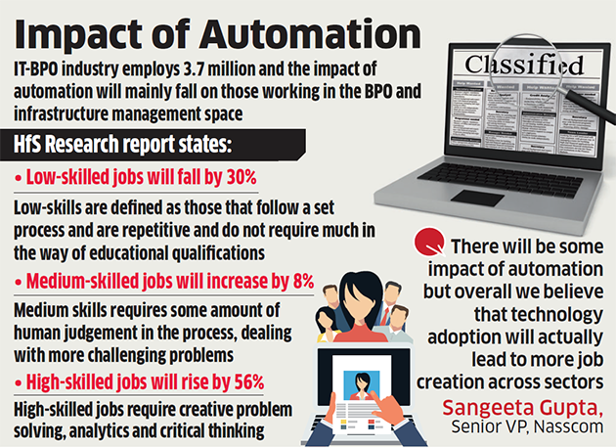
Impact of Automation
Opportunity or Disaster?

Slide 6
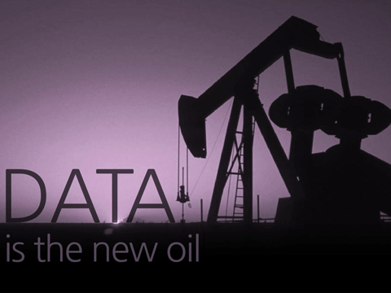
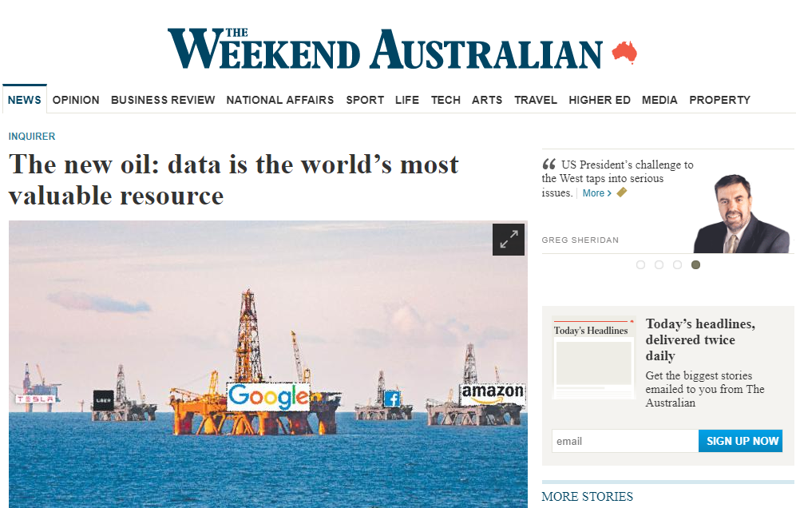
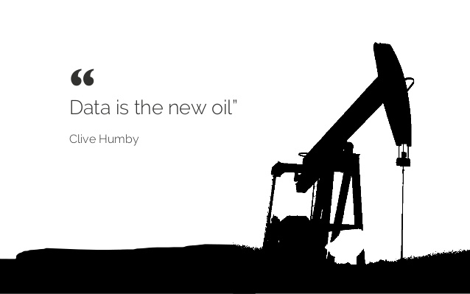
Data is the new oil

Slide 7
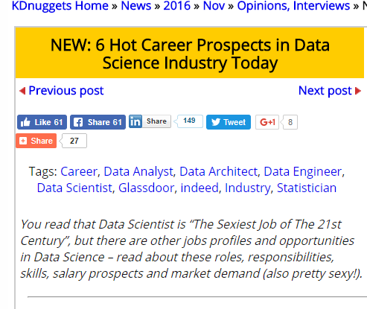
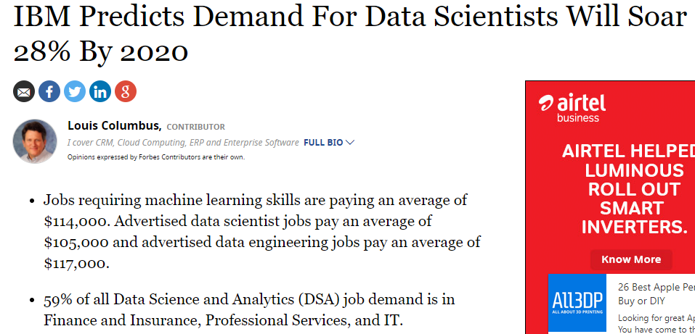
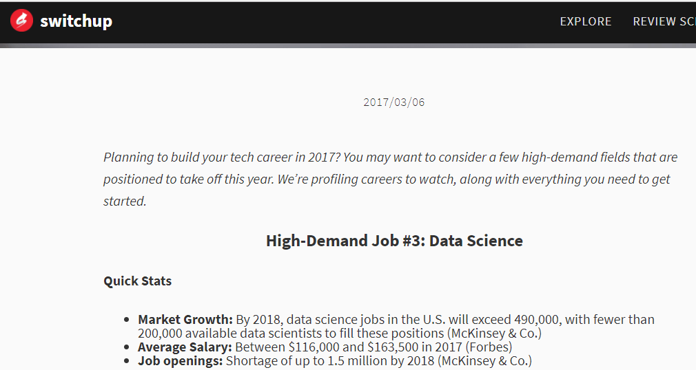
Data Science Job opportunities

Slide 8
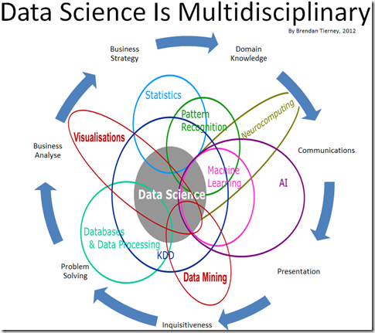
Skills needed by a Data Scientist

Slide 9
Analytics Intro: How can analytics help with data ?
Valuable Insights
Analytics
BI Reports
Data
Predictions

Slide 10
Analytics Intro: Questions answered!
Past
Present
Future
What happened?
(Reporting)
What is happening now?
(Alerts)
What will happen?
(Extrapolation)
Information
How and why did it happen?
(Modelling, experimental design)
What’s the next best action?
(Recommendation)
What’s the best/worst that can happen?
(Prediction, optimization, simulation)
Insight

Slide 11
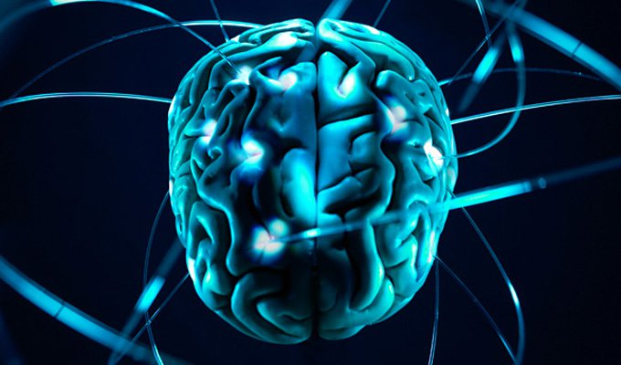
Analytics Intro: The Data Science Road map
EDA
BI reporting
Predictive Analytics
Forecasting
Machine Learning
AI
D
E
E
P
L
E
A
R
N
I
N
G

Slide 12
Thank You

