Slide 1
Introduction to R
R Module – 2
Data I/O, Functions and Loops
CII

Slide 2
Agenda
Data I/O File Read / Write
Functions
Misc. Functions
User Defined Functions
Loops

Slide 3
File I/O – Read and Write csv data
Read the data file into a data frame
Input
Extract and separate relevant portions
Computation Block
Data Processing
Populate Output Structure
Write Output File
Output

Slide 4
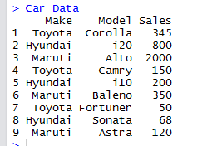
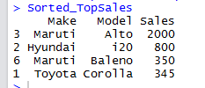
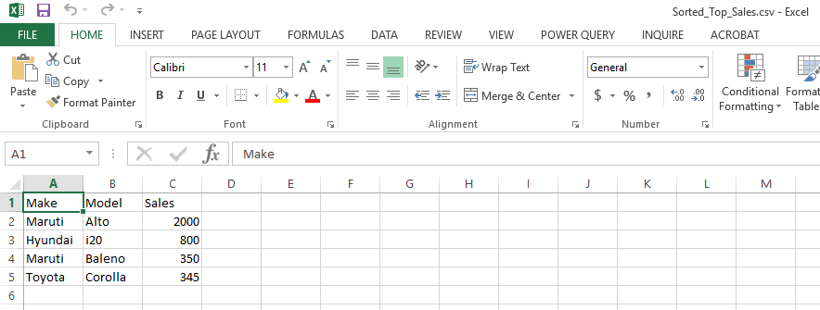
Data I/O – File Read Write contd.
Objective : Read Car Sales file and report car model and make for those models having sale value > 300,
List by highest sales first
# Read the Car Sales csv file
Car_Data<-read.csv(file="CarSales.csv")
# Display car sales data
CarData
# Subset- Choose car Make and Model, Sales for sales > 300
TopSales <- subset(CarData,Sales>300)
# and list in Descending Order
Sorted_TopSales <- TopSales[order(-TopSales$Sales),]
# Display Sorted Data
Sorted_TopSales
# Write output file
write.table(Sorted_TopSales,file="Sorted_Top_Sales.csv",sep=",",
row.names=FALSE)

Slide 5
Misc. Functions
Concatenation
Conditional Function
# Concatenate two characters
paste("a","b")
# Explicit separators used
paste("Hello","World", sep="_")
# Concatenate two strings
String1<-c("hello","world")
paste(String1)
# Concatenate as single string
paste(String1,collapse=" ")
# Concatenate without spaces
paste(String1,collapse="")
# Create a vector of 5 numbers
Vec1<-c(15,2,32,45,50)
# Return 1 if value is 2 return 0 otherwise
ifelse(Vec1==2,1,0)
paste("a","b")
[1] "a b"
ifelse(Vec1==2,1,0)
[1] 0 1 0 0 0
paste("Hello","World",sep="_")
[1] "Hello_World"
# Check for odd and even
TestVec = c(5,9,2,3)
ResultVec <- ifelse(TestVec %% 2 == 0,"even","odd")
# Dispay Result Vector
ResultVec
String1<-c("hello","world")
> paste(String1)
[1] "hello" "world"
paste(String1,collapse=" ")
[1] "hello world"
ResultVec
[1] "odd" "odd" "even" "odd”
paste(String1,collapse="")
[1] "helloworld"

Slide 6
Misc. Functions contd.
Null Handling
# Create a vector with NULL
Vec1 <-c(1,2,3,NA,4,5,NA,NA)
# Check for NULL
is.na(Vec1)
# Copy non Null values to another vector
No_Null_Vec <- Vec1[!is.na(Vec1)]
# Display No Null Vec
No_Null_Vec
# Replace Null with zeros in the original Vector
Vec1[is.na(Vec1)] <-0
#Display after replace
Vec1
is.na(Vec1)
[1] FALSE FALSE FALSE TRUE FALSE FALSE TRUE TRUE
No_Null_Vec
[1] 1 2 3 4 5
Vec1
[1] 1 2 3 0 4 5 0 0

Slide 7
Misc. Functions contd.
Merging
# Create Database With same col name for the Key Column
Cust_Data <- data.frame(Cust_ID= c(1,2,3,4,5), Name = c("Vinod","Ramesh","Ashish","Venkat","Raj"))
Sales_Data <- data.frame(Cust_Number = c(1,2,3,4,5), Purchase = c(450,60,75,83,92))
# Merge Customer and sales Data
Merged_Data <- merge(Cust_Data, Sales_Data, by.Cust_Data = "Cust_ID",by.Sales_Data="Cust_Number")
# Display Merged Data
Merged_Data
Cust_ID Name
1 1 Vinod
2 2 Ramesh
3 3 Ashish
4 4 Venkat
5 5 Raj
Cust_Number Purchase
1 1 450
2 2 60
3 3 75
4 83
5 92
Merged_Data
Cust_ID Name Purchase
1 1 Vinod 450
2 2 Ramesh 60
3 3 Ashish 75
4 4 Venkat 83
5 5 Raj 92

Slide 8
Misc. Functions contd.
How many males ?
Tabulation
Frequency table like information
# Create Gender Vector
Gender<-c("male","male","female","male","female")
# Create Marital Status Vector
Mstatus<-c("Married","Single","Married","Single","Married")
# One way tabulation
table(Gender)
# Two way tabulation
table(Gender,Mstatus)
How many single males ?
table(Gender)
Gender
female male
2 3
Cross Table Information
c
table(Gender,Mstatus)
Mstatus
Gender Married Single
female 2 0
male 1 2

Slide 9
User defined functions
No Arguments No Return Value
Multiple Argument and Return Values
# Function Definition
Hello_World<-function(){
print("Hello World")
return()
}
# Function Call
Hello_World()
# Function definition
Compute_mean_std_Tot<-function(x,y){
Tot<- x + y
mu<-mean(x+y)
sigma<-sd(x+y)
return(list(mean=mu,stand_dev=sigma,Totals=Tot))
}
# Prepare Data
X<-c(1,2,3,4,5)
Y<-c(10,10,10,10,10)
# Function Call
Compute_mean_std_Tot(X,Y)
Hello_World()
[1] "Hello World“
NULL
>$mean
[1] 13
>$stand_dev
[1] 1.581139
>$Totals
[1] 11 12 13 14 15
With Arguments No Return Value
# Function Definition
Sum_Two_Nos<-function(a,b){
sum2 <- a + b
print(paste("Sum is ",sum2))
}
# Function Call
ReturnVal <-Sum_Two_Nos(5,10)
ReturnVal <-Sum_Two_Nos(5,10)
[1] "Sum is 15"

Slide 10
Loops
For loops
while loops
[1] 1
[1] 2
[1] 3
[1] 4
[1] 5
for(i in 1:5){
print(i)
}
for(j in 1:5){
j
}
# Display 'j' outside loop
j
i<-1:5
for(j in i){
print(j)
}
x<-0
while(x <5){
print( x<-x+1)
}
[1] 1
[1] 2
[1] 3
[1] 4
[1] 5
No console output
Repeat – break
y<-0
repeat{
print(y<-y+1)
if(y>5){
break
}
}
[1] 1
[1] 2
[1] 3
[1] 4
[1] 5
[1] 6
[1] 5
[1] 1
[1] 2
[1] 3
[1] 4
[1] 5

Slide 11
Thank You

