Slide 1
Introduction to R
R Module 3
Graphs and Plots
CII

Slide 2
Agenda
The Plot function in R
Scatter Plots and Linear Fits
Histograms and Pie Charts
The Box Plot
Multiple Dimension Graphs
Exporting Graphs
Module 3 Quiz

Slide 3
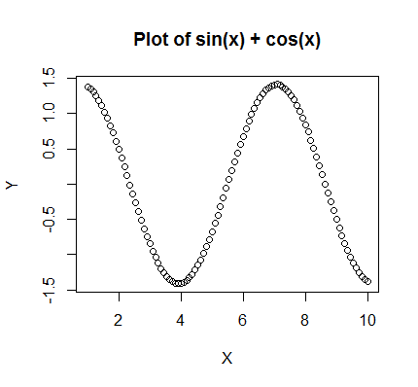
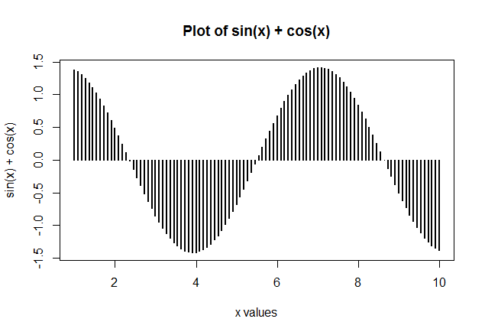
Plot Function in R
Example: Basic Plot
# Create a Vector of 100 points between 1 and 10
X <- seq(1, 10, length.out= 100)
# Create Y Values as Sin X + COS X
Y <- sin(X) + cos(X)
# Just a Basic plot
plot(X, Y, main = "Plot of sin(x) + cos(x)")
Example: A Juiced Up Version
# a Juiced up version
plot(X, Y, main = "Plot of sin(x) + cos(x)", xlab = "x values", ylab = "sin(x) + cos(x)", type = "h", lwd = 2.5)

Slide 4
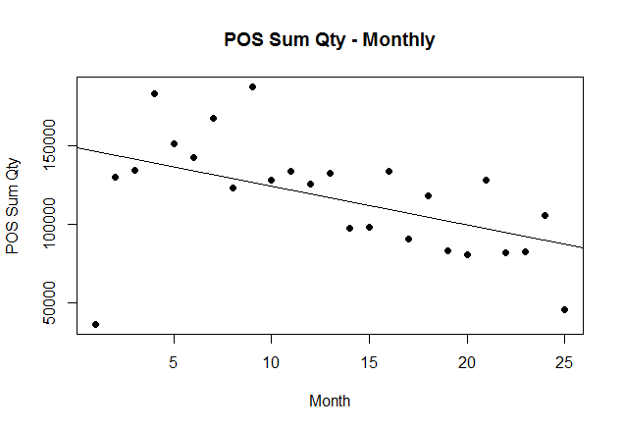
Scatter Plots and Linear Fits
Study Trends for Sell Out Qty and Sell in Qty
Scatter Plot - POS Monthly Trend
Sell Out quantity
Consider the Data File below (Part Shown Only )
# Read the data file
Data<- read.csv(file='HR_1N.csv', header=T, sep=',')
Sell In Quantity
# Get Col data
Month <- Data[,2]
POS <- Data[,3]
plot(Month, POS, main="POS Sum Qty - Monthly",
xlab="Month", ylab="POS Sum Qty", pch=19)
# Simple Regression
POS.simple.reg <- lm(POS~Month)
# Get Linear Model coeff
coeffs = coefficients(POS.simple.reg);
# Plot Regression Line
abline(POS.simple.reg)

Slide 5
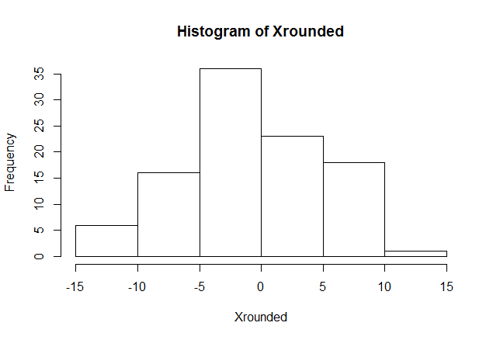
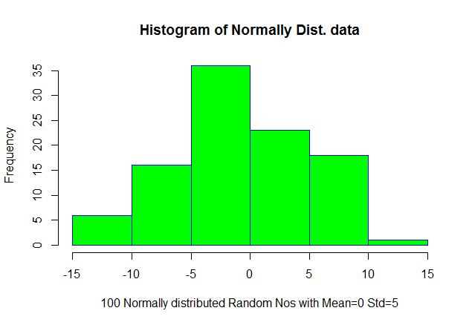
Histograms
Basic Histogram
Just the basics
# get some Normally Distributed Data with Zero Mean and Std = 5
x <- rnorm(100, mean = 0, sd = 5)
# Round Off the Data
Xrounded <- floor(x)
# Generate a Simple Histogram
hist(Xrounded)
Spicing things up a bit
hist(Xrounded,
main="Histogram of Normally Dist. data",
xlab="100 Normally distributed Random Nos with Mean=0 Std=5",
border="blue",
col="green",
breaks=5)
* Data Source: http://www.team-bhp.com/forum/motorbikes/179411-july-2016-two-wheeler-sales-figures-analysis.htm

Slide 6
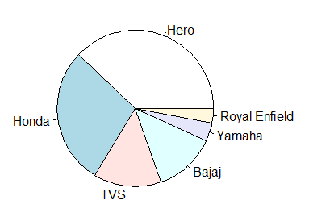
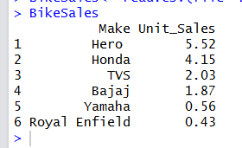
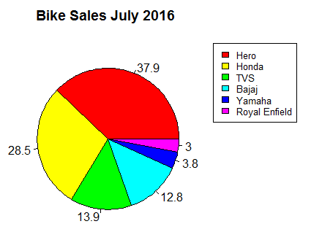
Pie Charts
A Simple Pie Chart
Consider the Data Frame “BikeSales” below *
# Simple Pie Chart
pie(BikeSales[, 2], labels = BikeSales[, 1])
Same Data Spiced Up Visuals
# Get Percentages
Xdata <- BikeSales[,2]
piepercent<- round(100*Xdata/sum(Xdata), 1)
# Plot the chart.
pie(Xdata, labels = piepercent, main = "Bike Sales July 2016 ",col = rainbow(length(Xdata)))
# Provide Legend
LegendData <- BikeSales[,1]
legend("topright", legend=LegendData, cex = 0.8,fill = rainbow(length(Xdata)))
* Data Source: http://www.team-bhp.com/forum/motorbikes/179411-july-2016-two-wheeler-sales-figures-analysis.htm

Slide 7
Box Plot
Maximum
Why would you use a box plot?
Box and whisker plots are very effective and easy to read. They summarize data from multiple sources and display the results in a single graph. Box and whisker plots allow for comparison of data from different categories for easier, more effective decision-making
Third Quartile
Median
First Quartile
Minimum

Slide 8
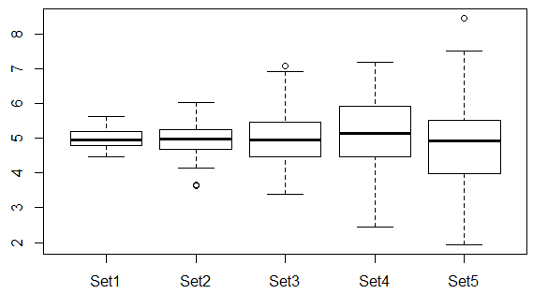
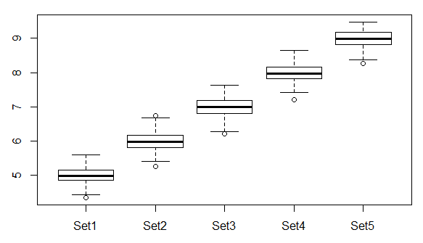
Box Plots
Box Plot for Population – 1
# Create a Population of 5 Sets with Mean = 5 and stdev increasing as 0.25, 0.5, 0.75, 1.0, 1.25
Pop1 <-data.frame(Set1=rnorm(100,mean=5,sd=0.25),
Set2=rnorm(100,mean=5,sd=0.5),
Set3=rnorm(100,mean=5,sd=0.75),
Set4=rnorm(100,mean=5,sd=1.0),
Set5=rnorm(100,mean=5,sd=1.25))
# Create a Box Plot
boxplot(Pop1)
Box Plot for Population – 2
# Create a Population of 5 Sets with Mean = 5,6,7,8, 9 and stdev = 0.25
Pop2 <-data.frame(Set1=rnorm(100,mean=5,sd=0.25),
Set2=rnorm(100,mean=6,sd=0.25),
Set3=rnorm(100,mean=7,sd=0.25),
Set4=rnorm(100,mean=8,sd=0.25),
Set5=rnorm(100,mean=9,sd=0.25))
# Create a Box Plot
boxplot(Pop2)

Slide 9
Thank You

