Slide 1
Introduction to R
R Module – 4
Data slicing and Dicing
CII

Slide 2
Agenda
Slicing Vectors and Matrices
Slicing Data Frames
Subsetting Data Frames
Important Verbs from DPLYR package
Converting between data types

Slide 3
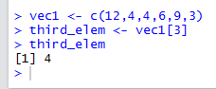
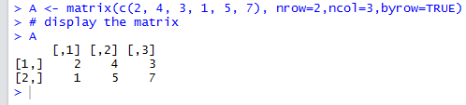
Slicing Vectors and Matrices
Example: extract the 3rd element of a given Vector
Consider the matrix
Extract a Particular Element
A23 <- A[2, 3]
Extract second row
ARow2Vec <- A[2, ]
Extract sub matrix
A2by2 <- A[1:2,1:2]

Slide 4
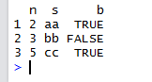
Slicing Data Frames
Consider the Data Frame below
Extract a Particular Element
df[1,2]
Extract a Particular Row ( Observation)
df[1,]
Extract a Particular Column
df[,2]

Slide 5
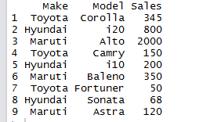
Subsetting Data Frames- The <subset> command
Consider the Data Frame “CarData” below
Business requirement
List All Car Make and Models Which had sales Above 300 units in Descending Order ( Fast Runner at the Top of the List )
Solution
TopSales <- subset(CarData,Sales>300)
Sorted_TopSales <- TopSales[order(-TopSales$Sales),]
# Display Sorted Data
Sorted_TopSales
Output
Make Model Sales
3 Maruti Alto 2000
2 Hyundai i20 800
6 Maruti Baleno 350
1 Toyota Corolla 345
>

Slide 6
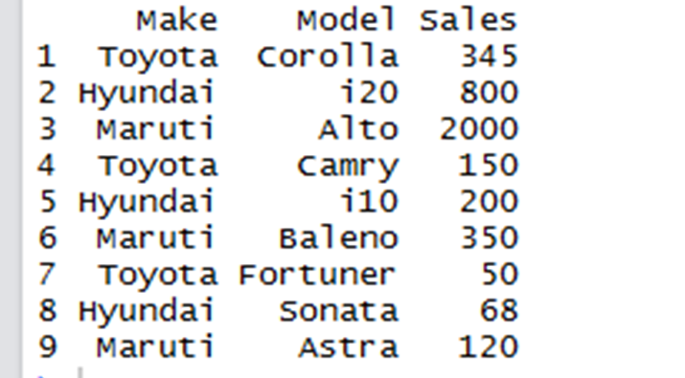
Subsetting Data Frames – The <which> command
Cardata
# Get Index/ Row positions meeting any particular criteria
IDX_POS <- which(CarData$Sales>300)
# Get the Subset using Index positions
CarSale_GT_300 <- CarData[IDX_POS,]
#Display Subset
CarSale_GT_300
# Get Rows for Sales LT 300
CarSale_LT_300 <- CarData[-IDX_POS,]
# Display Subset
CarSale_LT_300
> CarSale_GT_300
Make Model Sales
1 Toyota Corolla 345
2 Hyundai i20 800
3 Maruti Alto 2000
6 Maruti Baleno 350
> CarSale_LT_300
Make Model Sales
4 Toyota Camry 150
5 Hyundai i10 200
7 Toyota Fortuner 50
8 Hyundai Sonata 68
9 Maruti Astra 120
Which car model had the max sales figures ?
> Max_Sale_Model <- CarData$Model[which.max(CarData$Sales)]
> Max_Sale_Model
[1] Alto

Slide 7
DPLYR Package important verbs
Cardata
<select> – Columns
<filter – Rows >
# Selecting models column
from CarData
Car_Models <- select(CarData,Model)
# Display Models Column
Car_Models
# Select rows which
have sales > 500
Sales_GT_500 <- filter(CarData, Sales > 500)
#Display
Sales_GT_500
Car_Models <- select(CarData,Model)
> Car_Models
Model
1 Corolla
2 i20
3 Alto
4 Camry
5 i10
6 Baleno
7 Fortuner
8 Sonata
9 Astra
> Sales_GT_500
Make Model Sales
1 Hyundai i20 800
2 Maruti Alto 2000

Slide 8
DPLYR Package important verbs contd.
<arrange>
<mutate>
# Create new column - Perc_Tot_Sales
CarData<-mutate(CarData,Perc_Tot_Sales = (100*Sales)/(sum(Sales)))
# Display
CarData
# Sort CarData in descending order of highest sales
Sorted_CarData <- arrange(CarData,desc(Sales))
# Display
Sorted_CarData
> Sorted_CarData
Make Model Sales
1 Maruti Alto 2000
2 Hyundai i20 800
3 Maruti Baleno 350
4 Toyota Corolla 345
5 Hyundai i10 200
6 Toyota Camry 150
7 Maruti Astra 120
8 Hyundai Sonata 68
9 Toyota Fortuner 50
CarData
Make Model Sales Perc_Tot_Sales
1 Toyota Corolla 345 8.449669
2 Hyundai i20 800 19.593436
3 Maruti Alto 2000 48.983590
4 Toyota Camry 150 3.673769
5 Hyundai i10 200 4.898359
6 Maruti Baleno 350 8.572128
7 Toyota Fortuner 50 1.224590
8 Hyundai Sonata 68 1.665442
9 Maruti Astra 120 2.939015
>

Slide 9
DPLYR Package important verbs contd.
<summarise>
<group_by>
# Get the summary Statistics
Sale_Summary <- summarise(CarData,
avg_sales = mean(Sales),
min_sales = min(Sales),
max_sales = max(Sales),
total_Sales = sum(Sales))
# Display
Sale_Summary
#Get summary statistics average sales by car manufacturer
Mf_Avg_Sales <- CarData %>% group_by(Make) %>% summarise(Avg_Sales=mean(Sales))
# Display
Mf_Avg_Sales
> Mf_Avg_Sales
# A tibble: 3 × 2
Make Avg_Sales
<fctr> <dbl>
1 Hyundai 356.0000
2 Maruti 823.3333
3 Toyota 181.6667
> class(Mf_Avg_Sales)
[1] "tbl_df" "tbl" "data.frame"
> Sale_Summary
avg_sales min_sales max_sales total_Sales
1 453.6667 50 2000 4083

Slide 10
Thank You !

