Slide 1
Introduction to R
R Module – 5
Descriptive Statistics
CII

Slide 2
Agenda
Exploring Your Data
Descriptive Statistics
The apply() function
The lapply() function
The sapply() function
The tapply() function

Slide 3
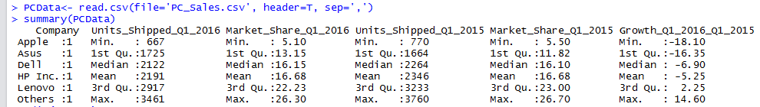
Exploring your data
Basic Data Set Explorations
# Provides basic descriptive statistics and frequencies.
summary(PCData)
# Open data editor
edit(PCData)
# Provides the structure of the dataset
str(PCData)
# Lists variables in the dataset
names(PCData)
# First few rows of the dataset
head(PCData)
# First 2 rows of dataset
head(PCData, n=2)
# Last few rows
tail(PCData)
# Last 2 rows
tail(PCData, n=2)
# Rows 2 to 4
PCData[2:4, ]
# Rows 2 to 4 with Columns 1 to 3
PCData[2:4,1:3]
# Rows 2 to 4 with Columns 1 and 3
PCData[2:4,c(1,3)]
Consider the following PC Sales data *
PC_Sales.csv
# Read the data file
PCData<- read.csv(file='PC_Sales.csv', header=T, sep=',')
Company | Units_Shipped_Q1_2016 | Market_Share_Q1_2016 | Units_Shipped_Q1_2015 | Market_Share_Q1_2015 | Growth_Q1_2016_Q1_2015
Dell | 3,461 | 26.3 | 3,358 | 23.9 | 3.1
HP Inc. | 3,109 | 23.7 | 3,760 | 26.7 | -17.3
Lenovo | 1,903 | 14.5 | 1,661 | 11.8 | 14.6
Apple | 1,666 | 12.7 | 1,672 | 11.9 | -0.3
Asus | 667 | 5.1 | 770 | 5.5 | -13.5
Others | 2,340 | 17.8 | 2,857 | 20.3 | -18.1
* Source: http://www.gartner.com/newsroom/id/3280626

Slide 4
Descriptive Statistics
Basic Descriptive Statistics
# Mean of a particuar column
mean(PCData$Units_Shipped_Q1_2016)
# Median
median(PCData$Units_Shipped_Q1_2016)
# Variance
var(PCData$Units_Shipped_Q1_2016)
# Standard Deviation
sd(PCData$Units_Shipped_Q1_2016)
# Maximum
max(PCData$Units_Shipped_Q1_2016)
# Minimum
min(PCData$Units_Shipped_Q1_2016) # Min value
# Range
range(PCData$Units_Shipped_Q1_2016) # Range
#Quantile 25%
quantile(PCData$Units_Shipped_Q1_2016)
# Number of Observations
length(PCData$Units_Shipped_Q1_2016)
# Which is the Maximum
PCData$Company[[which.max(PCData$Units_Shipped_Q1_2016)]]
Consider the following PC Sales data *
PC_Sales.csv
# Read the data file
PCData<- read.csv(file='PC_Sales.csv', header=T, sep=',')
Company | Units_Shipped_Q1_2016 | Market_Share_Q1_2016 | Units_Shipped_Q1_2015 | Market_Share_Q1_2015 | Growth_Q1_2016_Q1_2015
Dell | 3,461 | 26.3 | 3,358 | 23.9 | 3.1
HP Inc. | 3,109 | 23.7 | 3,760 | 26.7 | -17.3
Lenovo | 1,903 | 14.5 | 1,661 | 11.8 | 14.6
Apple | 1,666 | 12.7 | 1,672 | 11.9 | -0.3
Asus | 667 | 5.1 | 770 | 5.5 | -13.5
Others | 2,340 | 17.8 | 2,857 | 20.3 | -18.1
> mean(PCData$Units_Shipped_Q1_2016)
[1] 2191
> median(PCData$Units_Shipped_Q1_2016)
[1] 2121.5
> var(PCData$Units_Shipped_Q1_2016)
[1] 1031794
> sd(PCData$Units_Shipped_Q1_2016)
[1] 1015.773
> max(PCData$Units_Shipped_Q1_2016)
[1] 3461
* Source: http://www.gartner.com/newsroom/id/3280626

Slide 5
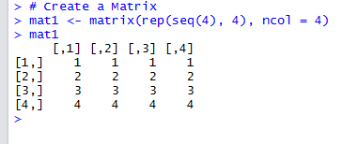
The apply function
Applies a function to sections of an array and returns the results in an array.
Consider the matrix
Output
[1] 4 8 12 16
#row sums of mat1
apply(mat1, 1, sum)
[1] 10 10 10 10
[1] 6 10 14 18
#column sums of mat1
apply(mat1, 2, sum)
# Applying a user defined function across Rows
# Row Sum + 2
apply(mat1, 1, function(x) sum(x) + 2)

Slide 6
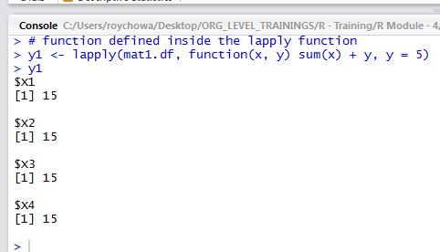
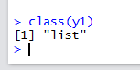
The lapply function
Applies a function to elements in a list or a vector and returns the results in a list.
Consider the dataframe
Output
> mat1.df
X1 X2 X3 X4
1 1 1 1 1
2 2 2 2 2
3 3 3 3 3
4 4 4 4 4
$X1
[1] 10
$X2
[1] 10
$X3
[1] 10
$X4
[1] 10
# obtaining the sum of each variable in mat1.df
lapply(mat1.df, sum) # Note a List is Returned
# user defined function with multiple arguments
# function defined inside the lapply function
y1 <- lapply(mat1.df, function(x, y) sum(x) + y, y = 5)

Slide 7
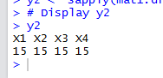
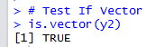
The sapply function
Applies a function to elements in a list and returns the results in a vector, matrix or a list.
Consider the matrix
Output
# User defined functions using sapply
y2 <‐ sapply(mat1.df, function(x, y) sum(x) + y, y = 5)
# Display y2
y2
# Test If Vector
is.vector(y2)

Slide 8
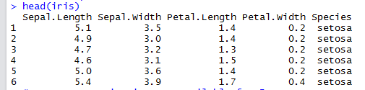
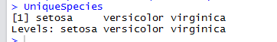
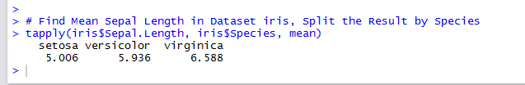
The tapply function
Output
Applies a function to sections of an array and returns the results in an array.
Consider the inbuilt dataset iris
# a sneak peek into iris
head(iris)
# What are the different species listed ?
UniqueSpecies <- unique(iris$Species)
UniqueSpecies
# How many Species is Data available for ?
UniqueSpeciesCnt <- length(unique(iris$Species))
UniqueSpeciesCnt
[1] 3
Find Mean Sepal Length in Dataset iris, Split the Result by Species ….
tapply(iris$Sepal.Length, iris$Species, mean)

Slide 9
Thank You

