Slide 1
Customer Segmentation Case Study with R
Business Case Study Part 1
CII

Slide 2
Contents
Customer Data Overview
Business Objectives
Solution Approaches
Direct Solutions
Approach toward tackling the Customer Segmentation problem
Aggregating Data (Optional)

Slide 3
Customer Data overview
Cust_id | Transaction_date | Age | Product_id | Qty | Unit Price
46855 | 01-11-2000 | 35-39 | 4710085120468 | 3 | 57
539166 | 01-11-2000 | 40-44 | 4714981010038 | 2 | 48
663373 | 01-11-2000 | 45-49 | 4710265847666 | 1 | 135
340625 | 01-11-2000 | <25 | 4710085120697 | 1 | 24
236645 | 01-11-2000 | 35-39 | 8999002568972 | 2 | 170
1704129 | 01-11-2000 | 25-29 | 4710734000011 | 1 | 46
# CSV file read - to be kept in the same folder as this code
data <- read.csv(file='CUSTOMER_DATA.csv', header=T, sep=',')
# Get a glimpse of the data
head(data)

Slide 4
Exploratory Data Analysis - Knowing the Data better!
High Level Questions
Drill Down Questions
Is the data transactional or aggregated ?
Any columns having only unique values ?
How many customers ?
How many transactions ?
How many transactions per day
Which day had the highest transaction
Transaction with highest value
Transaction with lowest value
Product ID occurring the maximum number of times
Extract Data for the Customer ID 539166
What is the Total Spend by this customer?
Which Customer has the Maximum Total Spend?
Which are the Customers that the marketing team should target ….

Slide 5
Solution Approaches
What Questions can we answer directly ?
-> Look for high level summary information
Do we need to create Derived columns to be able to answer the business objectives better ?
-> Think in terms of computed metrics
Does the data need to aggregated at any level ?
-> Which questions demand information at aggregated level ?

Slide 6
Easy to get information!
Customer count
Most frequently sold product
UniqueCust<- unique(data$Cust_id)
# Display
length(UniqueCust)
# Product id occurring max number of times
Prod_id_cnt <- as.data.frame(table(data$Product_id))
# Rename Columns of TranData
names(Prod_id_cnt)[1] <- "Prod_Id"
names(Prod_id_cnt)[2] <- "Count“
# Max Sell Product
Max_Sell_Prod_id <- Prod_id_cnt[which.max(Prod_id_cnt$Count),]
#Display
Max_Sell_Prod_id
How many transactions ?
NumTran <- nrow(data)
# Display
NumTran
How many transactions per day ?
TranData <- as.data.frame(table(data$Transaction_date))
# Display
TranData
Highest value transaction
# Create a computed column
data$Tran_Amt <- data$Qty*data$Price
# Transaction with the highest value
High_Tran <- data[which.max(data$Tran_Amt),]
# Display
High_Tran
Maximum Transaction day?
#Rename Columns of TranData
names(TranData)[1] <- "Tran_Date"
names(TranData)[2] <- "Count"
Max_Tran_Date <- TranData$Tran_Date[which.max(TranData$Count)

Slide 7
A Little drilling down now!
Get data for Customer ID 539166
Max spending customer
# Fetch Records For Customer iD 539166
Cust_539166 <-subset(data,Cust_id==539166)
#Display
Cust_539166
# Select relevant columns
library(dplyr)
Cust_Spend <- select(data,Cust_id,Tran_Amt)
# Aggregate by Customer id - summing on Tran_Amt
Cust_Tot_Spend <- as.data.frame(Cust_Spend %>% group_by(Cust_id) %>% summarise(Tot_Spend=sum(Tran_Amt)))
# Select Cust_Id for Max Tot_Spend
Max_Spend_Cust <- Cust_Tot_Spend$Cust_id[which.max(Cust_Tot_Spend$Tot_Spend)]
#Display
Max_Spend_Cust
Total Spend by Customer 539166
Tot_Spend_539166 <- sum(Cust_539166_data$Tran_Amt)
#Display
Tot_Spend_539166

Slide 8
Addressing the Big business problem !
Finding Target Customers for Marketing Team !
Given Customer Data
Application of a common clustering machine learning technique
Computed Columns
Advanced Data Manipulation with R
Data Aggregated at Customer id level
Shortlist Relevant columns for Analysis
K-means clustering
Summarized Clustering Information
Business Decision taken

Slide 9
Creating Information and Aggregating Data for Customer Segmentation (Optional)

Slide 10
Creating Information from Data for Decision making
What can we derive from the data at hand to better understand the customer spending behavior ?
Customer Data
Frequency of Purchase
Purchase Value
Intervals between Purchase
Weekend vs Weekday spend patterns

Slide 11
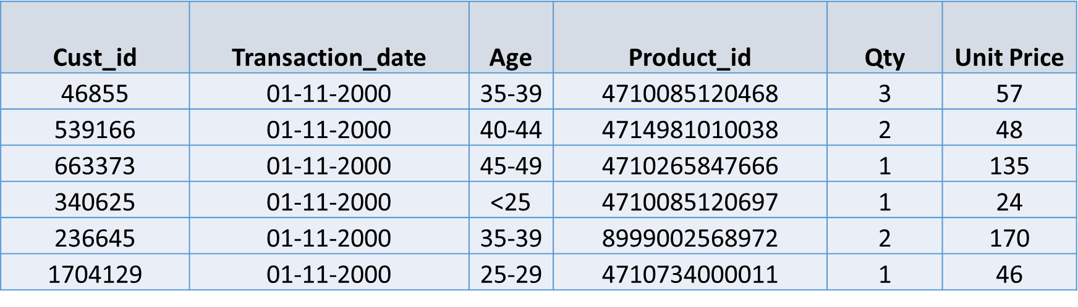
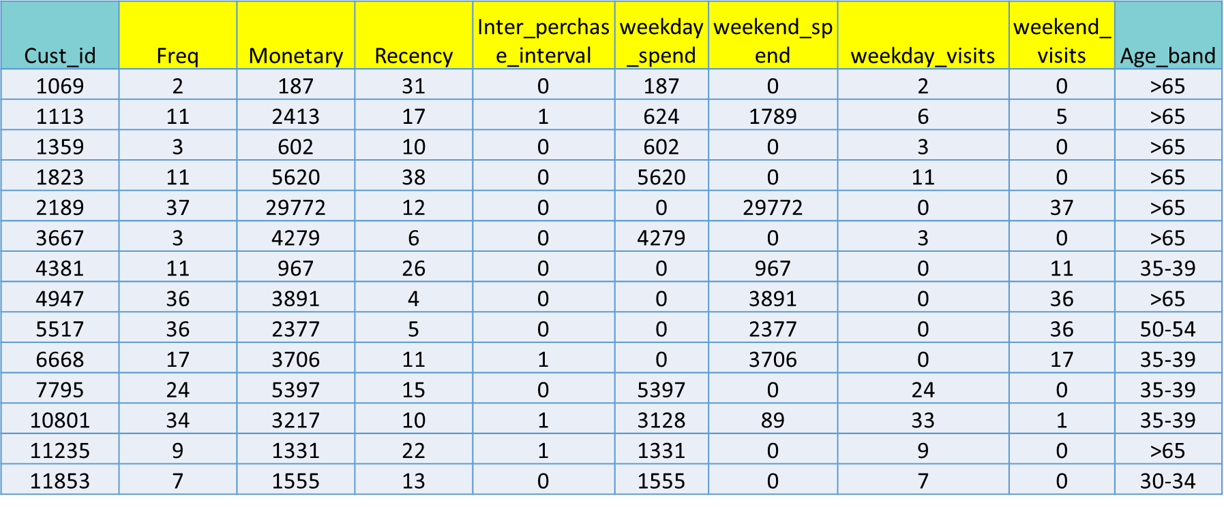
Creating Information from Data for Decision making
Data
Information

Slide 12
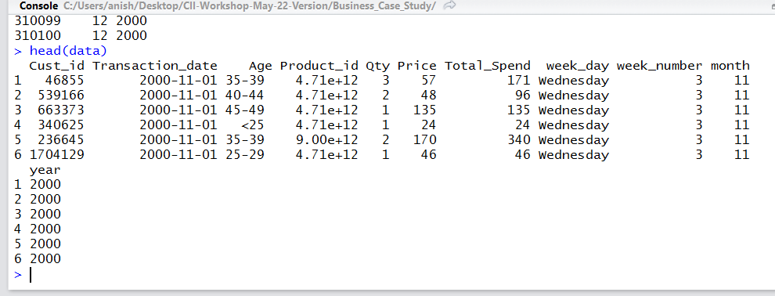
Creating Computed Columns
Total_Spend = Qty*unit_Price
New columns from Date column
# Create a Total Spend Column for the data
data$Total_Spend <- data$Qty*data$Price
# Day of Week
data$week_day<-weekdays(as.Date(data[,2]))
#Extract Day of the Week number eg/Mon = 1; TUE = 2 etc.
data$week_number<-as.numeric(format((data[,2]),"%w"))
#Extract Month Number
data$month<-as.numeric(format((data[,2]), "%m"))
# Extract Year
data$year<-as.numeric(format((data[,2]), "%Y"))
Converting to <DATE> data type
# Check the class of Date column
class(data$Transaction_date)
# Convert character data to Date format
data$Transaction_date<-as.Date(as.character(data$Transaction_date),
format="%d/%m/%Y")
Set MAX Date as Last Tran Day + 1 Day
Max_date<-max(data$Transaction_date)+1

Slide 13
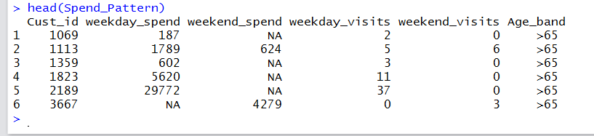
Aggregating Data by Customer Id : 1 - Spend Pattern
First Level Aggregation: Capture Spend Pattern based on day of the week
# Create Temp Table having Spend Pattern at Customer level
Spend_Pattern <-sqldf("select Cust_id,
sum(case when week_number not in ('0','6') then Total_Spend end) as weekday_spend,
sum(case when week_number in ('0','6') then Total_Spend end) as weekend_spend,
sum(case when week_number not in ('0','6') then 1 else 0 end) as weekday_visits,
sum(case when week_number in ('0','6') then 1 else 0 end) as weekend_visits,
Max(Age) as Age_band from data group by 1")

Slide 14
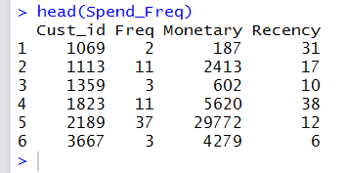
Aggregating Data by Customer Id : 2 – Spend Freq.
Second Level Aggregation: Capture Spend and Recency at Customer level
Spend_Freq <- ddply(data,.(Cust_id),summarize, Freq=length(Cust_id), Monetary=sum(Total_Spend),
Recency=round(as.numeric(difftime(Max_date,max(Transaction_date),units="days"))))

Slide 15
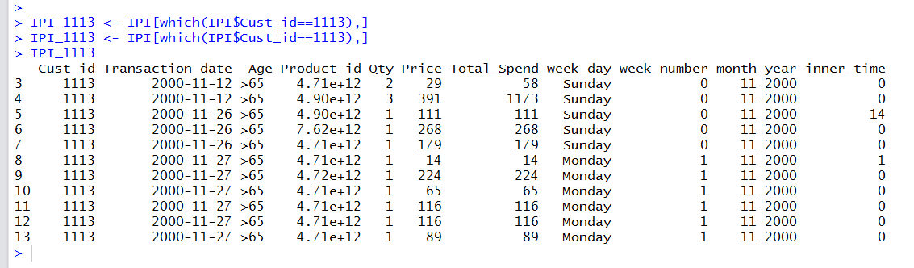
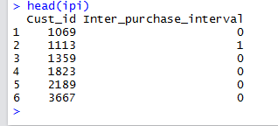
Aggregating Data by Customer Id : 3 – Inter Purchase Interval
STEP 1 : Get Difference vector for Transaction Date for every row, for each Customer Id
IPI<-ddply(data,"Cust_id",transform,inner_time=c(0,diff(Transaction_date)))
# Check the data for Cust_id = 1113
IPI_1113 <- IPI[which(IPI$Cust_id==1113),]
IPI_1113
STEP 2 : Aggregate at customer id level taking mean of IPI for a customer
ipi<-round(aggregate(IPI$inner_time,list(IPI$Cust_id),mean))
# Rename col 1
names(ipi)[1] <- "Cust_id"
# Rename col 2
names(ipi)[2] <- "Inter_purchase_interval"

Slide 16
Merging the Aggregated Data
Spend_Freq
Spend_Pattern
Cust_id
Freq
Monetary
Recency
Cust_id
Weekday_spend
Weekend_spend
Weekend_visit
Weekday_visit
Age Band
ipi
Cust_id
Inter_purchase_interval
Agg_data
Cust_id

Slide 17
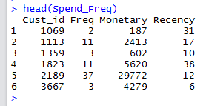

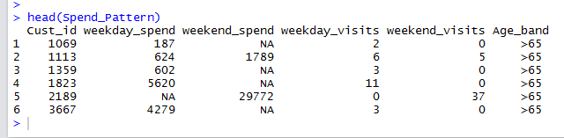
Merging in R: note Data Frames are already sorted !
Spend_Freq
ipi
a
Spend_Pattern

Slide 18
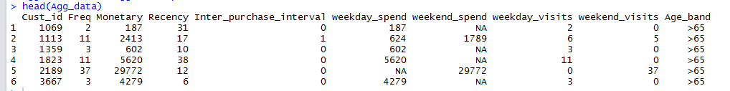
Using column bind
# Step 1 -- Combine Spend_Freq with ipi col 2
Agg_data<-cbind(Spend_Freq,ipi[2])
# Step 2
# We now column bind Agg_data with All columns of derived variable except Cust_id
Agg_data<-cbind(Agg_data,Spend_Pattern[,c(2:6)])

Slide 19
Handling NA’s in computed columns
# This tells us how many NA values in weekend_spend
length(which(is.na(Agg_data$weekend_spend)))
# This tells us how many NA values in weekday_spend
length(which(is.na(Agg_data$weekday_spend)))
# Replace NA with zeros in weekday_spend
Agg_data[is.na(Agg_data$weekday_spend),"weekday_spend"]<-0
# Replace NA with zeros in weekend_spend
Agg_data[is.na(Agg_data$weekend_spend),"weekend_spend"]<-0
# Write Data to output file
write.table(Agg_data, file="Agg_data.csv", sep=",", row.names=FALSE, col.names=TRUE, append=FALSE)

Slide 20
Thank You

