Slide 1
Business Case Study – Part 2
Aggregating Data
CII

Slide 2
Creating Information from Data for Decision making
What can we derive from the data at hand to better understand the customer spending behavior ?
Customer Data
Frequency of Purchase
Purchase Value
Intervals between Purchase
Weekend vs Weekday spend patterns

Slide 3
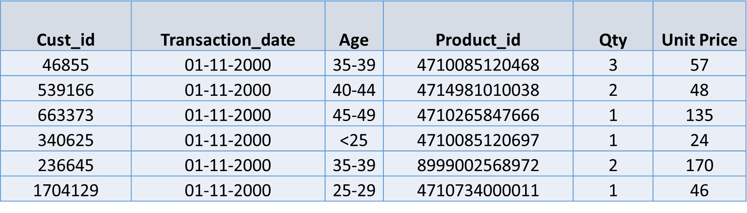
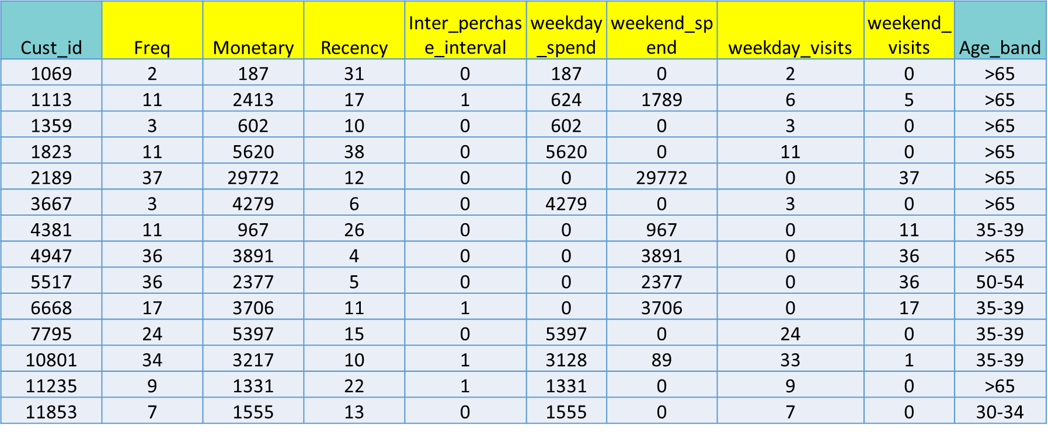
Creating Information from Data for Decision making
Data
Information

Slide 4
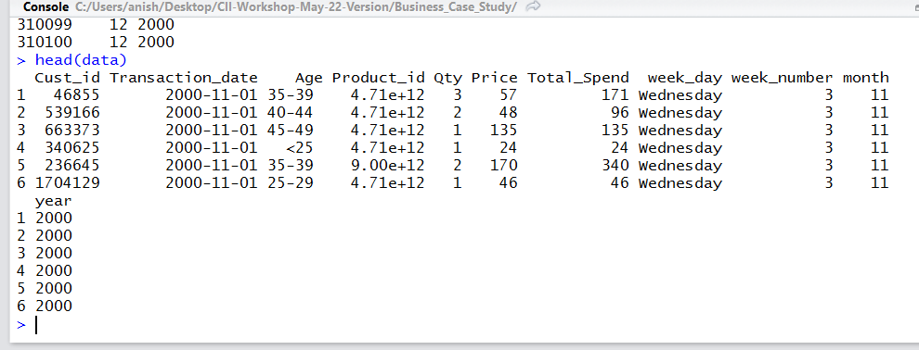
Creating Computed Columns
Total_Spend = Qty*unit_Price
New columns from Date column
# Create a Total Spend Column for the data
data$Total_Spend <- data$Qty*data$Price
# Day of Week
data$week_day<-weekdays(as.Date(data[,2]))
#Extract Day of the Week number eg/Mon = 1; TUE = 2 etc.
data$week_number<-as.numeric(format((data[,2]),"%w"))
#Extract Month Number
data$month<-as.numeric(format((data[,2]), "%m"))
# Extract Year
data$year<-as.numeric(format((data[,2]), "%Y"))
Converting to <DATE> data type
# Check the class of Date column
class(data$Transaction_date)
# Convert character data to Date format
data$Transaction_date<-as.Date(as.character(data$Transaction_date),
format="%d/%m/%Y")
Set MAX Date as Last Tran Day + 1 Day
Max_date<-max(data$Transaction_date)+1

Slide 5
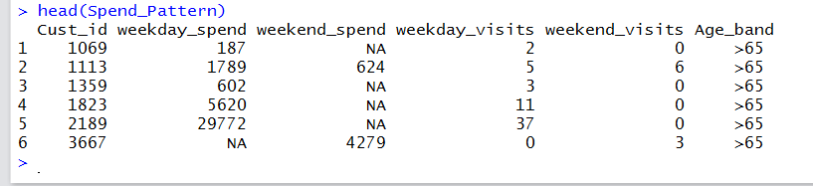
Aggregating Data by Customer Id : 1 - Spend Pattern
First Level Aggregation: Capture Spend Pattern based on day of the week
# Create Temp Table having Spend Pattern at Customer level
Spend_Pattern <-sqldf("select Cust_id,
sum(case when week_number not in ('0','6') then Total_Spend end) as weekday_spend,
sum(case when week_number in ('0','6') then Total_Spend end) as weekend_spend,
sum(case when week_number not in ('0','6') then 1 else 0 end) as weekday_visits,
sum(case when week_number in ('0','6') then 1 else 0 end) as weekend_visits,
Max(Age) as Age_band from data group by 1")

Slide 6
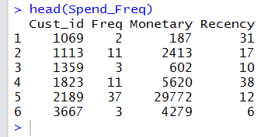
Aggregating Data by Customer Id : 2 – Spend Freq.
Second Level Aggregation: Capture Spend and Recency at Customer level
Spend_Freq <- ddply(data,.(Cust_id),summarize, Freq=length(Cust_id), Monetary=sum(Total_Spend),
Recency=round(as.numeric(difftime(Max_date,max(Transaction_date),units="days"))))

Slide 7
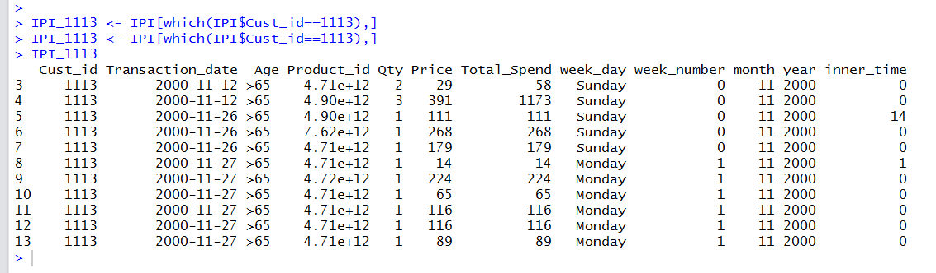
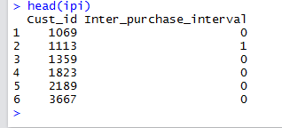
Aggregating Data by Customer Id : 3 – Inter Purchase Interval
STEP 1 : Get Difference vector for Transaction Date for every row, for each Customer Id
IPI<-ddply(data,"Cust_id",transform,inner_time=c(0,diff(Transaction_date)))
# Check the data for Cust_id = 1113
IPI_1113 <- IPI[which(IPI$Cust_id==1113),]
IPI_1113
STEP 2 : Aggregate at customer id level taking mean of IPI for a customer
ipi<-round(aggregate(IPI$inner_time,list(IPI$Cust_id),mean))
# Rename col 1
names(ipi)[1] <- "Cust_id"
# Rename col 2
names(ipi)[2] <- "Inter_purchase_interval"

Slide 8
Merging the Aggregated Data
Spend_Freq
Spend_Pattern
Cust_id
Freq
Monetary
Recency
Cust_id
Weekday_spend
Weekend_spend
Weekend_visit
Weekday_visit
Age Band
ipi
Cust_id
Inter_purchase_interval
Agg_data
Cust_id

Slide 9
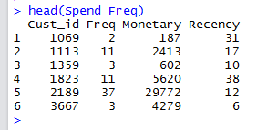

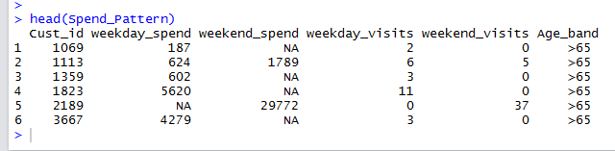
Merging in R: note Data Frames are already sorted !
Spend_Freq
ipi
a
Spend_Pattern

Slide 10
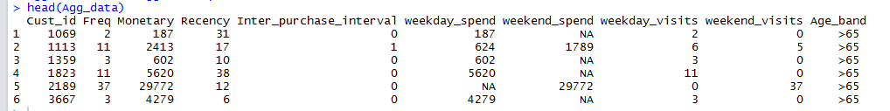
Using column bind
# Step 1 -- Combine Spend_Freq with ipi col 2
Agg_data<-cbind(Spend_Freq,ipi[2])
# Step 2
# We now column bind Agg_data with All columns of derived variable except Cust_id
Agg_data<-cbind(Agg_data,Spend_Pattern[,c(2:6)])

Slide 11
Handling NA’s in computed columns
# This tells us how many NA values in weekend_spend
length(which(is.na(Agg_data$weekend_spend)))
# This tells us how many NA values in weekday_spend
length(which(is.na(Agg_data$weekday_spend)))
# Replace NA with zeros in weekday_spend
Agg_data[is.na(Agg_data$weekday_spend),"weekday_spend"]<-0
# Replace NA with zeros in weekend_spend
Agg_data[is.na(Agg_data$weekend_spend),"weekend_spend"]<-0
# Write Data to output file
write.table(Agg_data, file="Agg_data.csv", sep=",", row.names=FALSE, col.names=TRUE, append=FALSE)

Slide 12
Thank You

