Slide 1
Illustrative Examples of ML
Copyright 2017 : Anish Roychowdhury and Jacob Minz

Slide 2
Contents
Association Rule Mining
Anomaly Detection
Computer Vision
NLP
AI Cometh!
Copyright 2017 : Anish Roychowdhury and Jacob Minz

Slide 3
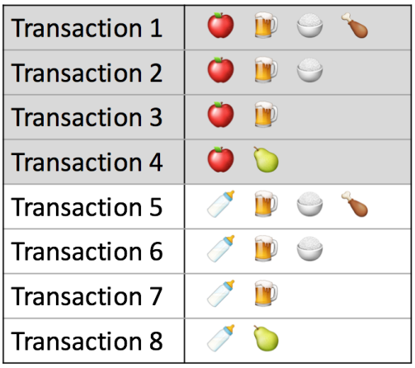
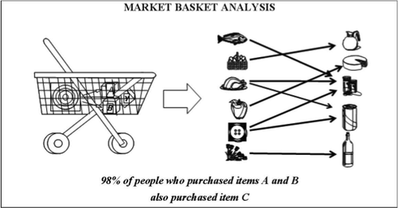
Association Rule Mining

Slide 4
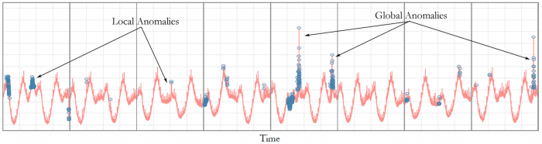
Anomaly Detection
In data mining, anomaly detection (also outlier detection) is the identification of items, events or observations which do not conform to an expected pattern or other items in a dataset.

Slide 5

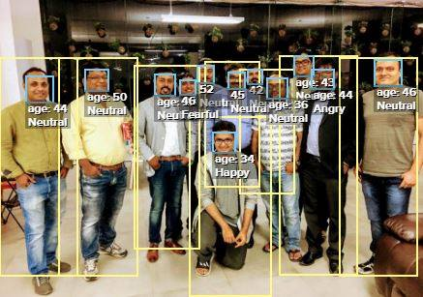
Computer Vision

Slide 6

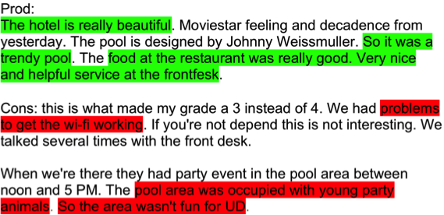
Natural Language Processing (NLP)
Sentiment Analysis
Chat-bots

Slide 7
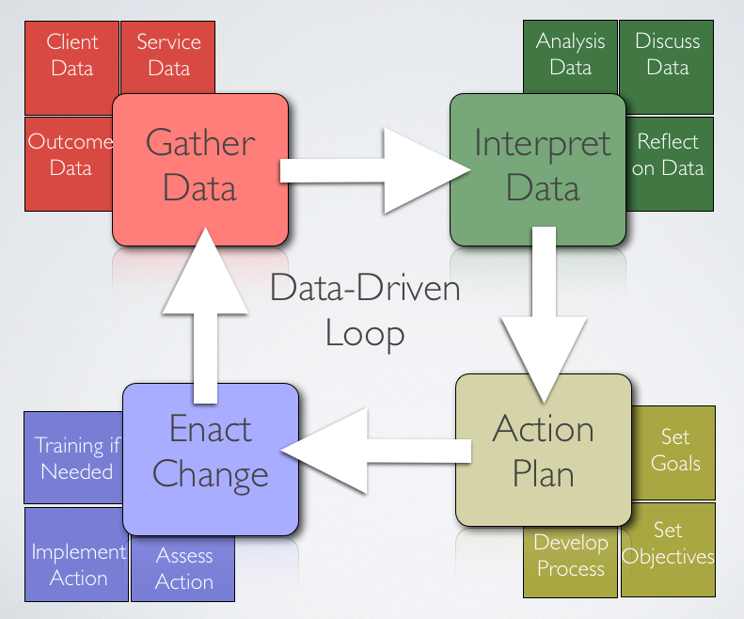
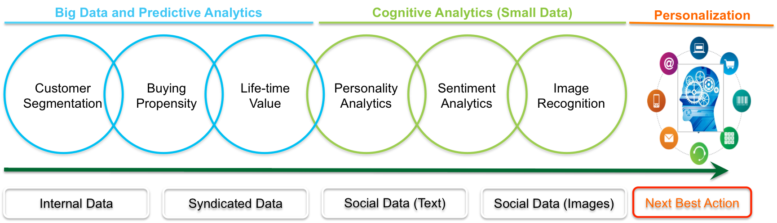
AI cometh..

Slide 8
Thank You

