Slide 1
Diagnosing Cancer with k NN Method
Implementing k NN Classification
CII Workshop

Slide 2
Contents
The k NN Introduction
Choosing ‘k’
Feature normalization
Nominal data handling
Computational complexity
Pros and cons
Further reading
Case study: Diagnosing breast cancer

Slide 3

What does k NN stand for ?
The k NN method
The ‘k’ nearest neighbor as the name suggest uses input from a data points nearest neighbours to classify a data point
Consider the following Plot in 2 Dimensions using Two Attributes
celery
Veggies
Can you see any emerging pattern ?
fruit
lettuce
carrot
apple
cucumber
pear
green bean
grape
Three Groups seem to emerge !
How crunch the food is
protein
nuts
shrimp
orange
Is Tomato a fruit or a Vegetable?
fish
banana
cheese
How sweet the food tastes

Slide 4
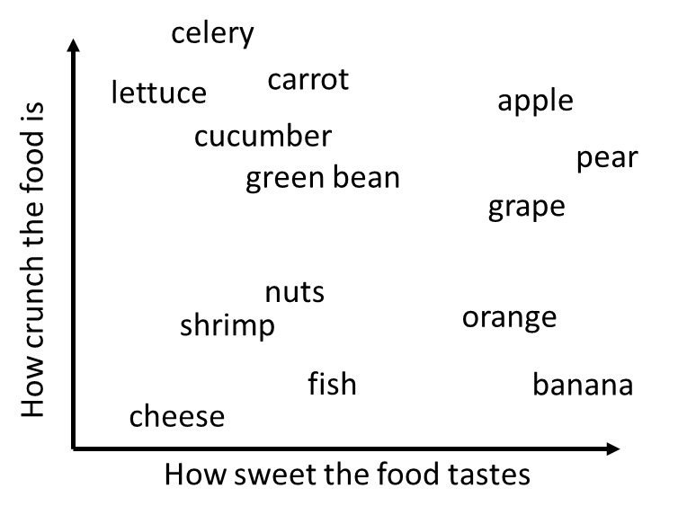





Nearest Neighbour Computation
Euclidean Distance in 2D
A
$$Distance_{AB}=\sqrt{{\left(x_{1}−x_{2}\right)}^{2}+{\left(y_{1}−y_{2}\right)}^{2}}$$
$$\left(x_{1}, y_{1}\right)$$
B
$$\left(x_{2}, y_{2}\right)$$
Consider the following attributes for the tomato
$$sweetness=6, crunchiness=4$$
Tomato and its neighbors!
We can compute the following table for its closest neighbours
Classification
1NN – Single nearest neighbor
orange
fruit
3NN – Three nearest neighbors
2 fruits, 1 protein
fruit

Slide 5

Choosing ‘k’ understanding the tradeoffs!
How the decision boundary varies with small or large k
Consider extremes :
k == n
The majority class will always be applied!!!
k = 1
Outliers will influence decisions
Finding the balance!
The best k is always between the two extremes!
Larger k
Smaller k
thumb rule
$$k= \sqrt{n}$$

Slide 6
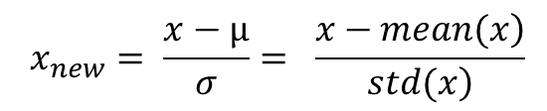
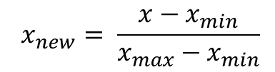
k NN : Feature Normalization
Why is this needed?
k NN being a distance dominated method , if a certain attribute is at a much higher scale than the others it will dominate the result
Min Max normalization
Z score standardization
$$x_{new}= \frac{x−x_{min}}{x_{max}−x_{min}}$$
$$x_{new}= \frac{x−µ}{σ}= \frac{\left.x−mean(x\right)}{\left.std(x\right)}$$

Slide 7
Handling nominal data with dummies
Consider an attribute: Hotness
Hot
Warm
Cold
Convert to New Dummy Variables
Hot
Hot = 1 (means Hot)
Hot = 0 (means Otherwise)
Warm
Warm = 1 (means Warm)
Warm = 0 (means Otherwise)
Caveat
No variable needed for being Cold, can you guess why ?
Could we have used one variable called Hotness and given values
If Hot = 1
If Warm = 0.5
If Cold = 0 ?

Slide 8
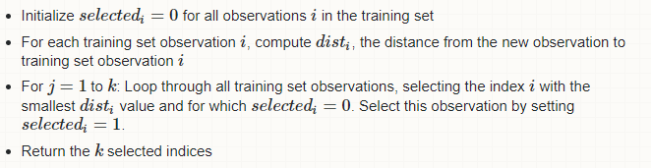
Computational complexity for ‘n’ examples with ‘d’ dimensions
Order of complexity O(nk + nd)
All data is stored
Need O(d) to compute distance to one example
Need O(nd) to compute distance for ‘n’ examples
Need O(nk) to find k closest examples
Total time O(nk + nd)
Algorithm for Order of complexity O(nk + nd)

Slide 9
Pros and Cons!
PROS
CONS
Simple and intuitive
Can be applied to data from any distribution
Data need not be linearly separable
Choosing k may be tricky
Test stage is computationally expensive
Needs large sample to work well

Slide 10
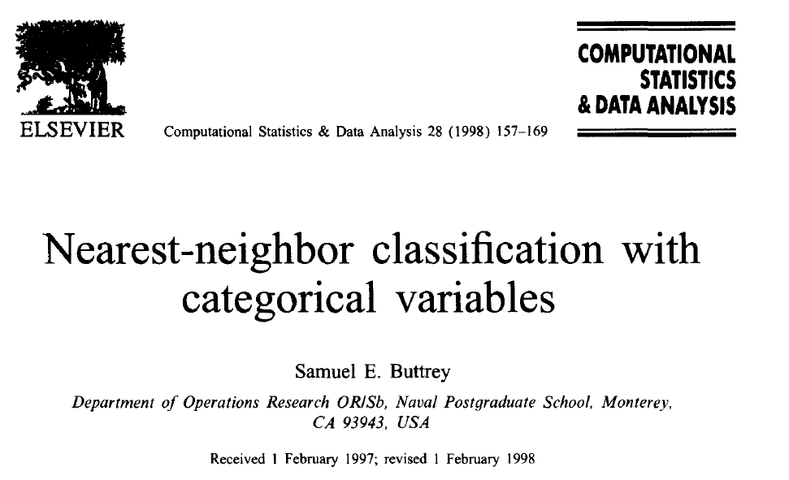
Further study in k NN… (Not covered here!)
Weighted Features
Handling Categorical variables
Suggested Read for Categorical variables implementation

Slide 11
Case Study: Detecting Breast Cancer
Manual Detection of Breast Cancer
How k NN helps!
Examine breast tissue for abnormal lumps or masses
If abnormal lump detected : extracted small sample tissue from suspected area
Examine clinically if sample is benign (B) or cancerous (C)
Collect Database of measured biopsied cells from women with abnormal breast masses
Determine attributes for comparison
Apply K NN to determine if test data falls in “B” or “M” category

Slide 12
Data Source and Attributes
Data Set
Cell Features
Wisconsin Breast Cancer Diagnostic dataset from the UCI
• Radius
• Texture
• Perimeter
• Area
• Smoothness
• Compactness
• Concavity
• Concave points
• Symmetry
• Fractal dimension
Source
http://archive.ics.uci.edu/ml.
Data Summary
569 examples with cancer biopsies
32 features for each example
One feature is ID number, another is Diagnosis
Mean, Std err , and Worst (Largest) Value of Ten measurements of cell nuclei make up the other thirty

Slide 13
Overall Steps in k NN Implementation
Exploring the data
Normalizing numeric data
Create Test and Train sets
Train model on data
Evaluate model performance
Improve model performance
Test with alternative k values

Slide 14
Thank You

