Slide 1
Diagnosing Heart Disease with Logistics Regression
Implementing Logistics Regression
CII Workshop

Slide 2
Contents
Why Linear Regression is not suitable for categorical output
Logistics Regression introduction
The Logistics function
The Odds ratio
Maximum likelihood
Pros and Cons
References for further reading
Case Study

Slide 3
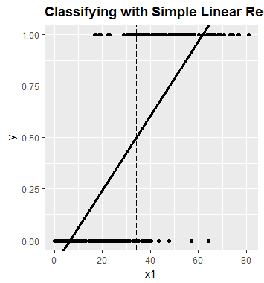
Classifying with Linear Regression
Approach
Value < =0.5 ?
Yes
Train LR Model to predict in [0,1]
Class 0
Wrongly classified as class 0
No
Let us Test !
Class 1
Wrongly classified as class 1

Slide 4
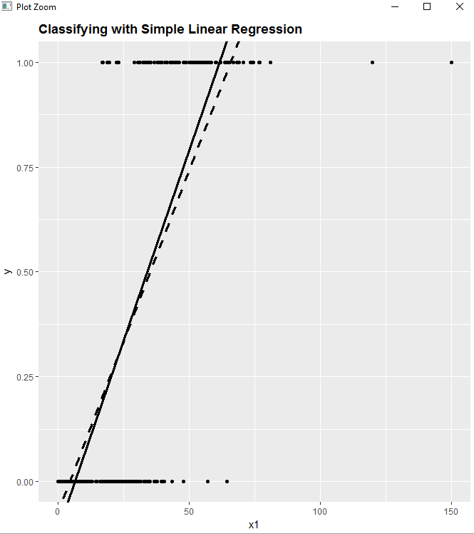
Why Linear Regression is not suitable
Raw output from LR predicts values beyond [0,1]
LR is designed for minimizing MSE
We want to partition data into two classes
New regression line
Decision boundary very sensitive to Outliers
Logistics Regression Advantages:
Can provide output bounded in [0,1]
Does not fit using MSE

Slide 5
Logistics Regression: Introduction
When used :
Consider scenarios where output variable is categorical, and input variable may be continuous or categorical. Output is typically Yes, No; Pass , Fail or 1,0 type; such as in Cancer / No Cancer predictions.
Assumptions
Dependent variable to be categorical in nature
Independent variables can take continuous or categorical values by nature , where the categorical variables needs to be dummy coded depending on the software
Based on the guidelines created cases/values per independent variable should be at least 10
Unlike linear discriminant analysis logistic regression does not make any assumptions of normality, linearity, and homogeneity of variance for the independent variables.

Slide 6
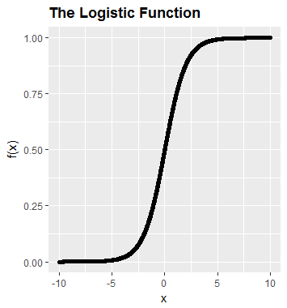

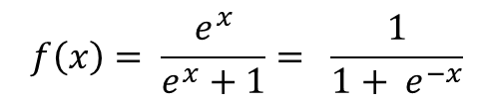
The Logistics Function: A part of GLM (Generalized Linear Models )
Linear Regression Eqn.
$$y=Ax+B+e$$
Large values of x would lead to y>>1 similarly highly negative values of x would lead to y<0
$$f\left(x\right)= \frac{e^{x}}{e^{x}+1}= \frac{1}{1+ e^{−x}}$$
The Key question
How do we get a y output of the form 0 or 1?
The Logistics Function
Feed the Regression as input to the Logistics Function
We are computing the probability that the output belongs to class 1

Slide 7
The Odds ratio!
Start with the Logistics Function
Solve for the Regression terms
End up with the Log of Odds Ratio or LOGIT Function !
Do you see a similarity with Linear Regression here ?

Slide 8
Maximum Likelihood
More compact form
The Likelihood function
Likelihood for class 1
Likelihood for class 0
Need to Maximize This
Maximize* the LOG Likelihood instead!
The overall likelihood is the product of ALL individual likelihoods!
Easier to handle sums than products!
* For derivation see reference mentioned at end of this presentation
Regression Parameters

Slide 9





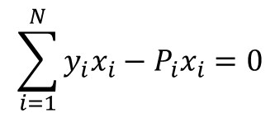

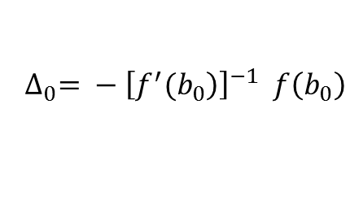


Solving for the Coefficients
Linear Regression
Logistics Regression
$$y=X^{T}b$$
We need to maximize
$$Xy={XX}^{T}b$$
$$b ={\left.{\left(XX\right.}^{T}\right)}^{−1}Xy$$
This results in …
Numerical Soln. using Newtons Method
$$\sum_{i=1}^{N}{y_{i}x_{i}}−P_{i}x_{i}=0$$
$$thus f\left(b_{opt}\right)=0$$
$$f\left(b_{0}+ Δ\right)≈f\left( b_{0}\right)+ f^{′}\left(b_{0}\right)Δ$$
Initial guess
$$at k_{th} iteration$$
Updated estimate
$$b_{1}= b_{0}+ ∆_{0}$$
$$\left.∆_{k}= {\left(XW_{k} X^{T}\right)}^{−1}X(y−P_{k}\right)$$
Where…
$$∆_{0}= − {\left[\left.f^{′}(b_{0}\right)\right]}^{−1} f\left(b_{0}\right)$$
Where…
$$W is the diagonal matrix of derivatives P_{i}^{′}$$

Slide 10
Pros and cons
Pros
Cons
Output is a Probability- Thus can be used for Ranking as well as classification
Has Low variance
Predictive variables can be categorical or continuous
Does not need much of parameter tuning other than regularization
It’s a GLM – cannot handle Non linear problems (Have to Use NON Linear Kernels)
Has High Bias
Cannot handle data with large amount of noise or Low Signal to Noise Ratio

Slide 11
Reference for further reading
http://www.win-vector.com/blog/2011/09/the-simpler-derivation-of-logistic-regression/
https://en.wikipedia.org/wiki/Logistic_regression
http://www.stat.cmu.edu/~cshalizi/uADA/12/lectures/ch12.pdf
http://repository.cmu.edu/cgi/viewcontent.cgi?article=1221&context=robotics

Slide 12
Case Study: Predicting heart disease
Data Set
Parameter Table
Statlog (Heart) dataset from UCI
Source
http://archive.ics.uci.edu/ml/datasets/Statlog+%28Heart%29.
Data Summary
270 patient examples with 120 having heart disease
32 features for each example

Slide 13
Process Steps
Factorize categorical variables
Create train-test sets
Apply GLM model for Logit
Assess model performance
Model deviance study
Test set performance study
Regularization with Lasso
Classification metrics

Slide 14
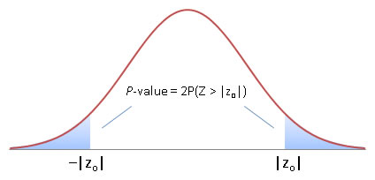




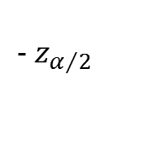

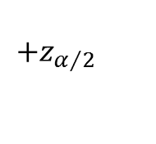
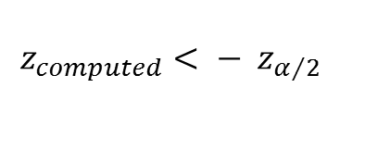

Wald’s Test : Model Performance
$$Null Hypothesis: H_{0} :Coefficient is equal to 0$$
$$Alternate Hypothesis: H_{\begin{aligned}1 \\ \end{aligned}}:Coefficient is significantly different from 0$$
Assessing Attribute “AGE”
Output from R Summary of the current model
Age Coeff Estimate : 1.641327
Age Coeff Std Er : 0.656291
Age Coeff Zscore : 2.501
Age Coeff P value : 0.012387
$$Z_{score}=\frac{Estimate for β_{Age} }{Std Err for β_{Age} }$$
Note: For
$α=0.05$
$Reject H_{0 }$if
$$z_{computed}> z_{α/2}$$
OR
$$z_{computed}< − z_{α/2}$$
$Reject H_{0 }$if
$$p value<0.05$$
Chestpain had n=4 categories , hence n-1 dummy variables
A1 = 0.025
A2 = 0.025
$$− z_{α/2}$$
$$+z_{α/2}$$

Slide 15



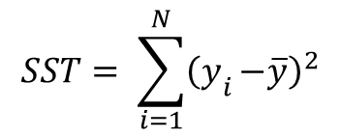
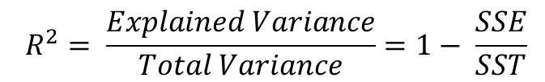

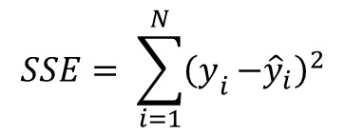






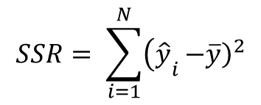
Linear Regression : Quick Reference
Some definitions
$$y$$
$$y_{i}$$
$$Total Sum of Squares \left(SST\right)$$
$$unexplained deviation:$$
$$y_{i}−{\hat{y}}_{i}$$
$$SST= \sum_{i=1}^{N}{{\left(y\right.}_{i}}{\left.−\overline{y}\right)}^{2}$$
$${\hat{y}}_{i}$$
$$explained deviation:$$
$${\hat{y}}_{i}− \overline{y}$$
$$Regression \left(explained\right) Sum of Squares \left(SSR\right)$$
$$\overline{y}$$
$$SSR= \sum_{i=1}^{N}{{\left(\hat{y}\right.}_{i}}{\left.−\overline{y}\right)}^{2}$$
$Total Deviation= explained+unexplained deviation$
$Residual \left(error\right) Sum of Squares \left(SSE\right)$
$$SSE= \sum_{i=1}^{N}{{\left(y\right.}_{i}}{\left.−{\hat{y}}_{i}\right)}^{2}$$
$$x_{i}$$
$$x$$
$$R^{2}= \frac{Explained Variance}{Total Variance}=1− \frac{SSE}{SST}$$

Slide 16
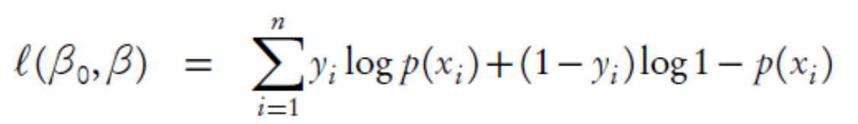
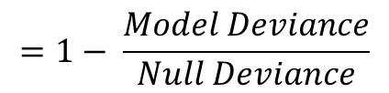
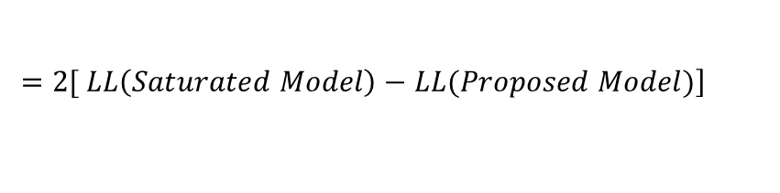

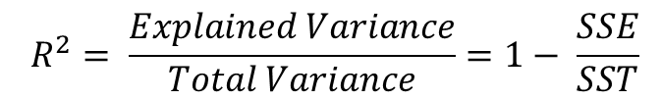
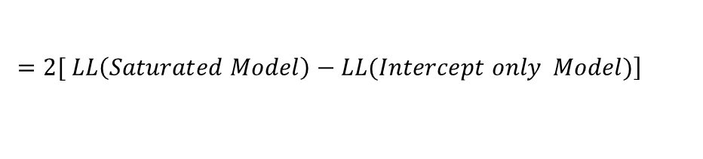
Concept of Deviance
Recall Log Likelihood
Compare with Linear Regression
$$Total Sum of Squares \left(SST\right)$$
$$SST= \sum_{i=1}^{N}{{\left(y\right.}_{i}}{\left.−\overline{y}\right)}^{2}$$
Deviance:
$$\left.=2[ LL\left(Saturated Model\right)−LL(Proposed Model)\right]$$
$$Regression \left(explained\right) Sum of Squares \left(SSR\right)$$
$$SSR= \sum_{i=1}^{N}{{\left(\hat{y}\right.}_{i}}{\left.−\overline{y}\right)}^{2}$$
NULL
Deviance:
$$\left.=2[ LL\left(Saturated Model\right)−LL(Intercept only Model)\right]$$
$Residual \left(error\right) Sum of Squares \left(SSE\right)$
$$SSE= \sum_{i=1}^{N}{{\left(y\right.}_{i}}{\left.−{\hat{y}}_{i}\right)}^{2}$$
Test Metric
$$χ^{2}=NULL Deviance−Model Deviance$$
Pseudo R Squared
$$=1− \frac{Model Deviance}{Null Deviance}$$
$$R^{2}= \frac{Explained Variance}{Total Variance}=1− \frac{SSE}{SST}$$

Slide 17
Model Performance
Common Metrics
Low p value for Chi Square
Large Pseudo R Squared
Wald’s Test : Individual Coeff different from zero
Model Tuning
Regularization with Lasso Regression
( Suggested Further Reading) - Out of current scope

Slide 18
Thank You

