Slide 1
Customer Segmentation Case Study with R
CII – Analytics and R Workshop
Understanding Data through plots

Slide 2
Contents
Insights on Frequency of Customer Visit
Insights on Total Spend by Customer
Insights of Recency of visit by Customer
Correlation Analysis thru plots

Slide 3
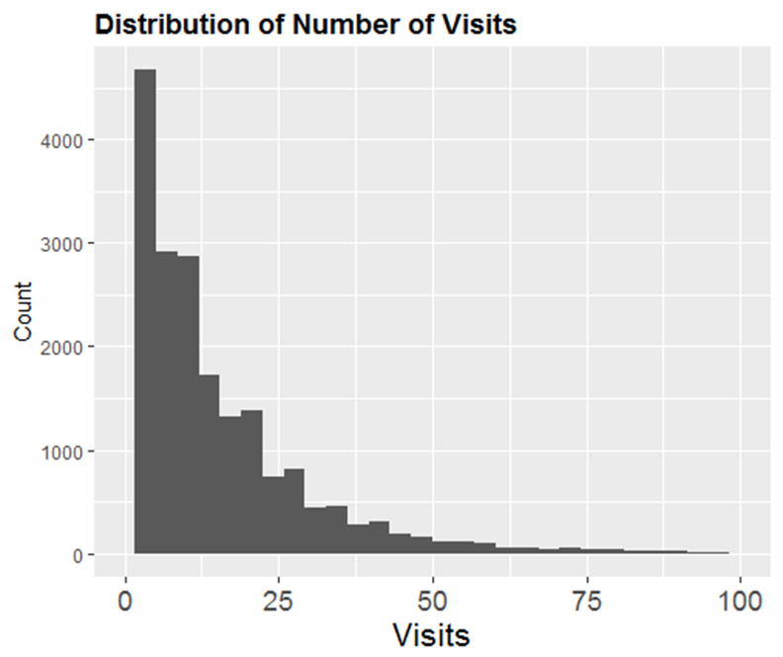
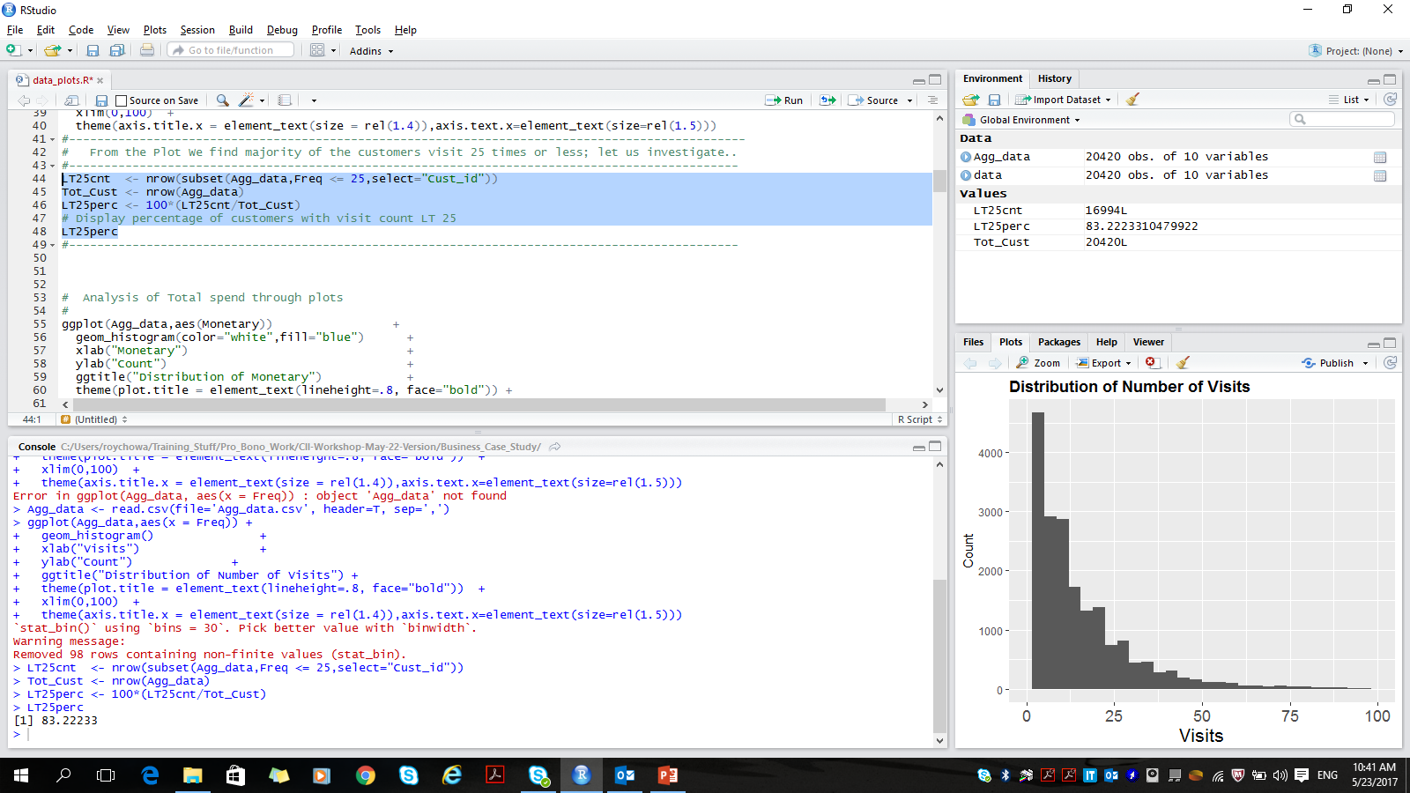
Insights on Customer Visit Frequency
Histogram Plot for customer visit count
ggplot(Agg_data,aes(x = Freq)) +
geom_histogram() +
xlab("Visits") +
ylab("Count") +
ggtitle("Distribution of Number of Visits") +
theme(plot.title = element_text(lineheight=.8, face="bold")) +
xlim(0,100) +
theme(axis.title.x = element_text(size = rel(1.4)),axis.text.x=element_text(size=rel(1.5)))
We find bulk of the population having less than 25 visits … let us investigate how much !!!
LT25cnt <- nrow(subset(Agg_data,Freq <= 25,select="Cust_id"))
Tot_Cust <- nrow(Agg_data)
LT25perc <- 100*(LT25cnt/Tot_Cust)
# Display percentage of customers with visit count LT 25
LT25perc

Slide 4
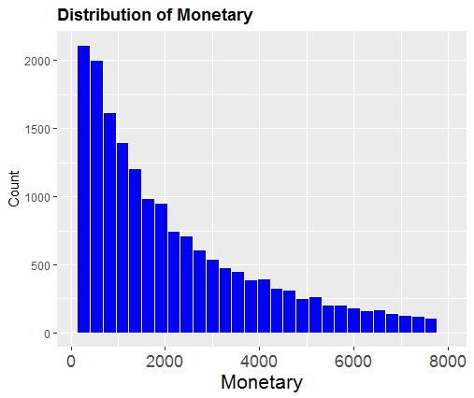
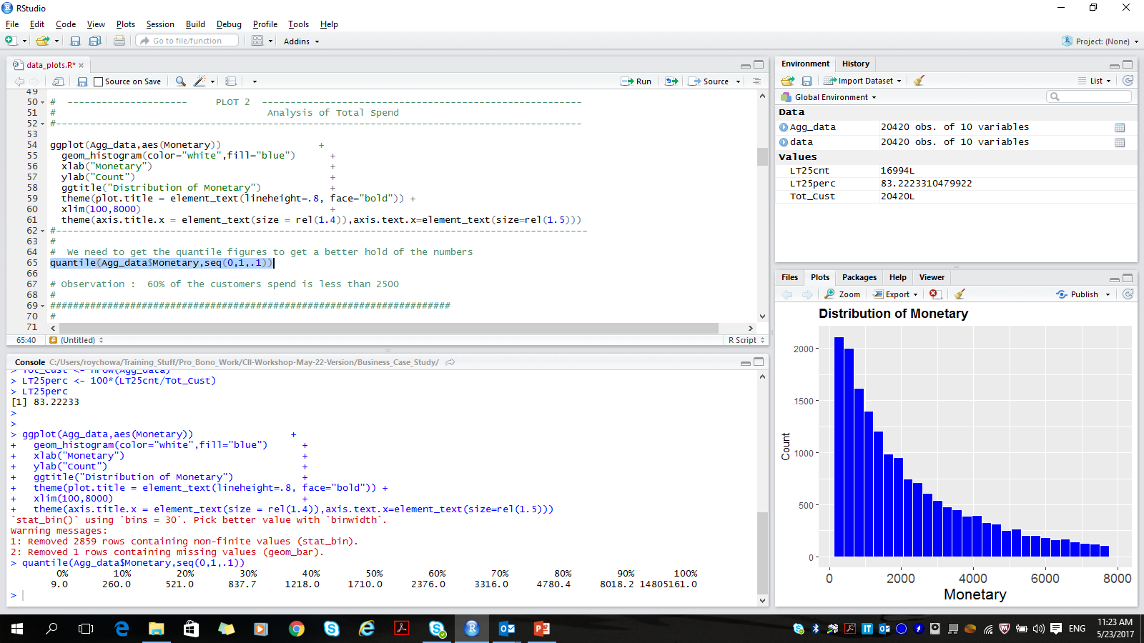
Insights on Total Spend by Customer
Histogram Plot for Total Spend by customer
ggplot(Agg_data,aes(Monetary)) +
geom_histogram(color="white",fill="blue") +
xlab("Monetary") +
ylab("Count") +
ggtitle("Distribution of Monetary") +
theme(plot.title = element_text(lineheight=.8, face="bold")) +
xlim(100,8000) +
theme(axis.title.x = element_text(size = rel(1.4)),axis.text.x=element_text(size=rel(1.5)))
We observe the count falls exponentially with Amt. Let us investigate the Quartiles to know more …
quantile(Agg_data$Monetary,seq(0,1,.1))
60% of the customers Total Spend is less than 2500

Slide 5
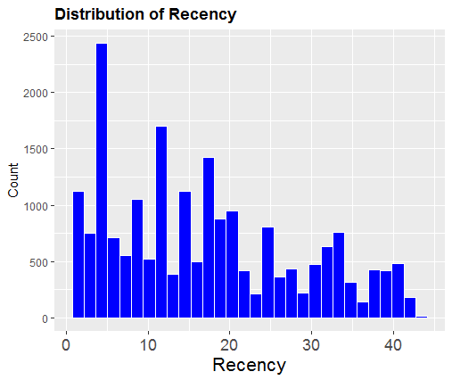
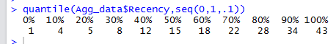
Insights on Recency of visit
Histogram Plot of Recency of customer visits
ggplot(Agg_data,aes(Recency)) +
geom_histogram(color="white",fill="blue") +
xlab("Recency") +
ylab("Count") +
ggtitle("Distribution of Recency") +
theme(plot.title = element_text(lineheight=.8,face="bold")) +
theme(axis.title.x = element_text(size = rel(1.4)),axis.text.x=element_text(size=rel(1.5)))
Need to perform a Quantile study to know more ..
quantile(Agg_data$Recency,seq(0,1,.1))
70 % of customers have Recency less than 22 days ..

Slide 6
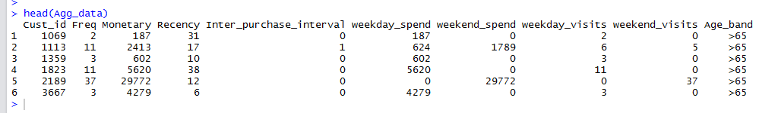
Pre Process before Correlation Studies
Check Data in columns for elimination
These columns maybe neglected in Correlation Studies

Slide 7
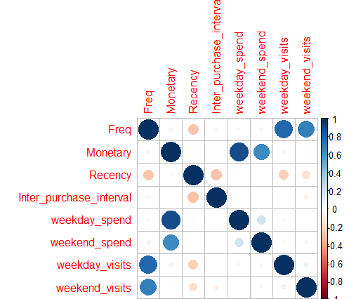
Correlation studies with plots
Neglect Unwanted Columns and study the rest
correlation<-cor(Agg_data[,c(-1,-10)])
corrplot(correlation)
Highly Correlated variable pairs …
Freq and weekday_visits
Monetary and weekday_spend
Verdict
Choose any one of the variable from each pair for further analysis for clustering

Slide 8
Thank You

