Slide 1
Title: AI Assistant Agent - Your All-in-One MLOps Intelligence
Revolutionizing MLOps with AI Platform Assistant
Your Smart Partner for Efficient Operations
Authors: Kaushik Das
- Tagline: Simplify, Optimize, and Scale Your AI Workflows

Slide 2
Current Challenges
❌ Finding Information is Hard: Knowledge silos across multiple repos. Users waste time searching for documentation.
❌ Checking Status Takes Time: Manual log digging for operations
❌ Costs Are a Mystery: User does not have a way to know how much their request is going to cost.
❌ Slow onboarding for new members
❌ Black-Box Operations: No visibility into pipeline statuses or failures.

Slide 3
AIPlatform Assistant Agent
The Unified Answer to MLOps Pain Points. One Assistant, Three Superpowers
A friendly assistant that makes MLOps easy by giving you quick answers, real-time updates, and cost clarity—all in one place.
Key Features
1. Knowledge Assistant: "Find answers instantly—no more digging through repos.
2. Operations Assistant: "Real-time pipeline status and troubleshooting.
3. Cost Assistant: "Transparent cost tracking and optimization.

Slide 4
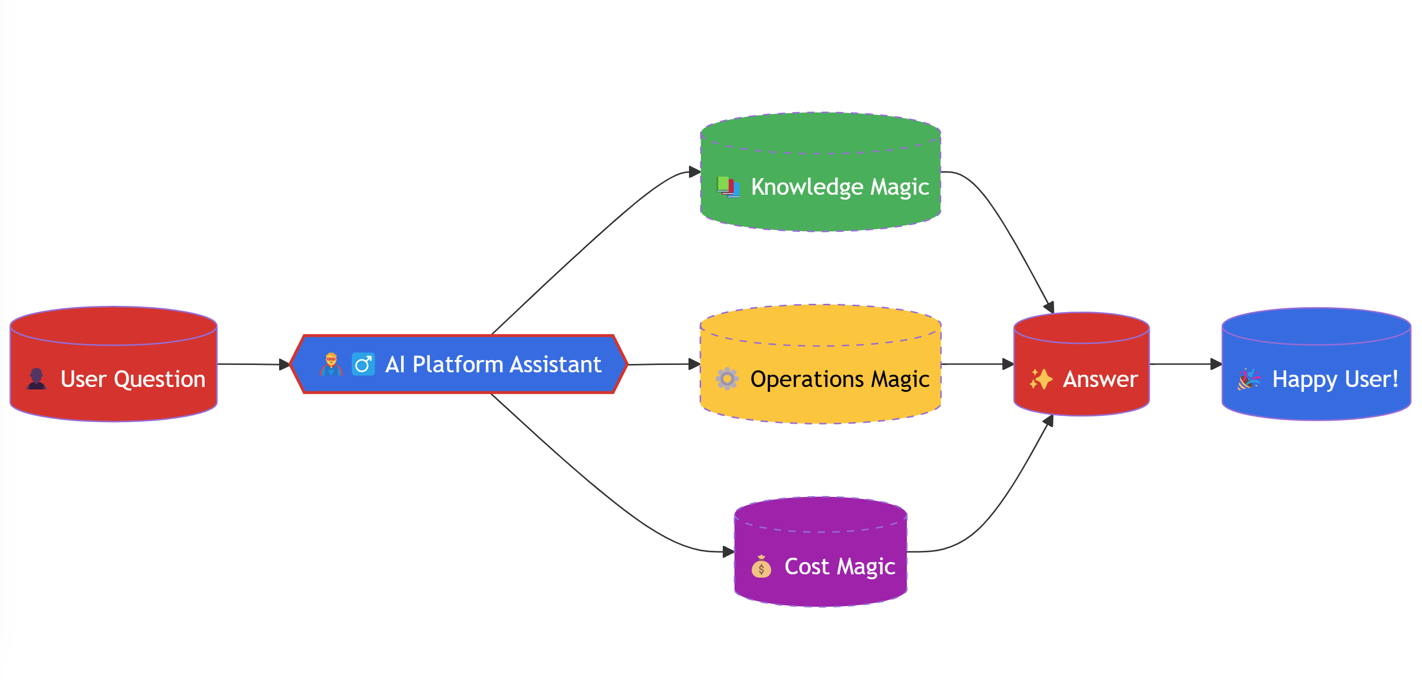
AIPlatform Assistant Agent contd.

Slide 5
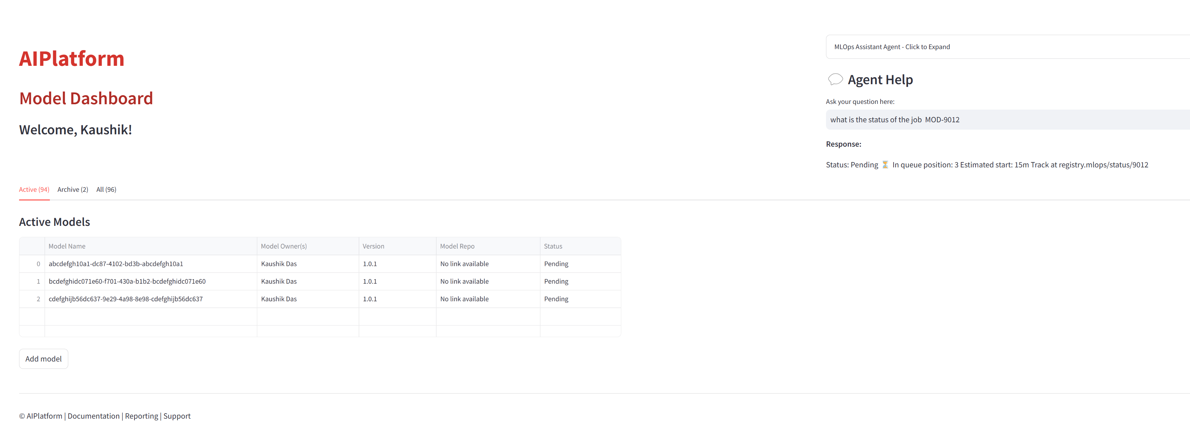
Feature Demo (Mockup)

Slide 6
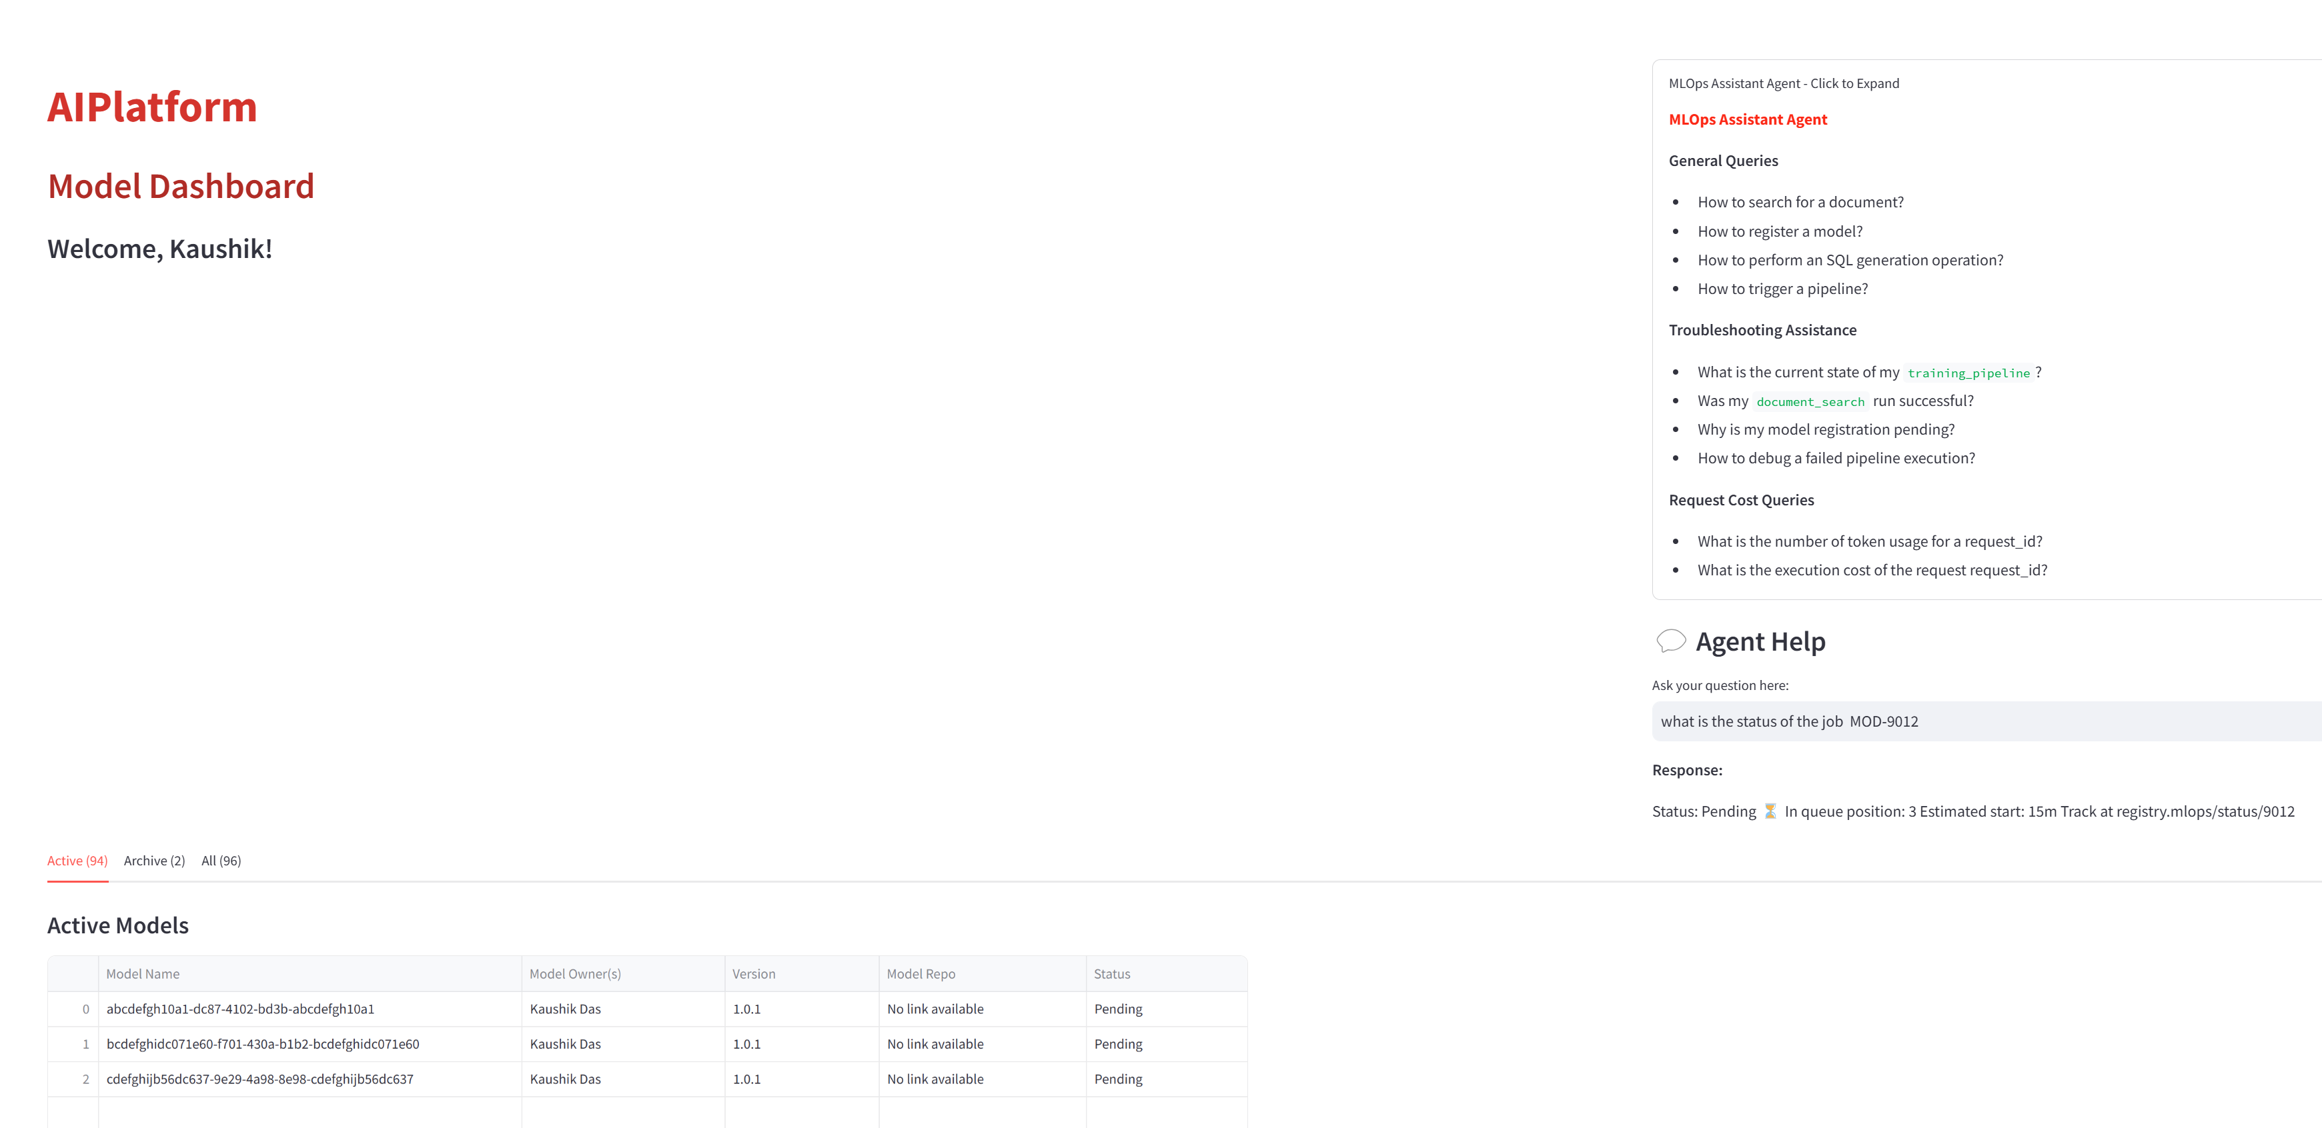
Feature Demo (Mockup) contd.

Slide 7
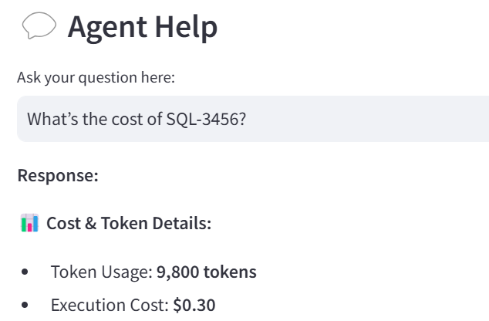
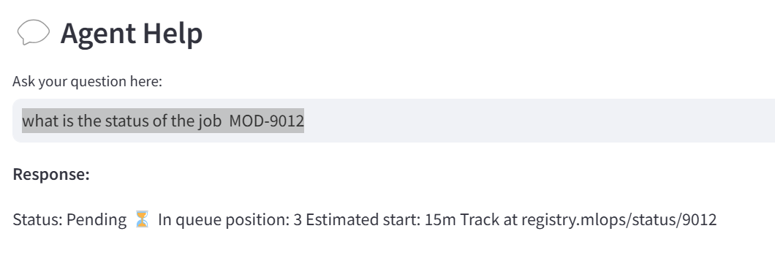
Feature Demo (Mockup) contd.
Some Questions
1. A user is asking - "What’s the cost of SQL-3456?“
2. What is the status of the job MOD-9012.

Slide 8
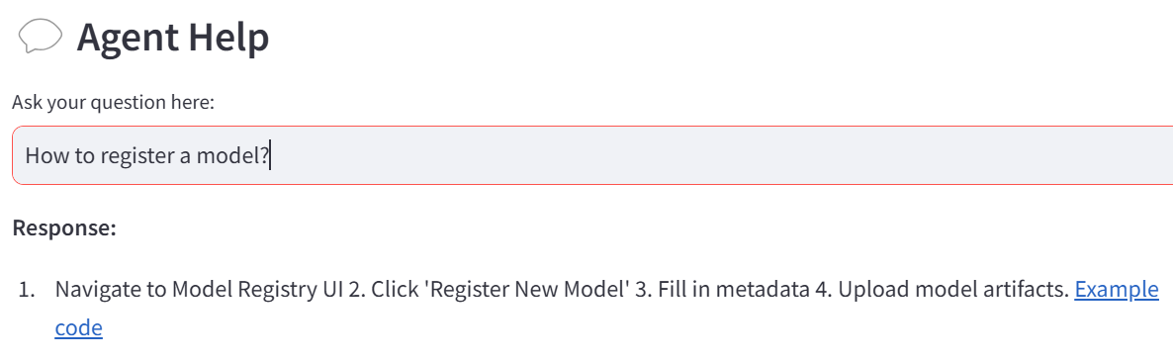
Knowledge Assistant
Have a question? Ask anything about your projects, and get instant answers pulled from our repositories—like a super-smart librarian!
Example
User: "How do I register a model?“ Knowledge Assistant: "Find answers instantly—no more digging through repos.
Assistant: "Go to the Model Registry UI, click ‘Register New Model,’ and upload your files. Easy!"

Slide 9
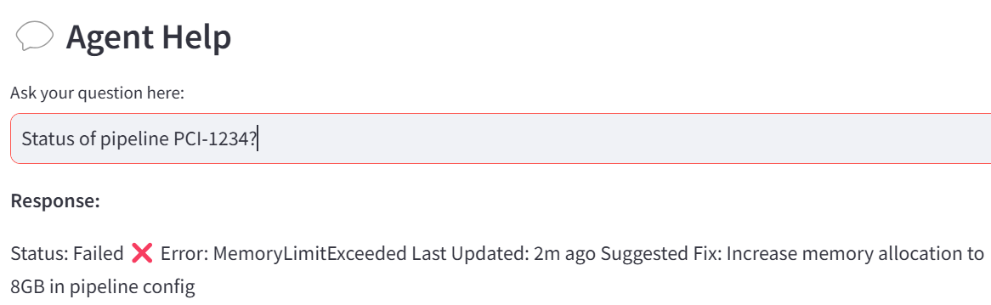
Operations Assistant
Wondering what’s happening with your tasks? Get instant updates on pipelines, document jobs, and more—no more guessing!"
Example
User: Status of pipeline PCI-1234?
Assistant: It failed due to memory issues. Try increasing to 8GB!

Slide 10
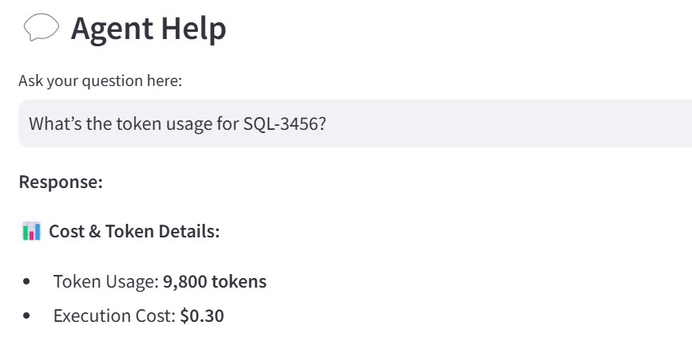
Request Cost
Curious about costs? Ask about token usage or expenses for any task and stay in control of your budget.
Example
User: What’s the token usage for SQL-3456?
Assistant: SQL-3456 used 9800 tokens and cost $0.30.

Slide 11
Benefits
"Why You’ll Love It"
Saves Time: No more searching endlessly for answers.
Boosts Efficiency: Instant updates keep things moving.
Controls Costs: Know exactly what you’re spending.

