Slide 1
Data Flow Diagrams
A graphical tool, useful for communicating with users, managers, and other personnel.
Used to perform structured analysis to determine logical requirements.
Useful for analyzing existing as well as proposed systems.
Focus on the movement of data between external entities and processes, and between processes and data stores.
A relatively simple technique to learn and use.

Slide 2
Why DFD ?
Provides an overview of-
  What data a system processes
  What transformations are performed
  What data are stored
  What results are produced and where they flow
Graphical nature makes it a good communication tool between-
  User and analyst
  Analyst and System designer

Slide 3

DFD elements
Source/Sinks (External entities)
Data flows
Processes
Data Stores

Slide 4

External Entities
External
Entities
A Rectangle represents an external entity
They either supply or receive data
They do not process data
Source – Entity that supplies data to the system.
Sink – Entity that receives data from the system.

Slide 5
Data Flows
Data in motion
Marks movement of data through the system - a pipeline to carry data.
Connects the processes, external entities and data stores.
  Generally unidirectional, If same data flows in both directions, double-headed arrow can be used.
Data Flow

Slide 6
Processes
Delivery Slip
Stores demand note
1. STORES
Issue Slip
A circle represents a process
Straight line with incoming arrows are input data flows
Straight lines with outgoing arrows are output data flows
Labels are assigned to Data flow. These aid documentation

Slide 7
Data Stores
D1
Data Stores
D1
Data Stores
D1
Data Stores
Writing
Reading
A Data Store is a repository of data
Data can be written into the data store. This is depicted by an incoming arrow
Data can be read from a data store. This is depicted by an outgoing arrow
External entity cannot read or write to the data store
Two data stores cannot be connected by a data flow

Slide 8
Rules of Data Flow
Data can flow from
  External entity to process
  Process to external entity
  Process to store and back
  Process to process
Data cannot flow from
  External entity to external entity
  External entity to store
  Store to external entity
  Store to store

Slide 9
Data Flow Diagrams
An alternate notation is often used:
A Process
A Data Store
3
Store Issue
Label
Name
D1
Data Stores
Name
Label

Slide 10

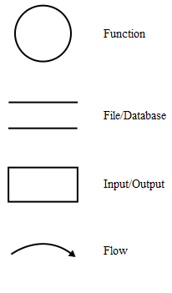

Slide 11

Flow chart shows “ flow of Control “ .
DFD shows “ flow of Data
The flowchart describes boxes that describe computations, decisions, interactions & loops.
It is important to keep in mind that data flow diagrams are not flowcharts and should not include control elements .

Slide 12

Processes on DFDs can operate in parallel (at-the-same-time)
Processes on flowcharts execute one at a time
DFDs show the flow of data through a system
Flowcharts show the flow of control (sequence and transfer of control)
Processes on a DFD can have dramatically different timing (daily, weekly, on demand)
Processes on flowcharts are part of a single program with consistent timing

Slide 13
Creating Data Flow Diagrams
Steps:
Create a list of activities
Construct Context Level DFD
(identifies external entities and processes)
Construct Level 0 DFD
(identifies manageable sub process )
Construct Level 1- n DFD
(identifies actual data flows and data stores )
Check against rules of DFD

Slide 14
Why Level DFD
If a DFD is too detailed it will have too many data flows and will be large and difficult to understand
Start from a broad overview. Expand to details – Idea similar to using procedures and linking these with a main program
Each DFD must deal with one aspect of a big system

Slide 15

Levels of DFD
Context diagram
Level-0 diagram (System diagram)
Level-n diagram
- Detail of one process from next
highest level
Primitive diagram (Lowest level DFD)

Slide 16

Creating Data Flow Diagrams
Lemonade Stand Example

Slide 17
Creating Data Flow Diagrams
Example
Steps:
The operations of a simple lemonade stand will be used to demonstrate the creation of dataflow diagrams.
Create a list of activities
Construct Context Level DFD
(identifies sources and sink)
Construct Level 0 DFD
(identifies manageable sub processes )
Construct Level 1- n DFD
(identifies actual data flows and data stores )

Slide 18
Creating Data Flow Diagrams
Example
Create a list of activities
Think through the activities that take place at a lemonade stand.
Customer Order
Serve Product
Collect Payment
Produce Product
Store Product

Slide 19
Creating Data Flow Diagrams
Example
Create a list of activities
Also think of the additional activities needed to support the basic activities.
Customer Order
Serve Product
Collect Payment
Produce Product
Store Product
Order Raw Materials
Pay for Raw Materials
Pay for Labor

Slide 20
Creating Data Flow Diagrams
Example
Create a list of activities
Group these activities in some logical fashion, possibly functional areas.
Customer Order
Serve Product
Collect Payment
Produce Product
Store Product
Order Raw Materials
Pay for Raw Materials
Pay for Labor

Slide 21

Creating Data Flow Diagrams
Example
Construct Context Level DFD
(identifies sources and sink)
Create a context level diagram identifying the sources and sinks (users).
Context Level DFD
CUSTOMER
0.0
Lemonade System
Sales Forecast
EMPLOYEE
Order
Customer Order
Serve Product
Collect Payment
Produce Product
Store Product
Order Raw Materials
Pay for Raw Materials
Pay for Labor
Production Schedule
Product Served
Pay
Payment
Time Worked
Received Goods
Payment
Purchase Order
VENDOR

Slide 22
Creating Data Flow Diagrams
Example
Construct Level 0 DFD
(identifies manageable sub processes )
Create a level 0 diagram identifying the logical subsystems that may exist.
Level 0 DFD
1.0
Sale
Customer Order
Serve Product
Collect Payment
Produce Product
Store Product
Order Raw Materials
Pay for Raw Materials
Pay for Labor
Customer Order
Sales Forecast
Product Ordered
CUSTOMER
Payment
2.0
Production
EMPLOYEE
Production
Schedule
Product Served
Received Goods
Inventory
VENDOR
3.0
Procure-ment
Purchase Order
Order
Decisions
Payment
Pay
Time Worked
4.0
Payroll

Slide 23


Creating Data Flow Diagrams
Example
Construct Level 1- n DFD
(identifies actual data flows and data stores )
Create a level 1 decomposing the processes in level 0 and identifying data stores.
Level 1 DFD
CUSTOMER
Customer Order
Customer Order
Serve Product
Collect Payment
Produce Product
Store Product
Order Raw Materials
Pay for Raw Materials
Pay for Labor
ORDER
Request for Forecast
1.1
Record Order
1.3
Produce Sales Forecast
Severed Order
Payment
Sales Forecast
1.2
Receive Payment
PAYMENT

Slide 24


Creating Data Flow Diagrams
Example
Construct Level 1 (continued)
Create a level 1 decomposing the processes in level 0 and identifying data stores.
Level 1 DFD
Product Order
ORDER
Customer Order
Serve Product
Collect Payment
Produce Product
Store Product
Order Raw Materials
Pay for Raw Materials
Pay for Labor
2.1
Serve Product
Quantity Severed
RAW MATERIALS
Production
Schedule
2.2
Produce Product
Quantity Used
INVENTORTY
Production Data
2.3
Store
Product
Quantity Produced & Location Stored

Slide 25


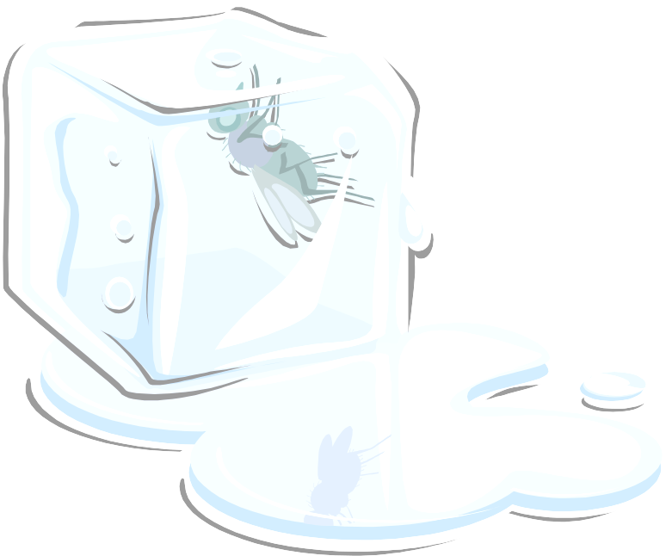
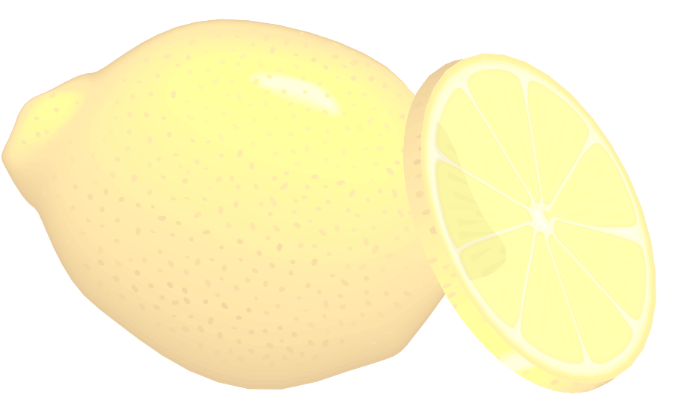
Creating Data Flow Diagrams
Example
Construct Level 1 (continued)
Create a level 1 decomposing the processes in level 0 and identifying data stores.
Level 1 DFD
Order Decision
3.1
Produce Purchase Order
PURCHASE ORDER
Customer Order
Serve Product
Collect Payment
Produce Product
Store Product
Order Raw Materials
Pay for Raw Materials
Pay for Labor
Quantity On-Hand
RAW MATERIALS
Quantity
Received
Received Goods
3.2
Receive Items
RECEIVED ITEMS
Payment Approval
3.3
Pay Vendor
VENDOR
Payment

Slide 26

Creating Data Flow Diagrams
Example
Construct Level 1 (continued)
Create a level 1 decomposing the processes in level 0 and identifying data stores.
Level 1 DFD
Time Worked
4.1
Record Time Worked
TIME CARDS
Customer Order
Serve Product
Collect Payment
Produce Product
Store Product
Order Raw Materials
Pay for Raw Materials
Pay for Labor
Employee ID
EMPLOYEE
Payroll Request
4.2
Calculate Payroll
Unpaid time cards
PAYROLL
Payment Approval
4.3
Pay Employee
PAYMENTS
Payment

Slide 27
Process Decomposition
1.0
Sale
1.1
Record Order
1.2
Receive Payment
2.0
Production
2.1
Serve Product
2.2
Produce Product
2.3
Store
Product
0.0
Lemonade System
3.0
Procure-ment
3.1
Produce Purchase Order
3.2
Receive Items
3.3
Pay Vendor
4.0
Payroll
4.1
Record Time Worked
4.2
Calculate Payroll
4.3
Pay Employee
Context Level
Level 0
Level 1

Slide 28
Levelling Rules
If a process p is expanded, the process at the next level are labelled as p.1, p.2 etc.
All data flow entering or leaving p must also enter or leave it’s expanded version
Expanded DFD may have data stores
No external entity can appear in expanded DFD
Keep the number of processes at each level less than 7

Slide 29

Balancing DFDs
Information presented at one level of a DFD is accurately represented in the next level DFD.
Ensures that the input and output data flows of the parent DFD are maintained on the child DFD.

Slide 30

Creating DFDs
Create a preliminary Context Diagram.
Identify Use Cases, i.e. the ways in which users most commonly use the system.
Create DFD fragments for each use case.
Create a Level 0 diagram from fragments.
Decompose to Level 1,2,…
Validate DFDs with users.

Slide 31

Creating the Context Diagram
Draw one process representing the entire system (process 0)
Find all inputs and outputs that come from or go to external entities; draw as data flows.
Draw in external entities as the source or destination of the data flows.

Slide 32
Creating Level 0 Diagram
Combine the set of DFD fragments into one diagram.
Generally move from top to bottom, left to right.
Minimize crossed lines.

Slide 33
Creating Level 1 Diagram
Each use case is turned into its own DFD.
Take the steps listed on the use case and depict each as a process on the level 1 DFD.
Inputs and outputs listed on use case become data flows on DFD.
Include sources and destinations of data flows to processes and stores within the DFD.
May also include external entities for clarity.

Slide 34
Good Style in Drawing DFD
Use meaningful names for data flows, processes and data stores.
Use top down development starting from context diagram and successively levelling DFD
Only previously stored data can be read
A process can only transfer input to output. It cannot create new data
Data stores cannot create new data

Slide 35

Decomposition of DFDs
A system is too complex to be shown on a single DFD.
Decomposition is the iterative process of exploding data flow diagrams to create more detail.
Level 0 data flow diagrams may be exploded into successive low levels of detail. The next level of detail would be a level 1 data flow diagram.
The DFDs become linked together in
a hierarchy, which would fully
document the system.

Slide 36
When to stop decomposing
DFDs?
  Ideally, a DFD has at least three levels.
  When the system becomes primitive i.e. lowest level is reached and further decomposition is useless.

Slide 37

Validating DFD
Check for syntax errors to assure correct DFD structure.
  Check for semantics errors to assure accuracy of DFD relative to actual/desired system.

Slide 38



DFD for University Admission System
Context Diagram
Student Information
Report Request
Student
0
Staff
University
Admission
System
Admission Approval
or Rejection
Report

Slide 39





Level 0
Student
Information
Report Request
Student
Name & ID
Student
1
3
Data Item Prompt
Staff
Perform Intake Procedure
Generate Reports
Admission Approval
or Rejection
Data Items
Data
Query
Approved
Application
Prior Application Data
Report
Data
D1
Student Data
Verified
Approved
Application
2
Maintain Student Information
Other Student Data
Request for Student Information Maintenance

Slide 40

Level 1 Process 1, Perform Intake Procedure
Student
Information
Student
Admission Application
1.1
1.2
Receive Admission Application
Verify Admission Application
Student Name and ID
Verified
Admission
Application
Prior Application Data
D1
Student Data
Application Data
Application
Request
1.3
Application Approval
or Rejection
Review Admission Application
Approved Application

Slide 41
Level 1 Process 2, Maintain Student Information
2.2
Approved Application to Add
Add New Student
Verified Approved Application
Verified Changed Student Data
2.3
Edit Existing Student
Approved Application
2.1
Approved Application to Edit
Determine Operation
Request for Student Information Maintenance
ID of Student to Delete
D1
Student Data
2.4
Delete Existing Student
Verified ID of Student to Delete
2.5
Cancel Operation
Determination to Cancel Operation

Slide 42
Logical and Physical DFD
DFDs considered so far are called logical DFDs
A physical DFD is similar to a document flow diagram
It specifies who does the operations specified by the logical DFD
Physical DFD may depict physical movements of the goods
Physical DFDs can be drawn during fact gathering phase of a life cycle

Slide 43




Cash
Token
CUSTOMER
Clerk
Verify A/C Signature Update Balance
Cashier
Verify Token
Take Signature
Cheque
Cheque with Token number
Token
Bad Cheque
Customer Accounts
Store cheques
Entry in Day Book

Slide 44
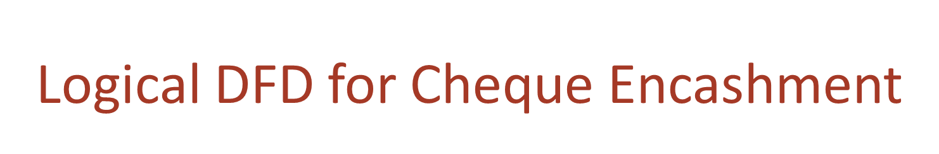







Retrieve Customer Record
Check Balance, Issue token
Cheque with Token
Store Token no & cheques
Cheque
Customer Accounts
Token Slip or Cheque
Store cheques
Cheque
CUSTOMER
Search & match token
Update Daily cash book
Token Slip
Cheque with token
Entry in Day Book
Cash

Slide 45
In a DFD external entities are represented by a
  Rectangle
  Ellipse
  Diamond shaped box
  Circle
External Entities may be a
  Source of input data only
  Source of input data or destination of results
  Destination of results only
  Repository of data
A data store in a DFD represents
  A sequential file
  A disk store
  A repository of data
  A random access memory

Slide 46
By an external entity we mean a
  Unit outside the system being designed which can be controlled by an analyst
  Unit outside the system whose behaviour is independent of the system being designed
  A unit external to the system being designed
  A unit which is not part of DFD
A data flow can
  Only enter a data store
  Only leave a data store
  Enter or leave a data store
  Either enter or leave a data store but not both
A circle in a DFD represents
  A data store
  A an external entity
  A process
  An input unit

