Slide 1

BACHELOR OF TECHNOLOGY
IN
Artificial Intelligence and Machine Learning
Section :ZETA
Project Title : -Translating the Language of Hands using Sign Language Interpretation Tool
Batch Number: ZT - 06
Roll Numbers :2211CS020656
2211CS020657
2211CS020658
2211CS020659
2211CS020660
Project Guide :: Prof. HEMALATHA
Department of AIML, School of Engineering
Malla Reddy University

Slide 2
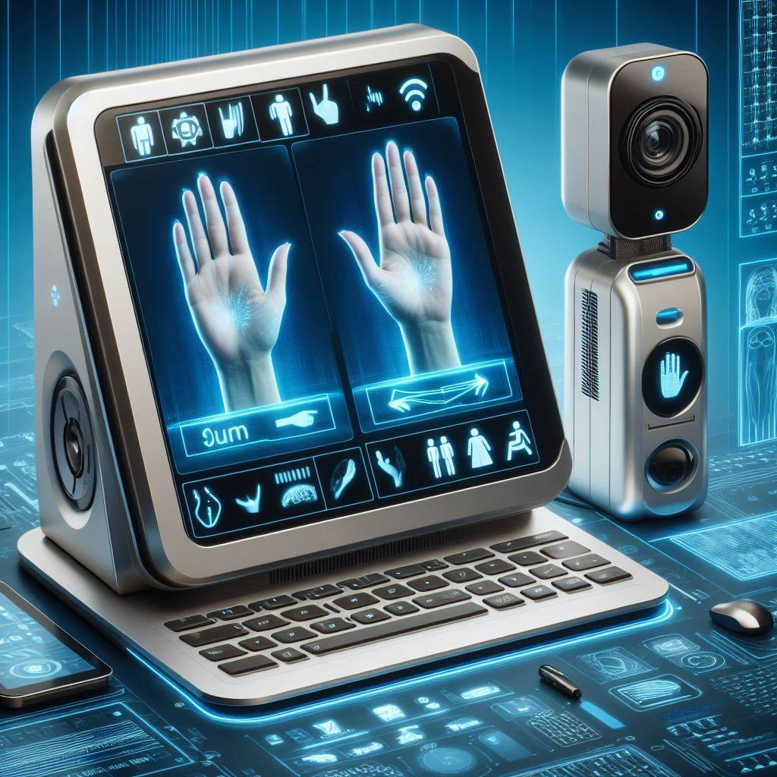
Translating the Language of Hands using Sign Language Interpretation Tool

Slide 3
CONTENTS
Abstract
Data Collection and Exploration
Data Pre processing and Transformation
Model Selection and Architecture
Model Implementation and Training

Slide 4
ABSTRACT
Aims to bridge communication gap between deaf individuals and hearing world by by SLD System.
Translate sign language gestures into spoken language in real-time.
Detect hand gestures and interpret them into textual form.
Convert textual form into spoken language using speech synthesis technology.
Facilitate seamless communication between deaf individuals and non-sign language speakers.

Slide 5
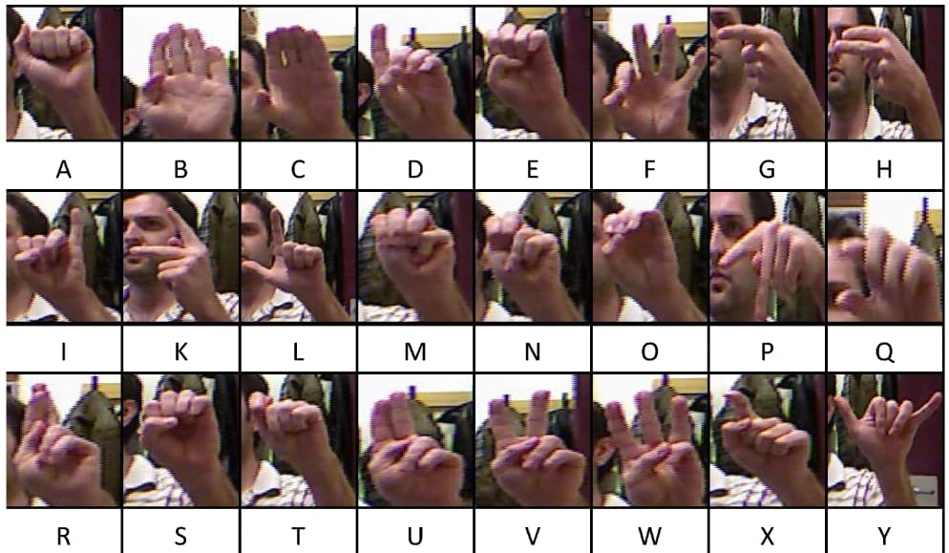

Slide 6
Data Collection and Exploration
Sign Language Gestures Dataset:
American Sign Language (ASL) Dataset:Utilized publicly available datasets specifically focused on American Sign Language gestures.
This dataset includes video recordings of individuals performing various ASL gestures corresponding to letters, words, and phrases.
Additional Data Sources:
Custom recordings of ASL gestures to augment the dataset and ensure diversity.
Feature Engineering:
Engineered new features and transformations to enhance the representation of sign language gestures.
Extracted relevant features and transformed categorical variables using techniques such as one-hot encoding.

Slide 7
Conducting Exploratory Data Analysis:
Calculate basic statistics such as mean, median, mode, and standard deviation for key features of the dataset.
Analyze the distribution of sign language gestures across different categories such as letters, words, and phrases.
Generate histograms to visualize the frequency distribution of gestures.
Remove any noise or irrelevant information from the dataset to ensure data quality.

Slide 8
Model Selection and Architecture
Image Recognition:
Convolutional Neural Networks (CNNs):
Excellent for analyzing visual data.
Identify hand gestures and signs from images or video frames.
Natural Language Processing (NLP):
Recurrent Neural Networks (RNNs) or Transformer Models:
Translate sign language gestures into text.
Convert text into spoken language.
Considerations:
Accuracy and robustness of image recognition.
Translation accuracy and language support.
Real-time processing capabilities for seamless translation.
Integration:
Combine image recognition and translation models for end-to-end sign language detection and translation.

Slide 9
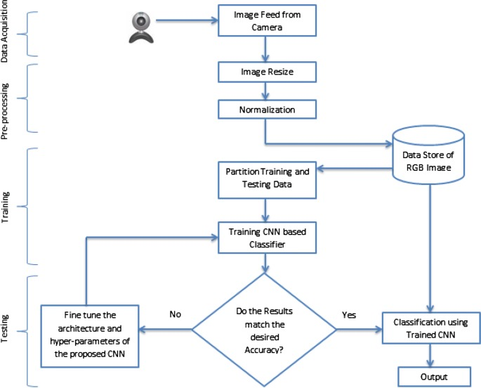
Architecture

Slide 10
Data Preprocessing and Transformation
Cleaning and Preprocessing the Data:
Identify and handle missing values using imputation or removal techniques.
Detect and address outliers through trimming or winsorization methods.
2. Data Transformation:
Standardize numerical features to have a mean of 0 and a standard deviation of 1.
Normalized numerical features to a specific range, such as [0, 1] or [-1, 1].

Slide 11
Categorical Encoding: Encoded categorical features using techniques such as one-hot encoding or label encoding, enabling their integration into machine learning algorithms.
By implementing these preprocessing and transformation techniques, we optimized the dataset for our sign language detection and translation system, ensuring robust performance and accurate interpretation of sign language gestures captured.

Slide 12
Model Implementation and Training
Implementing Chosen Model
Library Selection: Implemented the chosen model using TensorFlow library.
Model Configuration: Configured a Convolutional Neural Network (CNN) architecture with multiple convolutional and pooling layers.
.
Training Model on Preprocessed Dataset
Data Loading: Loaded the preprocessed sign language dataset into memory.
Training Configuration: Set training parameters such as batch size (64), learning rate (0.001), and number of epochs (50).
Training Process: Train the CNN model on the preprocessed dataset for 50 epochs using stochastic gradient descent (SGD) optimizer with cross-entropy loss.
Performance Monitoring
Metric Selection: Chose accuracy and loss as evaluation metrics to monitor the model's performance.
Real-time Monitoring: Monitored training and validation accuracy and loss using TensorFlow's callback functions.

Slide 13
