Slide 1

BACHELOR OF TECHNOLOGY
IN
Artificial Intelligence and Machine Learning
Section :ZETA
Project Title : -Translating the Language of Hands using Sign Language Interpretation Tool
Batch Number: ZT - 06
Roll Numbers :2211CS020656
2211CS020657
2211CS020658
2211CS020659
2211CS020660
Project Guide :: Prof. HEMALATHA
Department of AIML, School of Engineering
Malla Reddy University

Slide 2
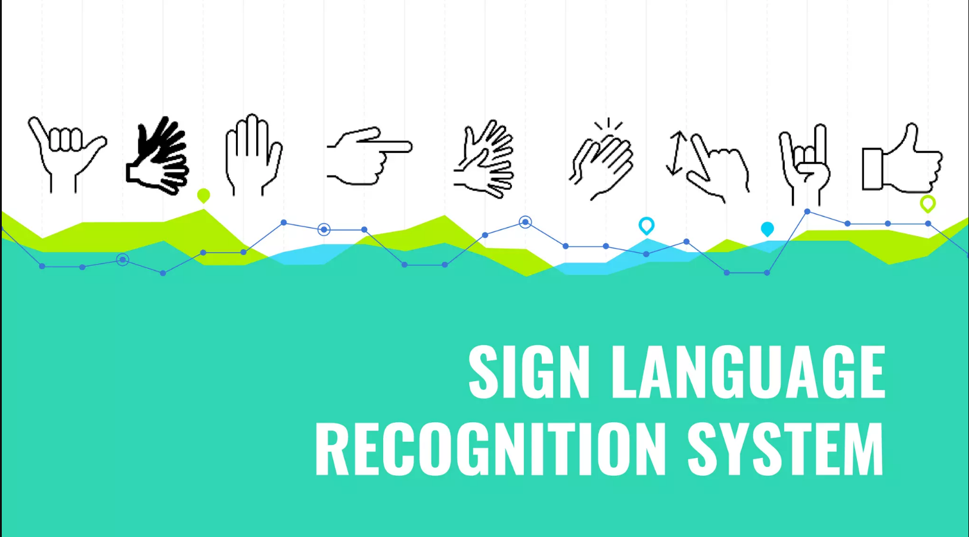

Slide 3
CONTENTS
Introduction
Model Implementation and Training
Model Evaluation Metrics
Model Deployment
Source Code
Web GUI’s Development & Integration
Results:Testing, Validation & Final Results
Project Conclusion
Fututre Scope

Slide 4
INTRODUCTION
The sign language is used widely by people who are deaf-dumb these are used as a medium for communication.
A sign language is nothing but composed of various gestures formed by different shapes of hand, its movements, orientations as well as the facial expressions.
There are around 466 million people worldwide with hearing loss and 34 million of these are children.
`Deaf' people have very little or no hearing ability .They use sign language for communication. People use different sign languages in different parts of the world. Compared to spoken languages they are very less in number.
Increasing the availability of interpreters and providing transcription in sign languages greatly improve accessibility.
Signs in sign languages are the equivalent of words in spoken languages Signed languages appear to favor.

Slide 5
Model Implementation and Training
Model Implementation:
Library Selection: For implementing the sign language detection we used opencv,cvzone,tensorflow.
Hand detection: Hand detection was achieved using the HandTrackingModule from the cvzone library, which allowed us to detect and track hands in real-time video frames.
Classification: For classification, we utilized the ClassificationModule from the cvzone library, which enabled us to classify hand gestures into predefined sign language categories.
Model Training:
Dataset Collection: We collected a dataset consisting of hand gesture images representing various sign language gestures.
Data Preprocessing: Prior to training, we preprocessed the dataset by resizing images and applying normalization techniques to ensure uniformity in data representation.
Training Process:
We split the dataset into training and validation sets, with 80% of the data used for training and 20% for validation.
The model was trained using a convolutional neural network (CNN) architecture implemented in TensorFlow.
Hyperparameters such as learning rate and batch size were tuned for optimal performance.
Training was conducted over multiple epochs until convergence, utilizing GPU resources for accelerated computation.

Slide 6
Model Evaluation Metrices
Data Augmentation:
Images were augmented to introduce more variability and difficulty in training.
Augmentation techniques included:
10° rotation,0.1 zoom range and height shift range,Horizontal flip
Aimed at preventing overfitting by exposing the model to diverse variations of the sign language gestures.
Dynamic Learning Rates:
Monitored validation accuracy with a patience of 15 epochs.
Minimum learning rate set to 0.00001 to prevent the learning rate from becoming too small.
Training and Testing Dataset:
Utilized a training dataset consisting of 5,000 images.
Testing dataset comprised 19,725 images.
The ratio of training to testing images ensured a comprehensive evaluation of model performance.
Training Epochs:
Trained the model for 50 epochs to converge to an optimal solution.
Monitored the training versus testing accuracy and loss across epochs to evaluate model performance.

Slide 7
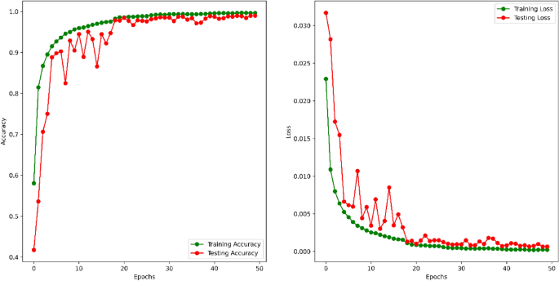
Training versus testing accuracy and loss for 50 epochs.

Slide 8
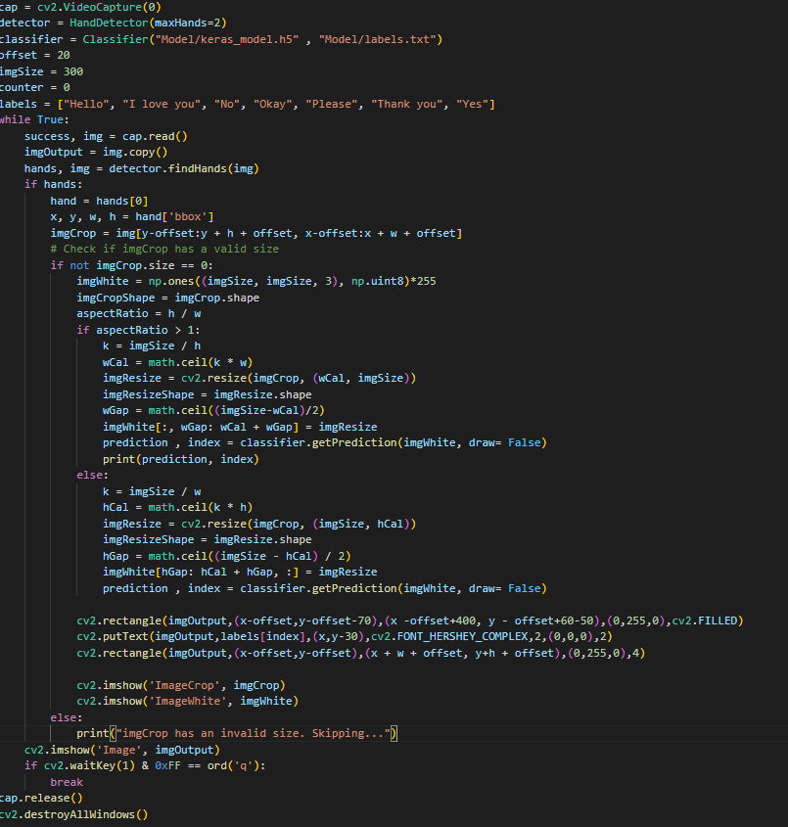
Source Code:

Slide 9
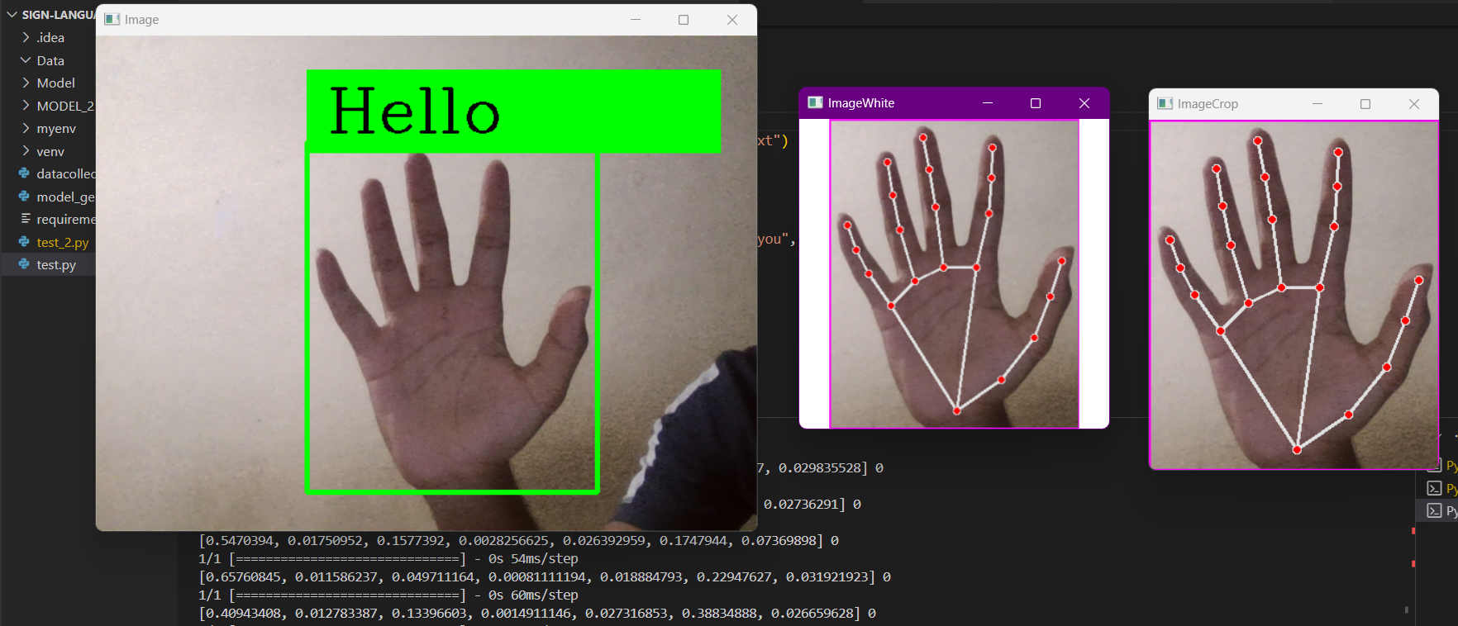
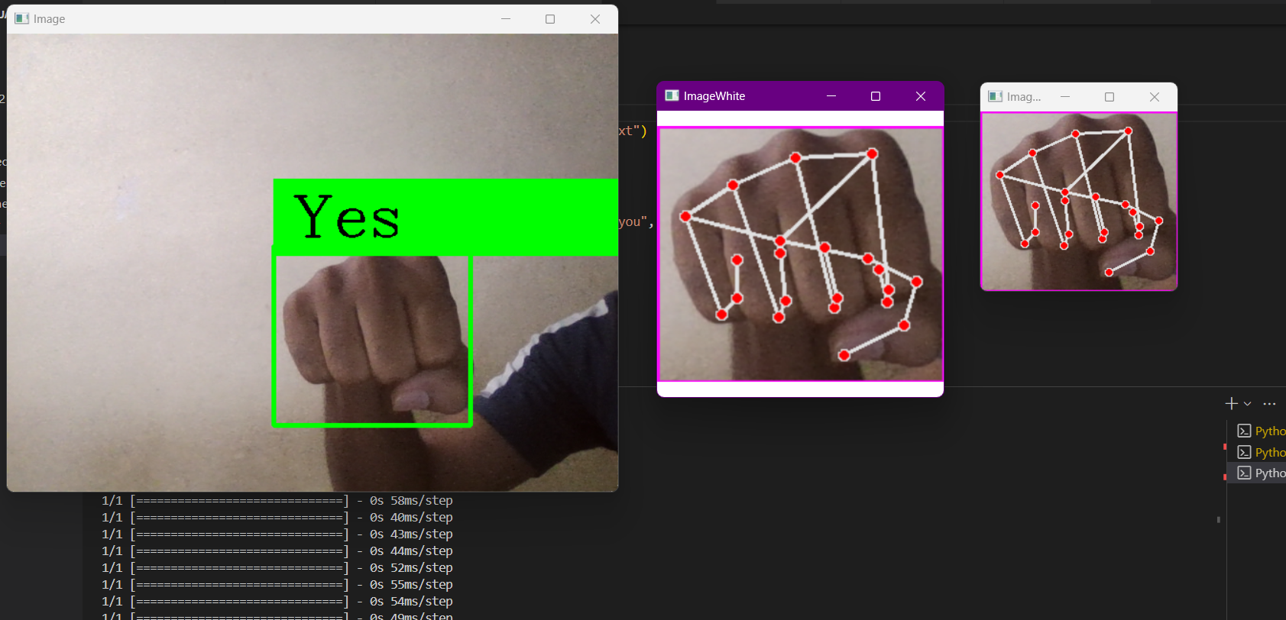
Graphical User Interface

Slide 10
Project Conclusion
The main purpose of sign language detection system is providing a feasible way of communication between a normal and dumb people by using hand gesture.
The proposed system can be accessed by using webcam or any in-built camera that detects the signs and processes them for recognition
From the result of the model Custom gestures can easily be added and more the images taken at different angle and frame will provide more accuracy to the model.
Thus, we can conclude that the proposed system can give accurate results under controlled light and intensity.
The model can be used by any person with a basic knowledge of tech and thus available for everyone.
This model can be implemented at elementary school level so that kids at a very young age can get to know about the sign language.

Slide 11
Future Scope
The implementation of our model for other sign languages such as Indian sign language or American sign language.
Further training the neural network to efficiently recognise symbols.
Enhancement of model to recognise expressions.
Language Translation Integration:
Integrate language translation capabilities to translate sign language gestures into spoken or written language in real-time.
Utilize machine translation techniques and APIs to support multiple languages, enhancing accessibility and communication for users.
Improved Accuracy and Robustness:
Enhance the accuracy and robustness of the sign language detection model.
Ensure more reliable recognition of sign language gestures, resulting in a better user experience and usability.
Enhanced User Interface and Multi-modal Integration:
Explore multi-modal integration with additional sensors and output modalities to enhance versatility and accessibility for individuals with disabilities.

Slide 12
