Slide 1

🧠 Alzheimer’s Disease Classification
PRESENTED BY:
M. RAJU

Slide 2
AGENDA
Objective
Dataset Overview
Exploratory Data Analysis
Methodology : Classification Models
Key Findings & Results
Deployment of the Application
Learnings
Future Scope
Conclusion

Slide 3
OBJECTIVE
Dataset of 2,149 patients with demographic, lifestyle, medical, and cognitive details
Goal: Classify patients into Alzheimer’s vs. non-Alzheimer’s groups
Help doctors and researchers identify Alzheimer’s patients early using patient health and lifestyle data.
Understand risk factors like age, family history, medical conditions, and lifestyle habits.
Build predictive models that classify patients into Alzheimer’s vs. non-Alzheimer’s groups.
Provide visual insights and an interactive app to make predictions accessible and easy to use.
Support better healthcare planning and awareness for patients, families, and clinicians.

Slide 4
DATASET OVERVIEW
Demographics: Age (60–90), Gender, Ethnicity, Education
Lifestyle: BMI, Smoking, Alcohol, Physical Activity, Diet, Sleep
Medical History: Family history, Cardiovascular disease, Diabetes, Depression, Head injury, Hypertension
Clinical Measurements: Blood pressure, Cholesterol (Total, LDL, HDL, Triglycerides)
Cognitive & Functional: MMSE, Functional Assessment, ADL, Memory complaints, Behavioral problems
Symptoms: Confusion, Disorientation, Personality changes, Forgetfulness
Diagnosis: Alzheimer’s (1) / No Alzheimer’s (0)

Slide 5
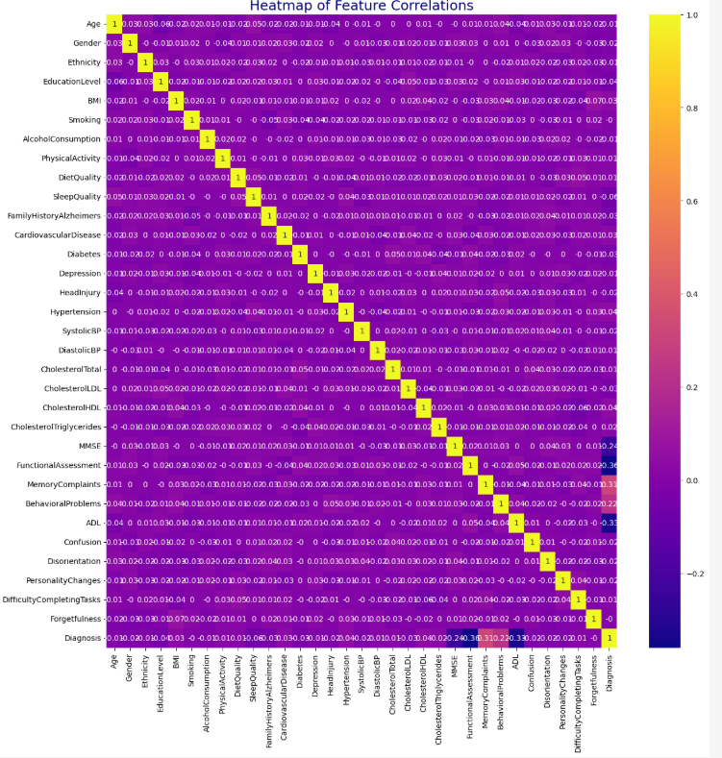
EDA Methodology
Descriptive statistics (mean, median, standard deviation)
Distribution analysis (histograms, boxplots)
Correlation analysis (heatmap)
Insights:
MMSE strongly linked with diagnosis
Lifestyle factors (diet, sleep, activity) show protective trends
Medical history (diabetes, hypertension) increases risk

Slide 6
⚙️ Classification Methodology
Techniques Used: Logistic Regression, Random Forest
Evaluation Metrics: Accuracy, Precision, Recall, F1-score
Feature Engineering: Scaling, encoding categorical variables, handling missing values
Model Comparison:
Logistic Regression: Baseline
Random Forest: Best balance of accuracy & interpretability

Slide 7
📈 Results & Visualization
Random Forest achieved - 100% accuracy
Top Predictors: MMSE, Functional Assessment, Family History, Age, Sleep Quality
 | PRECISION | RE-CALL | F1-SCORE | SUPPORT
0 | 1.00 | 1.00 | 1.00 | 1112
1 | 1.00 | 1.00 | 1.00 | 609
Accuracy | 1.00 | 1.00 | 1.00 | 1719
macro avg | 1.00 | 1.00 | 1.00 | 1719
weighted avg | 1.00 | 1.00 | 1.00 | 1719

Slide 8
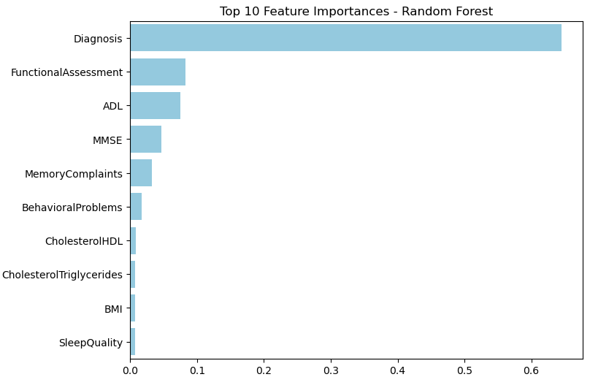
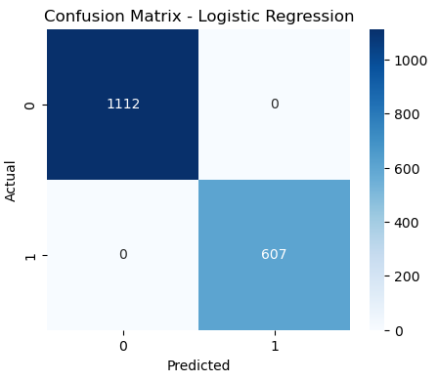
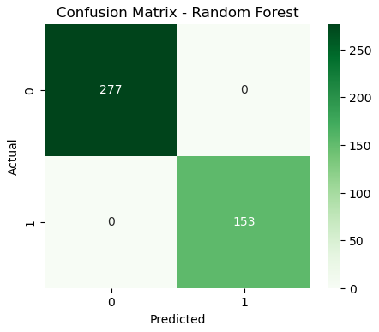
Visualizations
Confusion matrix feature importance chart

Slide 9
DEPLOMENT
Deployment
Platform: Streamlit
Purpose:
Upload patient data → Predict Alzheimer’s risk
Visualize feature importance & risk factors
Provide interactive healthcare insights

Slide 10
Learnings
Importance of preprocessing medical datasets
Strong correlation between cognitive scores and diagnosis
Lifestyle factors play a measurable role in risk reduction
Ensemble models outperform simple classifiers
🔮 Future Scope
Extend analysis with longitudinal patient data
Integrate genetic and imaging biomarkers
Use deep learning (CNN/RNN) for advanced prediction
Apply models in clinical decision support systems

Slide 11
✅ Conclusion
Dataset highlights key risk factors for Alzheimer’s
Classification models achieved strong predictive performance
Results can support early detection, healthcare planning, and policy-making
Interactive app makes insights accessible to researchers & clinicians

Slide 12
thank YOU

