Slide 1

🌍 Global Development Clustering
PRESENTED BY :
M. Raju
Spoorthi

Slide 2
AGENDA
Objective
Dataset Overview
Exploratory Data Analysis
Methodology : Clustering Models
Key Findings & Results
Deployment of the Application
Learning's
Future Scope
Conclusion

Slide 3
OBJECTIVE
We used a rich dataset of world economic and social data (like GDP, literacy, life expectancy).
Our goal is to group countries into clusters based on these development indicators.
These clusters give useful insights for comparing countries and supporting planning/decisions.
We built an interactive app (Streamlit/Flask) so anyone can upload data and see the results.

Slide 4
📊 DATASET OVERVIEW
The dataset includes a rich set of variables that capture various facts of a country's development
Source : World Development Measurements Dataset
Economic : GDP, Business Tax Rate, Lending Interest, Tourism Inbound/Outbound
Social : Birth Rate, Infant Mortality Rate, Life Expectancy (Female & Male), Population (Total & Urban)
Environmental : CO2 Emissions, Energy Usage
Technology & Infrastructure : Internet Usage, Mobile Phone Usage

Slide 5
EDA Methodology
Descriptive Statistics: Mean, Median, Standard Deviation
Distribution Analysis: Histograms, Boxplots
Correlation Analysis: Heatmap to detect relationships
Insights Extracted: GDP ↔ Life Expectancy correlation, variance in healthcare/education metrics

Slide 6
Clustering Methodology
Techniques Used: KMeans, DBSCAN, Hierarchical
Evaluation Metric: Silhouette Score
Dimensionality Reduction: PCA for visualization
KMeans Clustering
Tried values of k = 2 to 8
Optimal k selected based on silhouette score (~4)
Assigns each country to a development cluster
DBSCAN & Hierarchical
DBSCAN: Handles outliers and noise, flexible shape clusters
Hierarchical: Useful for small datasets, dendrogram view
Comparison made across methods
Silhouette Scores:
K-Means : 0.24
Hierarchical : 0.60
DBSCAN : -0.36

Slide 7
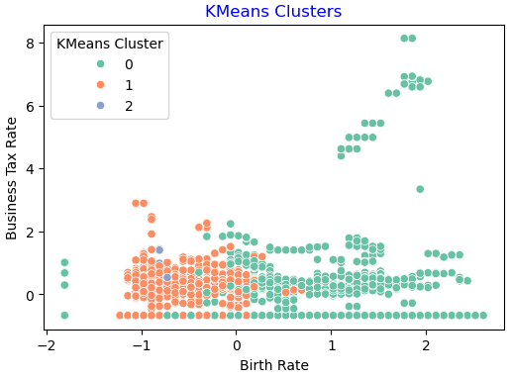
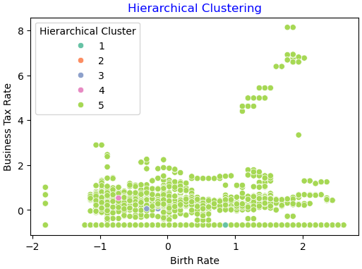
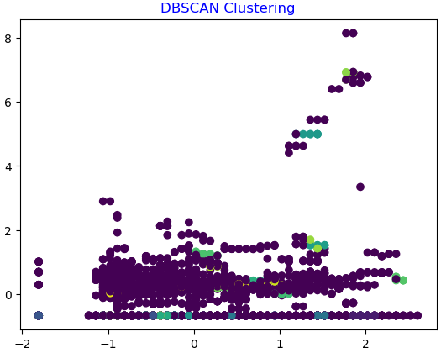
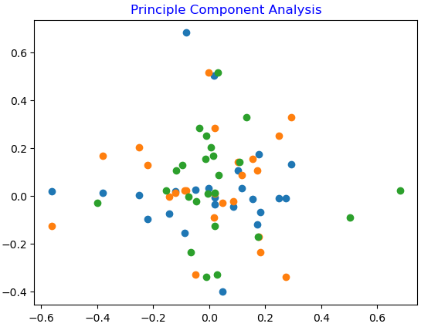
CLUSTERING VISUALIZATION

Slide 8
CLUSTER PROFILES
Cluster 0: High GDP, literacy, life expectancy (Developed nations)
Cluster 1: Medium GDP, improving literacy, moderate healthcare (Emerging economies)
Cluster 2: Low GDP, low literacy, poor healthcare (Underdeveloped)
Cluster 3: Mixed indicators, transitional countries
DEPLOYMENT
Platform: The final clustering application is deployed on a user-friendly platform ,Streamlit.
Purpose: The deployed application will provide an interactive way for stakeholders to:
  Visualize the clusters and the countries within them.
  Explore the defining characteristics of each cluster.
  Gain actionable insights from the data in real-time.

Slide 9
Project Overview
Objective: Cluster countries based on socio-economic indicators to uncover development patterns using unsupervised learning.
Clustering Methods: Implements KMeans, DBSCAN, and Hierarchical (Agglomerative) clustering.
Evaluation: Uses silhouette scores to compare clustering performance across methods.
Visualization: PCA-based 2D scatterplots with legends to show cluster separation.
Cluster Profiling: Describes each cluster using adaptive, percentile-based summaries (e.g., Low/Moderate/High GDP).
Interactive App: Streamlit interface for model selection, parameter tuning, and real-time visualization.
Notebook Analysis: Jupyter notebook includes reproducible code for comparative analysis and profiling.
Data Handling: Cleans missing values, scales features, and excludes noise points from summaries.
Use Case: Ideal for policy analysis, development research, and exploratory data science.
Tech Stack: Python, pandas, scikit-learn, matplotlib, Streamlit

Slide 10
LEARNINGS
Gained insights into preprocessing socio-economic datasets
Observed strong correlations among key development indicators
Understood the application of clustering algorithms on real-world data
Learned to evaluate clustering performance using silhouette score and visualization
FUTURE SCOPE
Extend analysis with time-series development data
Integrate environmental and governance indicators
Use advanced clustering (Gaussian Mixture Models, Spectral Clustering)
Apply supervised ML models for predictive analysis of country development

Slide 11
CONCLUSION
Clustering highlighted distinct groups of countries based on development metrics
Developed vs. underdeveloped nations show clear separation
Emerging economies identified as transitional clusters
Results can support policy-making and resource allocation decisions

Slide 12
THANK YOU

