Slide 1


Artificial Intelligence: Shaping the Future
Artificial Intelligence (AI) has become a transformative force, rapidly reshaping our world. This presentation explores the vast potential and challenges associated with AI, highlighting its diverse applications and the ethical considerations it raises.

Slide 2
Benefits of AI: Revolutionizing Industries
Increased Efficiency
24/7 Availability
AI automates repetitive tasks, reducing errors and boosting productivity.
AI systems work tirelessly, ensuring continuous operations and responsiveness.

Slide 3

AI Across Industries: A Transformative Impact
Healthcare
Finance
AI assists in diagnosis, treatment planning, and drug discovery.
AI detects fraud, manages risk, and automates trading in the stock market.
Transportation
AI powers self-driving cars, enhancing road safety and efficiency.

Slide 4



Navigating the Risks of AI
Job Displacement
Privacy Concerns
AI automation may lead to job losses in various sectors.
AI raises concerns about data collection and user privacy.

Slide 5
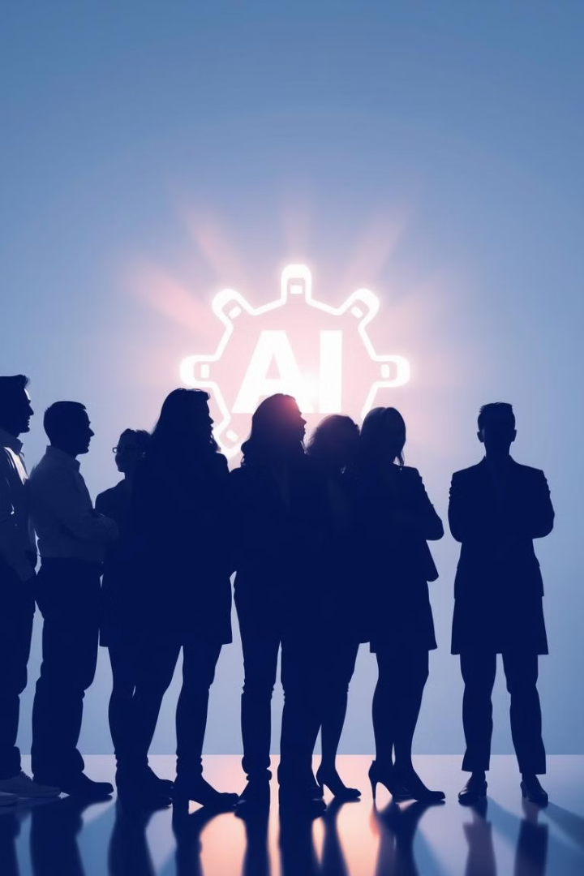
Aplication : Exam

Slide 6
Thank You

