Slide 1


ASP .NET WEB API
Neelam Rajendra naidu
19th December 2017

Slide 2
Agenda
What is ASP.NET WEB API & RESTful Services
HTTP Request and Response system
CRUD Operations
MediaTypeFormatters and content negotiation
Authentication
Routing
WEB API versioning
Notes:
String – reference type
Null-terminated – end of string
Seq of chars and some meta info
Unicode allows correctly render any symbol for every locale

Slide 3
What is ASP.NET WEB API ?
ASP.NET Web API is a framework for building Web API’s, i.e. HTTP based services on top of the .NET Framework. The most common use case for using Web API is for building RESTful services. These services can then be consumed by a broad range of clients like 1. Browsers 2. Mobile applications 3. Desktop applications
4.IOT’s (Security systems, Electronic appliances etc.)
What are RESTful services ?
REST stands for Representational State Transfer. REST is an architectural pattern for creating an API that uses HTTP as its underlying communication method.
The REST architectural pattern specifies a set of constraints that a system should adhere to.
Client Server constraint
Stateless constraint
Cacheable constraint
Uniform Interface
Notes:
String – reference type
Null-terminated – end of string
Seq of chars and some meta info
Unicode allows correctly render any symbol for every locale

Slide 4
HTTP Request and Response system
Request Verbs : These HTTP verbs (GET, POST, PUT & DELETE) describe what should be done with the resource. For example do you want to create, read, update or delete an entity. GET, PUT, POST and DELETE http verbs are the most commonly used one's. For the complete list of the HTTP verbs, please Request Header : When a client sends request to the server, the request contains a header and a body. The request header contains additional information such as what type of response is required. For example, do you want the response to be in XML or JSON. Request Body : Request Body contains the data to send to the server. For example, a POST request contains the data for the new item that you want to create. The data format may be in XML or JSON. Response Body : The Response Body contains the data sent as response from the server. For example, if the request is for a specific product, the response body includes product details either in XML or JSON format. Response Status codes : These are the HTTP status codes, that give the client details on the status of the request. Some of the common status codes are 200/OK, 404/Not Found, 204/No Content.

Slide 5
CRUD Operations
When we talk about a database table row, these are the following 4 actions that we can perform on the row C - Create a row R - Read a row U - Update a row D - Delete a row In the context of an ASP.NET Web API resource these 4 actions correspond to GET, POST, PUT and DELETE as shown in the table below
CRUD | HTTP Verb
Create | POST
Read | GET
Update | PUT
Delete | DELETE
Notes:
String – reference type
Null-terminated – end of string
Seq of chars and some meta info
Unicode allows correctly render any symbol for every locale

Slide 6
Web API Controller:
Web API Controller is similar to ASP.NET MVC controller. It handles incoming HTTP requests and send response back to the clients.
Web API controller is a class which can be created under the Controllers folder or any other folder under your project's root folder. The name of a controller class must end with "Controller" and it must be derived from System.Web.Http.ApiController class. All the public methods of the controller are called action methods.
public class EmployeesController : ApiController
{
public Ienumerable<Employee> Get()
{}
public HttpResponseMessage Post([FromBody]Employee employee)
{}
public HttpResponseMessage Delete(int id)
{}
public HttpResponseMessage Put(int id, [FromBody]Employee employee)
{}
}

Slide 7
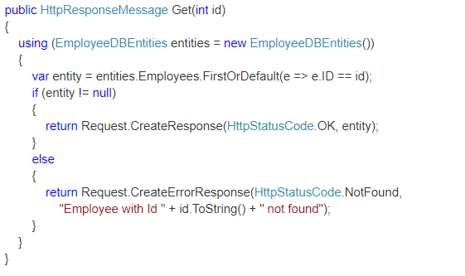
Implementing Get method in ASP.NET Web API

Slide 8
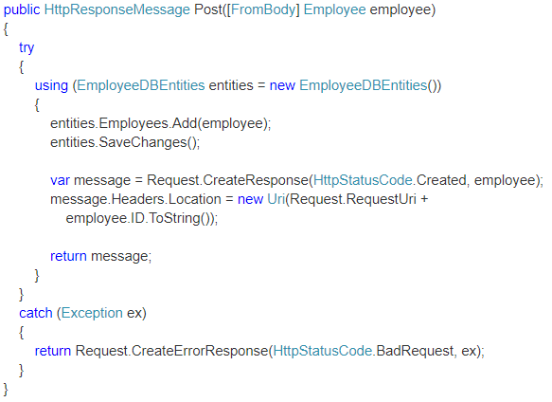
Implementing POST method in ASP.NET Web API

Slide 9
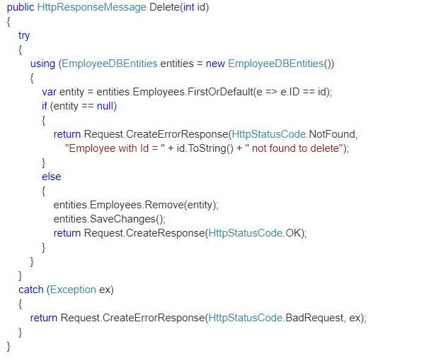
Implementing DELETE method in ASP.NET Web API

Slide 10
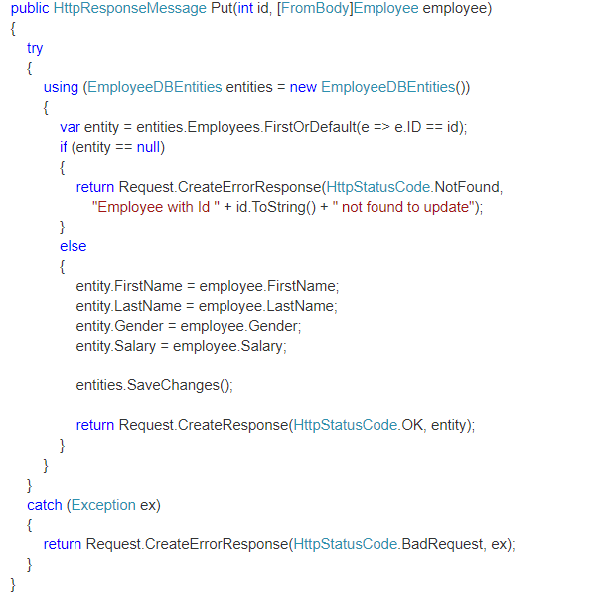
Implementing PUT method in ASP.NET Web API

Slide 11
Content negotiation and MediaTypeFormatters
One of the standards of the RESTful service is that, the client should have the ability to decide in which format they want the response - XML, JSON etc. A request that is sent to the server includes an Accept header. Using the Accept header the client can specify the format for the response.
For example Accept: application/xml returns XML Accept: application/json returns JSON Depending on the Accept header value in the request, the server sends the response. This is called Content Negotiation. So what does the Web API do when we request for data in a specific format : The Web API controller generates the data that we want to send to the client. For example, if you have asked for list of employees. The controller generates the list of employees, and hands the data to the Web API pipeline which then looks at the Accept header and depending on the format that the client has requested, Web API will choose the appropriate formatter. For example, if the client has requested for XML data, Web API uses XML formatter. If the client has requested for JSON data, Web API uses JSON formatter. These formatters are called Media type formatters.
Notes:
String – reference type
Null-terminated – end of string
Seq of chars and some meta info
Unicode allows correctly render any symbol for every locale

Slide 12
MediaTypeFormatters
MediaTypeFormatter is an abstract class from which JsonMediaTypeFormatter and XmlMediaTypeFormatter classes inherit from. JsonMediaTypeFormatter handles JSON and XmlMediaTypeFormatter handles XML
How to return only JSON from ASP.NET Web API Service irrespective of the Accept header value
Include the following line in Register() method of WebApiConfig.cs file in App_Start folder
config.Formatters.Remove(config.Formatters.XmlFormatter);
How to return only XML from ASP.NET Web API Service irrespective of the Accept header value
Include the following line in Register() method of WebApiConfig.cs file in App_Start folder
config.Formatters.Remove(config.Formatters.XmlFormatter);

Slide 13
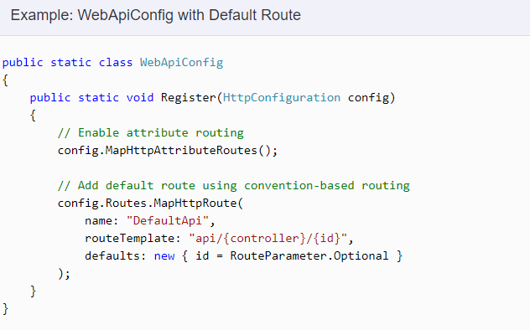
Routing
It routes an incoming HTTP request to a particular action method on a Web API controller.
Web API supports two types of routing:
Convention-based Routing
Attribute Routing
Convention-based Routing:
In the convention-based routing, Web API uses route templates to determine which controller and action method to execute. At least one route template must be added into route table in order to handle various HTTP requests
Notes:
String – reference type
Null-terminated – end of string
Seq of chars and some meta info
Unicode allows correctly render any symbol for every locale

Slide 14
Attribute Routing:
Using the [Route] attribute to define routes is called Attribute Routing
Attribute routing gives us more control over the URIs than convention-based routing. Creating URI patterns like hierarchies of resources (For example, students have courses, Departments have employees) is very difficult with convention-based routing. With attribute routing all you have to do is use the [Route] attribute as shown below. [Route("api/students/{id}/courses")] How to enable Attribute Routing In ASP.NET Web API 2, Attribute Routing is enabled by default. The following line of code in WebApiConfig.cs file enables Attribute Routing. config.MapHttpAttributeRoutes(); Can we use both Attribute Routing and Convention-based routing in a single Web API project: Yes, both the routing mechanisms can be combined in a single Web API project. The controller action methods that have the [Route] attribute uses Attribute Routing, and the others without [Route] attribute uses Convention-based routing

Slide 15
WEB API versioning
Why is versioning required in Web API?
Once a Web API service is made public, different client applications start using your Web API services.
As the business grows and requirements change, we may have to change the services as well, but the changes to the services should be done in way that does not break any existing client applications.
This is when Web API versioning helps. We keep the existing services as is, so we are not breaking the existing client applications, and develop a new version of the service that new client applications can start using.
Different options available to version Web API services :
Versioning can be implemented using
URI’s
Query String
Version Header
Accept Header
Media Type
Notes:
String – reference type
Null-terminated – end of string
Seq of chars and some meta info
Unicode allows correctly render any symbol for every locale

Slide 16
Q & A

Slide 17
THANK YOU
For your attention

