Slide 1
PERFORMANCE METRICS IN MACHINE LEARNING

Slide 2
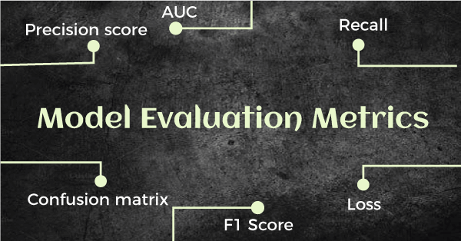
To evaluate the performance or quality of the model, different metrics are used, and these metrics are known as performance metrics or evaluation metrics.
These performance metrics help us understand how well our model has performed for the given data.

Slide 3
Performance Metrics for Classification
To evaluate the performance of a classification model, different metrics are used, and some of them are as follows:
Confusion Matrix
Accuracy
Precision
Recall
F-Score
AUC(Area Under the Curve)-ROC

Slide 4
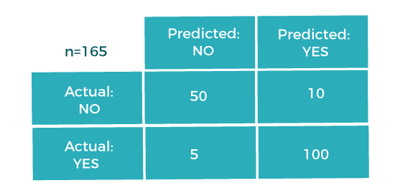
I. Confusion Matrix
A confusion matrix is a tabular representation of prediction outcomes of any binary classifier, which is used to describe the performance of the classification model on a set of test data when true values are known.
In the matrix, columns are for the prediction values, and rows specify the Actual values.
In this example, the total number of predictions are 165, out of which 110 time predicted yes, whereas 55 times predicted No.

Slide 5
Confusion Matrix
True Positive(TP): In this case, the prediction outcome is true, and it is true in reality, also.
True Negative(TN): in this case, the prediction outcome is false, and it is false in reality, also.
False Positive(FP): In this case, prediction outcomes are true, but they are false in actuality.
False Negative(FN): In this case, predictions are false, and they are true in actuality.

Slide 6
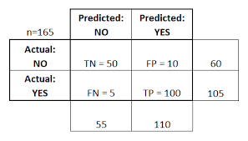

Slide 7

II. Accuracy
The accuracy metric is one of the simplest Classification metrics to implement, and it can be determined as the number of correct predictions to the total number of predictions.
To implement an accuracy metric, we can compare ground truth and predicted values in a loop, or we can also use the scikit-learn module for this.
It is suitable only for cases where an equal number of samples belong to each class.
It is good to use the Accuracy metric when the target variable classes in data are approximately balanced. For example, if 60% of classes in a fruit image dataset are of Apple, 40% are Mango

Slide 8

III. Precision
The precision metric is used to overcome the limitation of Accuracy.
The precision determines the proportion of positive prediction that was actually correct.
It can be calculated as the True Positive or predictions that are actually true to the total positive predictions
used in document retrievals, may be defined as the number of correct documents returned by our ML model

Slide 9

IV. Recall or Sensitivity
Recall may be defined as the number of positives returned by our ML model
The recall measures the model's ability to detect positive samples.
The higher the recall, the more positive samples detected.
It can be calculated as True Positive or predictions that are actually true to the total number of positives, either correctly predicted as positive or incorrectly predicted as negative

Slide 10
When to use Precision and Recall?
From the above definitions of Precision and Recall, we can say that recall determines the performance of a classifier with respect to a false negative, whereas precision gives information about the performance of a classifier with respect to a false positive.
So, if we want to minimize the false negative, then, Recall should be as near to 100%, and if we want to minimize the false positive, then precision should be close to 100% as possible.
In simple words, if we maximize precision, it will minimize the FP errors, and if we maximize recall, it will minimize the FN error.

Slide 11
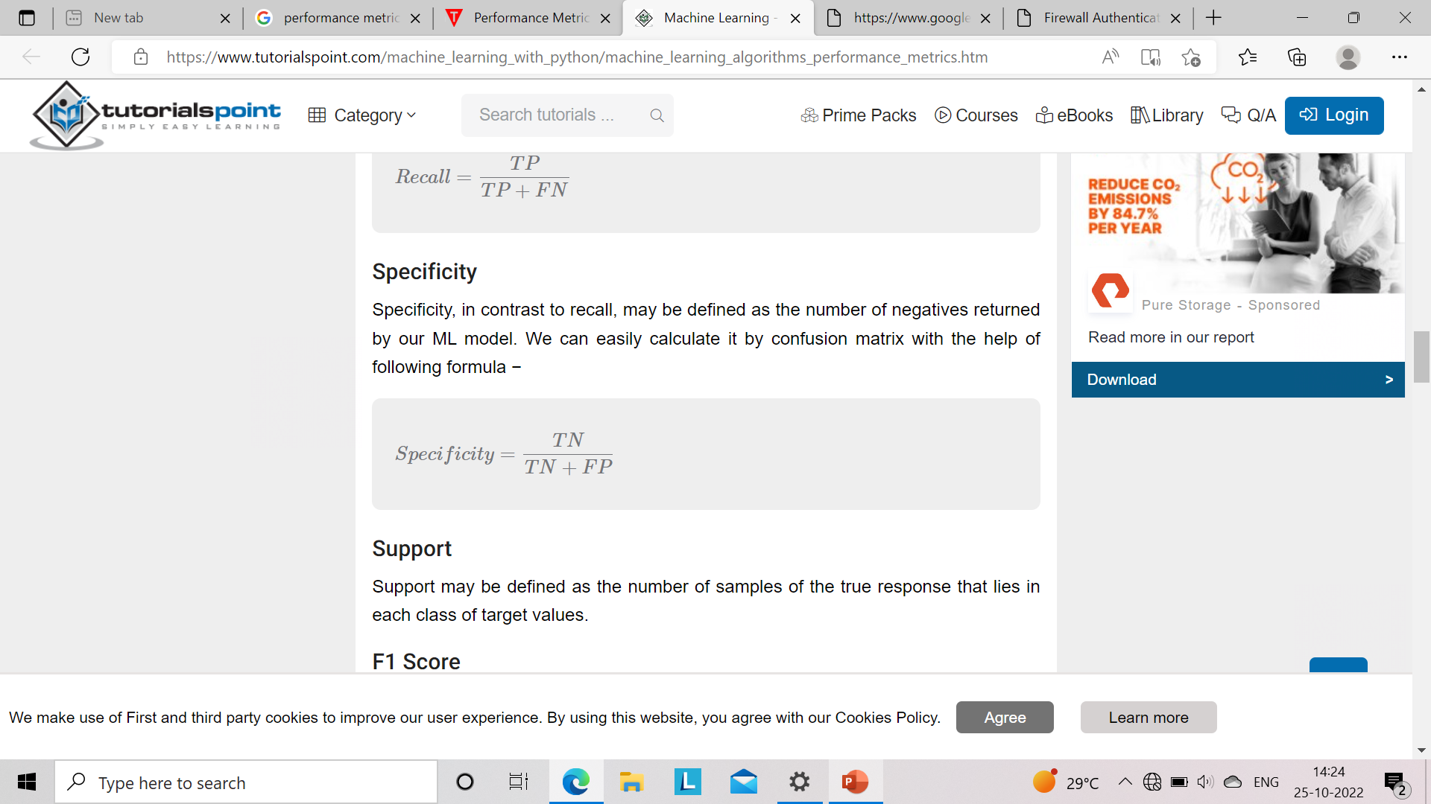

Slide 12

V. F-Scores
This score will give us the harmonic mean of precision and recall.
Mathematically, F1 score is the weighted average of the precision and recall
Metric to evaluate a binary classification model on the basis of predictions that are made for the positive class
It should be used if both of them are important for evaluation, but one (precision or recall) is slightly more important to consider than the other.
For example, when False negatives are comparatively more important than false positives, or vice versa.

Slide 13
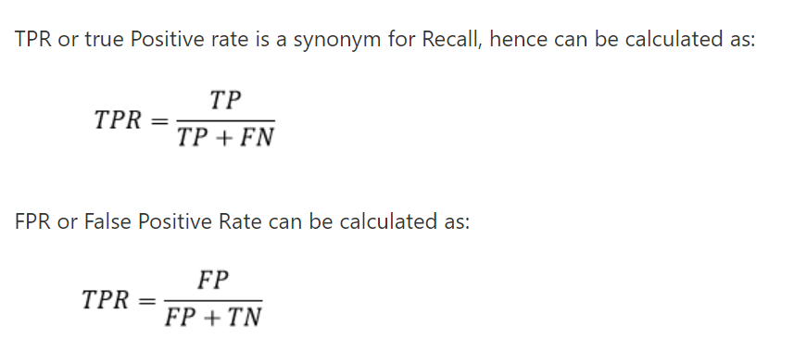
VI. AUC(Area Under Curve) -ROC (Receiver Operating Characteristic curve)
Used to visualize the performance of the classification model on charts
ROC represents a graph to show the performance of a classification model at different threshold levels
The curve is plotted between two parameters, which are:
True Positive Rate
False Positive Rate

Slide 14
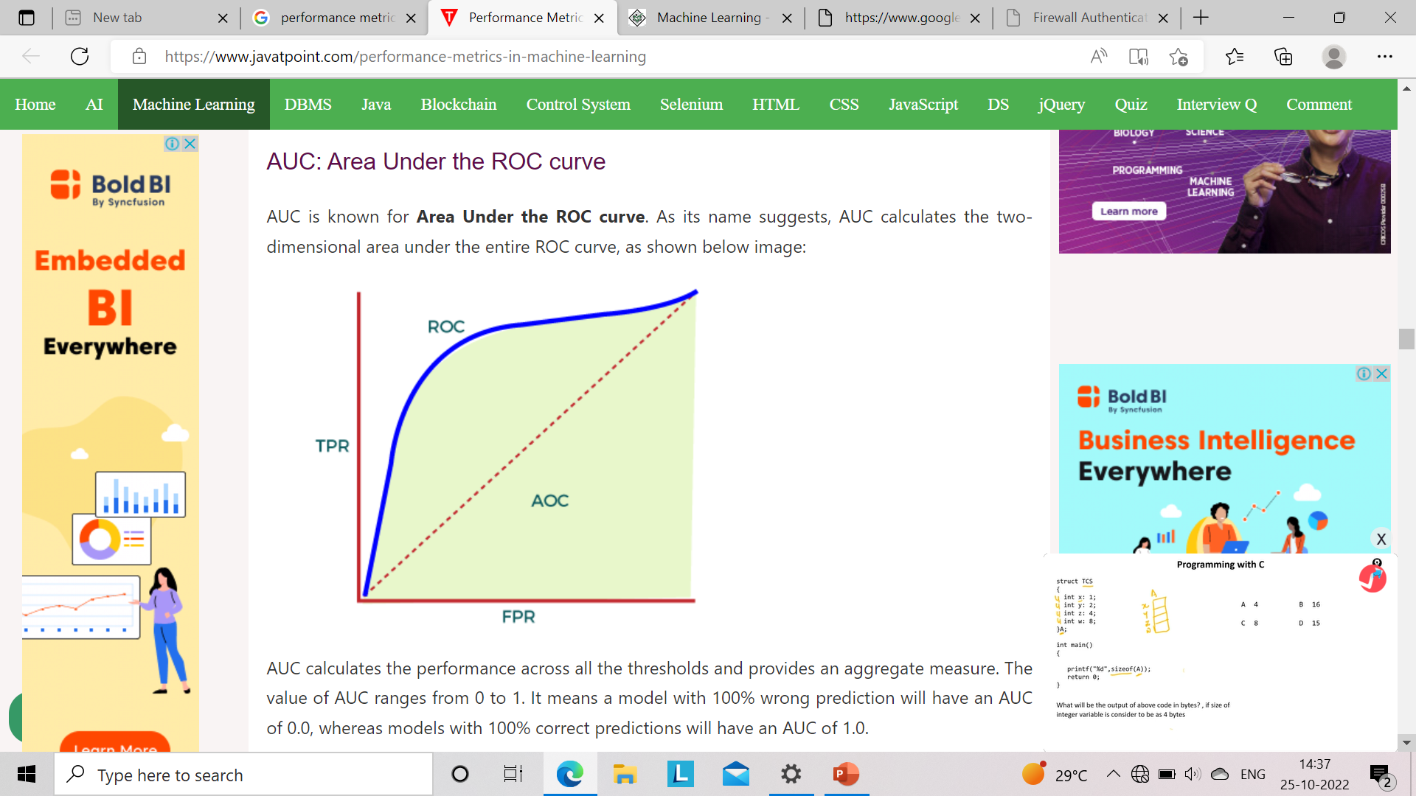

Slide 15
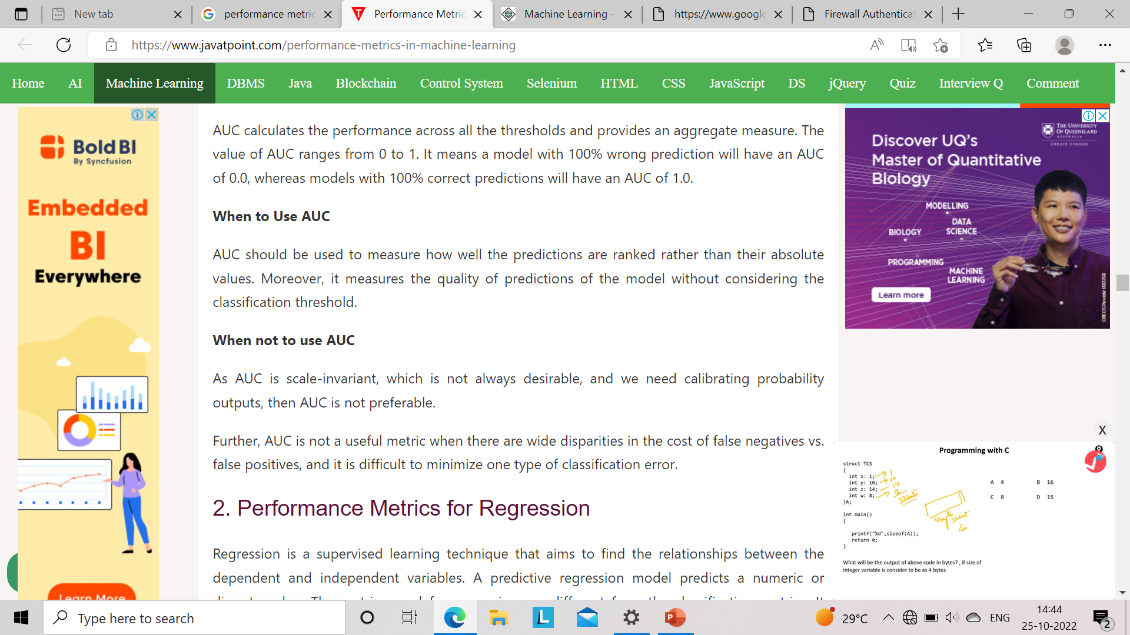

Slide 16
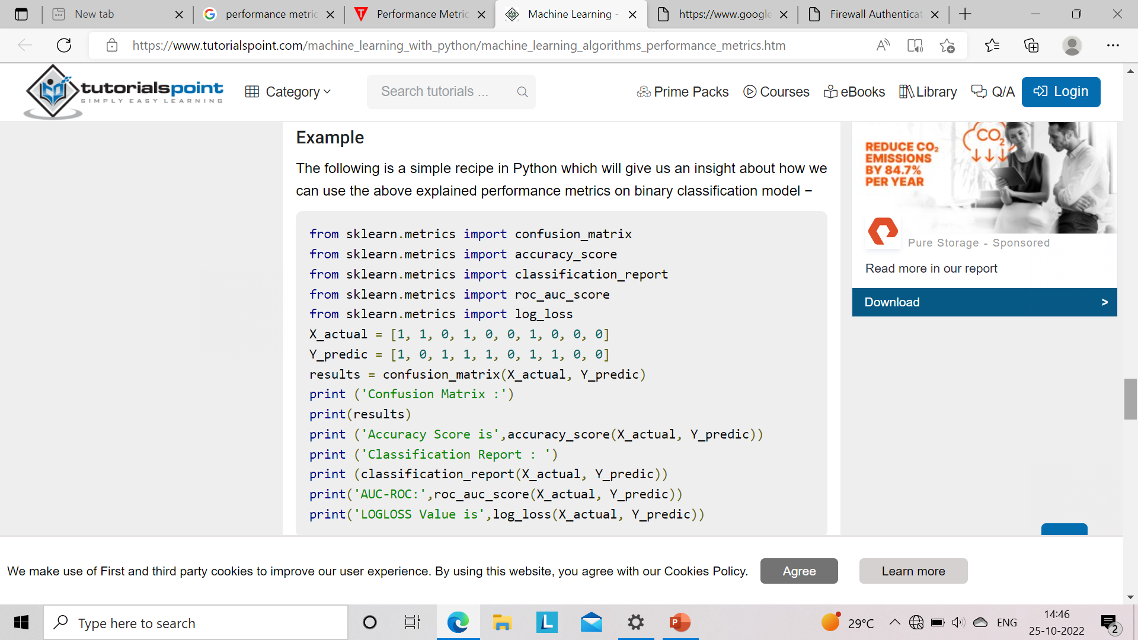
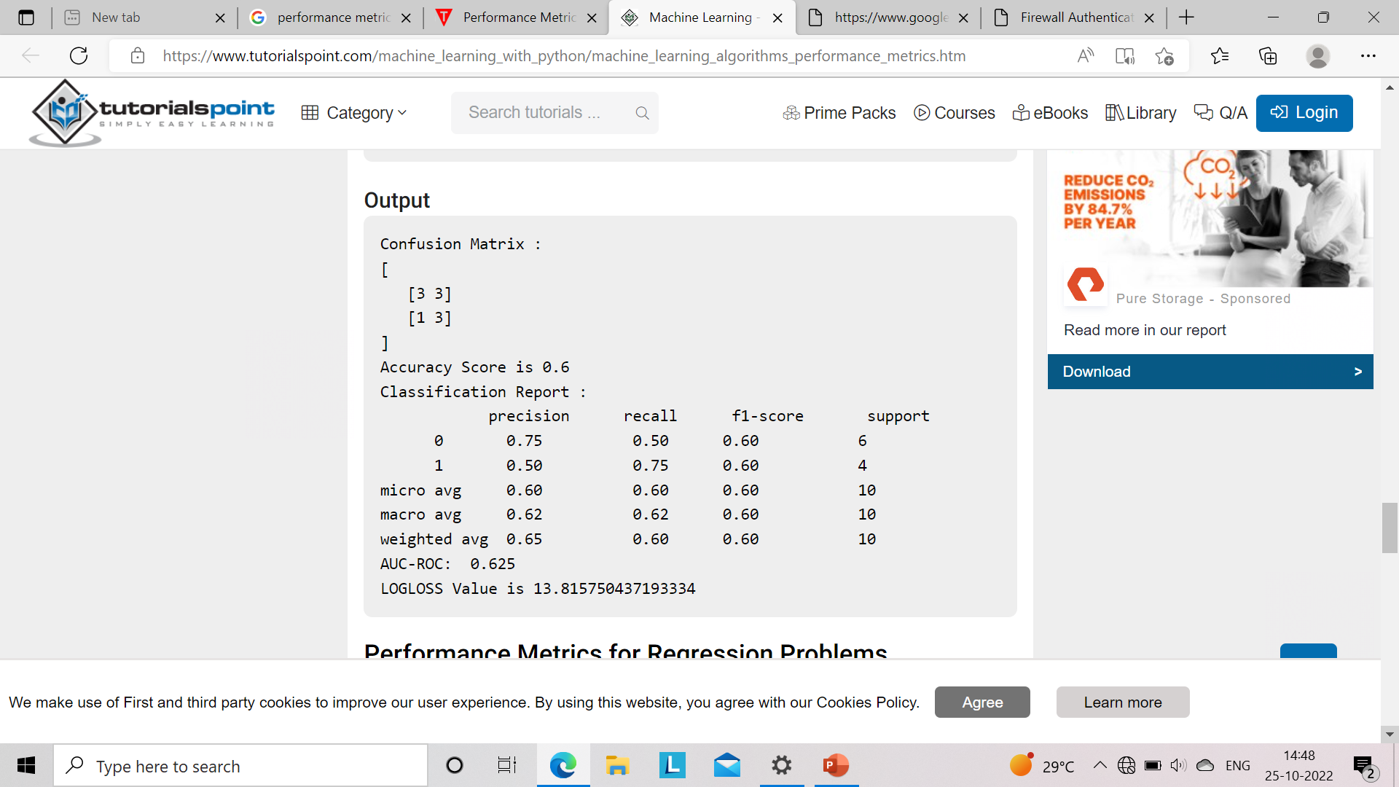

Slide 17
Performance Metrics for Regression
Popular metrics that are used to evaluate the performance of Regression models.
Mean Absolute Error
Mean Squared Error
R2 Score
Adjusted R2

Slide 18

I. Mean Absolute Error (MAE)
Mean Absolute Error or MAE is one of the simplest metrics, which measures the absolute difference between actual and predicted values, where absolute means taking a number as Positive.
It is basically the sum of average of the absolute difference between the predicted and actual values.
with MAE, we can get an idea of how wrong the predictions were.
Y is the Actual outcome, Y' is the predicted outcome, and N is the total number of data points.

Slide 19

II. Mean Square Error (MSE)
It measures the average of the Squared difference between predicted values and the actual value given by the model.
Since in MSE, errors are squared, therefore it only assumes non-negative values, and it is usually positive and non-zero.
Moreover, due to squared differences, it penalizes small errors also, and hence it leads to over-estimation of how bad the model is.
MSE is a much-preferred metric compared to other regression metrics as it is differentiable and hence optimized better.

Slide 20

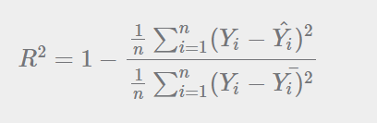
III. R Squared Score
R squared error is also known as Coefficient of Determination, which is another popular metric used for Regression model evaluation.
The R-squared metric enables us to compare our model with a constant baseline to determine the performance of the model.
To select the constant baseline, we need to take the mean of the data and draw the line at the mean.
The R squared score will always be less than or equal to 1 without concerning if the values are too large or small.
In the above equation, numerator is MSE and the denominator is the variance in 𝑌 values.

Slide 21


