Slide 1
Support Vector Machines (SVM) & SVM Classification

Slide 2
Definition
Support Vector Machine (SVM) is a supervised machine learning algorithm used for both classification and regression.
The main objective of the SVM algorithm is to find the optimal hyperplane in an N-dimensional space that can separate the data points in different classes in the feature space.
The hyperplane tries that the margin between the closest points of different classes should be as maximum as possible.
The dimension of the hyperplane depends upon the number of features. If the number of input features is two, then the hyperplane is just a line.
If the number of input features is three, then the hyperplane becomes a 2-D plane. It becomes difficult to imagine when the number of features exceeds three.

Slide 3
Why SVM
SVMs are used in applications like handwriting recognition, intrusion detection, face detection, email classification, gene classification, and in web pages.
One of the reasons we use SVMs in machine learning is : It can handle both classification and regression on linear and non-linear data.
Another reason we use SVMs is because they can find complex relationships between your data without you needing to do a lot of transformations on your own.
It's a great option when you are working with smaller datasets that have tens to hundreds of thousands of features.
They typically find more accurate results when compared to other algorithms because of their ability to handle small, complex datasets.

Slide 4
Perceptron Revisited: Linear Separators
Binary classification can be viewed as the task of separating classes in feature space:
w^{T}x + b = 0
w^{T}x + b > 0
w^{T}x + b < 0
f(x) = sign(w^{T}x + b)

Slide 5
Linear Separators
Which of the linear separators is optimal?

Slide 6
Classification Margin
Distance from example x_{i} to the separator is
Examples closest to the hyperplane are support vectors.
Margin ρ of the separator is the distance between support vectors.
ρ
r

Slide 7
Maximum Margin Classification
Maximizing the margin is good according to intuition and PAC theory.
Implies that only support vectors matter; other training examples are ignorable.

Slide 8


Slide 9
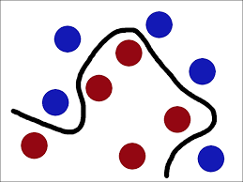
Types of SVM
Linear SVM: Linear SVM is used for linearly separable data, which means if a dataset can be classified into two classes by using a single straight line, then such data is termed as linearly separable data, and classifier is used called as Linear SVM classifier.
Non-linear SVM: Non-Linear SVM is used for non-linearly separated data, which means if a dataset cannot be classified by using a straight line, then such data is termed as non-linear data and classifier used is called as Non-linear SVM classifier.

Slide 10
Linear SVMs Mathematically (cont.)
Then we can formulate the quadratic optimization problem:
Which can be reformulated as:
Find w and b such that
is maximized
and for all (x_{i}, y_{i}), i=1..n : y_{i}(w^{T}x_{i} + b) ≥ 1
Find w and b such that
Φ(w) = ||w||²=w^{T}w is minimized
and for all (x_{i}, y_{i}), i=1..n : y_{i} (w^{T}x_{i} + b) ≥ 1

Slide 11
Soft Margin Classification
What if the training set is not linearly separable?
Slack variables ξ_{i} can be added to allow misclassification of difficult or noisy examples, resulting margin called soft.
ξ_{i}
ξ_{i}

Slide 12
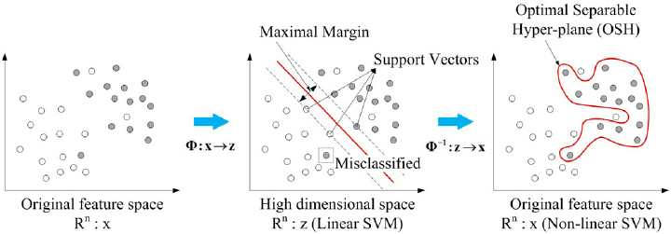
NON-LINEAR SVM

Slide 13
Types of SVM
There are two different types of SVMs, each used for different things:
Simple SVM: Typically used for linear regression and classification problems.
Kernel SVM: Has more flexibility for non-linear data because you can add more features to fit a hyperplane instead of a two-dimensional space.

Slide 14
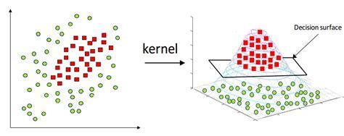

Slide 15
SVM : Pros and Cons
Pros
Effective on datasets with multiple features, like financial or medical data.
Effective in cases where number of features is greater than the number of data points.
Uses a subset of training points in the decision function called support vectors which makes it memory efficient.
Different kernel functions can be specified for the decision function. You can use common kernels, but it's also possible to specify custom kernels.

Slide 16
SVM : Pros and Cons
If the number of features is a lot bigger than the number of data points, avoiding over-fitting when choosing kernel functions and regularization term is crucial.
SVMs don't directly provide probability estimates. Those are calculated using an expensive five-fold cross-validation.
Works best on small sample sets because of its high training time.

Slide 17
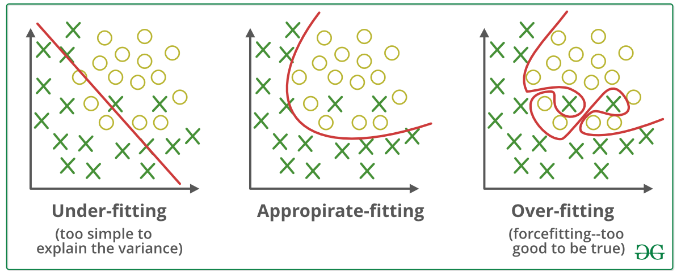

Slide 18
SVM Facts :
SVMs were originally proposed by Boser, Guyon and Vapnik in 1992 and gained increasing popularity in late 1990s.
SVMs are currently among the best performers for a number of classification tasks ranging from text to genomic data.
SVMs can be applied to complex data types beyond feature vectors (e.g. graphs, sequences, relational data) by designing kernel functions for such data.
SVM techniques have been extended to a number of tasks such as regression [Vapnik et al. ’97], principal component analysis [Schölkopf et al. ’99], etc.
Most popular optimization algorithms for SVMs use decomposition to hill-climb over a subset of α_{i}’s at a time, e.g. SMO [Platt ’99] and [Joachims ’99]
Tuning SVMs remains a black art: selecting a specific kernel and parameters is usually done in a try-and-see manner.

