Slide 1
Customer Offer Engagement Dashboard
Power BI Project Overview

Slide 2
Agenda
Project Overview
Dataset Summary -Table-wise Data Description
Team Contribution
Data Quality & Transformation Notes
Key Relationships (ERD)
DAX Calculations & Measures
Visualization & UX Design
Testing

Slide 3
Project Overview
Goal: Analyze how customers engage with marketing offers
Use Case: Optimize campaigns based on customer behavior
Tool: Microsoft Power BI
Data Sources: 4 CSV datasets (customers, offers, events, dictionary)

Slide 4
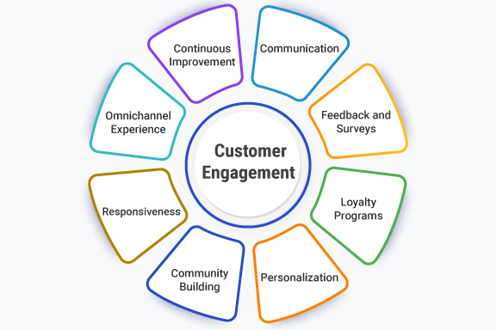

Slide 5
Dataset Summary
Dataset | Description
customers.csv | Customer demographics and signup date
offers.csv | Marketing offer types and distribution channels
events.csv | All customer interactions and transactions
data_dictionary.csv | Field-level metadata for all tables

Slide 6
Team Contribution
Learner | Assignments | Responsibility | Total Hours
1. | Data Ingestion, Customer & Offer Cleaning Data Model Setup User Guide, Coordination | Rakhmaji Dhawale | 25
2. | Event Parsing Data Model Setup Basic Measures Overview & Funnel visuals Coordination | Krishna S | 22
3. | Data Model Setup Basic Measures Segmentation & Cohorts Segmentation visuals DAX Validation, Coordination | Rajendra Chhip | 23
4. | Segmentation & Cohorts Offer Performance Behavior visuals Interactivity & Tooltips Tuning, Coordination | Ruchita Chaudhari | 24
5. | Transaction Behavior visuals DAX Validation Technical Doc, Coordination | Ruchita Kirshna Rajendra Rakhamaji | 21

Slide 7
Data Transformations Customer.csv
5 columns: customer_id, became_member_on, gender, age, income
Notes :
became_member_on: Needs conversion from text to YYYYMMDD (Date)
age: Placeholder value 118 = missing → needs cleanup and added “null”
gender/income: Handle nulls via imputation or unknown flag

Slide 8
Offers.csv -Transformations
6 columns: offer_id, offer_type, difficulty, reward, duration, channels
Notes:
channels: Stored as JSON array → requires expansion to split offer id
offer_type + rules (difficulty & reward = 0 → informational)

Slide 9
Event.csv - Transformation
4 columns: customer_id, event, value, time
Notes:
value:
JSON field → parse to extract:
offer_id_extracted for offer events
transaction_amount for purchase events
Time:
Add to became_member_on(customer.csv) to create event_timestamp

Slide 10
Data_dictionary-Transformation
3 columns: Table, Field, Description
Usage:
Helps document data model
Can be used for tooltip creation and onboarding

Slide 11
Data Modeling -Key Relationship
customers (1) ⟶ (∞) events
Primary Key: customer_id
Foreign Key in events: customer_id
Tracks which customer triggered which events
offers (1) ⟶ (∞) events
Primary Key: offer_id
Foreign Key in events: offer_id_extracted
Links events like “offer viewed” or “offer completed” to specific offers

Slide 12
offers (1) ⟶ (∞) offer_channels
Primary Key: offer_id
Foreign Key in offer_channels: offer_id
One offer may be delivered through multiple channels (email, web, mobile, etc.)

Slide 13
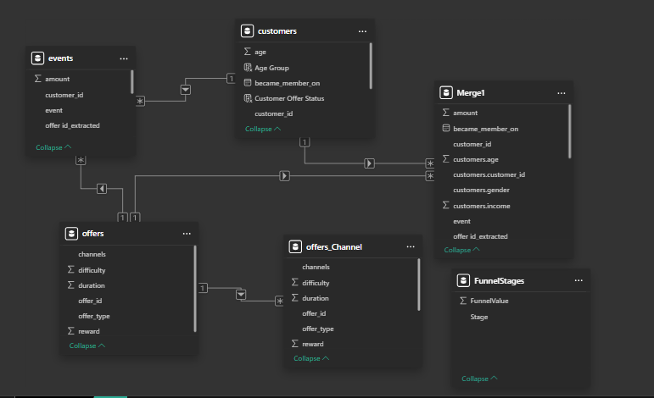

Slide 14
DAX Measures – Engagement & Demographics
Metric | DAX Expression (Simplified) | Purpose / Explanation
1. Offers Sent | COUNTROWS(events WHERE event = "offer received") | Total number of offers delivered to customers
2. Offers Viewed | COUNTROWS(events WHERE event = "offer viewed") | Measures customer interest by counting how many offers were opened
3. Offers Completed | COUNTROWS(events WHERE event = "offer completed") | Indicates how many offers led to a successful completion

Slide 15
Metric | DAX Expression (Simplified) | Purpose / Explanation
4. Redemption Rate | Offers Completed / Offers Sent | % of offers completed out of those sent – measures campaign success
5. Total Transactions | COUNTROWS(events WHERE event = "transaction") | Total number of purchase events unrelated to specific offers
6. Total Revenue | SUM(events[amount] WHERE event = "transaction") | Total monetary value of all transactions
7. Avg Transaction | AVERAGE(events[amount] WHERE event = "transaction") | Average amount spent per transaction

Slide 16
Metric | DAX Expression | Purpose / Explanation
8. Total Customers | DISTINCTCOUNT(customers[customer_id]) | Total number of unique customers in the dataset
9. Average Age | AVERAGEX(FILTER(...), customers[age]) | Average customer age, excluding blanks or placeholders
10. Income Bracket | SWITCH(TRUE(), ...) | Categorizes customers into income ranges: <40K, 40K–70K, etc. for segmentation
11. Completion Rate by Type | Offers Completed / Offers Sent grouped by offer_type | Tracks success rate for each offer category (BOGO, Discount, Informational)

Slide 17
Visualization and UX Design Page 1: Overview
Key Visuals:
- KPI Cards: Total Customers, Offers Sent, Offers Viewed, Offers Completed, Redemption Rate, Avg. Transaction Amount
- Trend Chart: Offers vs. Completions

Slide 18
Page 3: Customer Segmentation
Key Visuals:
- Demographic Slicers: Age Group, Gender, Income Bracket
- Bar Chart: Redemption Rate by Age Group
- Heatmap: Age vs Income vs Completion %

Slide 19
Page 4: Offer Performance
Key Visuals:
- Bar Chart: Redemption by Offer Type
- Bar Chart: Redemption by Channel
- Scatter Plot: Difficulty vs Completion Rate
Add Offer Type Slicer

Slide 20
Page 5: Transaction Behavior
Key Visuals:
- Line Chart: Avg. Spend Over Time
- Comparison: Customers Completed Offers vs Not
- KPI Card: Total Transactions, Total Revenue
- Filters: Date Range

Slide 21
Test Cases
Test Case ID | Description | Input | Expected Result | Actual Result | Status
TC-01 | Validate Offers Sent measure | events[event] = "offer received" | Count matches manual aggregation in PQ | Matches | ✅ Pass
TC-02 | JSON parsing for offer_id | Sample events row | Correct offer_id extracted | Correct | ✅ Pass
TC-03 | Slicer for Age Group | Select "18–25" | Only customers in range shown | Works | ✅ Pass
TC-04 | Refresh Time | Refresh full dataset | < 3 min | Works | ✅ Pass

