Slide 1

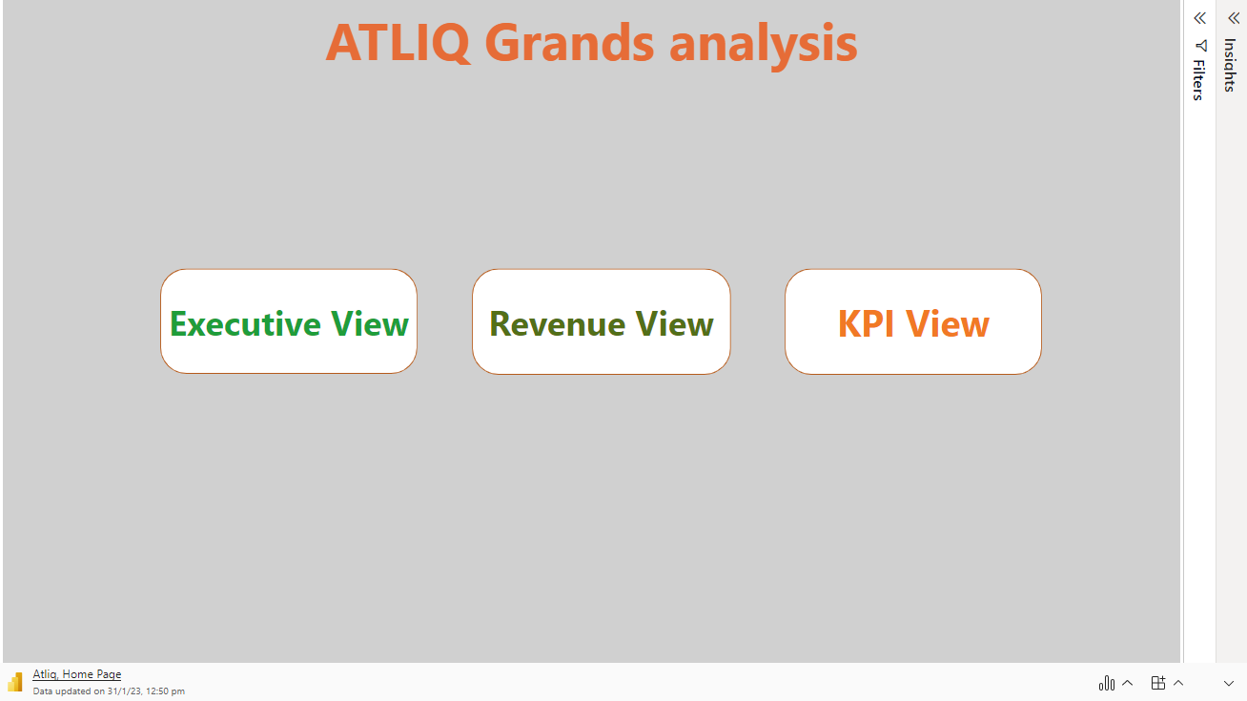
Microsoft Power BI

Slide 2
Key insights
1.𝗢𝘂𝘁 𝗼𝗳 𝘁𝗵𝗲 𝘁𝗼𝘁𝗮𝗹 𝗴𝗲𝗻𝗲𝗿𝗮𝘁𝗲𝗱 𝗿𝗲𝘃𝗲𝗻𝘂𝗲 𝗼𝗳 𝟮𝟬𝟬𝟴𝗠,𝗮𝗹𝗺𝗼𝘀𝘁 1𝟵𝟵𝗠 𝗿𝗲𝘃𝗲𝗻𝘂𝗲 𝗶𝘀 𝗹𝗼𝘀𝘁 𝘁𝗵𝗿𝗼𝘂𝗴𝗵 𝗰𝗮𝗻𝗰𝗲𝗹𝗹𝗮𝘁𝗶𝗼𝗻𝘀.
2.𝗠𝘂𝗺𝗯𝗮𝗶 𝗴𝗲𝗻𝗲𝗿𝗮𝘁𝗲𝘀 𝗵𝗶𝗴𝗵𝗲𝘀𝘁 𝗿𝗲𝘃𝗲𝗻𝘂𝗲 𝗼𝗳 𝟲𝟲𝟵𝗠 𝗮𝗺𝗼𝗻𝗴 𝗮𝗹𝗹 𝗰𝗶𝘁𝗶𝗲𝘀 𝘄𝗵𝗲𝗿𝗲𝗮𝘀𝗗𝗲𝗹𝗵𝗶 𝗴𝗲𝗻𝗲𝗿𝗮𝘁𝗲𝘀 𝗹𝗼𝘄𝗲𝘀𝘁 𝗿𝗲𝘃𝗲𝗻𝘂𝗲 𝗼𝗳 𝟮𝟵𝟱𝗠.
3.𝗪𝗵𝗲𝗻 𝗶𝘁 𝗰𝗼𝗺𝗲𝘀 𝘁𝗼 𝗿𝗼𝗼𝗺 𝗰𝗹𝗮𝘀𝘀 , 𝗘𝗹𝗶𝘁𝗲 𝗴𝗲𝗻𝗲𝗿𝗮𝘁𝗲𝘀 𝗵𝗶𝗴𝗵𝗲𝘀𝘁 𝗿𝗲𝘃𝗲𝗻𝘂𝗲 𝗼𝗳 𝟱𝟲𝟬𝗠 𝘄𝗵𝗲𝗿𝗲𝗮𝘀 𝘀𝘁𝗮𝗻𝗱𝗮𝗿𝗱 𝗰𝗹𝗮𝘀𝘀 𝗴𝗲𝗻𝗲𝗿𝗮𝘁𝗲𝘀 𝗿𝗲𝘃𝗲𝗻𝘂𝗲 𝗼𝗳 𝟯𝟭𝟬𝗠. 𝗦𝗼 𝗶𝘁 𝗶𝘀 𝗲𝘃𝗶𝗱𝗲𝗻𝘁 𝘁𝗵𝗮𝘁 𝗰𝘂𝘀𝘁𝗼𝗺𝗲𝗿𝘀 𝗰𝗵𝗼𝘀𝗲 𝗺𝗼𝗿𝗲 𝗼𝗳 𝗺𝗲𝗱𝗶𝘂𝗺 𝗿𝗮𝗻𝗴𝗲 𝗯𝘂𝗱𝗴𝗲𝘁 𝗿𝗼𝗼𝗺𝘀 .
4.𝗪𝗲𝗲𝗸 𝟮𝟭, 𝟮𝟯 ,𝟮𝟲 𝗮𝗻𝗱 𝟯𝟬 𝗵𝗮𝘀 𝗮 𝗰𝗼𝗻𝘀𝗶𝗱𝗲𝗿𝗮𝗯𝗹𝗲 𝗱𝗿𝗼𝗽 𝗶𝗻 𝗿𝗲𝘃𝗲𝗻𝘂𝗲.
5.𝗢𝘃𝗲𝗿𝗮𝗹𝗹 𝗼𝗰𝗰𝘂𝗽𝗮𝗻𝗰𝘆 𝘀𝘁𝗮𝗻𝗱𝘀 𝗮𝘁 𝟱𝟴%.
* These are the main key insights from the data *

