Slide 1

FUEL Conference 2016, Delhi
25th September, Raju Vindane

Slide 2

Brief history of Sailfish OS
Jolla is a smartphone and mobile OS provider founded in 2011 by members of the former Meego team exited when Nokia changed its strategy
Jolla continued MeeGo and has developed Sailfish OS with an innovative gesture based UI
Sailfish OS is an European Open Source mobile device operating system targeted for any mobile device
Currently Jolla Ltd. concentrates solely on mobile OS development and licensing

Slide 3

Sailfish OS
Modern Linux based operating system
Adaptable for multiple form factors and screen sizes
Many devices supporting Sailfish OS already exits and more are coming from Sailfish partners and active community

Slide 4
How the project started?

Slide 5
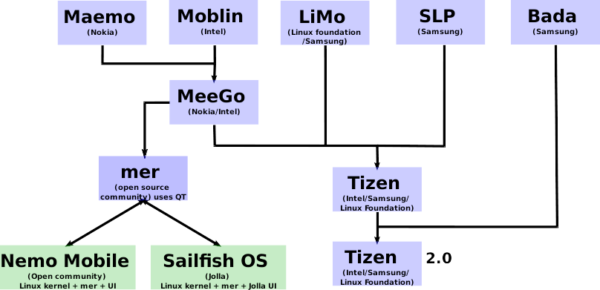

Slide 6
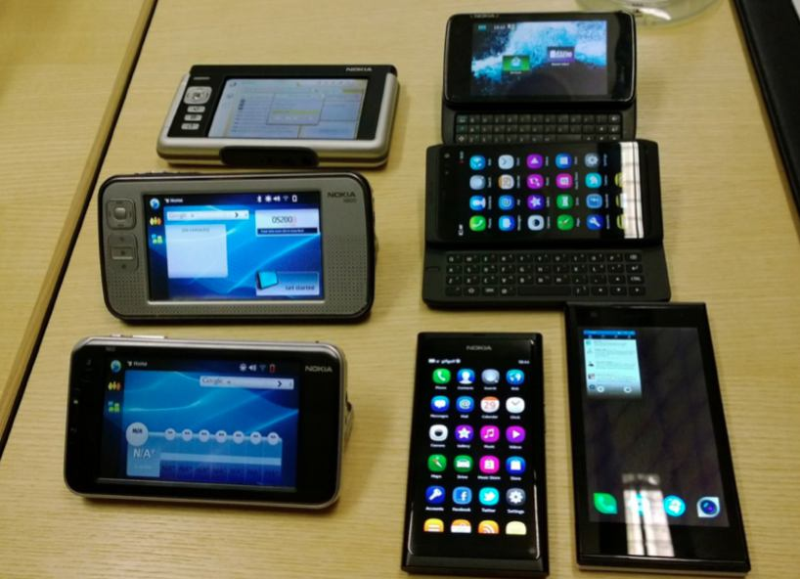

Slide 7
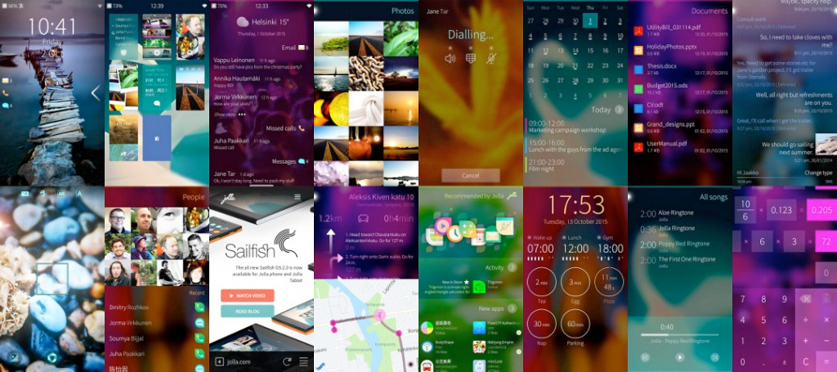

Slide 8
Devices running Sailfish OS

Slide 9


Slide 10


Slide 11


Slide 12
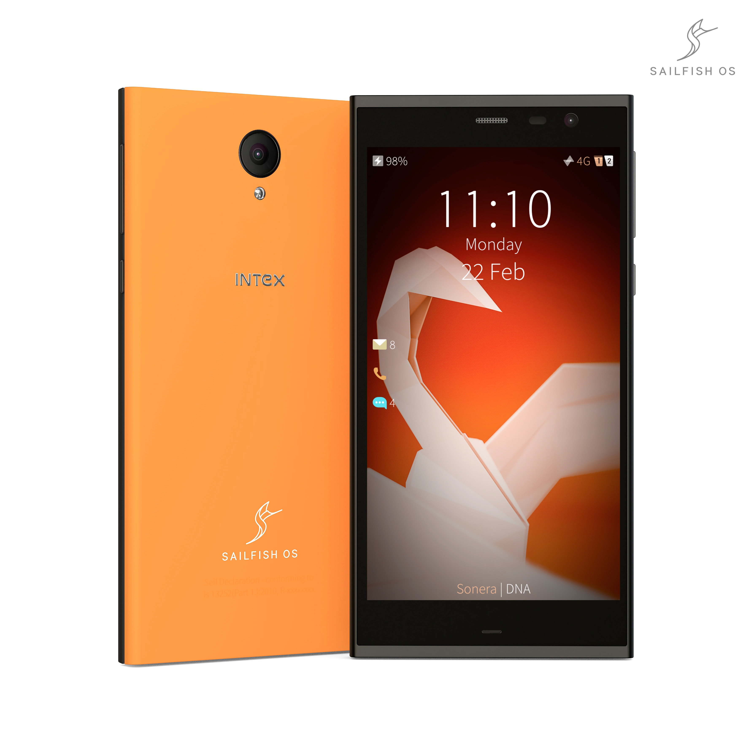

Slide 13
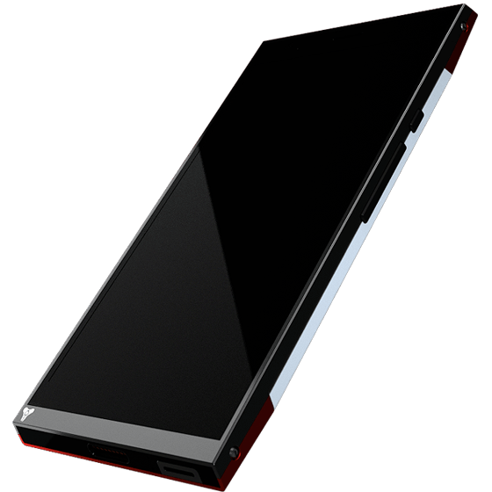
Turing Phone

Slide 14
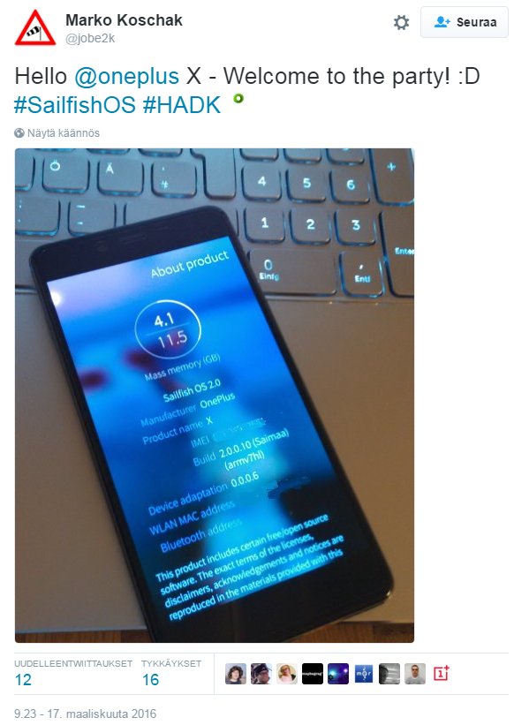
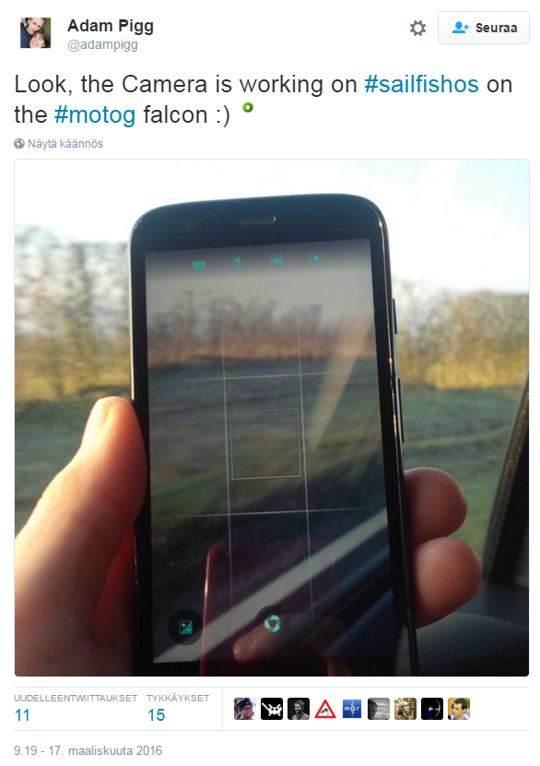
Community ports
The Sailfish OS community members around the world have build ports to make Sailfish OS run on a variety of devices, including e.g. Nexus, One Plus, Oppo, Fairphone and Samsung devices.
Active community ports use the Hardware Adaptation Development Kit (HADK) provided by Jolla.
Someone has even ported it to a Raspberry Pi

Slide 15
Rendering of scripts on different phone operating systems

Slide 16
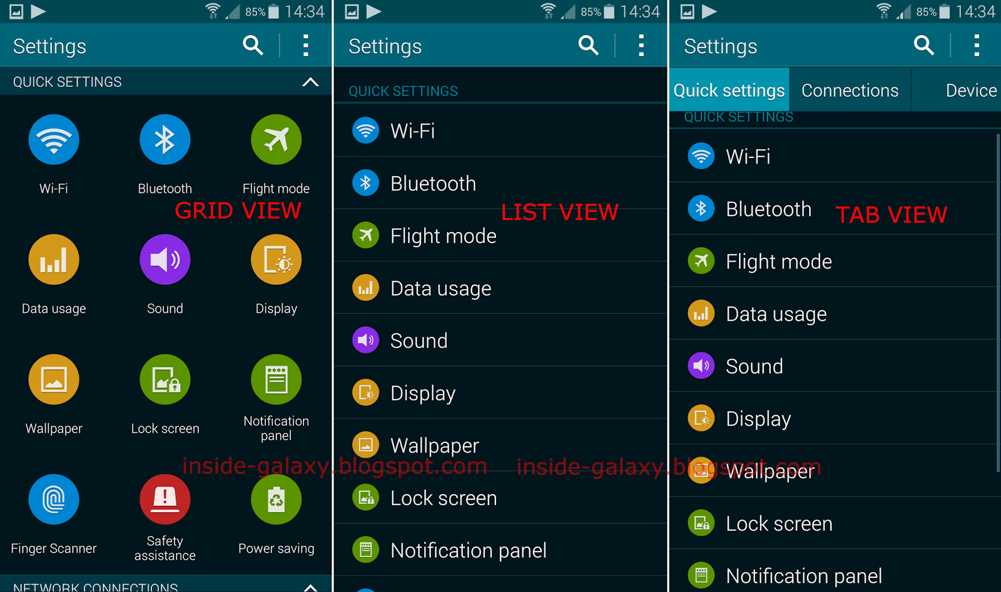

Slide 17


Slide 18
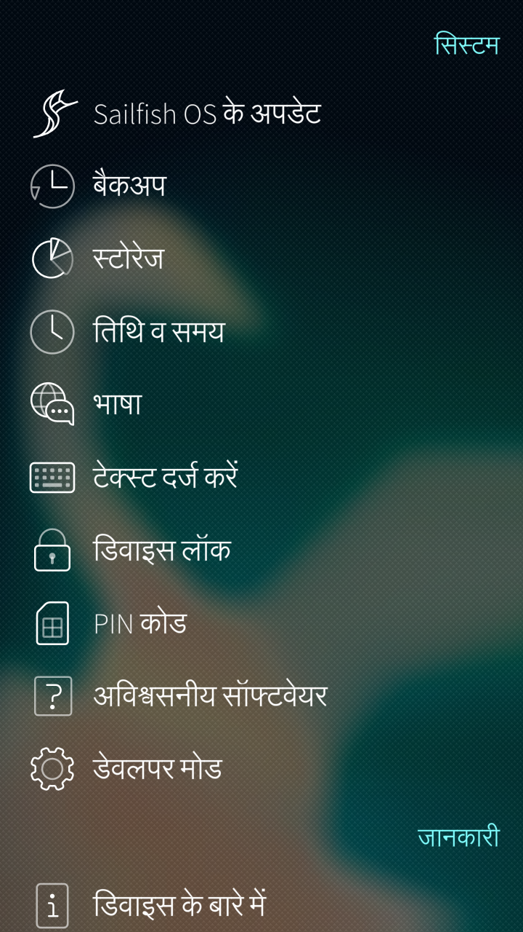

Slide 19


Slide 20


Slide 21
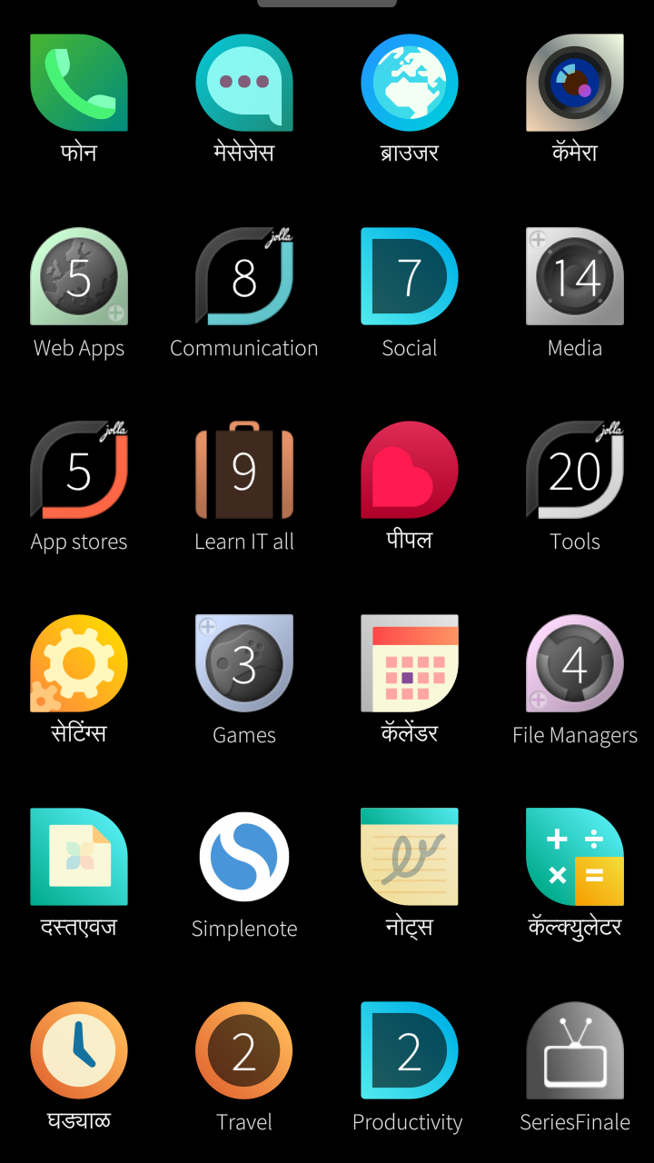

Slide 22


Slide 23
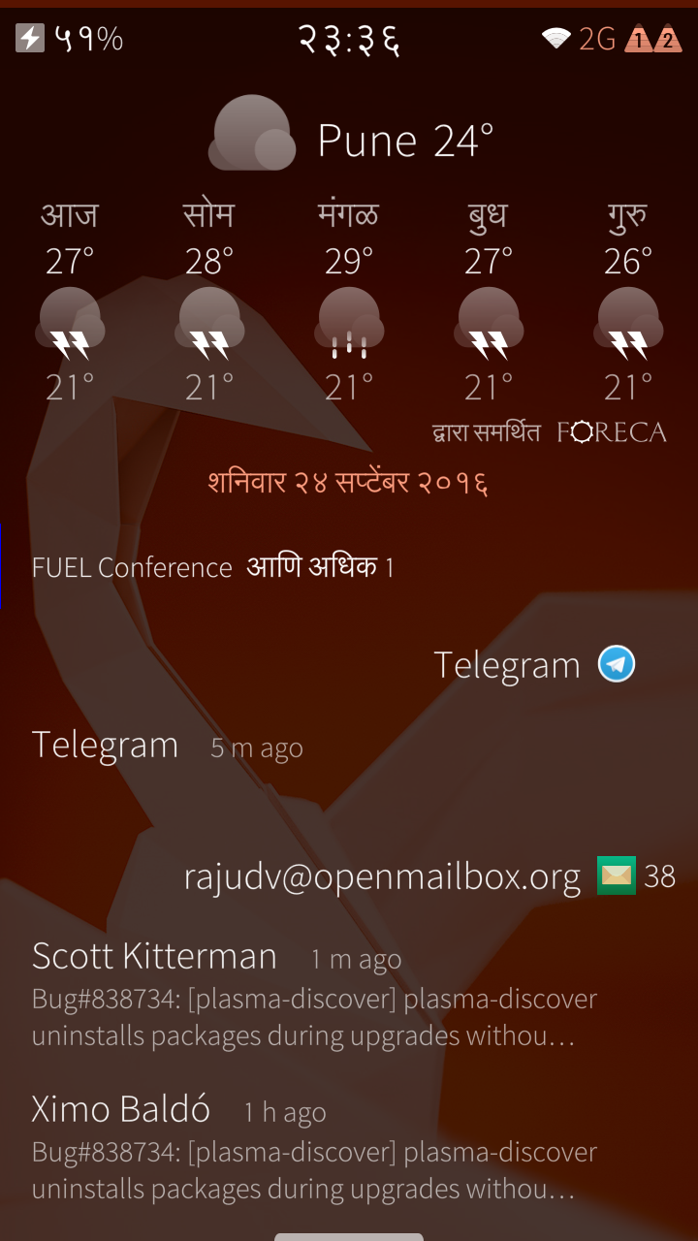

Slide 24
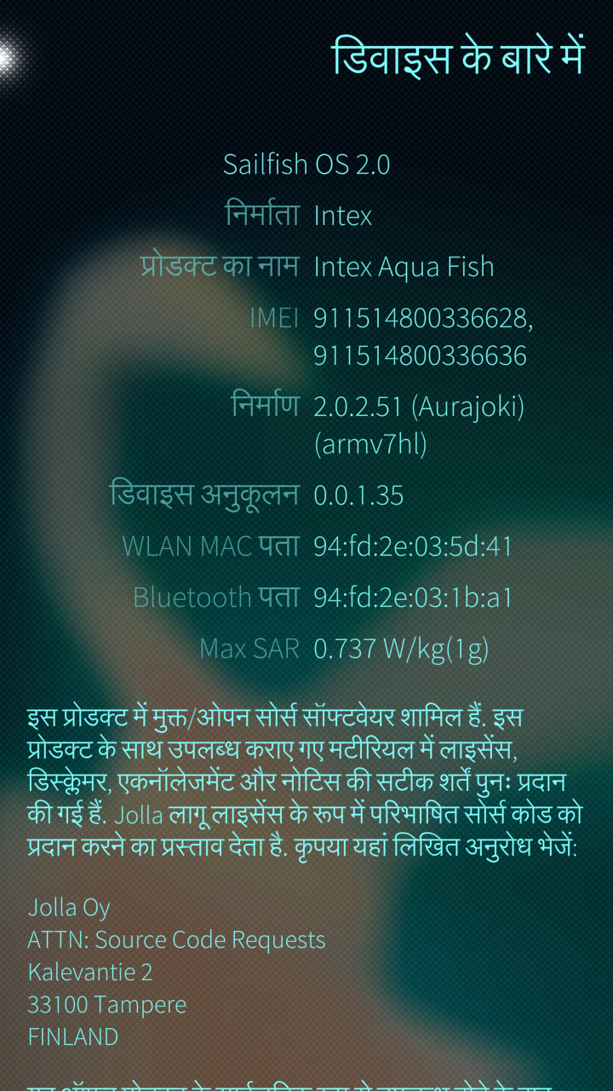

Slide 25
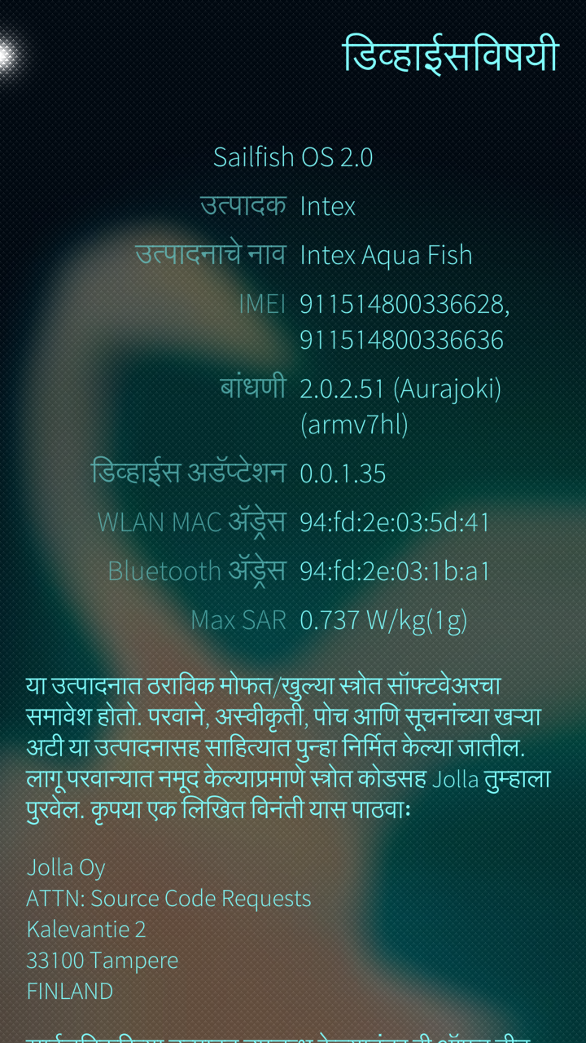

Slide 26
Everything is great, It all looks good. What are you here for?

Slide 27
The Third Party manufacturers
INTEX

Slide 28
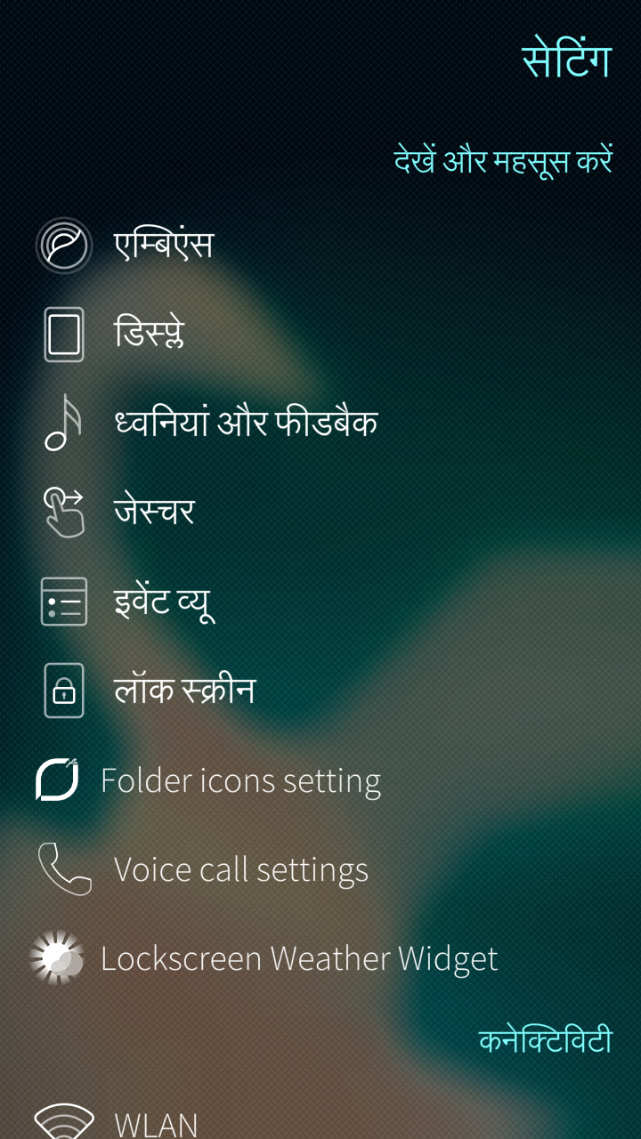
No translations for patches

Slide 29
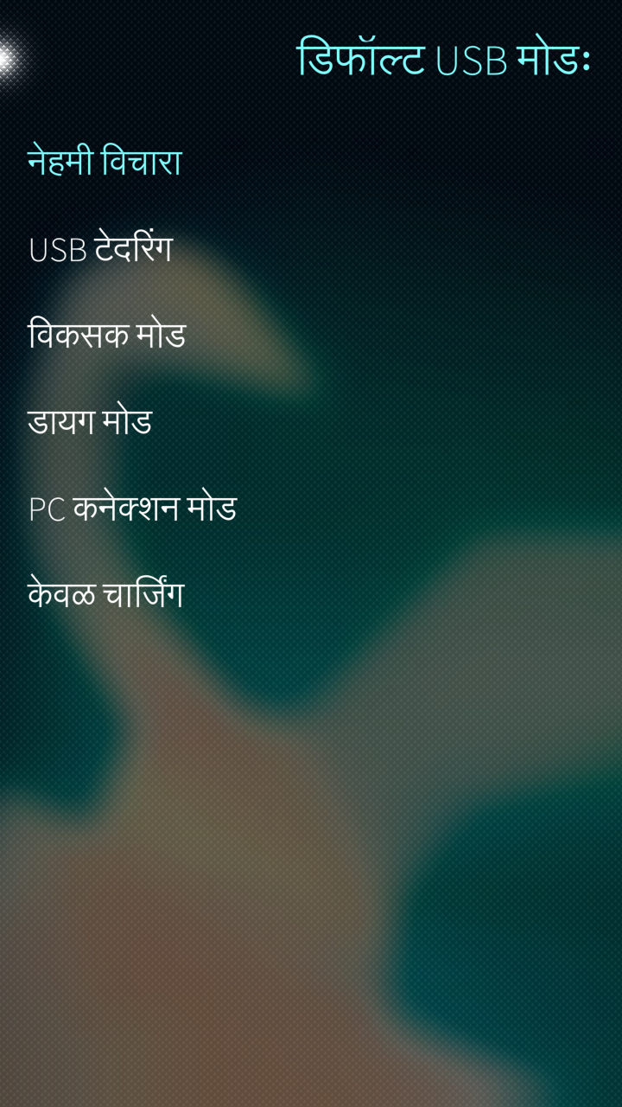
Bugs arriving due to non translated patches

Slide 30
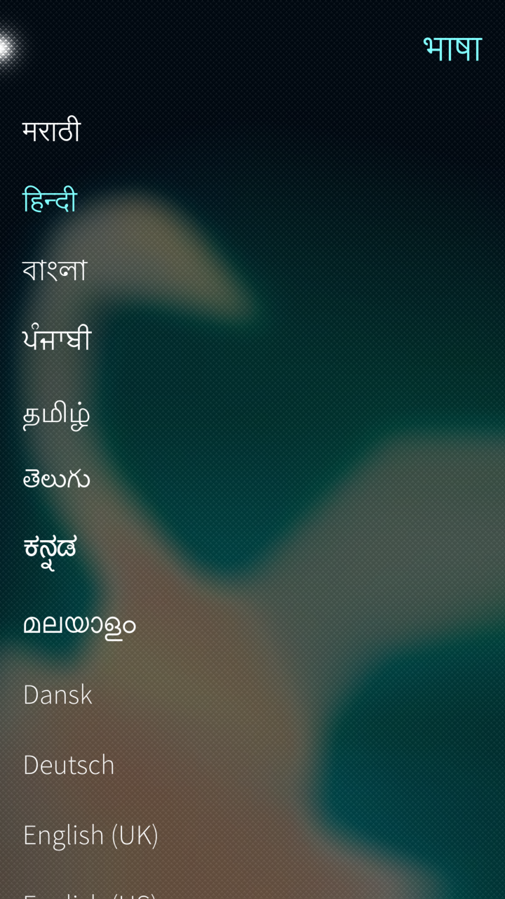
Compared to Firefox OS,
the number of Indian and
other locales are still very less.
Request and Contribute to
your languages on
translate.sailfishos.org

Slide 31


Slide 32


Slide 33
I have a device with me,
make sure you
get an experience of it.

Slide 34
SailFishOS Video

Slide 35
Sail on the Boat
jolla.com
together.jolla.com
Sailfishos.org
merproject.org
openrepos.net

Slide 36
On Twitter
@rajuvindane
raju@hamaralinux.org
github.com/rajuvindane
On telegram
@libregeekingkid

