Slide 1
Simulation and Scientific Computing – 2 (SS 2016)
Multigrid Solver
Team :-
BleedBlue
Paras Kumar
Raju Ram
Iniyan Kalaimani

Slide 2
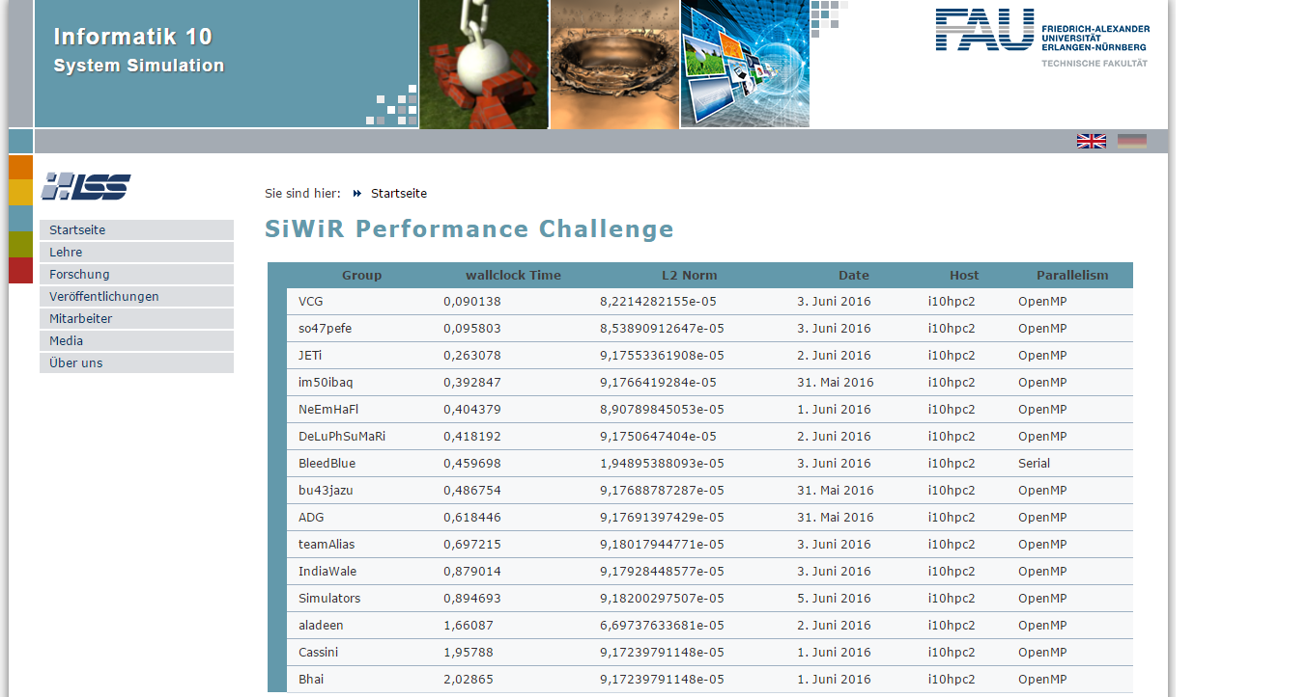
Performance Challenge
7

Slide 3
Optimizations
Implemented
Multigrid Algorithm - Full Multigrid
Smoother - SOR solver
Parallelization - OpenMP
We also tried SSE Vectorization !

Slide 4
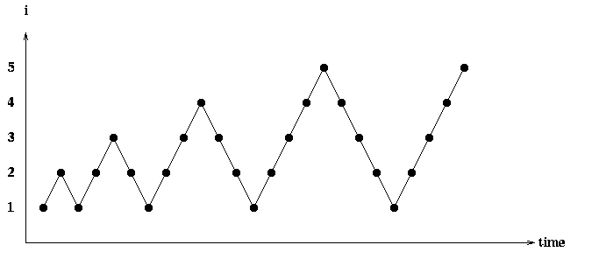
Full Multigrid cycle
Coarse grid approximation as a first guess to obtain a good initial approximation for Multigrid cycle
FMG cycle
V-cycles

Slide 5
Full Multigrid cycle
Coarse grid approximation as a first guess to obtain a good initial approximation for Multigrid cycle
FMG cycle
V-cycles

Slide 6
Full Multigrid cycle
Coarse grid approximation as a first guess to obtain a good initial approximation for Multigrid cycle
FMG cycle
V-cycles

Slide 7
Full Multigrid cycle
Coarse grid approximation as a first guess to obtain a good initial approximation for Multigrid cycle
FMG cycle
V-cycles

Slide 8
Full Multigrid cycle
Coarsest level – Slit boundary
V-cycles

Slide 9
Full Multigrid cycle
We start here
Coarsest level – Slit boundary
V-cycles

Slide 10
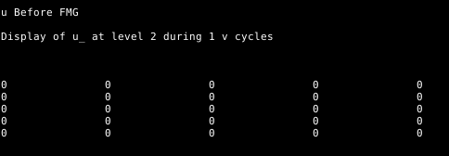
Full Multigrid cycle
We start here
Coarsest level – Slit boundary
V-cycles

Slide 11

Full Multigrid cycle
Set BCs
We start here
Coarsest level – Slit boundary
V-cycles

Slide 12
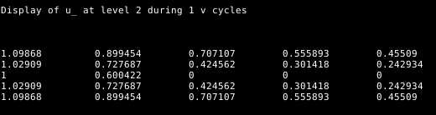
Full Multigrid cycle
After smoothing
We start here
Coarsest level – Slit boundary
V-cycles

Slide 13
Full Multigrid cycle
Set BCs after Interpolation
Coarsest level – Slit boundary
V-cycles

Slide 14
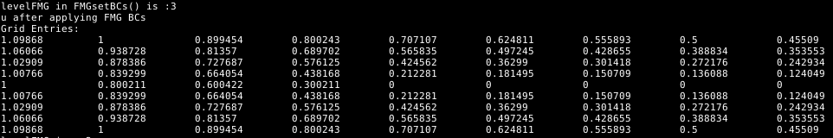
Full Multigrid cycle
Set BCs after Interpolation
Coarsest level – Slit boundary
V-cycles

Slide 15
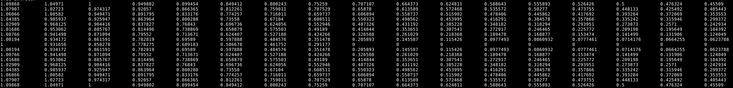
Full Multigrid cycle
We started here
Coarsest level – Slit boundary
V-cycles

Slide 16
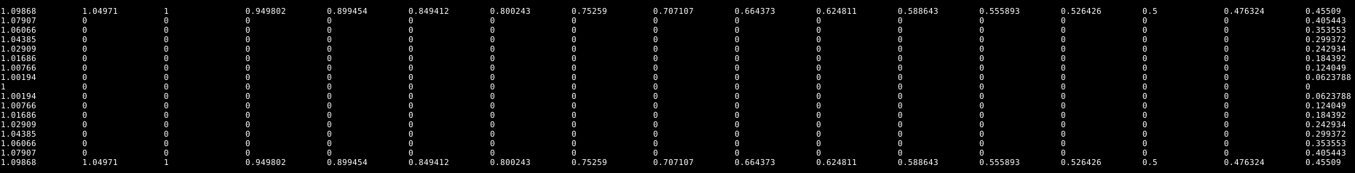
If (!Full Multigrid cycle)
We started here
Coarsest level – Slit boundary
V-cycles

Slide 17
Convergence ?
V-cycles

Slide 18
Convergence ?
Number of cycles reduced !
V-cycles

Slide 19
Convergence ?
Number of cycles reduced !
But…
V-cycles

Slide 20
Convergence ?
Number of cycles reduced !
But…
V-cycles

Slide 21
Convergence ?
Number of cycles reduced !
But…
V-cycles

Slide 22
Error plot

Slide 23
Challenges in FMG
Reset array values of coarser levels to zero
V-cycles

Slide 24
Challenges in FMG
Reset array values of coarser levels to zero
V-cycles

Slide 25
Challenges in FMG
Changes in the Interpolation method
V-cycles

Slide 26
Parallelization
OpenMP
#pragma omp parallel for schedule(static)
MultiGridSolver::applyRBGS_Iter() Red Black Smoother
MultiGridSolver::applyRestriction() Restriction Operator
MultiGridSolver::applyInterpolation() Interpolation Operator
MultiGridSolver::computeResidual() Residual Computation

Slide 27
Parallelization
OpenMP - Only V - Cycles
#CPUs (OpenMP option on Verifier) Runtime of MG Solver (seconds)
1 9.48118 2 4.53418 4 2.21559 8 1.10856 16 1.0314 32 0.68125 Serial option on cluster 0.65112

Slide 28
Parallelization
OpenMP – V - Cycles with FMG
#CPUs (OpenMP option on Verifier) Runtime of MG Solver (seconds)
1 5.46958 2 3.84408 4 1.9959 8 0.90064 16 1.10745 32 0.542416
Serial option on cluster 0.459698

Slide 29
Vectorization
Non- Vectorized code
./mgsolve 12 1 for non Vectorized Code Your Alias: BleedBlue Wall clock time of applyRBGS_Iter() is 62.596 ms Wall clock time of compute Residual()) is 76.07 ms Wall clock time of Restriction() is 31.649 ms Wall clock time of applyRBGS_Iter() is 60.905 ms Wall clock time of MG execution: 369.419 ms

Slide 30
Vectorization
Vectorized code
./mgsolve 12 1 for non Vectorized Code Your Alias: BleedBlue Wall clock time of applyRBGS_Iter() is 157.469 seconds Wall clock time of compute Residual() is 246.207 seconds Wall clock time of Restriction() in 91.559 seconds Wall clock time of applyRBGS_Iter() in 157.43 seconds Wall clock time of MGMSolve() in 1002.68 seconds Wall clock time of MG execution: 1002.72 ms

Slide 31
Vectorization
Suggestions ?

Slide 32
Comparison of Smoothening Parameters
Runtime (in seconds)
nu2
nu1
Variation of serial runtimes on the LSS cluster with the number of pre-smoothing(nu 1) and post smoothing steps (nu 2) has been studied.
This study was done using the RBGS Solver for intermediate steps.
The combinations – (1,3) and (2,2) show the least runtimes and took 11 v-cycles each for convergence.

Slide 33
Comparison of Smoothening Parameters (contd.)
nu1 | nu2 | V-cycles for Convergence | Error | Cluster Serial Runtime (in seconds)
1 | 1 | 16 | 9.17732E-05 | 6.5414
1 | 2 | 13 | 9.17619E-05 | 6.48613
1 | 3 | 11 | 9.17927E-05 | 6.45551
1 | 4 | 11 | 9.17443E-05 | 7.40991
1 | 5 | 10 | 9.17568E-05 | 7.66071
2 | 1 | 13 | 9.17693E-05 | 6.49229
2 | 2 | 11 | 9.17789E-05 | 6.45584
2 | 3 | 10 | 9.17806E-05 | 6.79593
2 | 4 | 10 | 9.17454E-05 | 7.67483
2 | 5 | 9 | 9.17715E-05 | 7.71864
3 | 1 | 12 | 9.17514E-05 | 7.0785
3 | 2 | 10 | 9.17885E-05 | 6.75157
3 | 3 | 10 | 9.17448E-05 | 7.66405
3 | 4 | 9 | 9.17670E-05 | 7.65531
3 | 5 | 9 | 9.17462E-05 | 8.49673
4 | 1 | 11 | 9.17549E-05 | 7.44863
4 | 2 | 10 | 9.17507E-05 | 7.66858
4 | 3 | 9 | 9.17707E-05 | 7.68896
4 | 4 | 9 | 9.17463E-05 | 8.50611
A comparative study of convergence rates for different iterative solvers has been done for these two combinations.

Slide 34
Comparison of Different Solvers
V-cycles to convergence, Normalized Runtimes for nu1 =1, nu2 =3
Solver | V-cycles for Convergence | Error | Serial Runtime (in ms) | Serial Runtime (Normalized)
Jacobi | 16 | 9.17733E-05 | 14201.1 | 1.0000
Damped Jacobi, w = 1/3 | 37 | 9.17984E-05 | 35672.3 | 2.5119
Damped Jacobi, w = 1/2 | 26 | 9.17884E-05 | 25245.8 | 1.7777
Damped Jacobi, w = 2/3 | 21 | 9.17702E-05 | 20299.2 | 1.4294
Natural Gauss Seidel (NGS) | 12 | 9.17586E-05 | 10829 | 0.7625
SOR on NGS, w = 4/3 | 9 | 9.17465E-05 | 9058.38 | 0.6379
SOR on NGS, w = 5/3 | 7 | 9.17399E-05 | 7003.42 | 0.4932
RBGS | 11 | 9.17904E-05 | 9862.52 | 0.6945
SOR on RBGS, w = 4/3 | 8 | 9.17398E-05 | 8022.64 | 0.5649
SOR on RBGS, w = 5/3 | 7 | 9.13771E-05 | 7017.09 | 0.4941
SOR on RBGS, w = 11/6 | 12 | 9.1712E-05 | 12015.7 | 0.8461
SOR on NGS works even better than SOR on RBGS with w = 5/3, but since it can’t be parallelized, the SOR on RBGS option is better.

Slide 35
Comparison of Different Solvers (contd.)
V-cycles to convergence, Normalized Runtimes for nu1 =2, nu2 =2
Solver | V-cycles for Convergence | Error | Serial Runtime (in ms) | Serial Runtime (Normalized)
Jacobi | 16 | 9.17713E-05 | 14243.5 | 1.0000
Damped Jacobi, w = 1/3 | 37 | 9.17936E-05 | 35729.2 | 2.5085
Damped Jacobi, w = 1/2 | 26 | 9.17799E-05 | 25358 | 1.7803
Damped Jacobi, w = 2/3 | 21 | 9.17621E-05 | 20315.2 | 1.4263
Nautral Gauss Seidel | 12 | 9.17474E-05 | 10854.5 | 0.7621
SOR on NGS, w = 4/3 | 9 | 9.17455E-05 | 9076.22 | 0.6372
SOR on NGS, w = 5/3 | 7 | 9.17352E-05 | 7018.52 | 0.4928
RBGS | 11 | 9.17767E-05 | 9885.48 | 0.6940
SOR on RBGS with w = 4/3 | 7 | 9.17847E-05 | 7026.47 | 0.4933
SOR on RBGS with w = 5/3 | 9 | 9.09422E-05 | 9024.19 | 0.6336
For this case, faster convergence is achieved for SOR on RBGS with w=4/3.
Damped Jacobi Solver shows worse performance than Jacobi Iteration .
Thus, nu 1=2,nu 2=2 for SOR on RBGS with w=4/3 seems to be the optimum choice for implementation.

Slide 36
THANK YOU

