Slide 1
DevOps Automation Tools
Automate all the testing processes and configure them to achieve speed and agility. This process is known as DevOps automation.
Infrastructure Automation
Configuration Management
Deployment Automation
Performance Management
Log Management
Monitoring.

Slide 2
GIT Installation
Git Binaries Installation
Now let us start by installing "Git Binaries".
Step 1) Launch the Browser and navigate to URL- https://git-scm.com/
Step 2) Download the latest stable release.
Step 3) Click on downloads for windows once the file is downloaded we can begin with our installation.

Slide 3
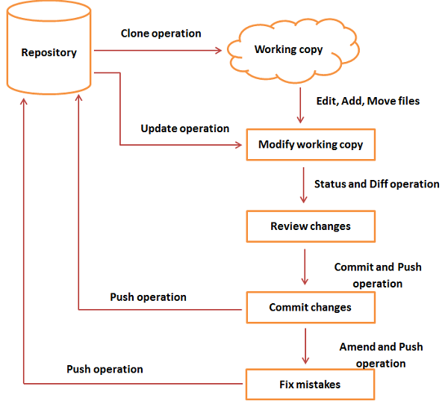
GIT workflow

Slide 4

GIT Commands
git config (This command sets the author name and email address respectively to be used with your commits.)
git config –global user.name “[name]”
git config –global user.email “[email address]”
git config --list
git init
git init [repository name]
This command is used to start a new repository.
git clone
Usage: git clone [url]
This command is used to obtain a repository from an existing URL.

Slide 5

git add
git add [file]
This command adds a file to the staging area.
git add *
This command adds one or more to the staging area.
git commit
git commit -m “[ Type in the commit message]”
This command records or snapshots the file permanently in the version history.
git diff
This command shows the file differences which are not yet staged.
git diff –staged
This command shows the differences between the files in the staging area and the latest version present.
To remove files from the staging area, use the following command
git rm --cached my-file.ts

Slide 6
git reset
git reset [file]
This command unstages the file, but it preserves the file contents.
git reset [commit]
This command undoes all the commits after the specified commit and preserves the changes locally.
git reset –hard [commit]
This command discards all history and goes back to the specified commit.
git status
This command lists all the files that have to be committed.
git rm [file]
This command deletes the file from your working directory and stages the deletion.
git log
This command is used to list the version history for the current branch.
git show [commit]
This command shows the metadata and content changes of the specified commit.
git branch
This command lists all the local branches in the current repository.
git branch [branch name]
This command creates a new branch.

Slide 7
git branch -d [branch name]
This command deletes the feature branch.
git checkout [branch name]
This command is used to switch from one branch to another.
git merge [branch name]
This command merges the specified branch’s history into the current branch.
git remote add [variable name] [Remote Server Link]
This command is used to connect your local repository to the remote server.
Git remote add origin https://github.com/rajukavi/gitdemo.git
git push [variable name] master
This command sends the committed changes of master branch to your remote repository.
git pull [Repository Link]
This command fetches and merges changes on the remote server to your working directory.

Slide 8
To bind this remote repository to your local repository:
$ git remote add origin https://github.com/rajukavi/some-small-app.git.
The "origin" option is the default name for the server on which your remote repository is located.
Git, copying your code to a remote repository looks:
$ git push -u origin master

Slide 9
Jenkins
Jenkins is an open-source DevOps testing tool. It can be used to automate all types of tasks such as building, testing, and deploying software. This tool allows developers to quickly find and solve defects in their code base to automate testing of their builds. Features:
Provides support to scale out to a large number of nodes and distribute the workload equally
Compatible with all OS and versions of Linux, Mac OS or Windows
It offers easy installation as Jenkins comes as a WAR file. All user needs to do is to drop WAR into your JEE container and your setup up ready to run.
Jenkins can be easily set-up and configured with the help of its web interface
It's can easily distribute work across several machines

Slide 10
Install Jenkins
Download from https://jenkins.io/ the Long-Term Support Release tab in the download section.
Starting Jenkins
D:\>Java –jar Jenkins.war
jenkins.exe stop
Jenkins is up and running, one can access Jenkins from the link − http://localhost:8080
Jenkins Dashboard (Home screen), click the Manage Jenkins option
click the ‘Manage Plugins’ option.
Tab will give a list of plugins which are available for downloading. In the ‘Filter’ tab type ‘Git plugin’

Slide 11
Downloading and Setting Up Maven

Slide 12
Commands executed

