Slide 1
Week 12 Assignment Final Project Kannur, Gyaneshwar Department of Data Science, Bellevue University DSC530 Professor: Matthew Metzger Assignment Date: 2025-01-20

Slide 2
DSC 530 Final Project
Exploratory Data Analysis on Health Insurance Claims

Slide 3

Introduction
The objective of this project is to explore the relationship between smokers and non-smokers on the health claims, along with the outcomes of the Exploratory Data Analysis (EDA) conducted on these variables.
The project aims to use exploratory data analysis, transformations, and summary statistics to identify patterns and relationships between these variables.

Slide 4

Data Sources
This used the below dataset found in Kaggle .
https://www.kaggle.com/datasets/shivadumnawar/health-insurance-dataset

Slide 5
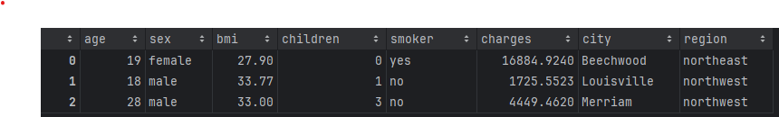
Provide and describe what the 5 variables mean in the dataset.

Slide 6

Provide and describe what the 5 variables mean in the dataset.
Age- Age of the insured
Sex- The gender of the insured
Bmi- The body mass index for the insured
Children - Number of children of the insured.
Smoker - Whether the insured smokes or not
Charges - What is the medical expenses claimed.
City - Which city is the insured.
Region - The region in which the city falls under.

Slide 7
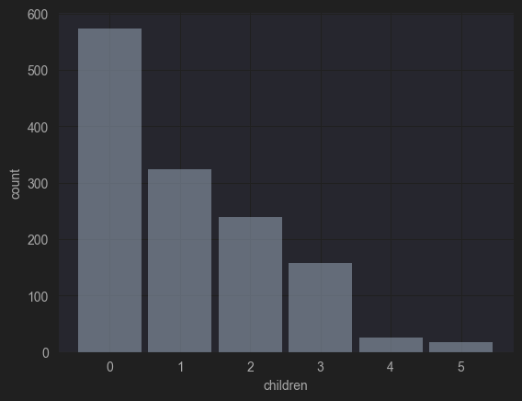
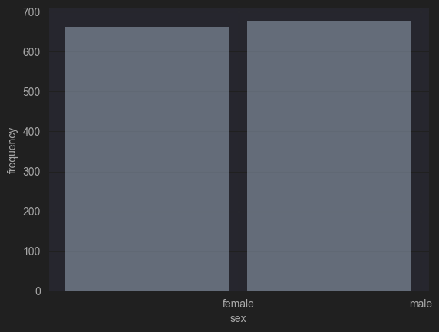
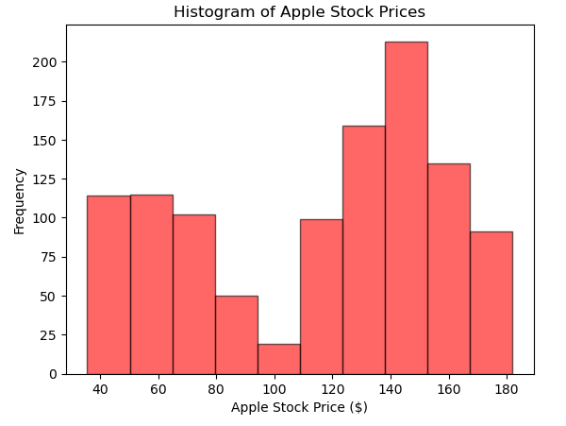
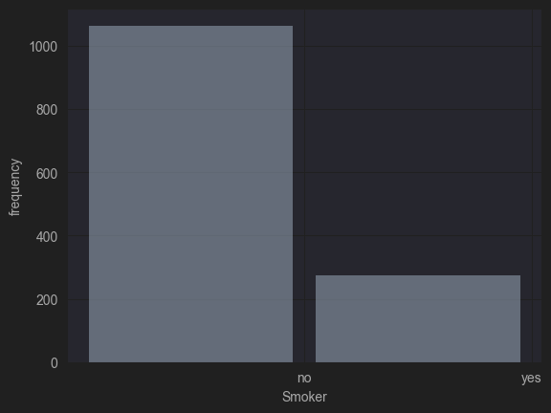
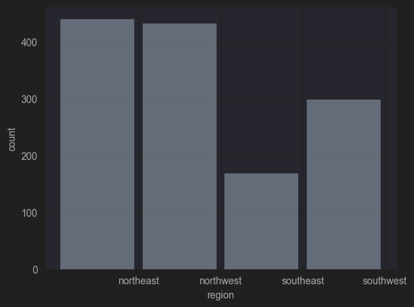
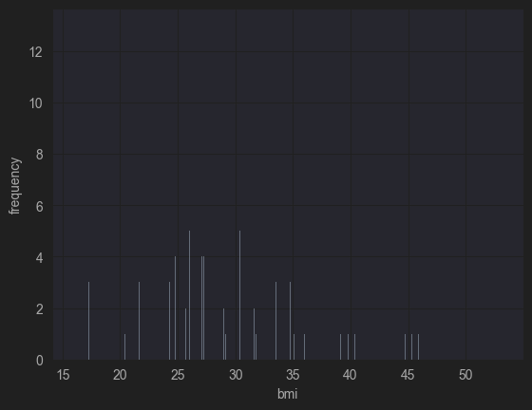
Include a histogram of each of the 5 variables – in your summary and analysis, identify any outliers and explain the reasoning for them being outliers and how you believe they should be handled
In the histograms, outliers may appear as individual bars or bins that are significantly higher or lower than the others.
Outliers can be caused by various factors such as extreme events, or other anomalies in the data.
I decided to leave the outliers in the dataset because histogram may not be as precise as using statistical measures such as z-scores, percentiles, or box plots.

Slide 8
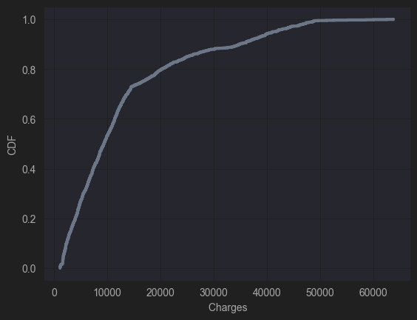
Create 1 CDF with one of your variables what does this tell you about your variable and how does it address the question you are trying to answer
I first sort the data in ascending order and calculate the cumulative probability for each data point.
I then plot the cumulative probability as a function of the total charges to create the CDF.
By analyzing the CDF, I can gain insights into the distribution of the data and the likelihood of different outcomes.
I can see that the CDF starts at 0, indicating that there is a 0% chance of the charges being less than the minimum value in the dataset.
As moving along the x-axis, the cumulative probability increases, indicating that higher charges are becoming more likely.

Slide 9
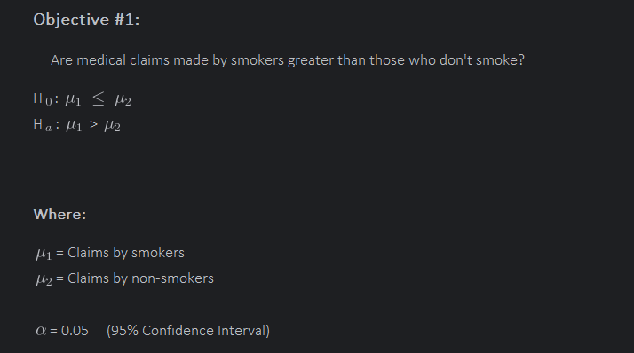
Conduct a test on your hypothesis
The p-value was near to 0, which means it is plausible that the observed difference is just a result of random sampling and might not be generally true in the population. Reject the null hypothesis

Slide 10
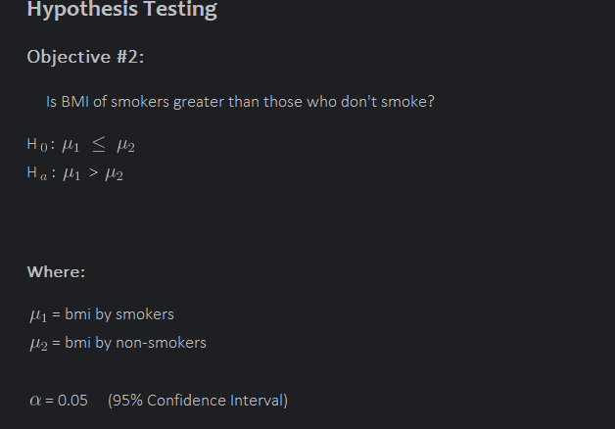
Hypothesis Testing Object #2:

Slide 11
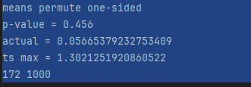
Results:

