Slide 1
PYTHON

Slide 2
CONTENT
Introduction
Python Building blocks
Control statements
Loops
Strings
Lists
Tuples
Dictionaries
Functions and Modules
File systems(Text files, csv files and webscrapping)
Data Science Modules(Numpy, Matplotlib,pandas,sklearn)

Slide 3
PYTHON FEATURES
Python's features include:
Easy-to-learn: Python has few keywords, simple structure, and a clearly defined syntax.
Easy-to-read: Python code is more clearly defined and visible to the eyes.
Easy-to-maintain: Python's source code is fairly easy-to-maintain.
A broad standard library: Python's bulk of the library is very portable and cross-platform compatible on UNIX, Windows, and Macintosh.
Interactive Mode: Python has support for an interactive mode which allows interactive testing and debugging of snippets of code.
Portable: Python can run on a wide variety of hardware platforms and has the same interface on all platforms.
Extendable: You can add low-level modules to the Python interpreter. These modules enable programmers to add to or customize their tools to be more efficient.

Slide 4
Databases: Python provides interfaces to all major commercial databases.
GUI Programming: Python supports GUI applications that can be created and ported to many system calls, libraries and windows systems, such as Windows MFC, Macintosh, and the X Window system of Unix.
Scalable: Python provides a better structure and support for large programs than shell scripting.
Apart from the above-mentioned features, Python has a big list of good features, few are listed below:
It supports functional and structured programming methods as well as OOP.
It can be used as a scripting language or can be compiled to byte-code for building large applications.
It provides very high-level dynamic data types and supports dynamic type checking.
IT supports automatic garbage collection.
It can be easily integrated with C, C++, COM, ActiveX, CORBA, and Java.

Slide 5
Basic Structure of Python
    Its simple structure program

Slide 6
BASIC SYNTAX
Basic syntax of a python program is too simple than other languages.
Example: To print Welcome to Python Developers
print(“Welcome to Python Developers")

Slide 7
KEYWORDS AND IDENTIFIER
Keywords are the reserved words in Python.
We cannot use a keyword as variable name, function name or any other identifier. They are used to define the syntax and structure of the Python language.
In Python, keywords are case sensitive.
There are 33 keywords in Python 3.3. This number can vary slightly in course of time.
All the keywords except True, False and None are in lowercase and they must be written as it is.

Slide 8
Keywords in Python programming language
False | class | finally | is | return
None | continue | for | lambda | try
True | def | from | nonlocal | while
and | del | global | not | with
as | elif | if | or | yield
assert | else | import | pass
break | except | in | raise

Slide 9
Keywords cannot be used as identifiers.
Ex: global=1
SyntaxError: invalid syntax
nonlocal=12
SyntaxError: invalid syntax

Slide 10
Python Identifiers
Identifier is the name given to entities like class, functions, variables etc. in Python. It helps differentiating one entity from another.
Rules to define identifiers
1.Identifiers can be a combination of letters in lowercase (a to z) or uppercase (A to Z) or digits (0 to 9) or an underscore (_). Names like myClass, var_1 and print_this_to_screen, all are valid example.
2.An identifier cannot start with a digit. 1variable is invalid, but variable1 is perfectly fine.

Slide 11
3.We cannot use special symbols like !, @, #, $, % etc. in our identifier.
Ex:a@=12
Traceback (most recent call last):
File "<pyshell#2>", line 1, in <module>
a@=12
NameError: name 'a' is not defined
4. Identifier can be of any length.
Note: Python is a case-sensitive language. This means, Variable and variable are not the same.
Assignments
1.add two numbers
2.concatinate two strings

Slide 12
STATEMENTS & COMMENTS
Python uses indentation instead of curly braces for code blocks.
Indentation must be consistent in a code block
Ex:
if True:
print("Python is a high level language")
else:
print("Present trend is python")
Python Statement
  Instructions that a Python interpreter can execute are called statements.
  For example, a = 1ist an assignment statement. if statement, for statement, while statement etc.
  Ex:a=25,str=“Python”
Multi-line statement
  In Python, end of a statement is marked by a newline character. But we can make a statement extend over multiple lines with the line continuation character (\).
  Ex:x1=4,x2=6,sum=x1+\
      X2+\

Slide 13
Comments in Python
Single line comment: #
Multiline comments:
‘’’ ‘’’ or “”” “””
Ex:#add two numbers
Ex2:’’’ 1.add two numbers
    2.add three numbres
    3.check the boolean values
    ‘’’

Slide 14
PYTHON DATATYPES
Python supports simple primitive data types, such as numbers(integers, float and exponential numbers)
Strings and dates
Python also supports more complex data types,such as lists(or arrays),tuples and dictionaries.
Numbers:
Python provides arithmetic operations for manipulating numbers.
Integers:
  Ex:2+3
Float:
  Ex:2.6+3.2

Slide 15
Type casting :
Converting from one data type to another data type
Ex:
F1=45.65
w1="12"
w2="456.78"
var1=int(w1)
var2=float(w2)
Var3=int(f1)
print(var1)
print(var2)
Print(var3)

Slide 16
WORKING WITH STRINGS
A string in python is a sequence of Ascii-encoded bytes.
We can concatenate two strings with ‘+’ operator.
#working with strings
str1="Python"
str2="Developer"
print(str1+" "+str2)
print('a'+'a'+'a')
print('a'*3)

Slide 17
#ex2
str3="Be Indian"
x1,x2,x3,x4,x5,x6,x7,x8,x9=str3
print(x1)
#ex3
str4="Buy Indian"
print(str4[4])
#ex4
x="Be Good do Good"
l=len(x)
print(x[0:l])

Slide 18
Working with Dates
Python provides a rich set of date-related functions
import time
import datetime
print(datetime.datetime.now())
print(datetime.datetime.now().strftime("%y-%m-%d-%H-%M"))
print("Current Year: ",datetime.date.today().strftime("%Y"))
print("Month of Year: ",datetime.date.today().strftime("%B"))
print("Day of the month: ",datetime.date.today().strftime("%d"))

Slide 19
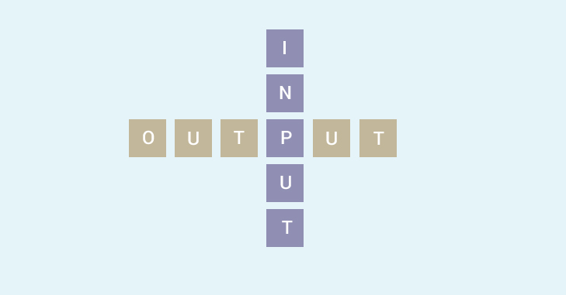
PYTHON I/O AND IMPORT
Python focuses on two built-in functions print() and input() to perform I/O task in Python. Also, you will learn to import modules and use them in your program.
Python provides numerous built-in functions that are readily available to us at the Python prompt.

Slide 20
Python Output Using print() function
The print() function to output data to the standard output device (screen).
Syntax:
print(*objects, sep=' ', end='\n', file=sys.stdout, flush=False)
E1:
print('This sentence is output to the screen')
# Output: This sentence is output to the screen
a = 5
print('The value of a is', a)
# Output: The value of a is 5
Ex2:
x = 12.3456789
y=34.78
print('The value of x is %3.2f' %x)
print('The value of y is %3.4f' %y)

Slide 21
Python Input
The value of variables were defined or hard coded into the source code.
To allow flexibility we might want to take the input from the user.
In Python, we have the input() function to allow this.
The syntax for input() is
input([prompt])
Ex:
num = input('Enter a number: ')
print(num)
num1 = int(input('Enter a number1: '))
num2 = int(input('Enter a number2: '))
print(num1+num2)

Slide 22
Python Import
It is a good idea to break it into different modules.
we can import the math module by typing in import math.
Ex:
import math
print(math.pi)

Slide 23
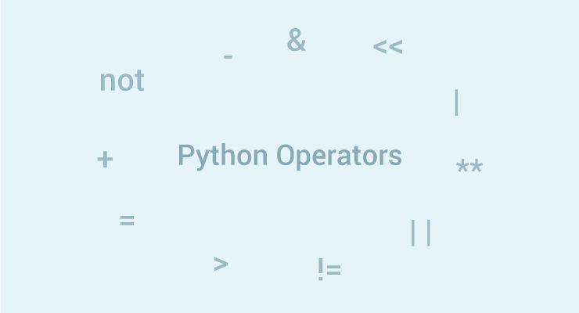
PYTHON OPERATORS

Slide 24
Operators are special symbols in Python that carry out arithmetic or logical computation. The value that the operator operates on is called the operand.
Types of operators in Python
Arithmetic operators
Comparison (Relational) operators
Logical (Boolean) operators
Bitwise operators
Assignment operators
Special operators

Slide 25
ARITHMETIC OPERATORS
Arithematic operatiosn are used to perform mathematical operations like +,-,*,/ and % etc…
Ex1:
Addition of two numbers
x=int(input("Enter number1\n"))
y=int(input("Enter number2\n"))
#addition
print("Addition of two numbers is " + str(x+y))
Assignment:
1.Multiplication of two numbers
2.Perform -,/ and % on two numbers

Slide 26
COMPARISON (RELATIONAL) OPERATORS
Comparison operators are used to compare values. It either returns True or False according to the condition.
Comparions operators are:
>,<,>=,<=,==,!=
Ex1:
Compare two integers
a=2
b=3
print("a>b is",a>b)
Assignment:
1.perform comparison operations on two integers
2. perform comparison operations on two characters
3.perform comparison operations on two strings

Slide 27
LOGICAL (BOOLEAN) OPERATORS
Logical operators are and,or and not operators
Ex:
x=True
y=False
print('x and y is',x and y)
Assignment
1.To check the numbers 4 and 5 are logically true or false

Slide 28
BITWISE OPERATORS
Bitwise operators act on operands as if they string of binary digits.it operates bit by bit.
Bitwise Operators are:
&(AND),|(OR),~(Bitwise not),^(Bit wise XOR),>>(right shift),<<(left shift)
Ex1:
Perform bitwise and operation on two numbers
a=4
b=5
Print(a&b)
Assignement
1.perform bitwise OR,NOT XOR operation on two digits
2.perform bitwise >>,<< operation on two digits

Slide 29
ASSIGNMENT OPERATORS
Assignemtn operators are used in Python to assign values to variables.
Ex:
A=5
C=‘c’
Str1=“hello”

Slide 30
SPECIAL OPERATORS
Python offers some special type of operators like identity or membership operators.
Identity Operators are:
“is “ and “is not” are used to check if two values(or variables) are located on the same part of the memory.
Ex1:a=10
a=10
b=20
print(a is b)
Assignment
1.To check for two characters and strings

Slide 31
Membership Operators
In and not in .
They are used to test whether a value or variable is found in a sequency(string, list,tuple,set and dictionary).
Ex:
x="welcome to hyd"
print('to' in x)
Assignment :
1.To test whether the 2 is in string Y=“Be good do good”

