Slide 1

FDP on Advances in Network Modeling and Optimization Techniques
(ANMOT 2019)
Biogeography Based Optimization Algorithm
Mr. Raju Pal
(Assistant Professor)
raju.pal@jiit.ac.in, Mob.No.: 7840045107
Jaypee Institute of Information Technology, Noida

Slide 2
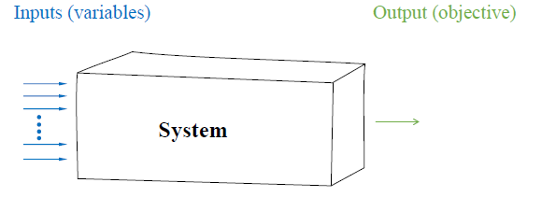
Optimization problem
2

Slide 3
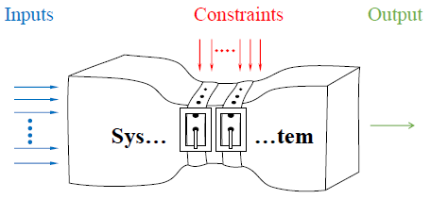
Optimization problem
3

Slide 4
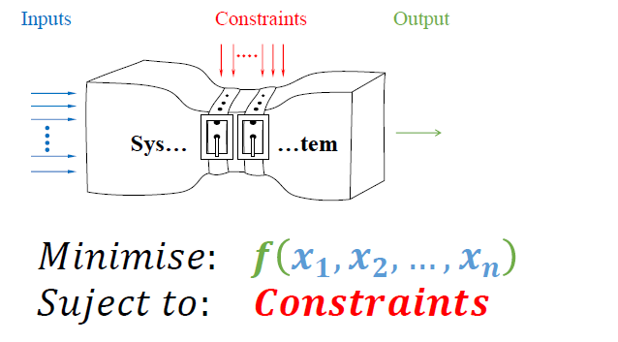
Formulating Optimization problem
4

Slide 5
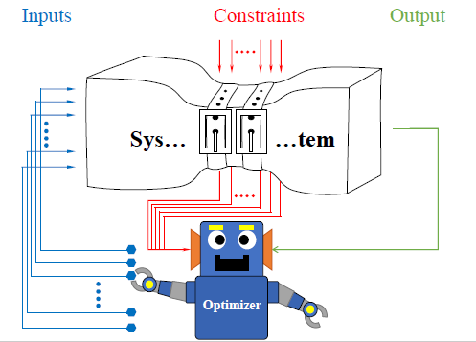
Optimization algorithm
5

Slide 6
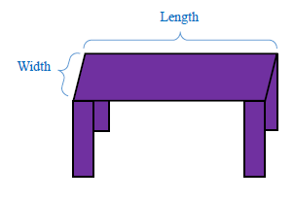
Example: designing a table
6

Slide 7
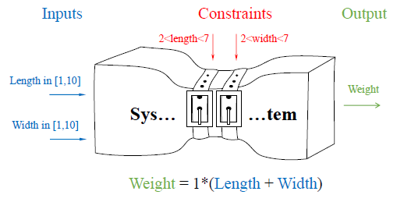
Example: designing a table
7
The objective is to minimize the weight

Slide 8
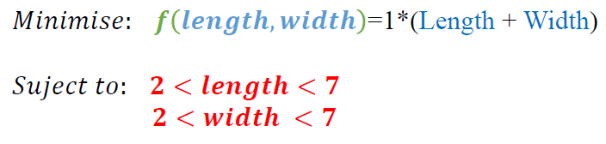
Example: designing a table
8

Slide 9
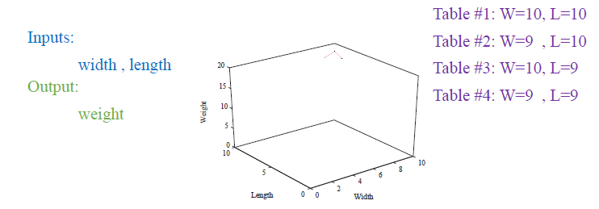
Search landscape of the table problem
9

Slide 10
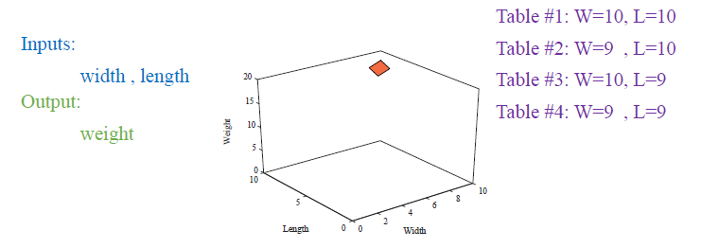
Search landscape of the table problem
10

Slide 11
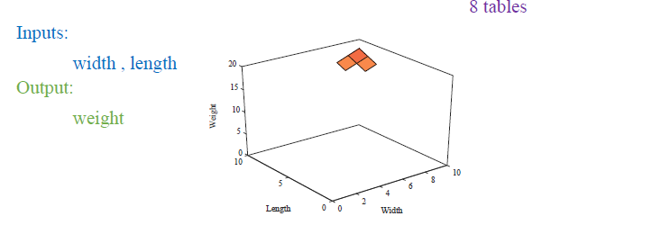
Example
11

Slide 12
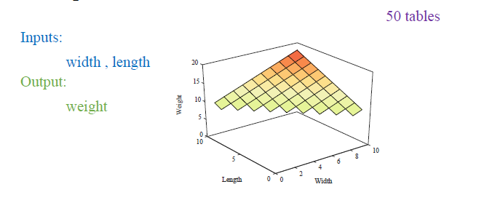
Example
12

Slide 13
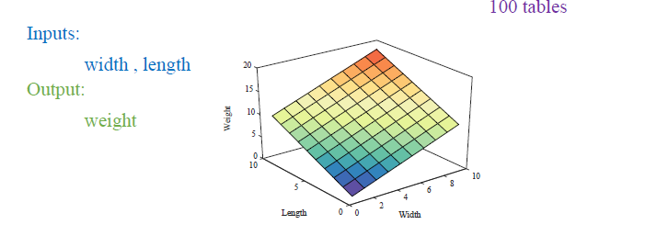
Example
13

Slide 14
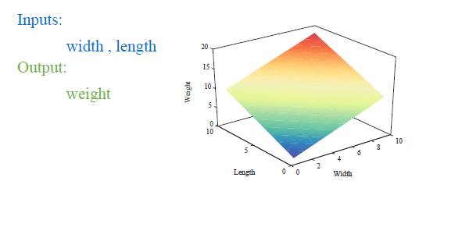
Example
14

Slide 15
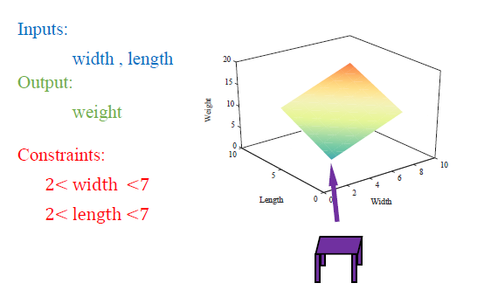
Example
15

Slide 16
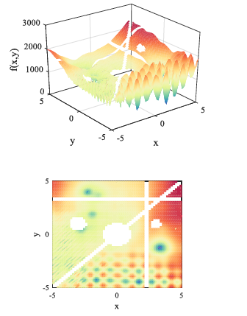
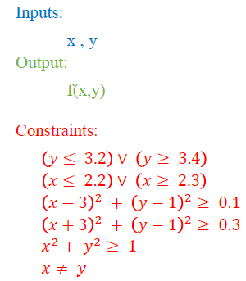
Search landscape
16

Slide 17
Difficulties of a real world problems
17
A large number of local solutions
A large number of constraints
Discrete variables
Multiple objectives
Uncertainties in inputs, outputs, or constraints
Etc.

Slide 18
Nature Inspired Algorithms (NIA)
18
Nature inspired algorithm is the algorithm which has its foundation in the biological components of the nature i.e., humans and animals.
Inspired and motivated from the nature.
Known as population base optimization algorithm.
Deal with optimization problem.
Considered as stochastic approach.

Slide 19
Some Existing Nature-inspired Algorithms
19
Simulated Annealing (SA)
Random Search Technique (RST)
Genetic Algorithm (GA)
Memetic Algorithm (MA)
Ant Colony Optimization (ACO)
Differential Evolution (DE)
Biogeography Based Optimization (BBO)
Particle Swarm Optimization (PSO)
Artificial Bee Colony (ABC)
Spider Monkey Optimization (SMO)

Slide 20
Some Basic Terminology in NIA
Exploration:
20
Exploration is the process of visiting entirely new regions of a search space.
Exploitation:
Exploitation is the process of visiting those regions of a search space within the neighborhood of previously visited points.
Stagnation :
Stagnation refers to a situation in which the optimum seeking process stagnates before finding a globally optimal solution.

Slide 21
Some Basic Terminology in NIA
Premature Convergence :
21
A population for an optimization problem converged too early, resulting in being suboptimal.
Stochastic Nature:
Intelligence + Randomness + Previous Experience.
Heuristic and Meta-heuristics :
Heuristics are problem-dependent techniques and Meta-heuristics problem-independent techniques.

Slide 22
Biogeography Based Optimization

Slide 23
Biogeography based optimization
BBO is introduced by Dan Simon in 2008.
BBO belongs to the class of meta-heuristics.
BBO does not make any assumptions about the problem and can therefore be applied to a wide class of problems.
BBO optimizes a problem by maintaining a population of candidate solutions, and creating new candidate solutions .

Slide 24
BBO is Motivated by
Bio - geo - graphy
Life Earth Description
Study of the distribution of biological species through time and space.
Notes:
24

Slide 25

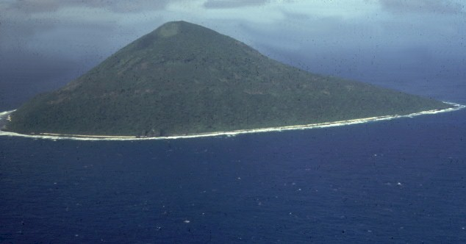
Island Biogeography
25
Islands can serve almost as a laboratory for the study of biogeography.

Slide 26
Scientific model
Scientific models of biogeography describe
Speciation (the evolution of new species),
Migration of species (animals, fish, birds, or insects) between islands, and
Extinction of species.
26
Species migrate between “islands” via flotsam, wind, flying, swimming, …

Slide 27
Is BBO a simulation of Biogeography ?
BBO is motivated by biogeography but is not intended to be a simulation of biogeography.
In biogeography the number of species varies from island to island, while in BBO the number of solution features is constant for all individuals and is equal to the problem dimension.
Although the analogy is not perfect, the key point in BBO is that the migration of solution features between individuals is motivated by the mathematical theory of species migration in biogeography.

Slide 28
BBO Terminology
HSI(Habitat Suitability Index):
28
Islands that are friendly to life are said to have a high habitat suitability index (HSI).
Suitability Index Variable (SIVs):
The features that characterize habitability are called suitability index variable (SIVs). Features that correlate with HSI include rainfall, vegetation diversity, land area, temperature and others.
In terms of habitability, SIVs can be considered the independent variables of the island and HSI can be considered the dependent variable.

Slide 29
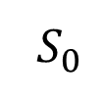
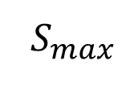
Island Migration Model
29
max. possible immigration rate
Immigration rate (λ)
I
E
Emigration rate (μ)
Rate
max. possible emigration rate
Largest possible no. of species that a habitat can support
No. of species
equilibrium no. of species
Notes:
The figure on the right illustrates an island migration model. The immigration rate and the emigration rate are functions of the number of species on the island. The maximum possible immigration rate occurs when there are zero species on the island. As the number of species increases, the island becomes more crowded, fewer species are able to survive immigration, and the immigration rate decreases. The largest possible number of species that the habitat can support is , at which point the immigration rate is zero.
If there are no species on the island, then the emigration rate is zero. As the number of species on the island increases, it becomes more crowded, more species representatives are able to leave the island, and the emigration rate increases. When the island contains the largest number of possible species , the emigration rate reaches its maximum possible value

Slide 30
Biogeography-Based Optimization
emigrating islands (individuals)
----
immigrating island (individual)
λ = the probability that the immigrating individual’s solution feature is replaced
μ = the probability that an emigrating individual’s solution feature migrates to the immigrating individual

Slide 31
High HSI Vs Low HSI
31
Islands with a high HSI can support many species, and islands with a low HSI can support only a few species.
Species diversity is correlated with HSI, so when more species arrive at a low HSI island, the island's HSI will tend to increase.

Slide 32
Emigration and Immigration
32
High HSI islands have too much competition for resources
Islands with a high HSI have
A high emigration rate,
A low immigration rate
Low HSI islands have a lot of room for additional species.
Islands with a low HSI have
A high immigration rate,
A low emigration rate

Slide 33
Solution fitness
Good solution high HSI island (Contain high number of species)
Poor solution low HSI island (Contain less number of species)
Poor solutions accept a lot of new features from good solutions.
This addition of new features to low HSI solutions may raise the quality of those solutions.

Slide 34
Flow Chart of BBO

Slide 35
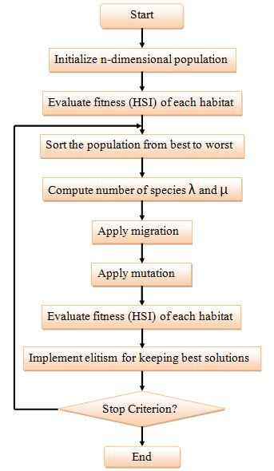

Slide 36
Initialization of population
BBO creates a randomly dispersed population of habitats :
No. Of Population | x1 | x2 | F(x)
1 | 1.4112 | -2.5644 | 8.5678
2 | 0.4756 | 1.4338 | 2.2820
3 | -0.1824 | -1.0323 | 1.0990

Slide 37
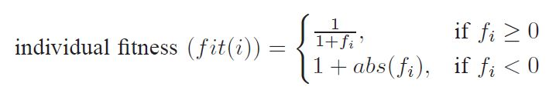
Fitness Evaluation and best fitness computation (HSI)
Objective value can also be considered as fitness (HSI)
Fitness
Ranking best fit to worst fit
F(x) | Initial Fitness
F(1) | 0.1045
F(2) | 0.3047
F(3) | 0.4764
F(x) | Rank | Fitness
F(1) | 1 | 0.1045
F(2) | 2 | 0.3047
F(3) | 3 | 0.4764

Slide 38
Immigration rate (λ) and Emigration rate (μ) for each habitat
K_{i} is the fitness rank of i^{th} habitat after sorting fitness of i^{th} habitat.

Slide 39
Immigration and Emigration
Rate
Where E=I=1
Emigration rate (μ)
μ₁=1/3=.33
μ₂=2/3=.67
μ₃=3/3=1
Immigration rate (λ)
λ ₁=1-.33=.67
λ₂=1-.67=.33
λ₃=1-1=0

Slide 40
Structure of BBO
Like other EAs, BBO includes two steps:
Information sharing – implemented using migration
Mutation

Slide 41
Operators of BBO
Migration
Select H_{i} with prob α λ_{i}
If H_{i} is selected
For j=1 to n
Select H_{j} with prob α μ_{i}
If H_{j} is selected
H_{i} (k) ← H_{j} (k)
End
End
End

Slide 42
Position Updation
H_{i} (k) ← H_{j} (k)
NewH(1,1)=H(2,1)
NewH(1,1)= 0.4756

Slide 43
Position Updating
Initially
After Position Update
No. Of Population | x1 | x2 | F(x)
1 | 1.4112 | -2.5644 | 8.5678
2 | 0.4756 | 1.4338 | 2.2820
3 | -0.1824 | -1.0323 | 1.0990
No. Of Population | x1 | x2 | F(x)
1 | 0.4756 | -2.5644 | 6.8023
2 | 0.4756 | 1.4338 | 2.2820
3 | -0.1824 | -1.0323 | 1.0990

Slide 44
Operators of BBO
Mutation
Mutation
For k=1 to m
Select H_{i} (k) with mutation prob
If H_{i} (k) is selected
H_{i} (k) ← random SIV
End
End
End

Slide 45
Operators of BBO
Elitism
In elitism approach we save the features of the best habitat that has the best solution in BBO process.
KeepRate=0.2; % Elitism Keep Rate
nKeep=round(KeepRate*nPop); % Number of Kept Habitats
nKeep=round(0.2*50)=10
nNew=nPop-nKeep; % Number of New Habitats
nNew=50-10=40
% Select Next Iteration Population
pop=[pop(1:nKeep) newpop(1:nNew)];

Slide 46
BBO Algorithm
46
Create and Initialize a n-dimensional population;
Evaluate fitness (HSI) of each habitat;
while termination condition met do
Sort the population from best to worst;
Compute number of species λ and μ ;
Apply migration;
Apply mutation;
Evaluate fitness (HSI) of each habitat;
Implement elitism for keeping best solutions;
end

Slide 47
Comparison and Termination Criteraia
47
In NIA, comparison is take place in terms of:-
Success Rate = Reliability
Function Evaluation = Efficiency
Standard Deviation = Robustness
Mean Error = Accuracy
Termination Criteria is:-
Number of Iteration
Function Evaluation
Acceptable Error

Slide 48
48
Some Recent Advances in BBO

Slide 49
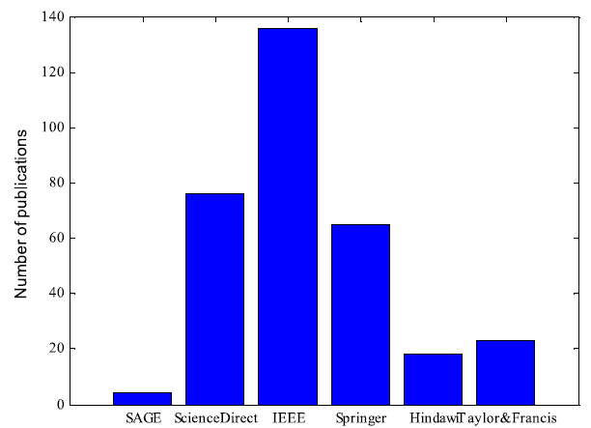
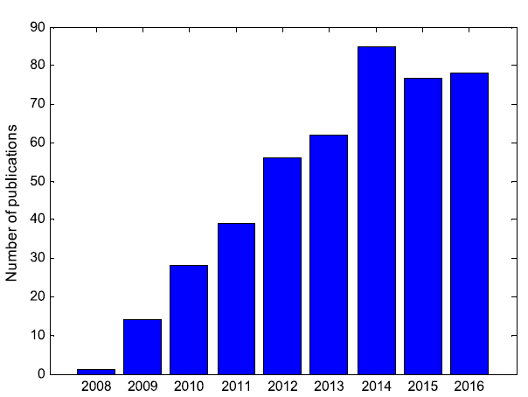
Some Recent Advances in BBO
Number of BBO publications by database
Number of BBO publications by year.
Ref: Ma, Haiping, et al. "Biogeography-based optimization: a 10-year review." IEEE Transactions on Emerging Topics in Computational Intelligence 1.5 (2017): 391-407.

Slide 50
Original migration operator
50
Immigrating habitat
Emigrating habitat
In original migration, solution feature of immigrating habitat is directly replaced by solution feature of emigrating habitat.

Slide 51
Blended BBO
51
Instead of replacing a SIV entirely by another SIV, the blended migration operator combines the features of both variables. This approach prevent the degradation of solution. The blended migration operator is as follows:
Real no. between 0 and 1
Immigrating habitat
Emigrating habitat

Slide 52
aBBOmDE
52
Lohakare et al. proposed a memetic BBO named as Accelerated biogeography-based optimization with neighborhood search for optimization (aBBOmDE), for improving convergence speed by modifying mutation operator and maintained exploitation by keeping original migration. Mutation as follows
Parent SIV

Slide 53
LBBO
53
Simon et al. proposed LBBO (linearized BBO) for improving solution of non separable problems. LBBO combined with periodic re-initialization and local search operator and obtain algorithm for global optimization in a continuous search space.
Emigrating habitat
Immigrating habitat
Emigration rate

Slide 54
Modified Migration Operator
54
Pushpa Farswan et al. proposed a new migration operator, the solution feature of immigrating habitat is not replaced directly by the solution feature of emigrating habitat, instead new solution feature combines the features of more than two habitats.
Random habitat
Immigrating habitat
Neighborhood habitat

Slide 55
Improved BBO
55
Pal and Saraswat proposed new migration and mutation operators.
Improved Migration operator
Select H_{i} with prob α λ_{i}
If H_{i} is selected
For j=1 to n
Select H_{j} with prob α μ_{i}
If H_{j} is selected
H_{i} (k) ← H_{j} (k)
Else
H_{i} (k) ← H_{best} (k)
End
End
End
Improved mutation operator
For i=1 to n
Select H_{i} with mutation prob
If H_{i} is selected
s_{i}=P₁ – P₂
H_{i} ← H_{i} + s_{i} * rand(0,1)
End
End
End

Slide 56
References
56
Weian Guo, Wuzhao Li, Qun Zhang, Lei Wang, Qidi Wu, and Hongliang Ren. Biogeography-based particle swarm optimization with fuzzy elitism and its applications to constrained engineering problems. Engineering Optimization, 46(11):14651484, 2014.
Dan Simon, Mahamed GH Omran, and Maurice Clerc. Linearized biogeographybased optimization with re-initialization and local search. Information Sciences,267:140–157, 2014.
.
Pushpa Farswan and Jagdish Chand Bansal. Migration in biogeography-based optimization. In Proceedings of Fourth International Conference on Soft Computing for Problem Solving, pages 385–397. Springer, 2015.
Xiangtao Li, Jinyan Wang, Junping Zhou, and Minghao Yin. A perturb biogeography based optimization with mutation for global numerical optimization. Applied Mathematics and Computation, 218(2):598–609, 2011.
Haiping Ma and Dan Simon. Blended biogeography-based optimization for constrained optimization. Engineering Applications of Artificial Intelligence, 24(3):517–525, 2011

Slide 57
Cont…
MR Lohokare, Shyam S Pattnaik, Bijaya K Panigrahi, and Sanjoy Das. Accelerated biogeography-based optimization with neighborhood search for optimization.Applied Soft Computing, 13(5):2318–2342, 2013.
Mehmet Ergezer, Dan Simon, and Dawei Du. Oppositional biogeography-based optimization. In Systems, Man and Cybernetics, 2009. SMC 2009. IEEE International Conference on, pages 1009–1014. IEEE, 2009.
Dan Simon. Biogeography-based optimization. Evolutionary Computation, IEEE Transactions on, 12(6):702–713, 2008.

