Slide 1

Online_v2 – An upgraded control &
monitor software for GMRT
                Presenter : Raju Uprade
                Date : 23/04/2015
Online_v2 Team :-
Santaji Katore Charu Kanade N.G.Kantharia
Deepak Bhong Naresh Sisodiya S.Nayak
Sachin sherkar Mahadev Misal
Raju Uprade C Sateesh

Slide 2
Outline of Presentation
1. Background
2. Architecture block diagram of Online_v2.
3. Online_v2 software
4. New MCM Rabbit card
5. QT/QML GUI
6. Python Enviornment
7. Monitoring Tools
8. Online_v2 testing
9. Antenna base configuration
10. Summary

Slide 3
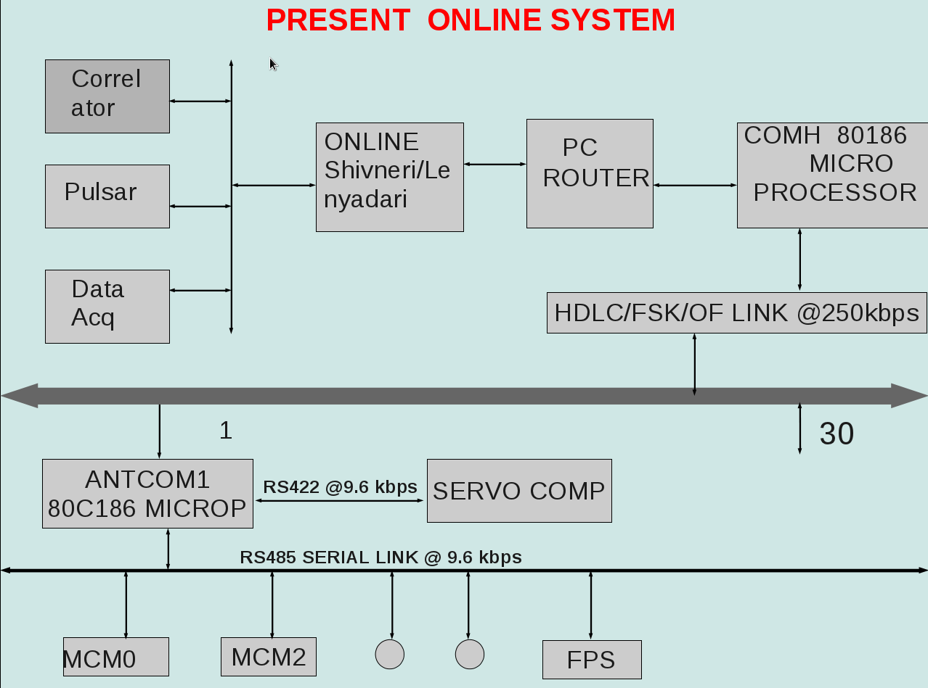
Background

Slide 4
Background
Online_v2
An expanded system using present day technology and other features of the GMRT upgrade is desirable.
The hardware work for this was started a few years ago with the development of a new MCM.
An upgraded version of ONLINE is currently under development at NCRA and is referred to as Online_v2.
Online_v2 is Linux based and aims at reducing the RFI footprint at the antenna base by not requiring a separate computer.
Instead Online_v2 focuses on exploiting the power of fast 1 Gbps Ethernet connection and in-built capabilities of the Rabbit processor on the MCM card.
Online_v2 uses and expands the control algorithms developed for ONLINE on a new framework.

Slide 5
Features of Online_v2
The new features of OnlineV2 include :
(1) Parallel & fast control of 30 antenna
(2) Extensive web-based control data monitoring tools allowing for real time and statistical studies
(3) Full web based tools & support for observing in absentia
(4) Generalized framework to support future expansion
(5)Customized graphical interfaces for operators, engineers and astronomers
(6) Fast background monitoring of system parameters
(7) Higher level Python Environment

Slide 6
Difference between Online_v2 & Online
ONLINE V2 :
Linux
Absentee observing support
C, C++
Desktop GUI for Operator Engineer
MCM – Rabbit processor Based Card
Control data monitoring :
Real time : shared memory
Offline : From database
Web-based interfaces for Astronomer
Ethernet communication
Environment – python
No separate Antenna base computer
- reduction in internal RFI
ONLINE
Solaris
No absentee observing support
Fortran
No GUI
MCM – 8051 microcontroller
Control data monitoring -
Real time – shared memory
Offline – log file
No web-based components
Serial communication
Environment - AIPS
Antenna based computer – 8087 microprocessor

Slide 7
Time Line
Project started: October 2012
Prototype Demonstration: April 2014
Three antennae tested software: October 2014
16 Antennae tested software : April 2015
Time Line :
Project start: October 2012
Prototype Demonstration: April 2014
Final Version: October 2014
Time Line :
Project start: October 2012
Prototype Demonstration: April 2014
Final Version: October 2014
Time Line :
Project start: October 2012
Prototype Demonstration: April 2014
Final Version: October 2014
Time Line :
Project start: October 2012
Prototype Demonstration: April 2014
Final Version: October 2014
Time Line :
Project start: October 2012
Prototype Demonstration: April 2014
Final Version: October 2014
Time Line :
Project start: October 2012
Prototype Demonstration: April 2014
Final Version: October 2014
Time Line :
Project start: October 2012
Prototype Demonstration: April 2014
Final Version: October 2014

Slide 8
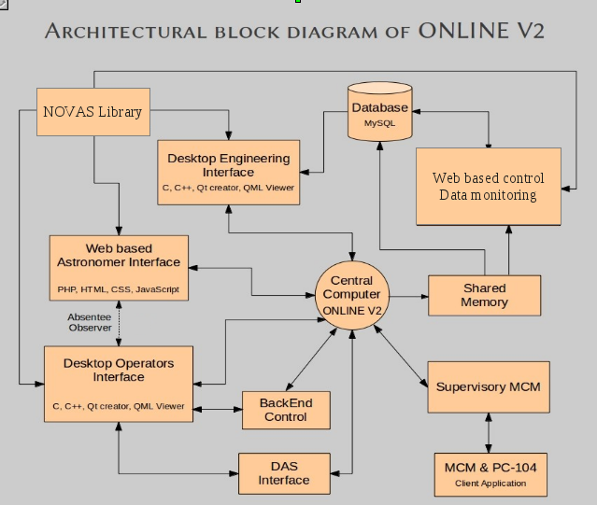
Online_v2 Architecture diagram

Slide 9
Online_v2
Online_V2 is the New control & monitoring software being developed for GMRT.We have used experience of present Online, TELESET-ABCCOM & 15 M NCRA CMS in Online_V2.
It is a multithreaded server based on Producer-Consumer principle where all antenna sub-systems act as client devices. Communications between server/client happen using TCP/IP based Ethernet communication channel with 1 sec response time.
Online_V2 takes input through three input channel
1. Python Environment 2. QML/QT based GUI 3. User terminal
Online_V2 write all command & response in shared memory.
Online_V2 also create a Message Queue for communication with DAS SERVER.
Various commands related to user creation like create user,showuser, cmd2sub has been implemented and tested successfully.
Online_v2 has successfully controlled & monitored all sub-systems in the lab & almost all commands for all sub-systems have been implemented.
Eight MCM and 1 PC104 cards have been put in Lab set up for Online_V2. Online_V2 has been tested successfully by configuring eight MCM cards as two antenna four sub-system each & eight antenna one sub-system each. (Front End, Fiber optics, GAB, Sentinel)
All basic servo commands have been implemented in Online_v2 which has been tested with actual hardware set up in servo lab. As well as one antenna tracking routine has been implemented in Online_V2, which has been tested with a prototype servo client program.Basic servo commands have been successfully tested in Servo Lab with their test setup.

Slide 10
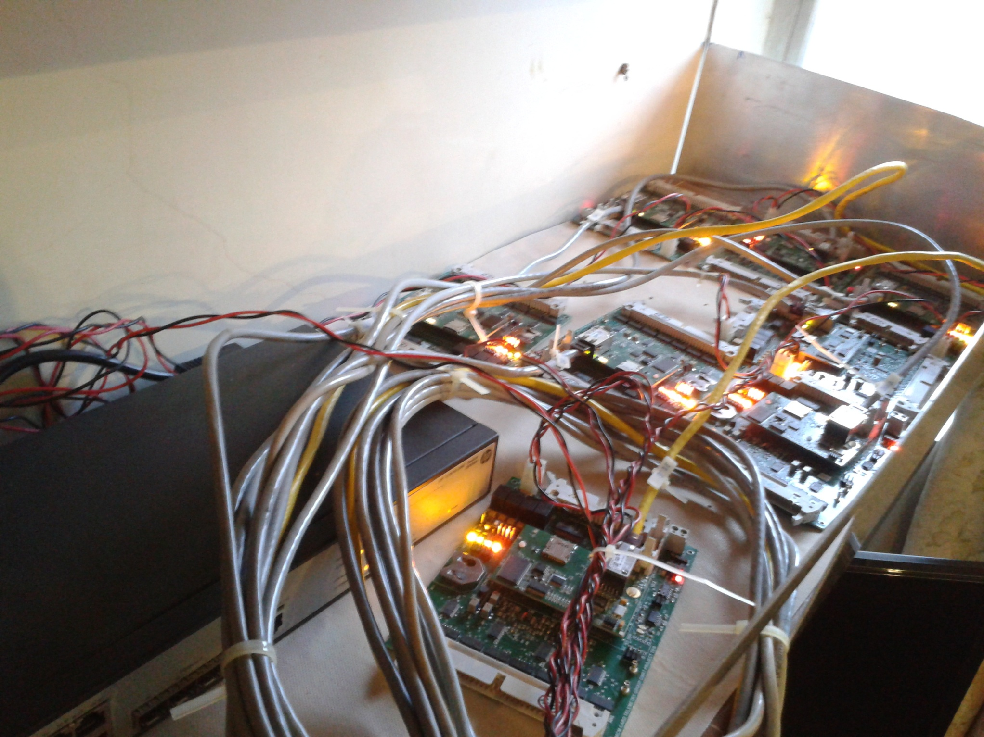
Online_v2 Lab set up

Slide 11
Online_v2 details
Software Languages used :
Insistence on using Open Software - LAMP
Software Language used: C, C++, Dynamic C, Perl, Python, PHP,HTML, Javascript, gnuplot, QT/QML
Database: MySQL
Libraries: XML, Readline, TCP/IP, HTTP,Pthread

Slide 12
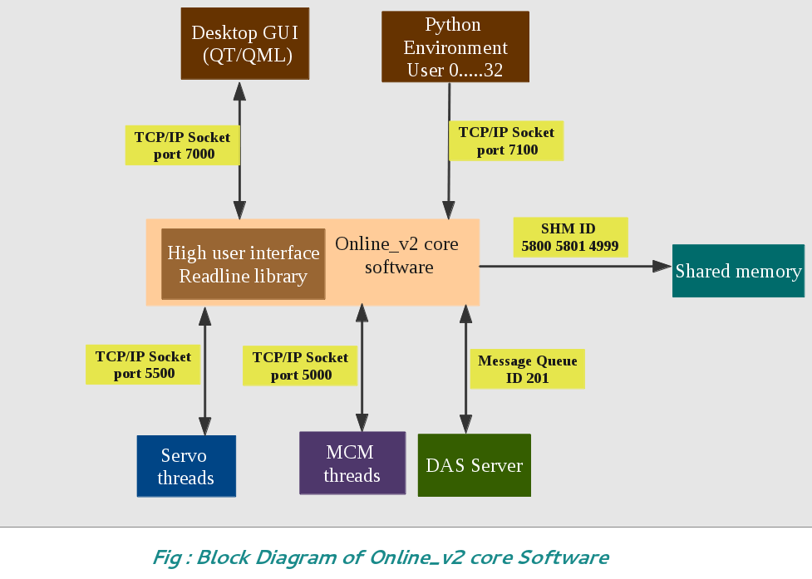
Online_v2 core software

Slide 13
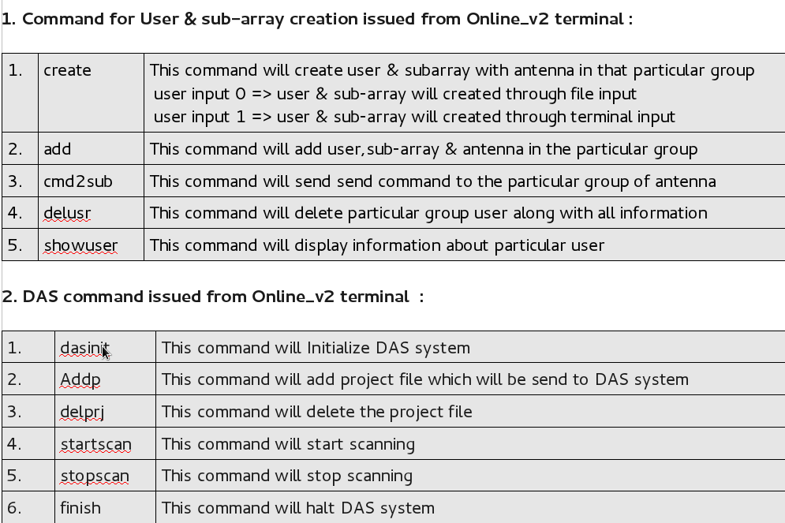
Online_v2 command syntax

Slide 14
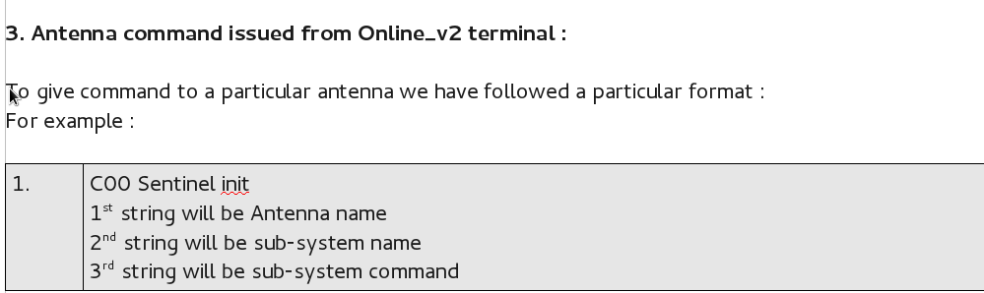
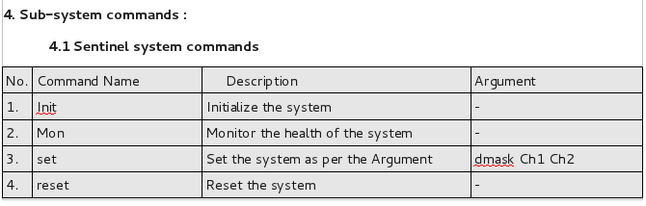
Online_v2 command syntax

Slide 15
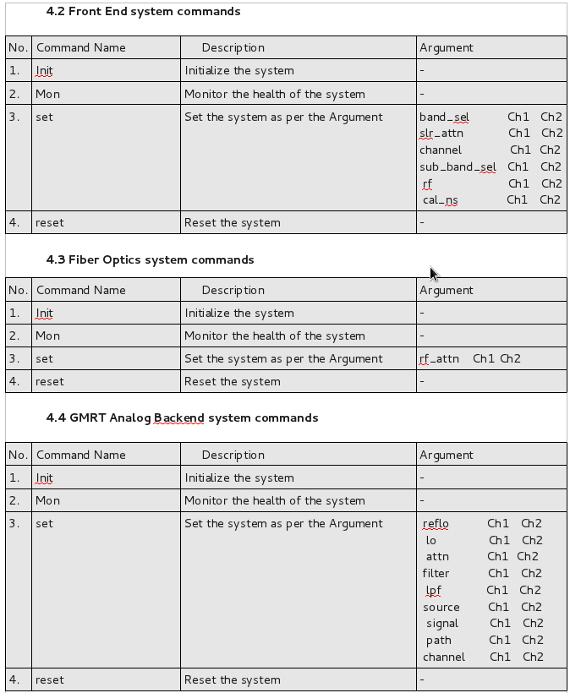
Online_v2 command syntax

Slide 16
Online_v2 communication protocol
In Online_v2 we are following a structure based communication protocol to communicate with antenna sub-system. We have two separate communication structure to communicate with MCM card & PC104 card.
Command Structure for Online_v2-MCM communication :
typedef struct
{
int seq; // Unique Sequence
char timestamp[64]; // Timestamp of command
char system_name[16]; // System Name for which command is
char op_name[16]; // Operation to perform ( Init/Set/Mon/Reset )
short int number_param; // Number of parameter
char parameter_name[32][16]; // Parameter Name
char Argument_Ch1[32][16]; // Channel One argument
char Argument_Ch2[32][16]; // Channel Two argument
} cmd;
Response structure for MCM-Online_v2 communication : typedef struct
{
int response_type; // Response type
int seq; // Sequence number
char timestamp[64]; // Time stamp
char system_name[16]; // System name
char Mon_raw[64][8]; // 64 channel raw data
char Mon_sum[32][64]; // Monitoring summary prepared from 64 channel raw data
short int num_resp_msg; // Number of Response Message
char response_message[32][64]; // Response message from MCM
} resp;
Command structure for Online_v2-Servo Communication :
typedef struct
{
int seq;
char timestamp[64];
char system_name[16];
char op_name[16];
short int number_param;
char para_name[32][16];
char para_value[32][16];
} servocmd;
Response structure for Servo -Online_v2 Communication :
typedef struct
{
int seq;
char timestamp[64];
char system_name[16];
int response_code; // immediate =1 ( ACK or NAK ) event=3 & final =2 data mon = 4
int response_type; // success =1 or failure = 2
char response_msg[50]; // Accepted ,not accepted, syntax error, irrelevant command,incomplete,unknown + Event
short int num_resp_msg;
char para_name[32][32];
char para_value[32][32];
} servoresp;

Slide 17
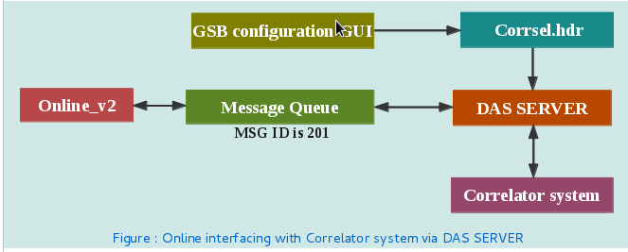
DAS interfacing with Online_v2
DAS server starts reading corresel.hdr file generated by GSB configuration GUI. Online_v2 send commands and read response to & from DAS server via message queue id 201. Command received from Online_v2 is sent on sockets to the correlator system by DAS server. Response from correlator system is received on socket by DAS server, which is then written to message queue by DAS server to be read by Online_v2.

Slide 18
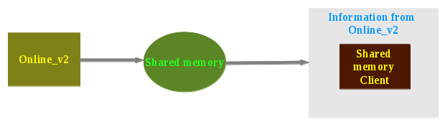
shared memory
Shared Memory :
Online_v2 writes command-response from every thread of every antenna, user & sub-array information and DAS command-response messages from DAS server into the shared memory. Shared memory client program gets attached to the shared memory ID created by Online_v2 and reads all the information which can be displayed as per user's wish. Any number of clients can get attached to this shared memory segments.

Slide 19
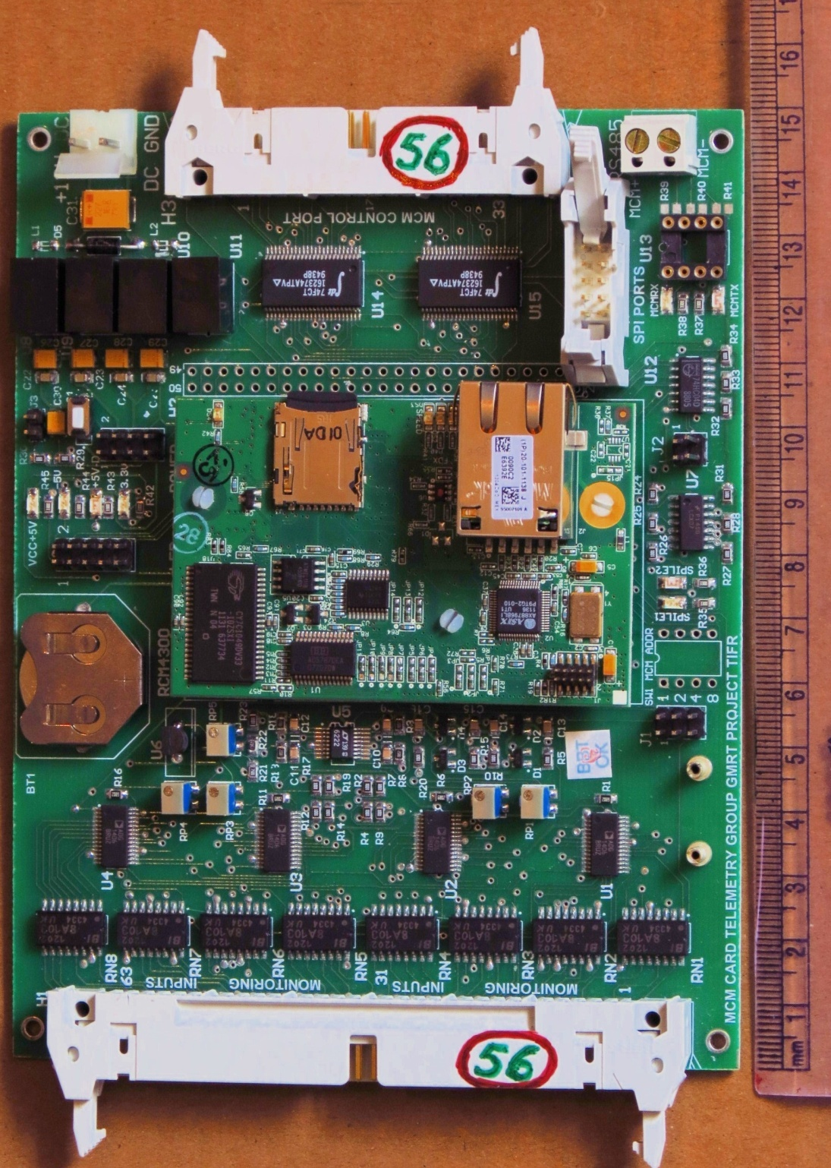
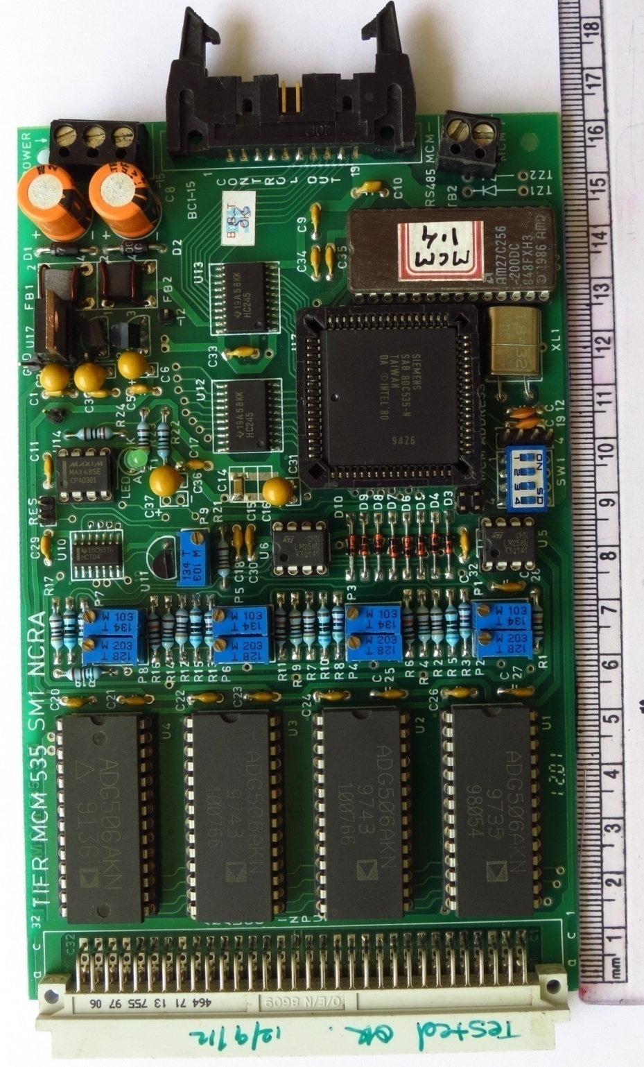
Monitor & Control Module (MCM)
New Rabbit MCM
Old MCM

Slide 20
Performance Improvment in MCM
1. New MCM is 30 times faster than the existing one.
2. Higher program and data memory and 1GB storage
3. Higher ADC resolution
4. Double control bits
5. Ethernet, RS485 and SPI connectivity
6. High level programming language and method
7. 20dB less EMI
8. Additional features like : Real Time Clock, Battery Backup
9. ASCII structure based Command structure
10.Failure rate will be minimum

Slide 21
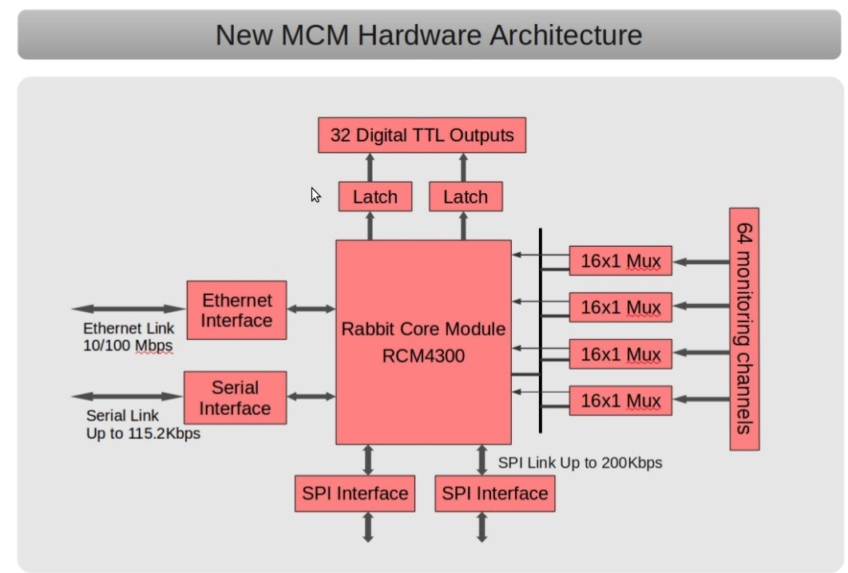

Slide 22
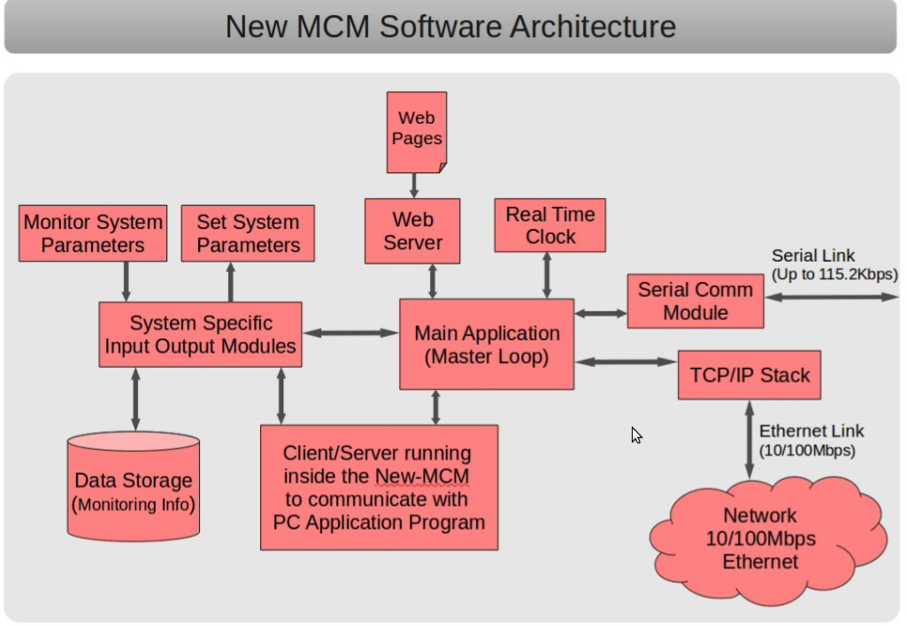

Slide 23
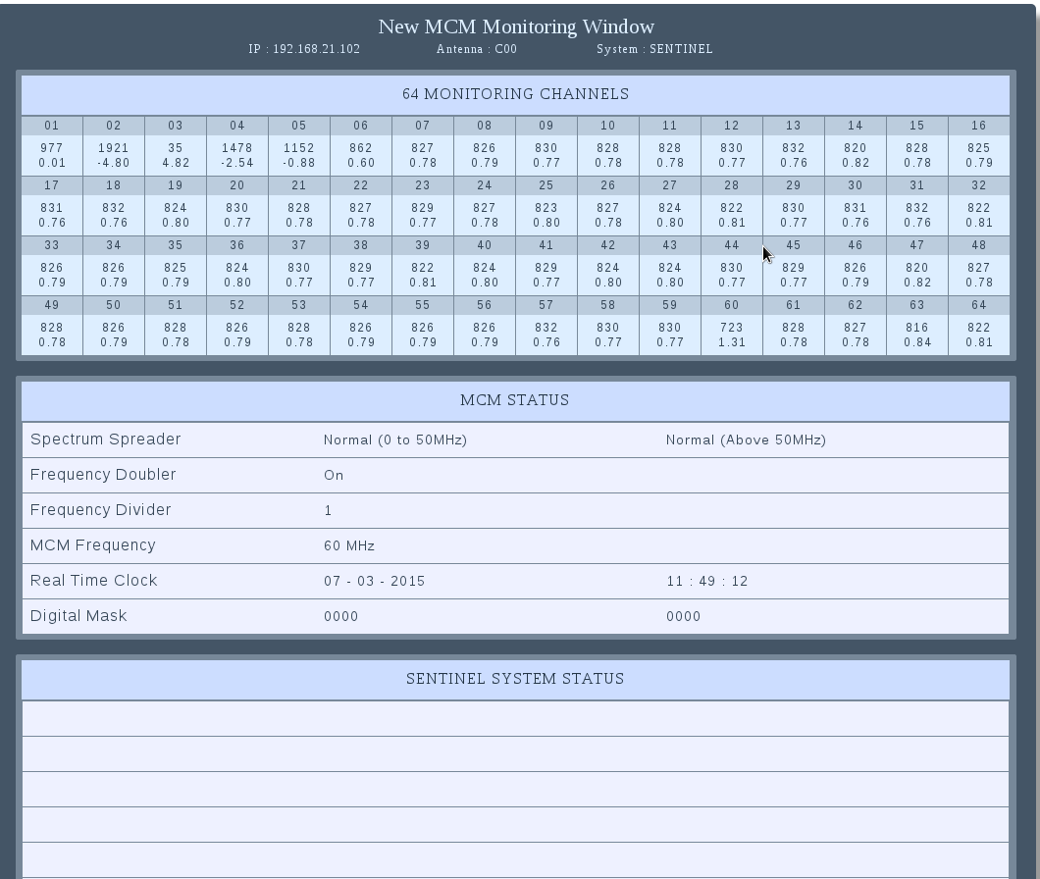
Rabbit MCM web server display

Slide 24
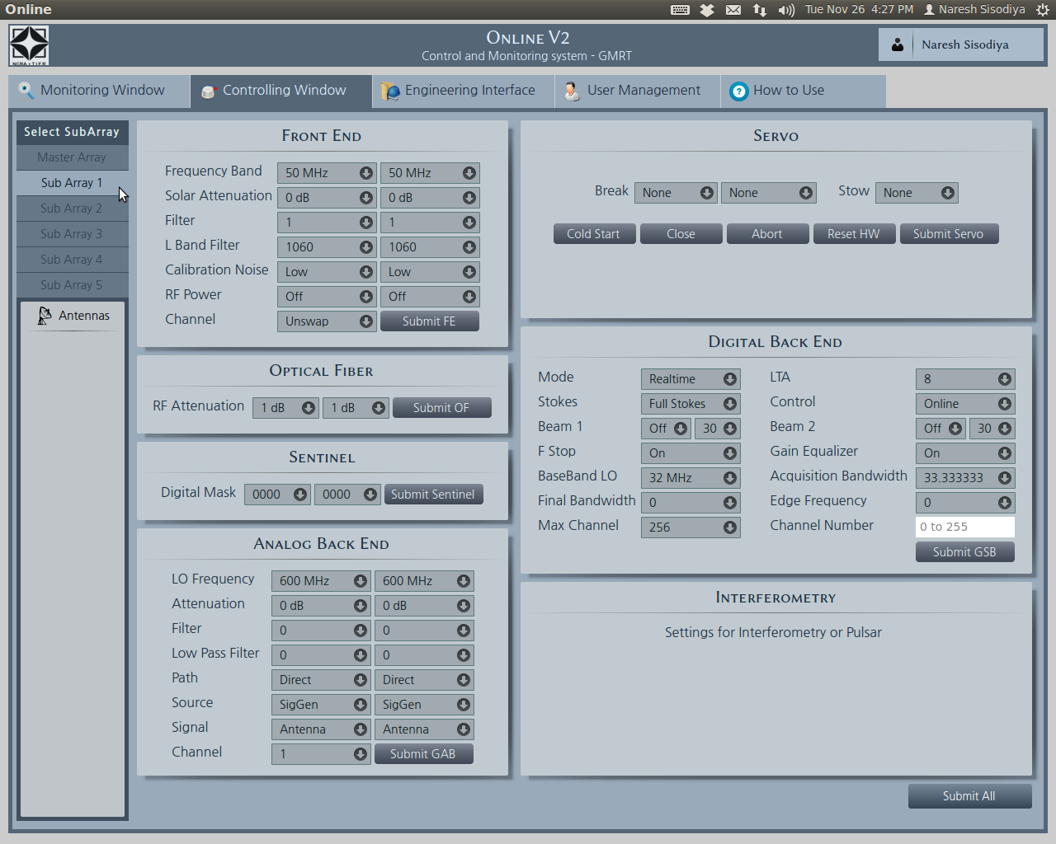
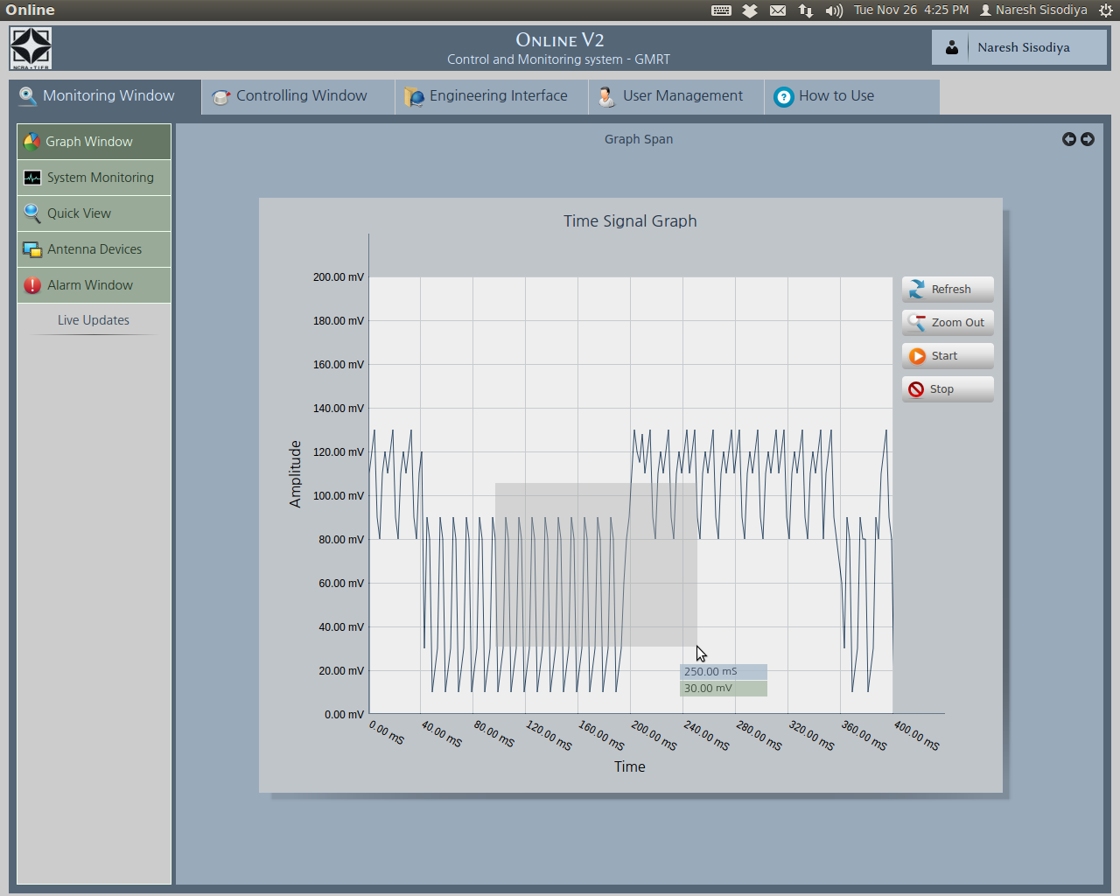
Online_v2 : QT/QML GUI

Slide 25
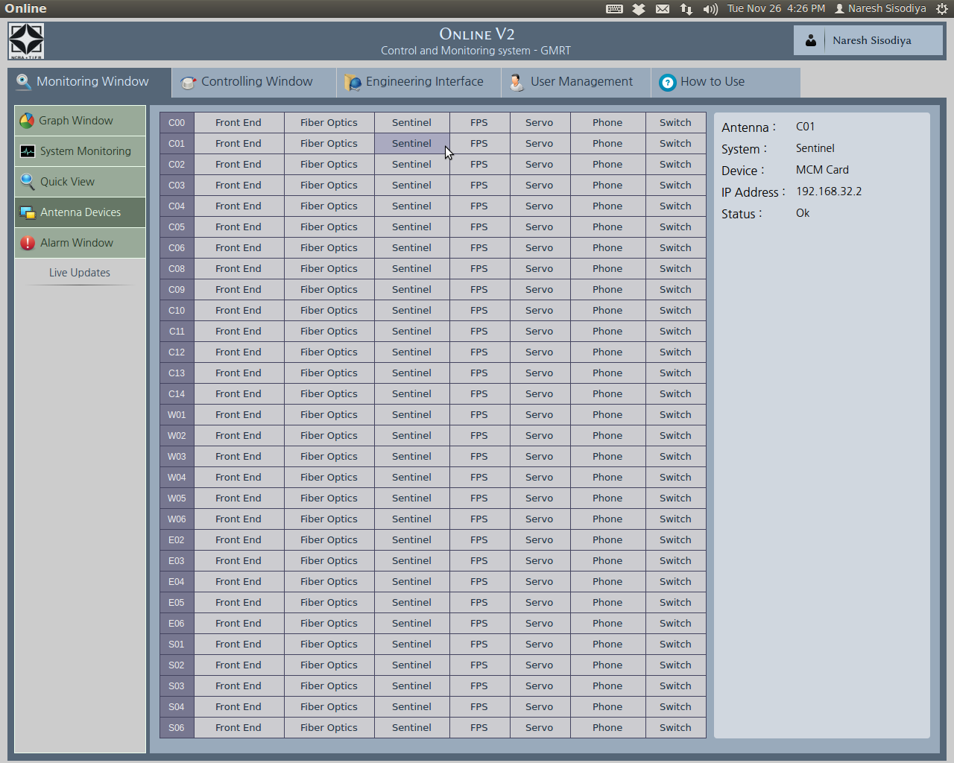
Online_v2 : QT/QML GUI

Slide 26
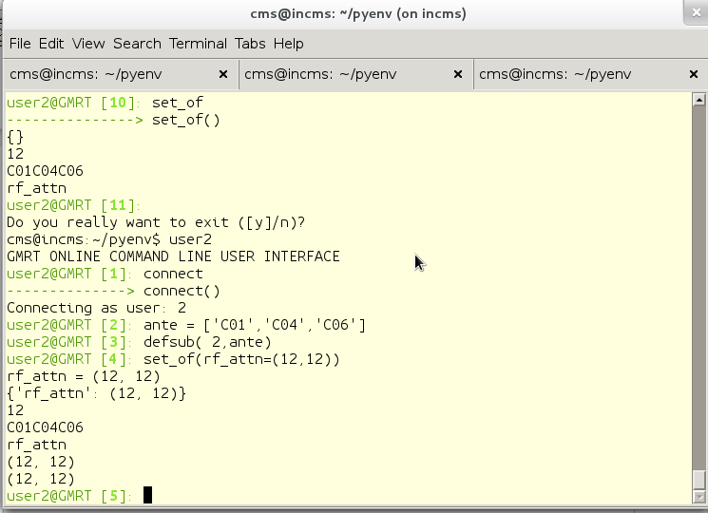
Python Enviornment

Slide 27
Online_v2 monitoring tools
a) Data collection on the data server.
-> A 'C' program is running on the central server
-> Collect data from shared memory
-> sends the data to data monitoring server.
-> Data size : 1 GB per day per MCM card.
b) Data Display on Web:
-> An Apache web server is running on the monitoring server
-> web display
-> client -> Java-script
->Server side -> PHP script
-> Selection of MCM card is provided.

Slide 28
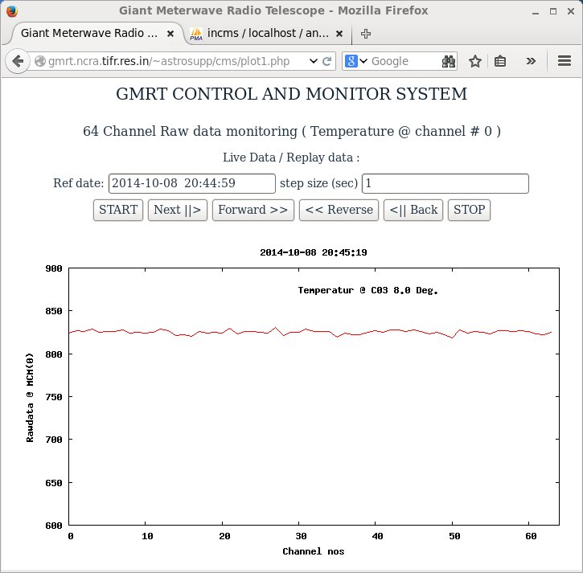
Online_v2 monitoring tools
Fig. web interface for raw data monitoring

Slide 29
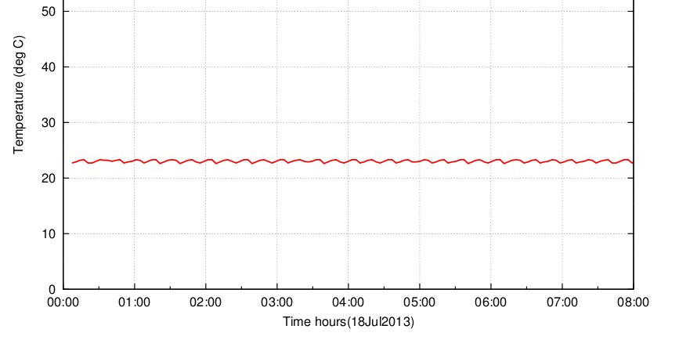
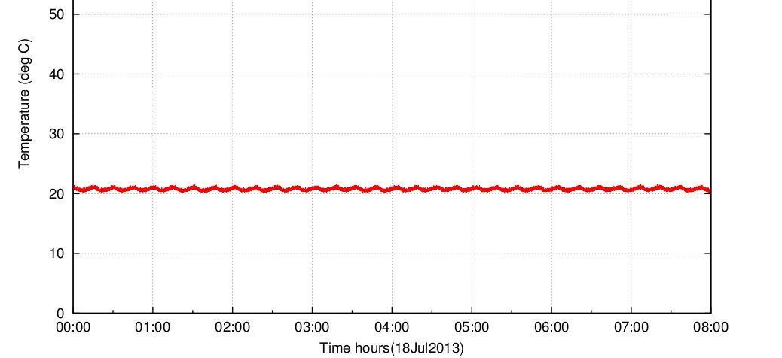
Online_v2 monitoring tools
c) Temperature monitor test:
One temperature monitoring unit was connect to the MCM card at C03 antenna. The data behavior was similar like existing online with higher resolution.
Fig. existing online temperature monitoring @ C03 antenna
Fig. online_v2 temperature monitoring @ C03 antenna

Slide 30
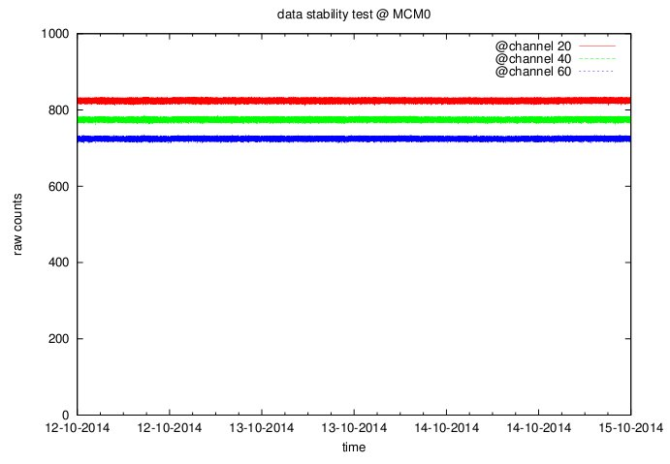
Online_v2 monitoring tools
d) Raw data recording test:
Long period raw data recording test was conducted to check the stability or any dropouts. Here three different plots indicates three channels 20,40 and 60. Offsets are purposely added to avoid overlap.
As per the Online V2 design plan, we have successfully implemented and tested the data base for the raw data monitoring. This data can be easily accessed through the web interface. Long period recording test is successfully conducted. Temperature monitoring results are also matching with existing online.

Slide 31
Online_v2 Testing
New cisco L3 network switch has been configured for Lab setup. Eight MCM card with different subnet have been connected to the switch.Online_V2 is communicating with every MCM within 1 second reponse time.
We have done several test to measure the round trip time taken by command & response packet.
Front end,GAB,FPS system has been tested in respective labs.
MCM cards were installed at C01,C04,C06,C09 & C10. They communicated very well with Online_v2, sending monitoring response every 1 second time interval.
Servo system PC104 card has been tested using Online_v2 in C01 antenna.
C03 rabbit MCM card was connected with a temperature sensor which was sending Antenna shell temperature every 1 second.
GWB correlator has been successfully interfaced with Online_V2 through GPU DAS server. All commands were tested.
During April 2014 MTAC, We installed a L2 N/W switch in C06 antenna and connected two MCM cards configured as Sentinel and Optical fiber system. And successfully controlled and monitored both the system.
FPS system has been tested with Online_v2 over Rabbit card serial link in C06 antenna
During October 2014 MTAC, we tested three antenna C01, C04 & C06 two sub-system( OF+Sentinel) software.
During April 2015 MTAC we tested 16 antennae two sub-system(OF+Sentinel) using Online_v2 software.

Slide 32
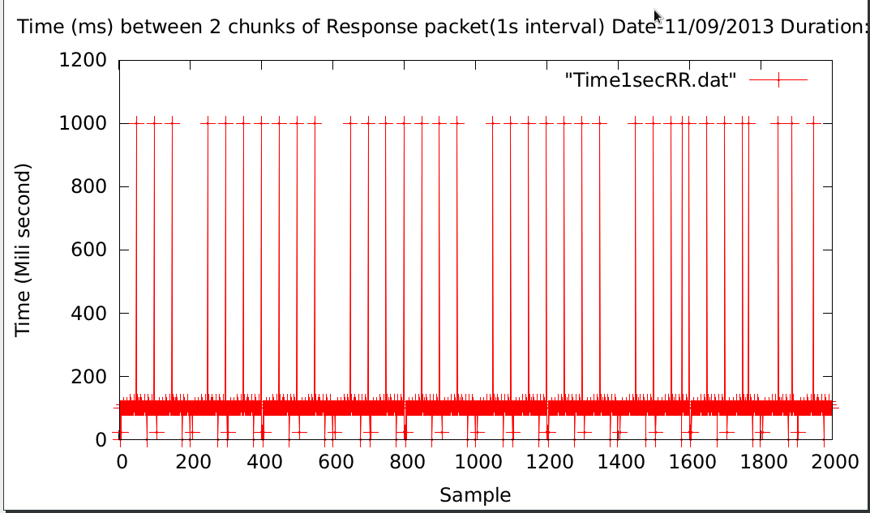
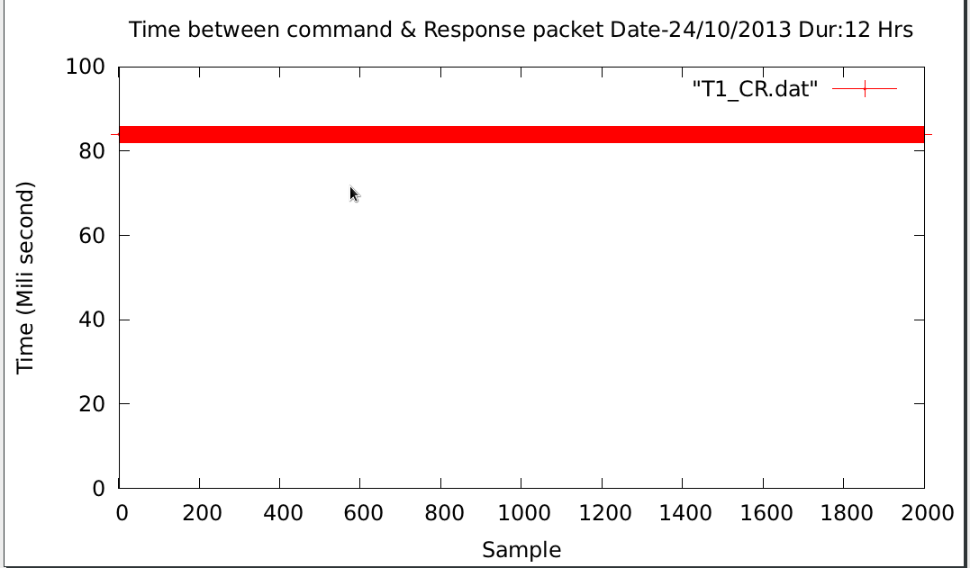
Round time trip plots
Fig(a) : When connected to
Common network & 8 port N/W switch
Fig(b) : When connected to
Isolated sub net network & basic L3 24 port N/W switch

Slide 33
Antenna base configuration
Online_v2 software
CEB
L3 N/W switch
CEB
L2 N/W Switch
Antenna
OF+SEN+Super
visory
FE
PC104
Serial link
FPS
** RFI shieding is provided in form of boxes for the MCM & L2 switches.

Slide 34
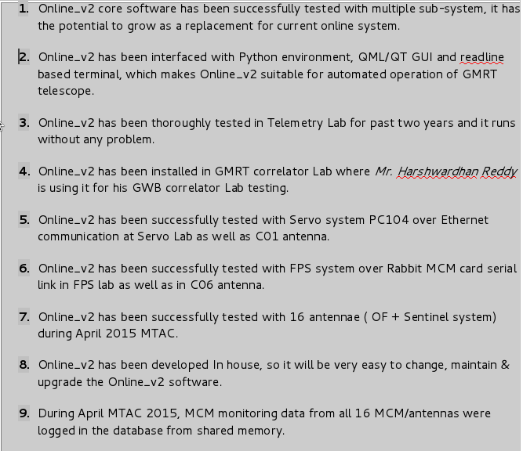
Summary

Slide 35

Ongoing Development
Interfacing NOVAS library in ONLINE_v2 software.
GUI to Python interface.
Completing the QT/QML GUI.
Testing of Online_v2 software on Antennae and all sub-systems when avilable.
Rabbit MCM to FE system serial link development.
Performance testing and optimization of Online_v2.

Slide 36
Acknowledgement
Prof. Swarna Ghosh
Prof. Yashwant Gupta
Prof Jayaram Chengalur
Shri. R Balasubramaniam, Shri Pramesh Rao
OF Lab ( Suresh Kumar,Pravin,Satish L,Sanchit R)
FE Lab ( Anil Raut,Gaurav P,Sougato,Vishal T)
GAB Lab ( Ajit,Navnathh, Ajay,Abhijeet, Shri Hari)
FPS Lab (Suresh S, Abhay bhumkar)
Servo Lab ( S bagde,Thiyagu)
Correlator (Ajit, sandeep,Harsha,sanjay K)
Control Room ( Nilesh,Shilpa,Pramod)
Telemetry Lab's semi skilled workers ( Bharat Sethe & Anil Muley)

