Slide 1
In-House CnM for GMRT antennas
1 Teleset, Teledisp
2 ABCcom
3 Monitor & Control Module

Slide 2
Teleset
Increase functionality
Generality
Adding Functions
Powerful GUIs – for all parts
User interface:
Operator interface,

Slide 3
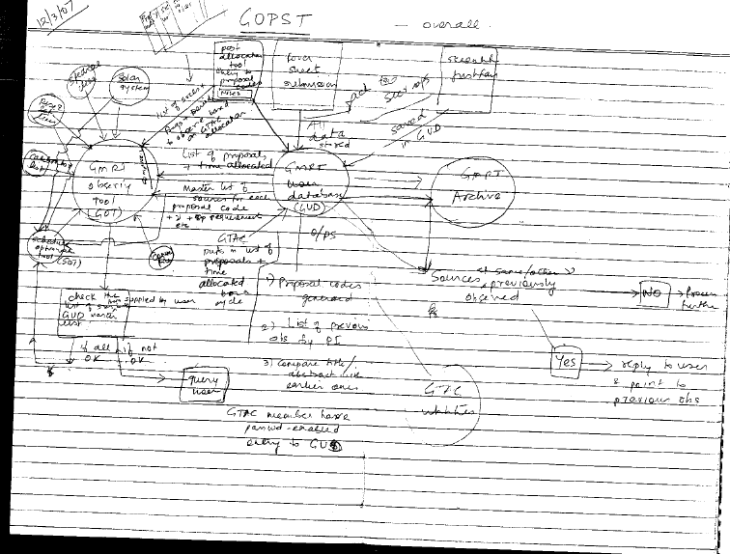

Slide 4
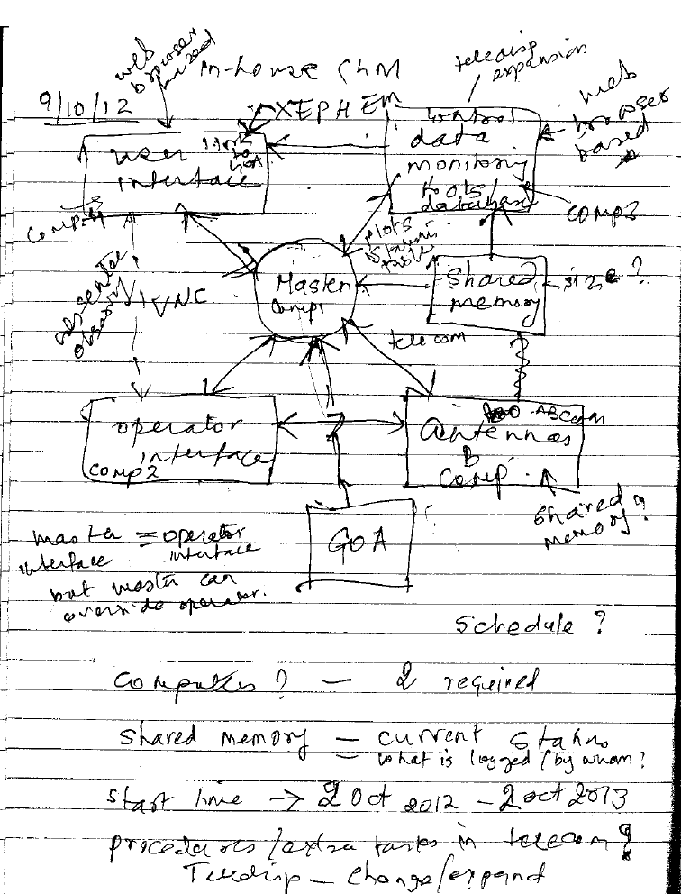

Slide 5
Data monitoring tools

